Slide 1
“LIBRARY MANAGEMENT SYSTEM”
Student Name : Nikita Patil | USN:2BU21CS075
Student Name : Pranjal B. | USN:2BU21CS086

Slide 2
Table of Contents
Introduction
Methodology
System requirements and specification
System Design
Implementation
Result

Slide 3
INTRODUCTION
Problem Statement :
In the physical library management system, manual processes, outdated technology, and disjointed systems lead to inefficiencies and errors.
Our project aims to develop a modern library management system to automate processes, integrate systems, and enhance user experience.
By automating cataloging and record-keeping, integrating systems, and implementing online access, we streamline operations, ensure data consistency, and improve accessibility.
Real-time reporting and analytics capabilities empower administrators with insights for informed decision-making.
Through this project, we address these challenges, transforming the library management system into a modern, efficient, and user-friendly platform.

Slide 4
Objectives:
Automate processes: Develop automated cataloging and record-keeping systems to reduce manual errors and administrative workload.
Integrate systems: Consolidate disparate systems into a unified platform to ensure data consistency and streamline administrative tasks.
Enhance user experience: Implement online access and self-service functionalities to improve accessibility and convenience for users.
Enable real-time reporting: Introduce reporting and analytics capabilities to provide administrators with insights for informed decision-making.
Modernize library management: Transform the physical library management system into a modern, efficient, and user-centric platform to meet the evolving needs of librarians and users.
Ensure scalability and adaptability: Design the system to be scalable and adaptable to accommodate future growth, technological advancements, and evolving user needs, ensuring its long-term effectiveness and relevance in the ever-changing library landscape.

Slide 5
METHODOLOGY
About Backend Connection:
The connection setup involves configuring the backend to establish a connection with the database management system. This typically includes:
Database Configuration: Setting up the database server, creating the necessary databases and tables, and configuring user permissions and access rights.
Backend Configuration: Configuring the backend application to connect to the database. This involves specifying the database host, port, username, password, and other connection parameters. In PHP applications, this is often done using functions like `mysqli_connect()` or PDO (PHP Data Objects) to establish a connection to the MySQL database.

Slide 6
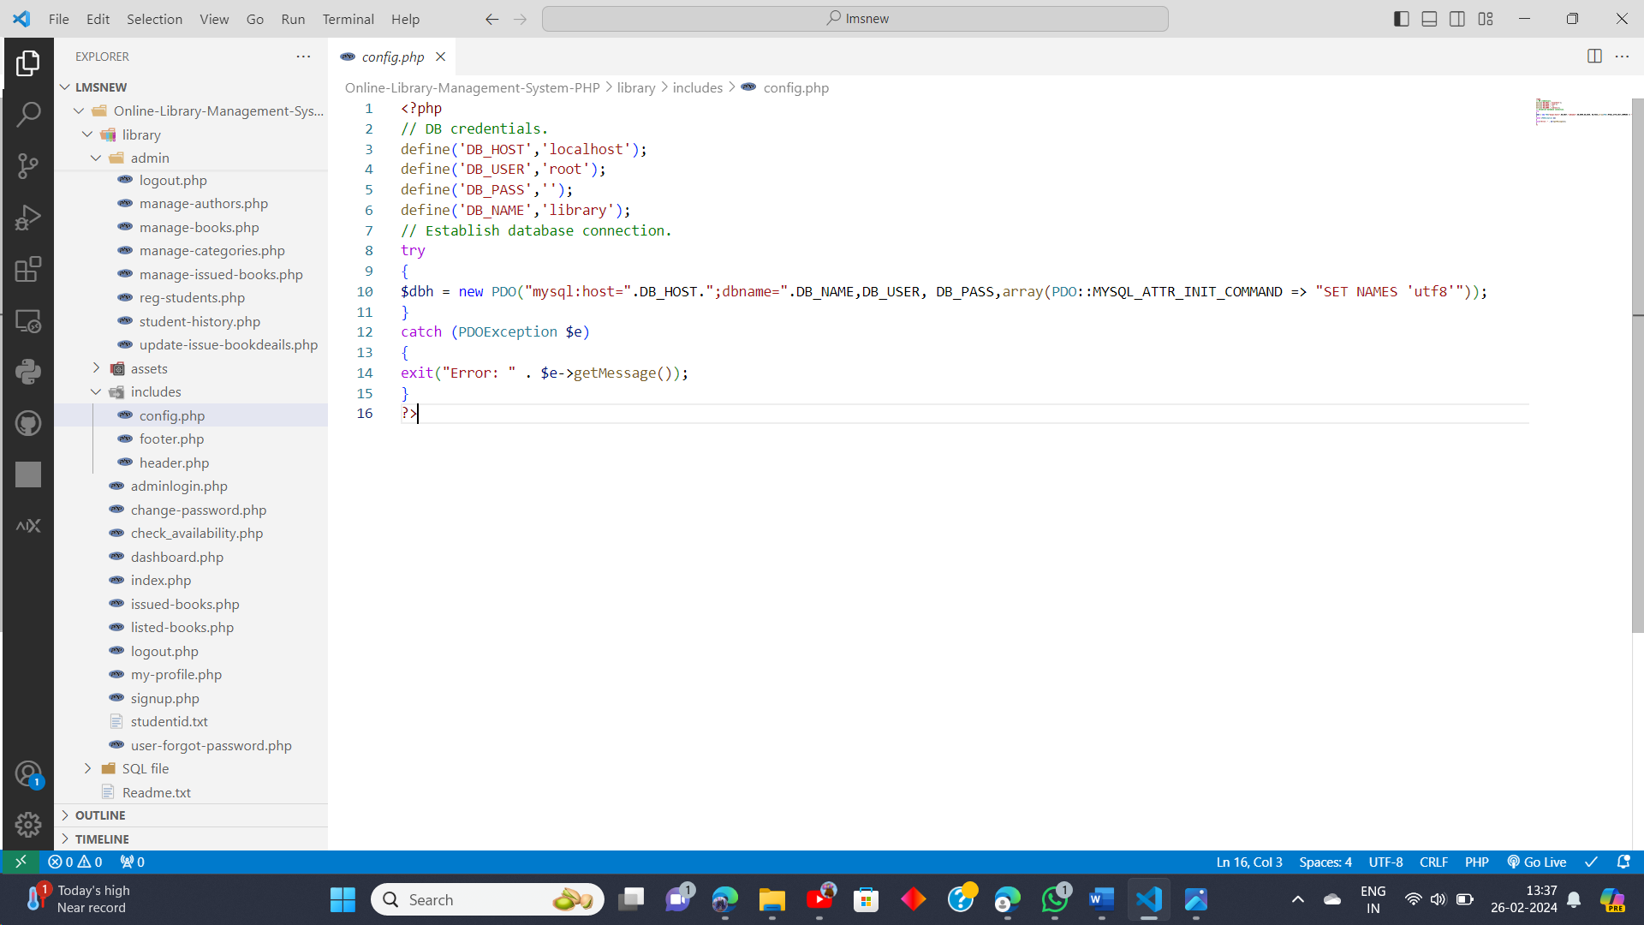
This is the configuration code used in our project for backend connection:
DB credentials: These constants (`DB_HOST`, `DB_USER`, `DB_PASS`, `DB_NAME`) store the database connection details, including the host (localhost), username (root), password (blank in this case), and database name (library).
Establish database connection: The `try-catch` block attempts to establish a connection to the MySQL database using PDO. The `PDO()` constructor is used to create a new PDO object, passing the database DSN (Data Source Name) as the first argument, which includes the host, database name, username, and password.
Error handling: If an exception (PDOException) occurs during the connection attempt, the `catch` block captures the exception, and an error message is displayed, providing details about the error.
Web Server: Install and configure a web server such as Apache or Nginx to handle HTTP requests.
Database Server: Set up a database management system (e.g., MySQL, PostgreSQL) to store and manage library data.

Slide 7
SYSTEM REQUIREMENTS AND SPECIFICATIONS
Software Requirements:
Web Server : Apache HTTP Server,XAMPP
Database Management System : MySQL
Development Tools : Visual Studio Code (VSCode) , Browser
Hardeware Requirements:
Processor: Dual-core or higher for handling server operations efficiently.
RAM: At least 4GB, though 8GB or more would be beneficial for smoother performance.
Storage: 512 SSD storage for faster read/write operations.
Network: Stable internet connection for serving requests to client devices.

Slide 8
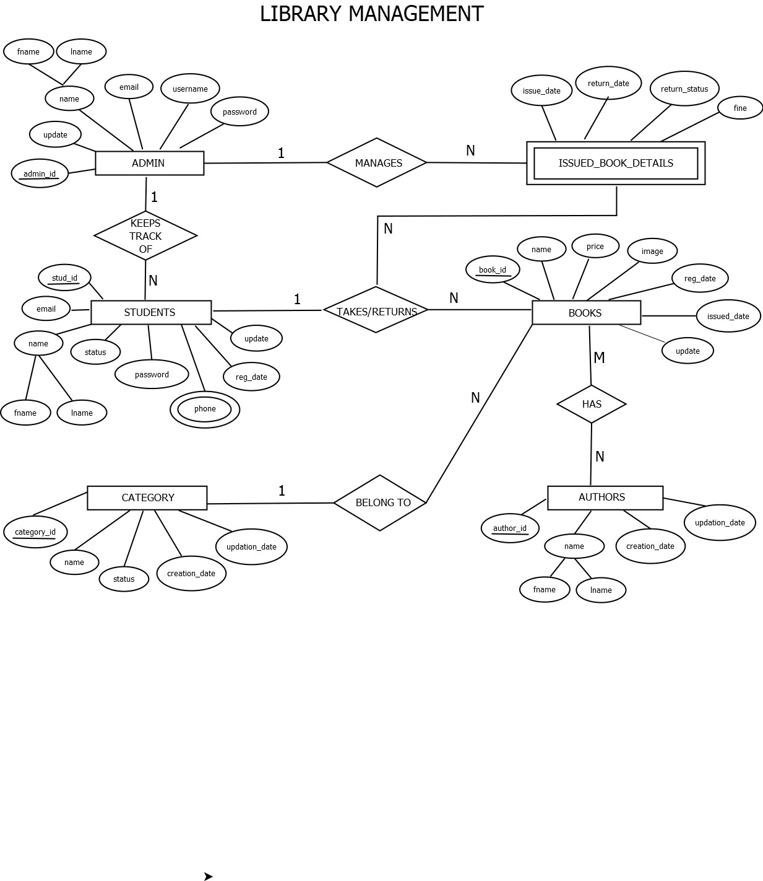
SYSTEM DESIGN
ER Diagram:

Slide 9
Attribute | Relationship | Attribute | Cardinality Ratio
Admin | Manages | Books | 1:N
Admin | Manages | IssuedBookDetails | 1:N
Admin | Keeps_track_of | Students | 1:N
Students | Takes/returns | Books | 1:N
Books | Belongs_To | Category | N:1
Books | Have | Authors | N:N

Slide 10
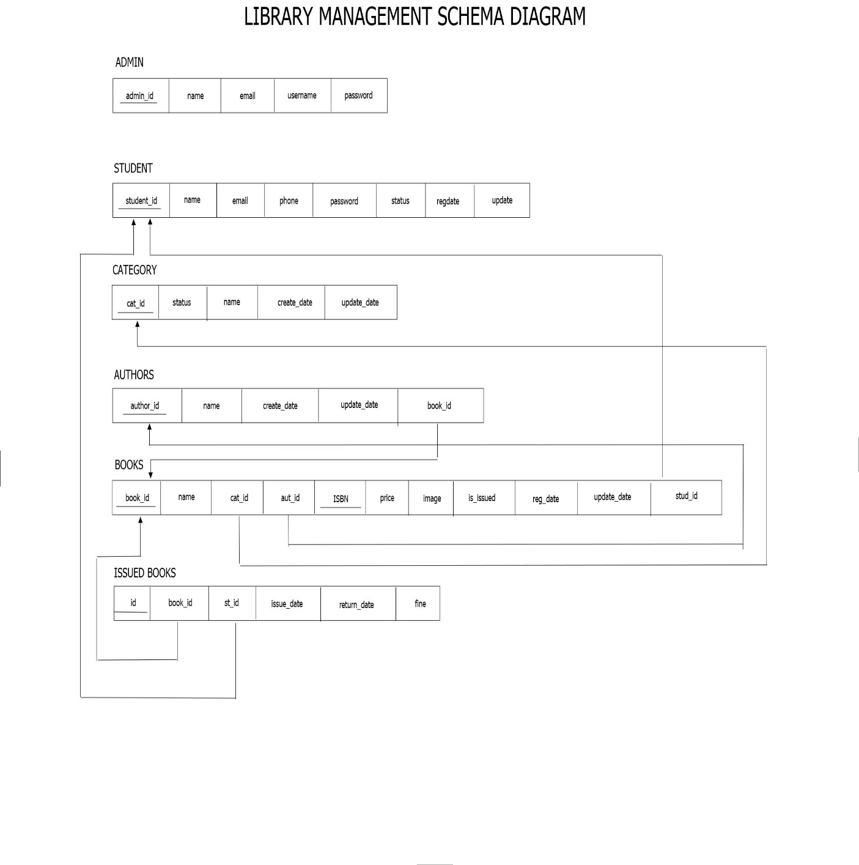
Schema Diagram:

Slide 11
THANK
YOU

