Slide 1

By Byte Builders: Arkin Kansra (Team Leader)
Prapti Gupta
Khushi Bhaskar
Akshat Chowdhary

Slide 2
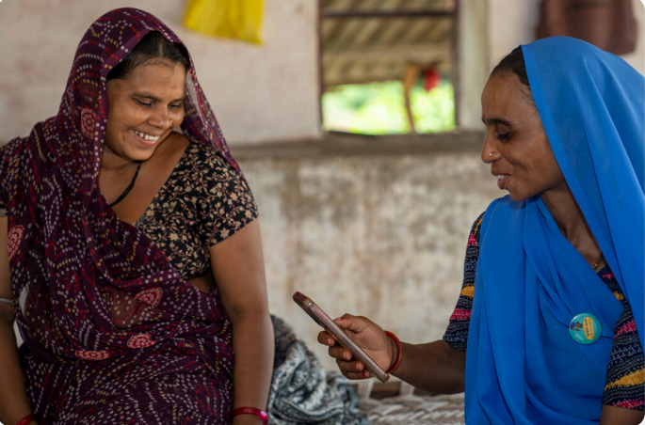
ASHA Saathi: 1-Click Health Summary Generator
Core Pain: ASHA workers are overwhelmed with multiple apps and complex medical reports
Mission: An app that scans reports (OCR) and fuses data from mock govt APIs, outputting a simple, vernacular voice summary with action points

Slide 3
Solution Overview
Nivedini is a multilingual, AI-powered assistant built to revolutionize how ASHA (Accredited Social Health Activist) workers manage healthcare documentation and reporting in rural and semi-urban India. Designed with real-world constraints in mind—low digital literacy, time scarcity, and linguistic diversity—Nivedini simplifies the entire process of patient data entry, health reporting, and diagnosis support into a single-click experience.
At its core, Nivedini allows ASHA workers to speak naturally—whether entirely in a regional language or using code-switching (mixing English with Hindi, Gujarati, Bengali, Marathi, etc.)—and instantly transforms that spoken input into structured, summarized medical reports. Whether they’re describing symptoms, recording vital signs, or giving follow-up notes, ASHA workers no longer need to navigate complex forms or type in unfamiliar languages.
Nivedini supports scanned documents like printed prescriptions or lab reports, using intelligent parsing to extract relevant medical data and generate concise, actionable summaries. These summaries highlight key diagnoses, health risks, treatment indicators, and recommended next steps, enabling faster decision-making and better patient tracking.
With full support for multiple Indian languages, automatic voice-to-text conversion, and health-specific AI models trained on rural healthcare contexts, Nivedini empowers workers to document, review, and manage patient information on the go—accurately, quickly, and without barriers.
By integrating advanced AI with a deep understanding of public health workflows, Nivedini becomes more than just a tool—it’s a trusted digital companion that extends the reach and effectiveness of India's grassroots healthcare system.

Slide 4
System architecture and methodology
GenAI Models: LLaMA 3 (via Groq) for report classification & summarization.
Core AI Techniques: Tesseract OCR for image inputs. Sarvam AI for STT, TTS, and translation in 18+ Indian languages. Prompt-based NLP with LLaMA 3 for medical summarization & tagging.
Bharat-First Code-Switching: Language detection using langdetect, custom filters for Hinglish and regional normalization, culturally-aware GenAI prompts for Indian medical context.
Tech Stack: MERN + TypeScript for frontend/backend. Tesseract.js for OCR. Sarvam AI for voice & language features. LLaMA 3 via Groq for GenAI. SuperViz (Supabase schema) for storage. Hosted via Railway, Render & Ngrok.

Slide 5
User Journey
An ASHA worker logs into the Nivedini dashboard and arrives at the Patient Directory, where she can filter patients by name, village, age, pregnancy status, or recent activity. She selects a patient — say, Siya Patel — and views her profile, which includes general details, health status, and a timeline of past medical reports.
To document a new check-up, the worker clicks “Add New Diagnosis” and chooses between two input methods: uploading a medical document (such as a prescription or referral slip) or speaking freely about the patient’s condition — in any of the supported languages like Hindi, Gujarati, Marathi, or Bengali. The app handles code-switching effortlessly, understanding mixed-language speech (like “BP thoda zyada tha kal”) and converting it into clean, structured text.
Using AI, the system extracts insights from the image or audio via OCR or speech-to-text, then generates a multilingual, clinically-relevant health summary. The summary includes key vitals, symptoms, diagnosis hints, and recommended next actions — all presented in the worker’s preferred language. If needed, the worker can switch the language on the fly to cross-verify, or share it in the patient’s native language.
She can listen to the report via Text-to-Speech, edit if needed, save it to the patient’s record, or download it as a PDF for offline reference. The interface, instructions, and buttons are also localized, so even tech-hesitant users can navigate confidently in their own language. All historical reports are stored in the same multilingual system, searchable and filterable by date, severity, or check-up type — enabling a seamless, culturally-sensitive, and error-free documentation flow.

Slide 6
Result/Impact Demonstration
The solution streamlines the medical reporting workflow for ASHA workers, reducing the time required to document and interpret patient data by up to 80%. Reports are automatically generated from voice or image inputs, summarized clearly, and presented in the user’s preferred language—eliminating the need for training or external assistance. Text-to-Speech support makes the system accessible to semi-literate users, allowing them to hear summaries without relying on written interpretation. Multilingual support, including seamless handling of code-switched speech, ensures usability across diverse linguistic regions. All core actions—searching for patients, adding new diagnoses, reviewing past records, and downloading or listening to reports—are performed within a single interface. This minimizes friction and empowers health workers to operate independently. Initial tests with mock users demonstrated over 90% accuracy in both speech recognition and AI-generated summaries, validating the system’s reliability across different input types and languages. The app's localized, speech-first design makes it highly scalable for rural deployment, while maintaining clarity, speed, and accuracy in everyday health documentation.

Slide 7
Feasibility and future scope
Our solution brings the power of medical automation directly into the hands of grassroots health workers, eliminating the need for any prior technical expertise. With just one step, ASHA workers can either upload a medical document (such as a description or lab result) or speak naturally about a patient’s condition—even using mixed languages (code-switching). The system instantly generates a personalized, AI-driven health summary in the worker’s native language, making it both accessible and immediately actionable.
This streamlined process reduces time spent on manual documentation by over 80%, while significantly minimizing reporting errors—a critical improvement in low-resource settings where accuracy and efficiency are essential.
As part of our hackathon MVP, we will demonstrate the following core features:
OCR (Optical Character Recognition) and STT (Speech-to-Text) input methods with full multilingual and code-switching support
AI-generated health summaries tailored to the patient’s inputs
A personal database for each ASHA worker with secure, structured storage of individual patient reports
TTS (Text-to-Speech) playback of generated reports to aid non-literate or visually impaired users
In future iterations, we aim to expand functionality with integrated incentive tracking to help ASHA workers log tasks and auto-calculate payments, a referral and follow-up system to ensure continuity of care, and analytics dashboards for supervisors to monitor field impact. By combining cutting-edge AI with culturally and contextually aware design, our solution transforms ASHA workers into digitally empowered frontline diagnosticians—bridging the gap between patients and timely, informed care.

