Slide 1
MINI PROJECT DEMONSTRATION ON SPEECH RECOGNITION SYSTEM
PROJECT MENTOR:- SUBMITTED BY:-
MR. YUVRAJ JOSHI MISS. PRAPTI RANA
2014772 (6 SEMESTER)
SEC –C ROLL NO-37

Slide 2
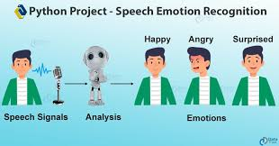
SPEECH EMOTION RECOGNITION

Slide 3
WHY I HAVE CHOSEN THIS PROJECT ?
Emotion detection has become one of the biggest marketing strategies to predict the mood of the consumer plays an important role.so to detect the current emotion of person and suggest him the apt product, will increase the demand of product or the company.
Detecting emotion is one of the most important marketing strategy in today’s world.
For this reason I have decided to make this project in which a person’s emotion can be detect only through voice .
Some examples are call centers to play music when one is angry on the call. Another could be a smart car slowing down when one is angry or fearful.

Slide 4
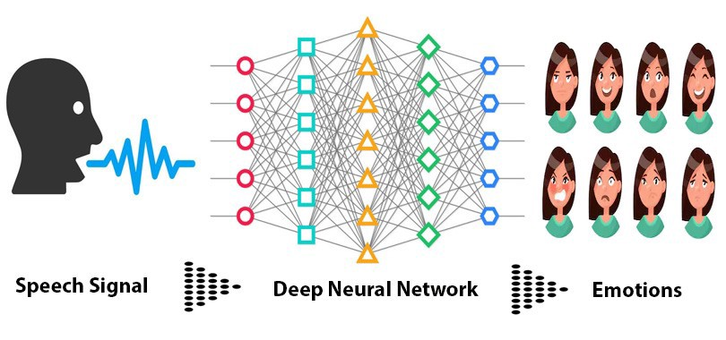
BASIC ANALOGY OF PROJECT

Slide 5
IDEOLOGY BEHIND THE PROJECT
The idea behind creating the project was to build a machine learning model that could detect emotions from the speech we have with each other all the time.
So why not have a emotion detector that will gauge your emotions and in the future recommend you different things based on your mood. This can be used by multiple instructions to offer different services like marketing company suggesting you to buy products based on your emotions , automotive industry can detect the person’s emotions and suggest the speed of autonomous cars as required to avoid any collisions etc.

Slide 6
DATASET USED:-
The dataset which has been used in this project was firstly uploaded on the drive then it would imported through reference.
This dataset includes 1500 audio file.
Input from 24 different actors, 12 male and 12 female.
Each audio file is named in such a way that the 7 th character is consistent
With the different emotions that they represent.

Slide 7
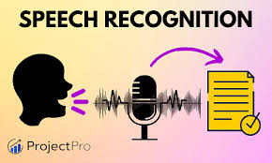
Speech To Text Translation using Speech emotion Recogniton
Initially we tested the Audio y translating it back into the text mode using Speech emotion API to know what the audio is all about.

Slide 8
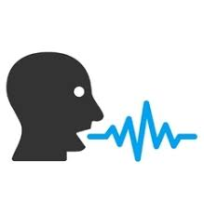
FEATURE EXTRACTION:-
The next step involves extracting the features from the audio file which will help this model to work between these audio files. For feature extraction we make use of the “LIBROSA” library from python which is one of the libraries used for audio analysis.
Also there are labels of emotions defined .When the DATASET is loaded with the calling of feature EXTRACTION process, every audio is classified into the labels.

Slide 9
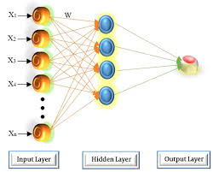
BUILDING THE MODEL
Since the project is a classification of MULTILAYER PERCEPTION seems the obvious choice. We chose this model to predict the right emotions.
This classifier connects to a Neural Network, Unlike other classification algorithms such as Support Vectors. MLP classifier relies on an underlying Neural Network to perform a task of classification.

Slide 10
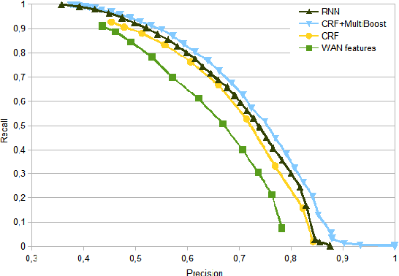
Predictions And Accuracy
After turning the model, tested it out by predicting the emotions for the test data. Then the splitting of training and testing data to saving the model. Model is again loaded to predict the tested data and store in the test files folder uploaded on drive as well for mapping individual result to its .wav file name.
The accuracy rate of prediction of emotion through speech is 68.43%.
More the emotions of different types lower down its accuracy rate. So in order to increase its accuracy rate we need to decrease its dataset and differentr types of emotions.

Slide 11
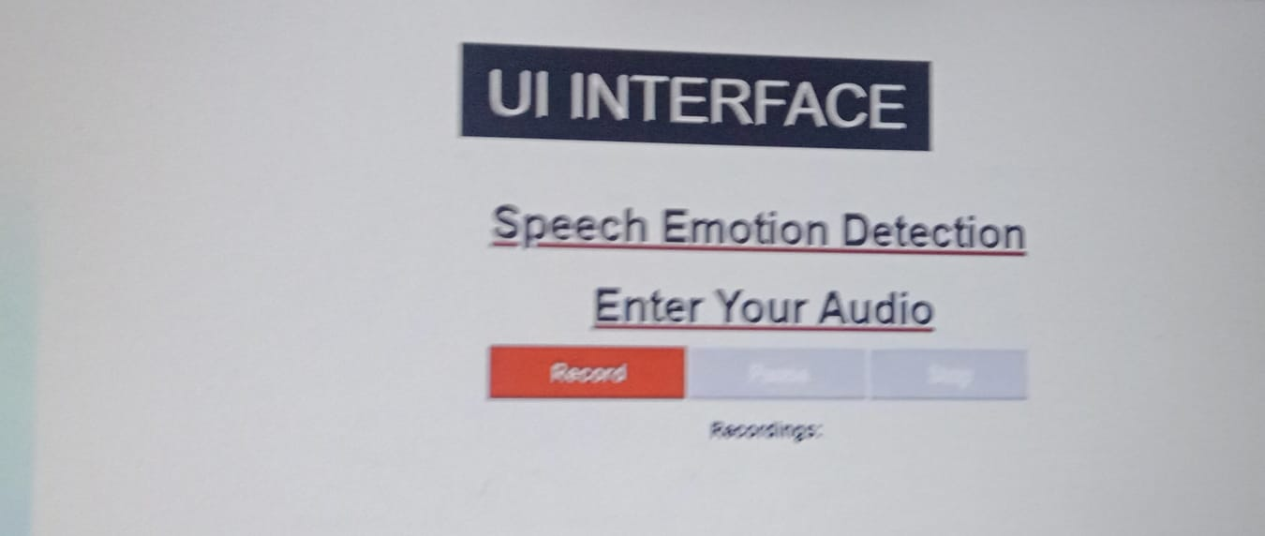
LIVE DEMO PREDICTION
The user interface (UI) is the point of human-computer interaction and communication in a device. This can include display screens, keyboards, a mouse and the appearance of a desktop. It is also the way through which a user interacts with an application or a website.
In this project I have made live demo of the speech recognition through UI interface which can record , play , pause , stop button embedded in it and a feature to download the recorded audio as well with the help of HTML,CSS,JAVASCRIPT,BOOTSRAP.

Slide 12
Conclusions And Challenges
The literature in the speech emotion detection is not very rich and researchers are still debating what features influence the recognition of emotion in speech. There is also considerable uncertain as to the best algorithm for classifying emotion and which emotion to class together.
In the real problem , different individuals reveal that their emotions in a diverse degree and maintain. There are also many differences between acted and spontaneous speech.

Slide 13
Drawbacks
You can try different other classifiers as well to predict the emotion behind the audio like CNN,SVM etc.
Predicting the Live Audio takes a lot of process and its sometimes difficult to process as it is unlike the binary data with some csv file associated with it.

Slide 14
FUTURE SCOPE
In Future we can predict the random recorded audio as well.
We can also Embed our UI Interface with ML MODEL and can build web based apps with ML using Flask in future, this point can be a great scope.
More advancement can be more variety of voices can be trained and dataset can be increased to deploy more realistic model.

Slide 15
CODE REVIEW…
GITHUB LINK:-https://github.com/prapti410/Speech-Recognition-System
DATASET:- https://drive.google.com/drive/u/0/folders/1kumrP5Hmvoaf1qhNxnlY809305yfw8rV
CODE:-https://colab.research.google.com/drive/1Q8jnBzwt7pMjX50AtXPnnF54XnXUXVzh?usp=sharing

Slide 16
THANK YOU

