Slide 2
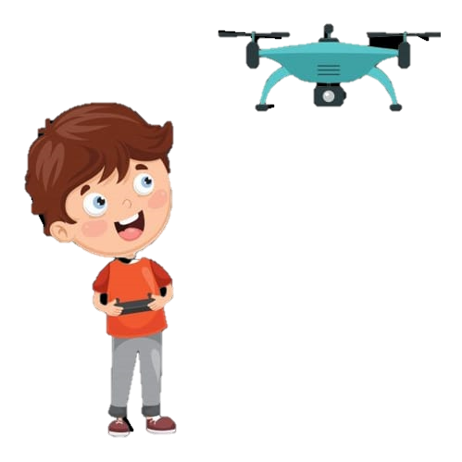
TEAM AMPHIBIONS

Slide 3
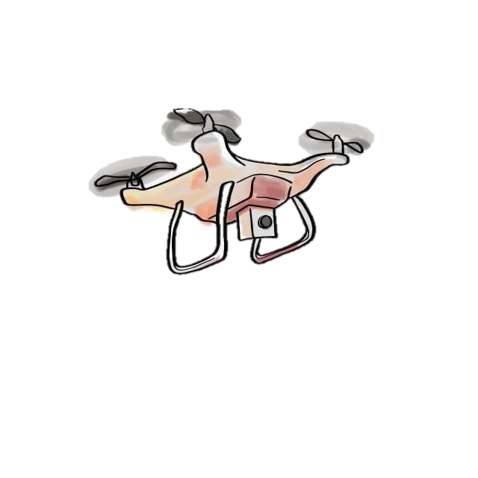
THE AMPHIBIOUS DRONE
What is amphibious drone?
It is a drone which can operate both in atmosphere as well as in water.

Slide 4
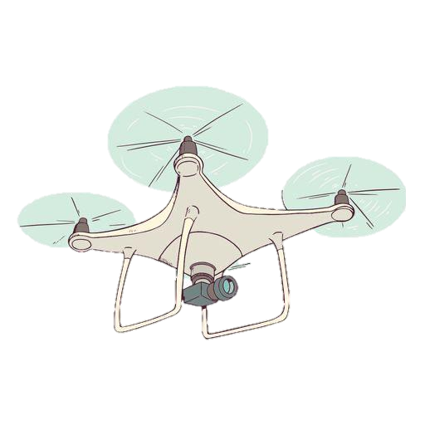
Analyzation
As we see the attacks through waterbodies to get previous warning about such an actions such an amphibious drone is the most use full.
In the cases of oil split such an under water kind of drone is very helpful .
Inspections of underwater pipeline.
Different marine life studies .
Loon could spot sharks from the air , then land in the water and use a deterrent system to chase them away from nearby swimmers .
Also during floods this is used for rescue operations .

Slide 5
Originality & Innovation
As we have been knowing about the kind of drones but have been some where thinking about a drone that can be made in such a manner that can be used under water too .
Those drone we have been knowing about is far different from this amphibious drone as the innovation added in it of it working on both land as well as water bodies .

Slide 6
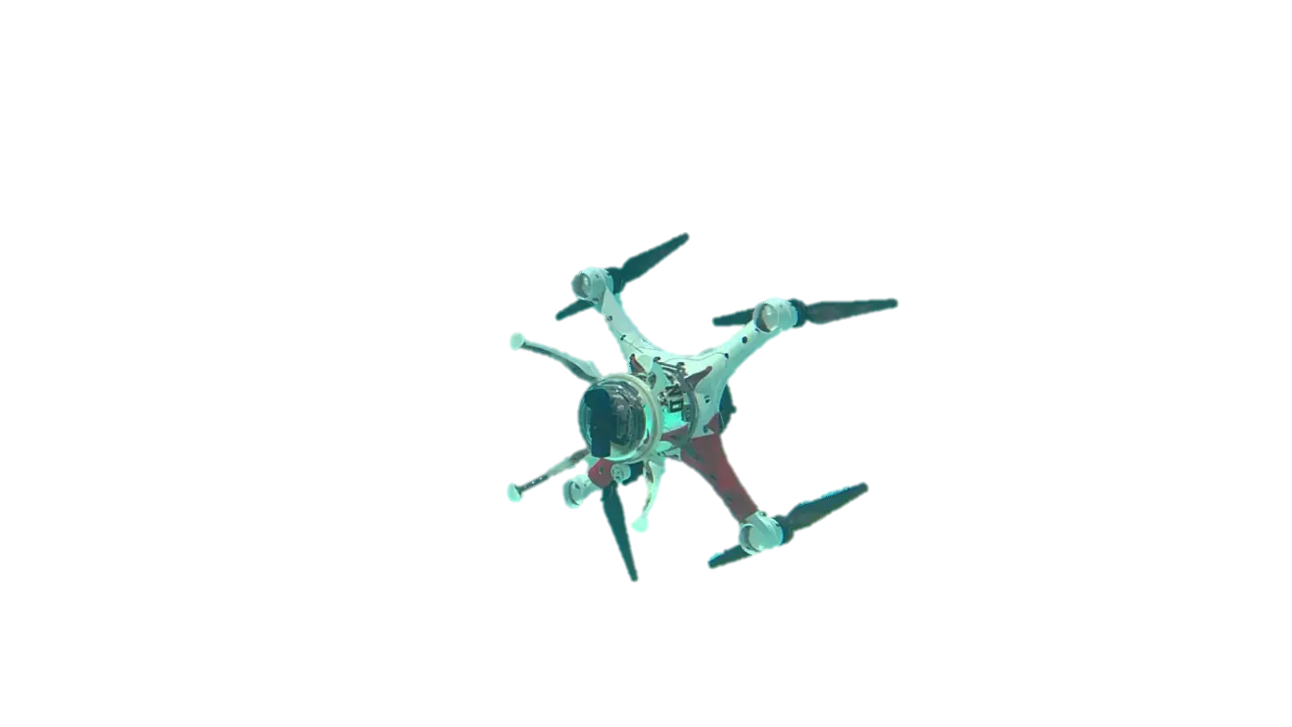
Feasibility & Cost efficiency
It is very easy to be used .
The making of such a drone at a perfect scale must not be affordable to a normal citizens but at the industrial and defense level is much more affordable .

Slide 7
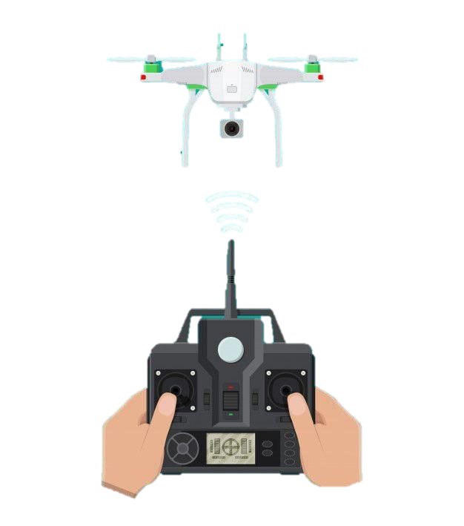
Reason / Preposes
The occurring problems in the aquatic lives due to spiling of oil from huge tankers .
The increase in damaged bridges under the water level .
And to gain knowledge about more spices of marine lives.

Slide 8
Use Of Multidisciplinary Collaboration
Aeronautical Engineer
The work of an Aeronautical Engineer is to used the laws of fluid dynamics and the aerodynamics to make the drone balanced and work properly in both water and air.
Computer Science and Designing
The work of these engineers are to make the controller and the sensor work at a time with the programming

Slide 9



