Slide 1



Customer data analysis
By :- Prapti Dhameliya

Slide 2
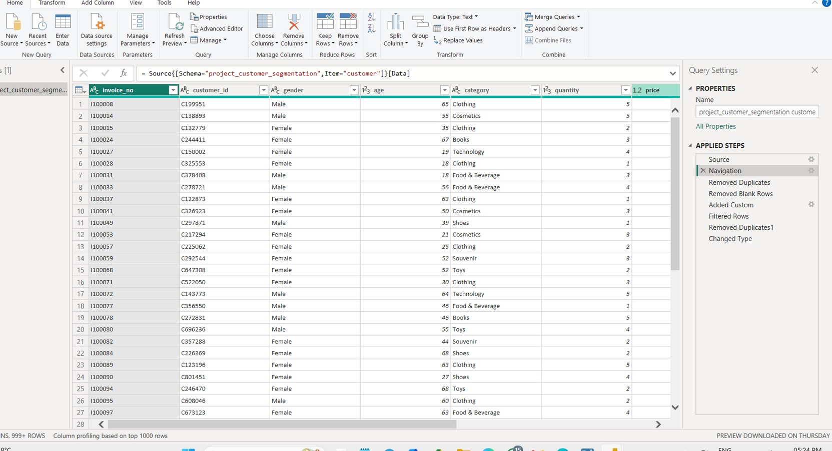
cleaned data in power bi

Slide 3

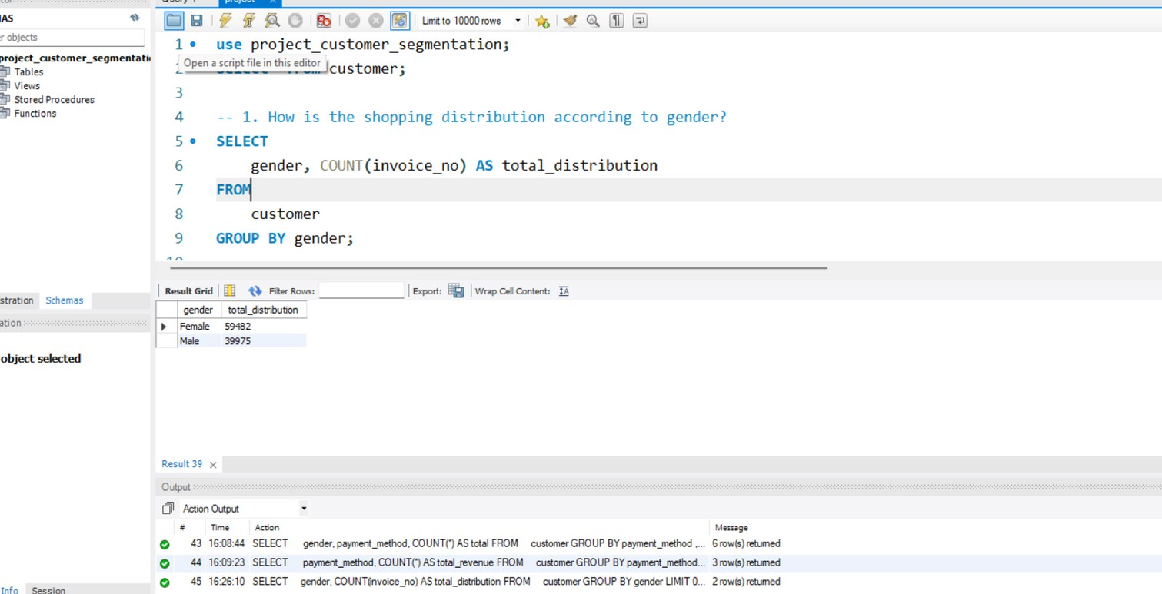
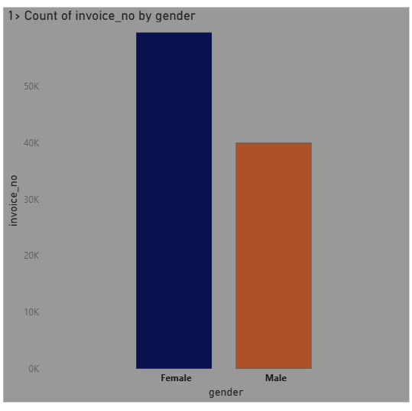

Shopping Distribution by Gender
1.
Females made more purchases than males. This shows female customers are more active shoppers.

Slide 4

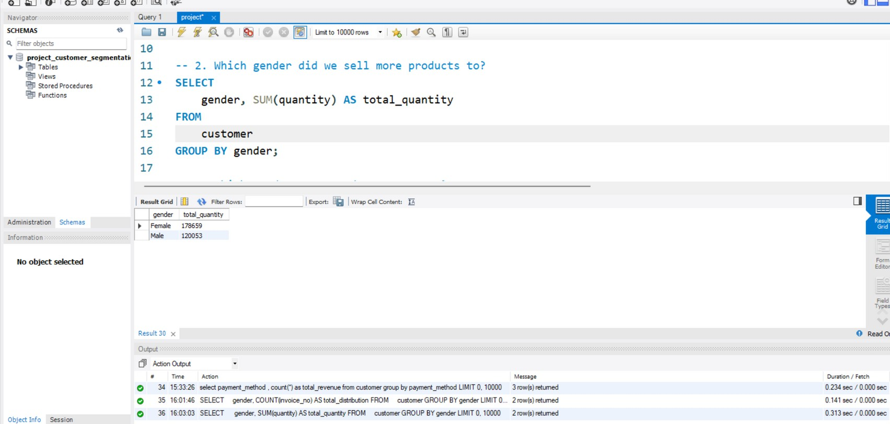

2. which gender did we sell more products to?

Slide 5

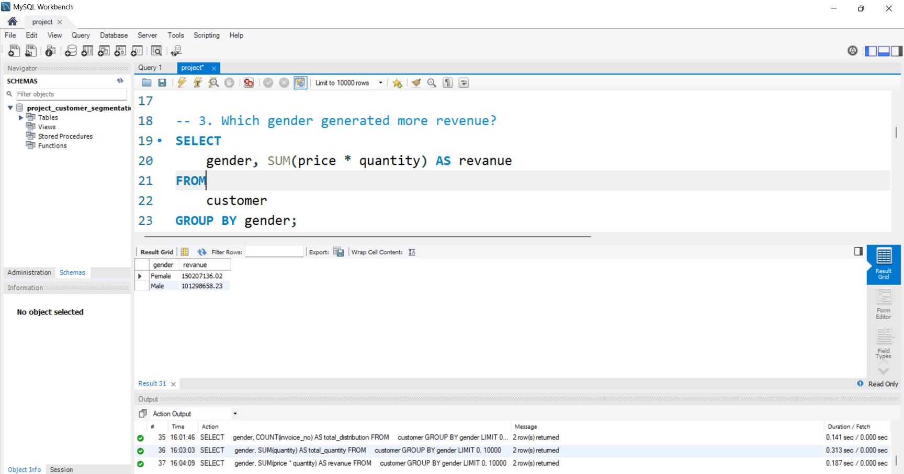
Which gender generated more revenue?
3.

Slide 6

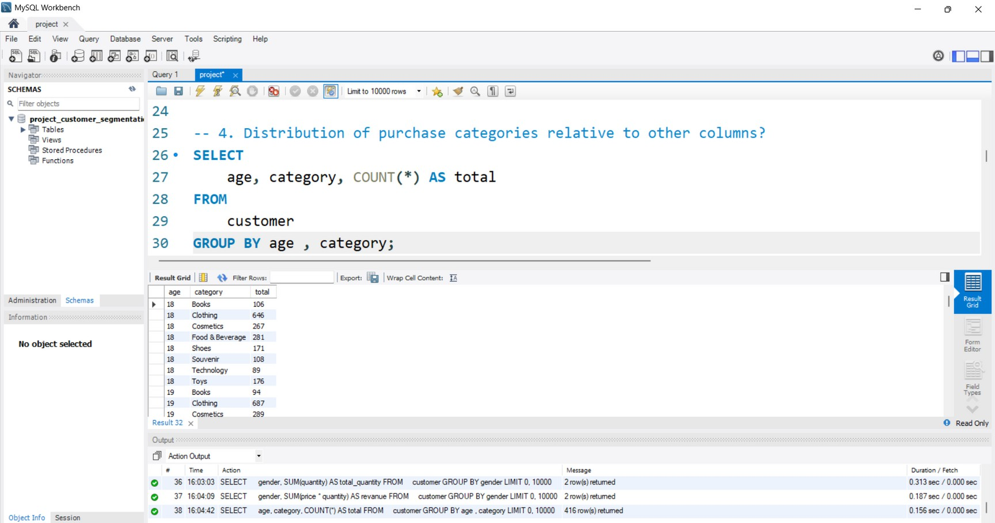

Distribution of purchase categories relative to other columns
4.

Slide 7

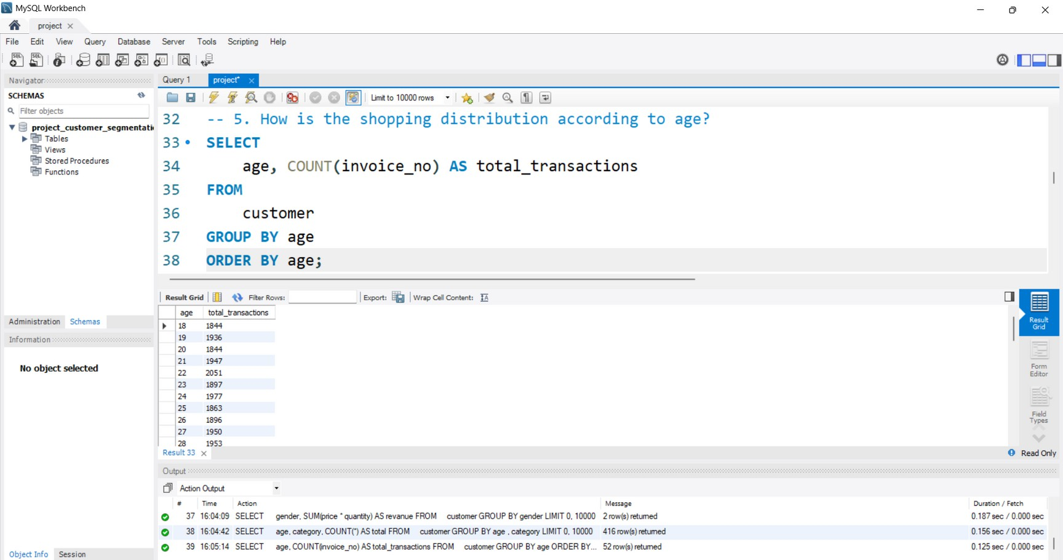
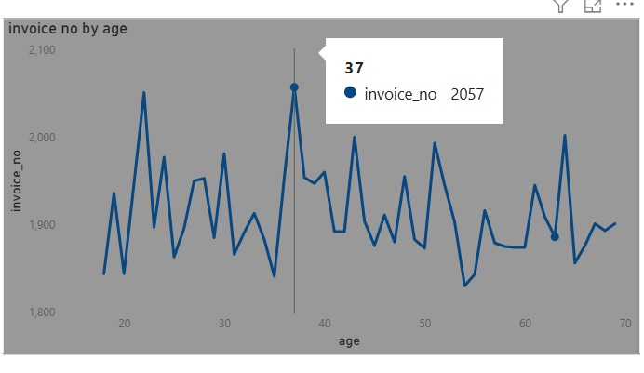

How is the shopping distribution according to age?
5.
Shopping is steady across ages, with age 37 slightly higher. Middle-aged customers are consistent buyers.

Slide 8
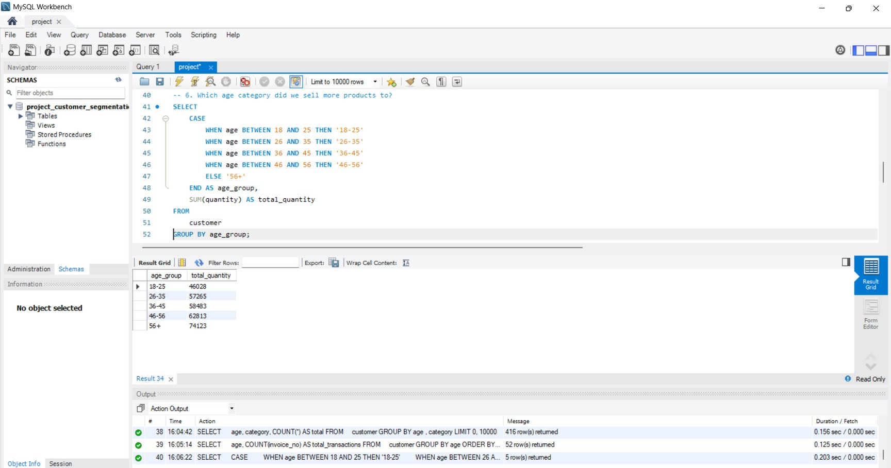
Which age category bought more products?
6.

Slide 9
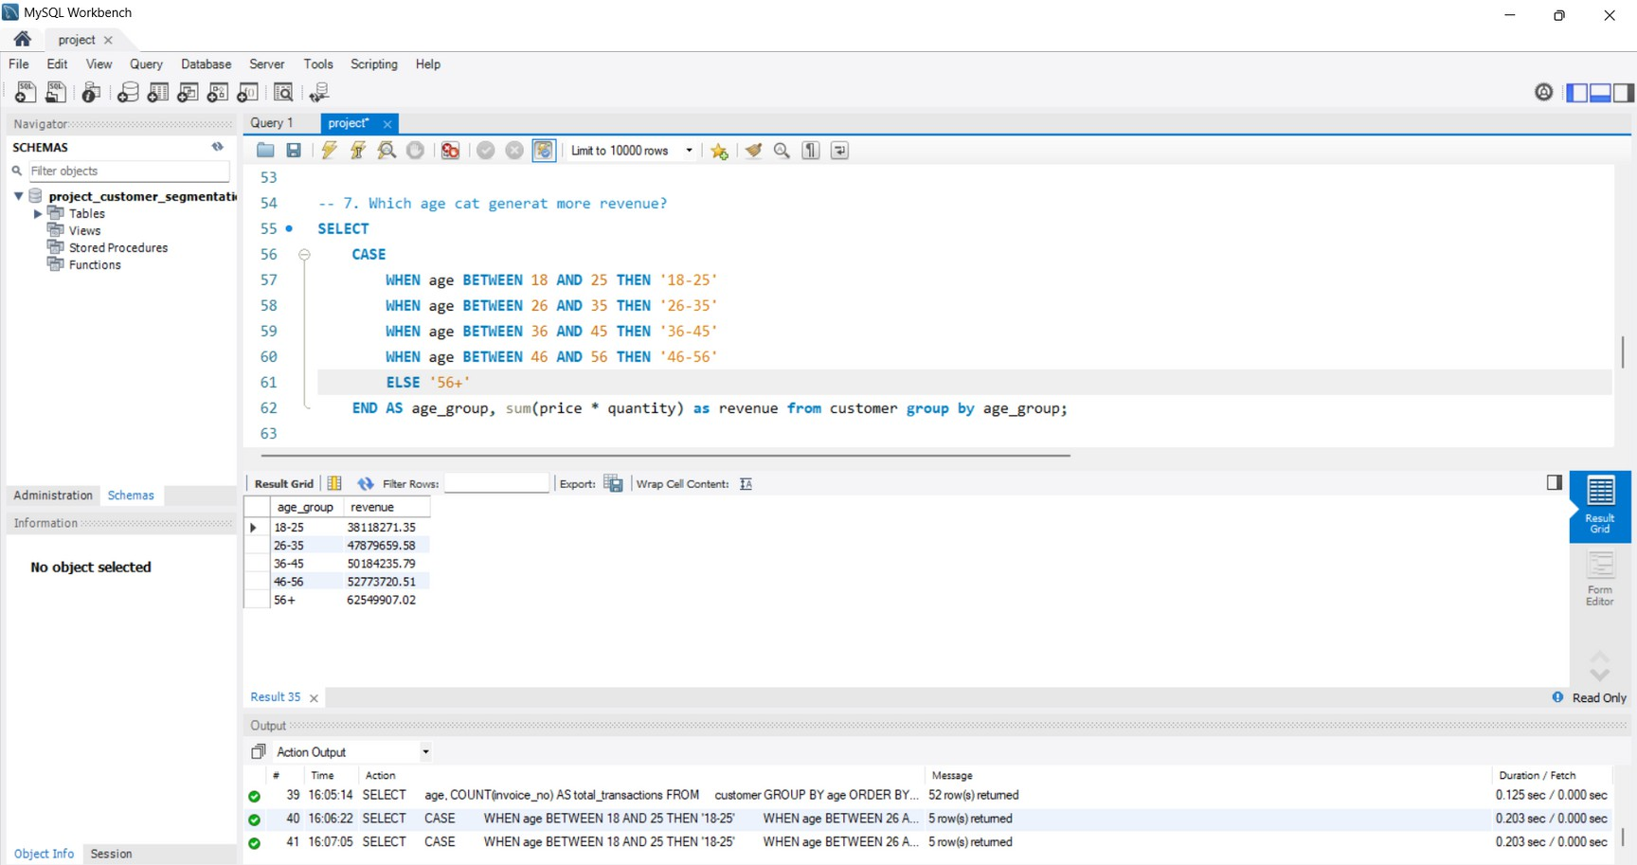
Which age category generated more revenue?
7.

Slide 10

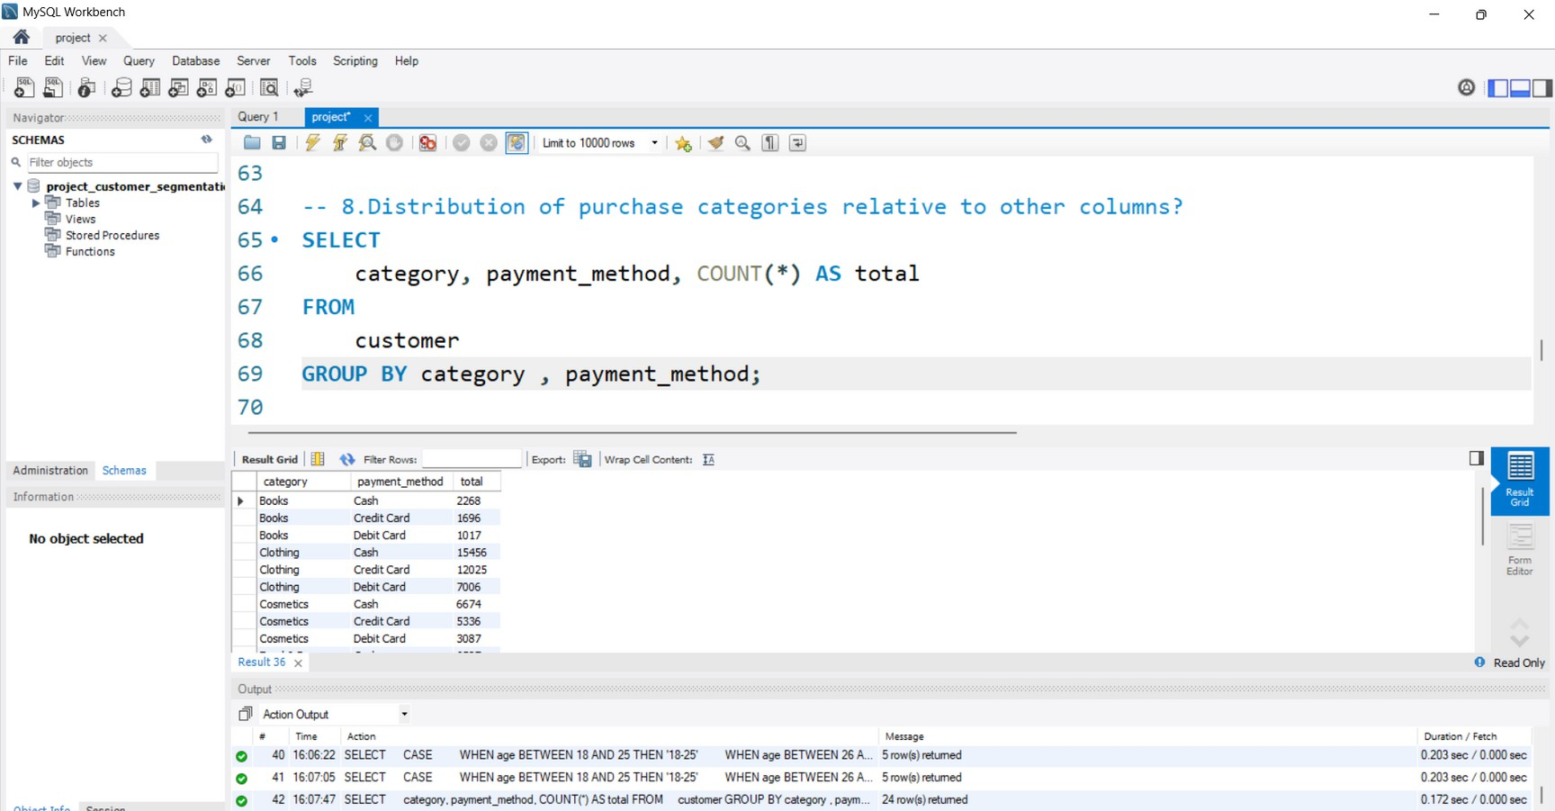

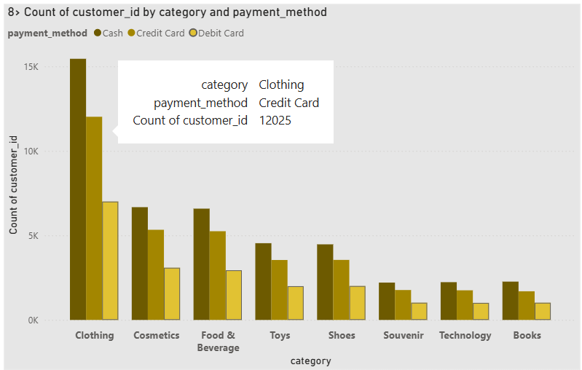
Distribution of purchase categories relative to other columns
8.
Clothing is most popular, and Credit Card is the top choice. Customers prefer cards for fashion purchases.

Slide 11
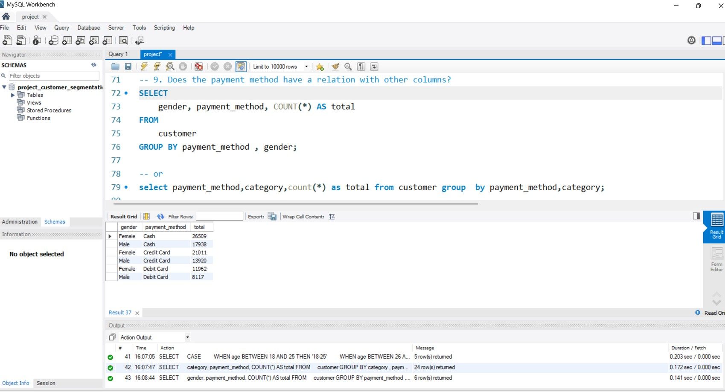
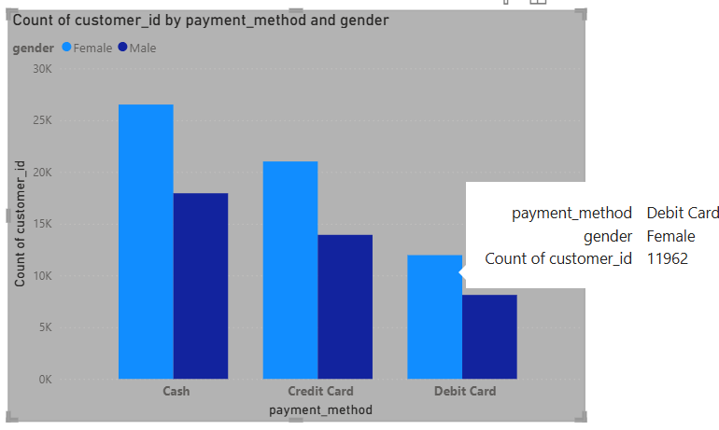
Does the payment method have a relation with other columns?
9.
Females use all payment methods more than males. Debit Card is least used overall, but still more popular among women.

Slide 12
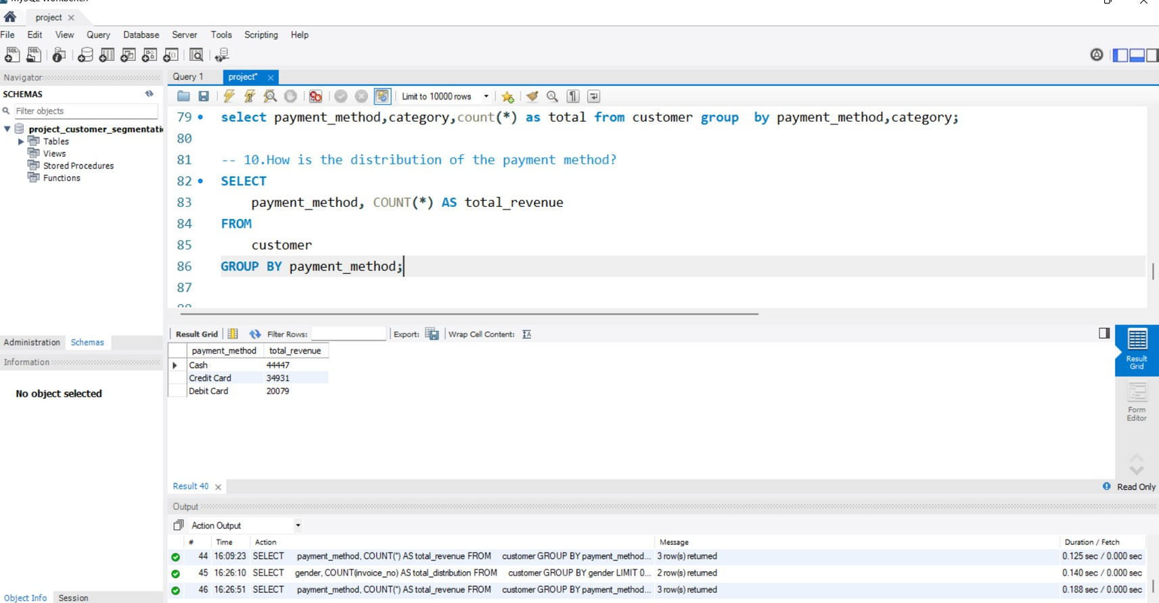
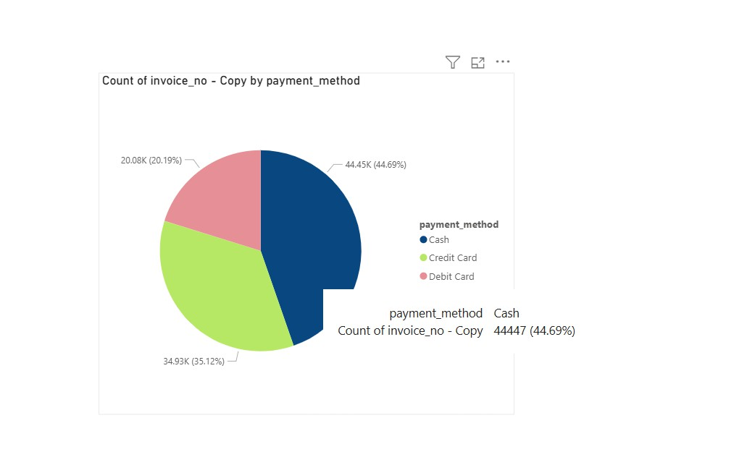
Distribution of the payment method
10.
Cash is most used, Credit Card comes second, Debit Card is least preferred. Customers still rely heavily on cash.

Slide 13




Thank you!

