Slide 1

Prayosha
20BCA019 Prapti Patel
20BCA021 Atmik Virani

Slide 2

PROJECT PROFILE
PROJECT NAME : Prayosha
TYPE OF APPLICATION : E-Commerce Web Application
PROJECT DESCRIPTION: Prayosha is a feature-rich online application for managing leads, customers, and projects for solar companies. Prayosha equips solar firms with the tools they need to fulfil their sustainability goals, including a flexible design, safe operations, and efficient procedures.
TEAM SIZE: 2

Slide 3

TECHNOLOGIES USED
FRONT-END: HTML, CSS, JavaScript
BACK-END: PHP, MySQL
TOOLS: VS CODE, XAMPP

Slide 4

FRONT-END TOOLS
HTML: HyperText Markup Language (HTML) is a shorthand for this language. Markup language is used to develop websites online.
CSS: The style sheet language CSS (Cascading Style Sheets) is used to apply styles to web sites.
JavaScript: The most popular lightweight, interpreted written computer language is JavaScript (JS). Both client-side and server-side programming are possible with it. An web site programming language is called JavaScript.

Slide 5

BACK-END TOOLS
PHP: PHP is a popular server-side programming language for databases, e-commerce, and dynamic content. With Java support in PHP4, it supports well-known databases and protocols, has forgiving syntax, and allows n-tier development.
MySQL: Popular open-source RDBMS for PHP called MySQL. Quick, trustworthy, and simple to use. supports a variety of operating systems and languages, huge databases, and conventional SQL.

Slide 6

SYSTEM STUDY
EXISTING SYSTEM
Web applications may suffer from challenges including poor user experiences, technological difficulties, security breaches, and data loss. Users may become irritated by challenging navigation, a crowded layout, sluggish loading times, and unresponsiveness. Performance and user confidence can be affected by bugs, crashes, and security breaches. It could take a long time and cost a lot of money to fix security problems in an established online project.

Slide 7

Scope of the System
Strong defences against data breaches and theft.
Comprehensive features that guarantee ease of use for solar firms.
Navigation across the UI is quick and simple.
For optimum operation, ongoing assistance and maintenance are required.
Sophisticated security measures for sensitive data.
Scalable and adaptable to changing business requirements.

Slide 8

Aim of System
The admin controls user profiles, permissions, and user accounts. Additionally, the admin handles user reporting and invoice creation. plays a critical role in user happiness and system administration.
After login in or registering, users may use the web application to see products, edit their profiles, contact admin online, add things to carts, and complete transactions. Easy-to-use features for a seamless online shopping experience.

Slide 9

Feasibility Study
Economic Feasibility: Customers and sellers in poor nations can benefit from a cost-effective e-commerce deployment with varied revenue streams for security.
Operational Feasibility: Operational viability gauges how successfully a planned system takes advantage of opportunities, resolves problems, and complies with specifications during development.
Technical Feasibility: While the production plan defines the logistics for producing, storing, transporting, and monitoring the goods/services, technical feasibility assesses the provision of such goods/services.

Slide 10

REQUIREMENT ANALYSIS

Slide 11

The system needs the register option.
Users may browse the company's offerings and information.
A must-have is safe registration and data security.
Online solar watt calculator for further process.
Return guidelines within a set timeframe
Users have the option to write and read reviews and ratings
Admin authority over users.

Slide 12
SYSTEM ANALYSIS

Slide 13
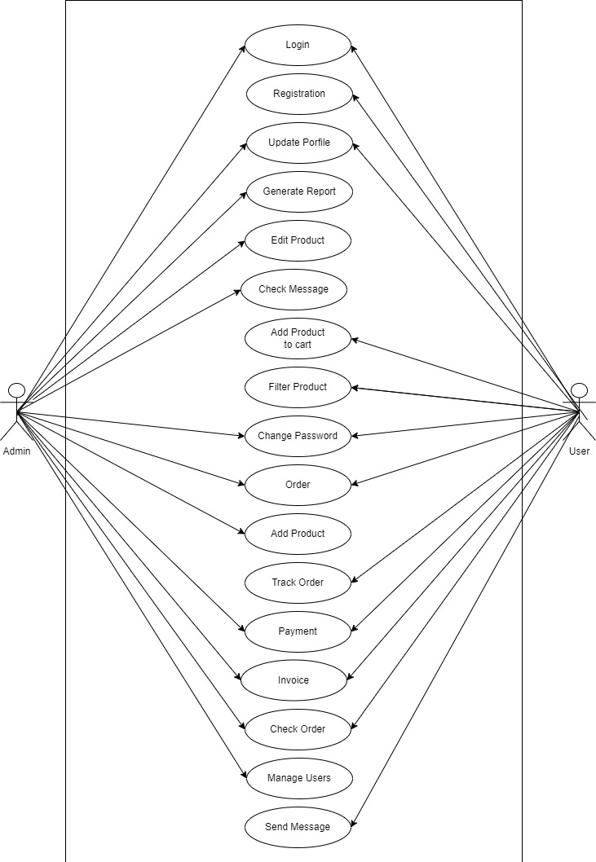
Use Case Diagram

Slide 14
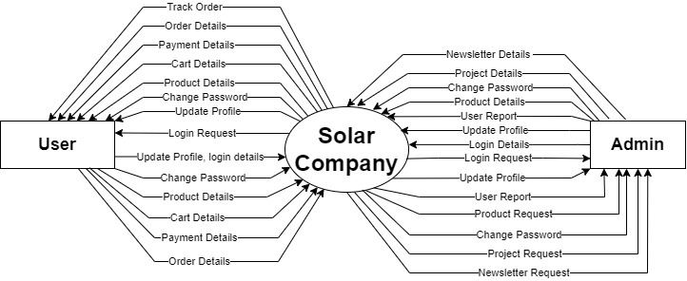
Data Flow Diagram
Context Level

Slide 15
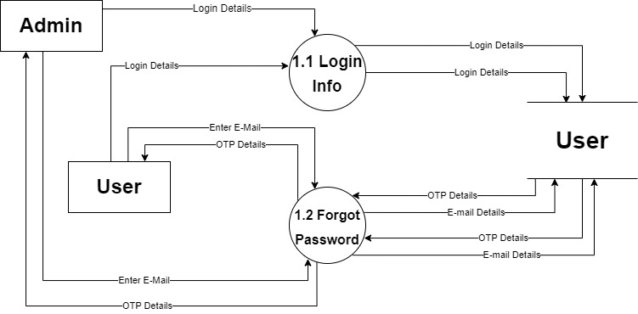
Second Level Data Flow Diagram

Slide 16
SCREEN LAYOUTS

Slide 17
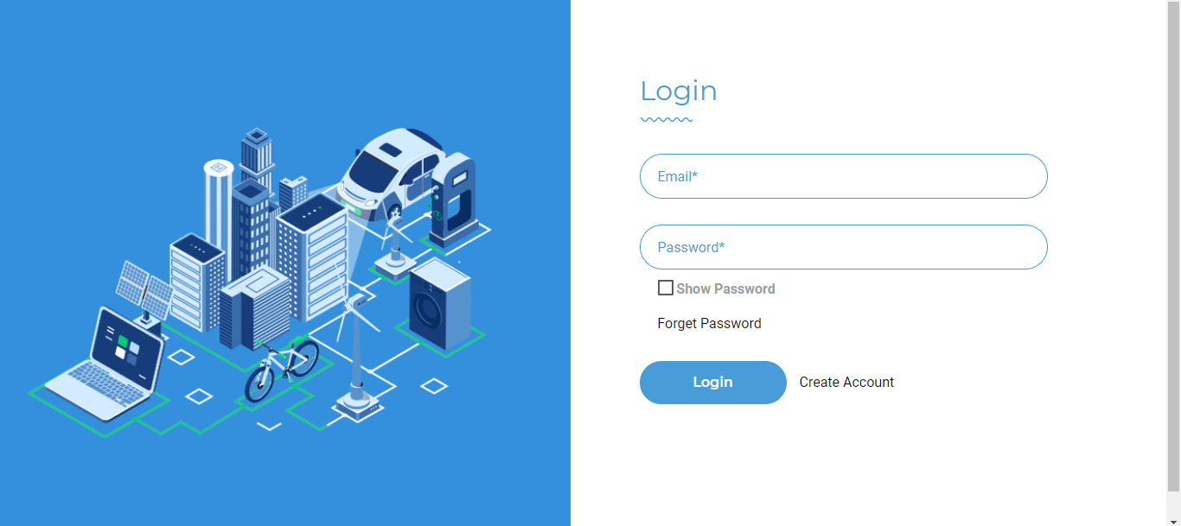
Login

Slide 18
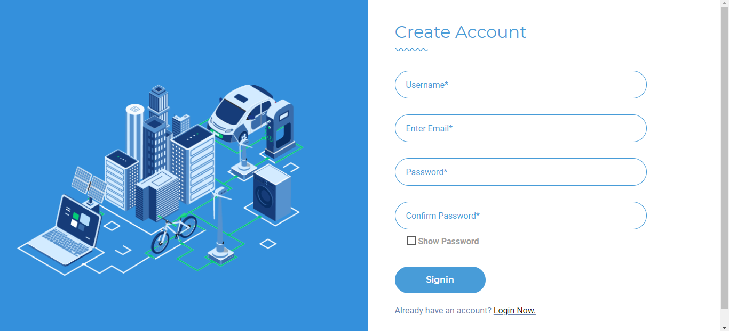
Registration

Slide 19
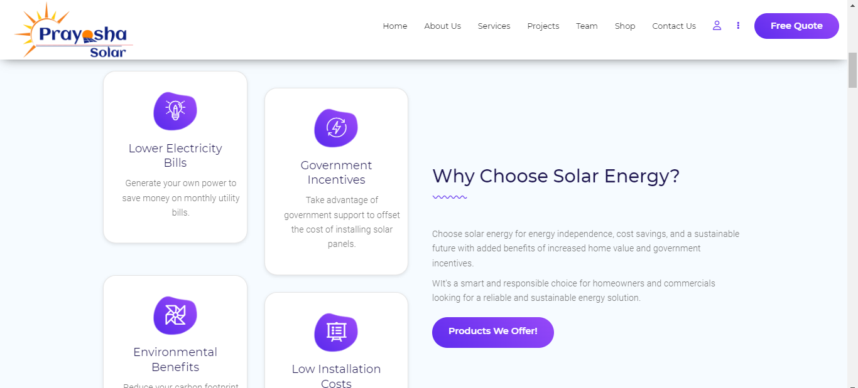
Home Screen

Slide 20
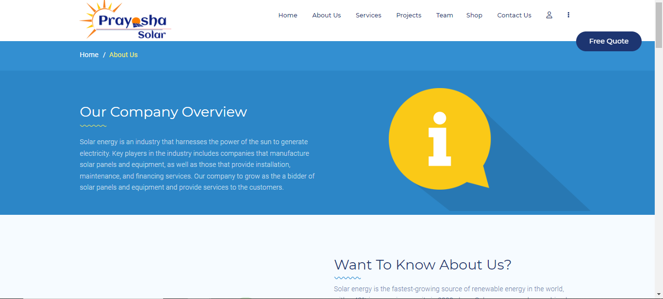
About Us

Slide 21
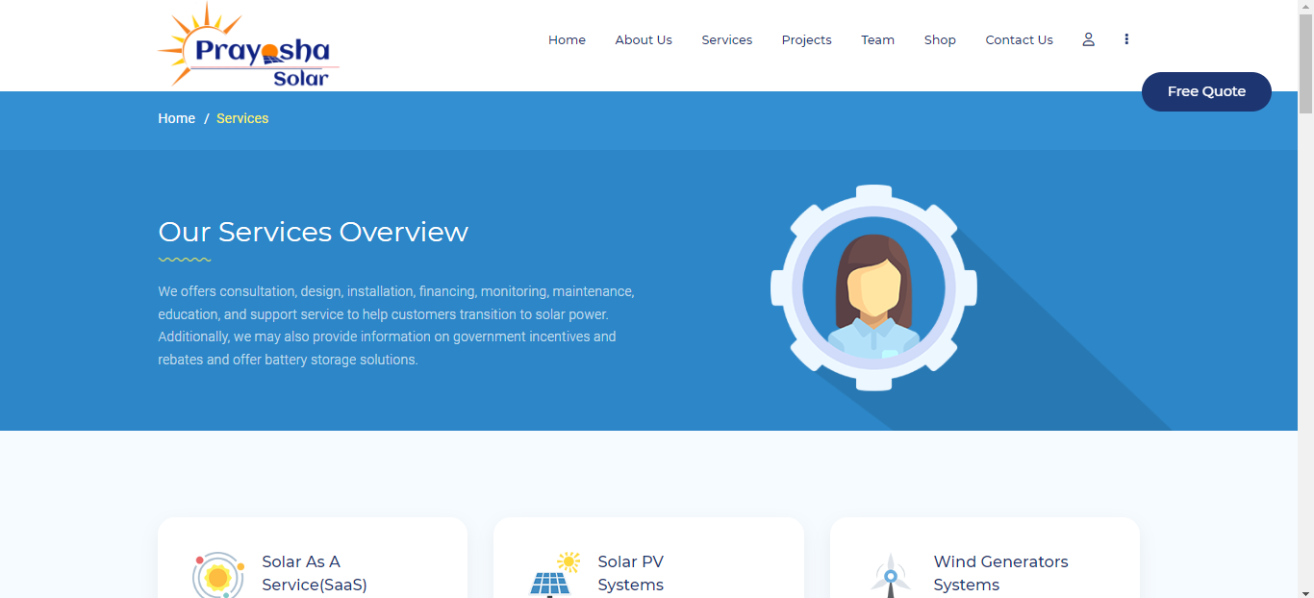
Services

Slide 22
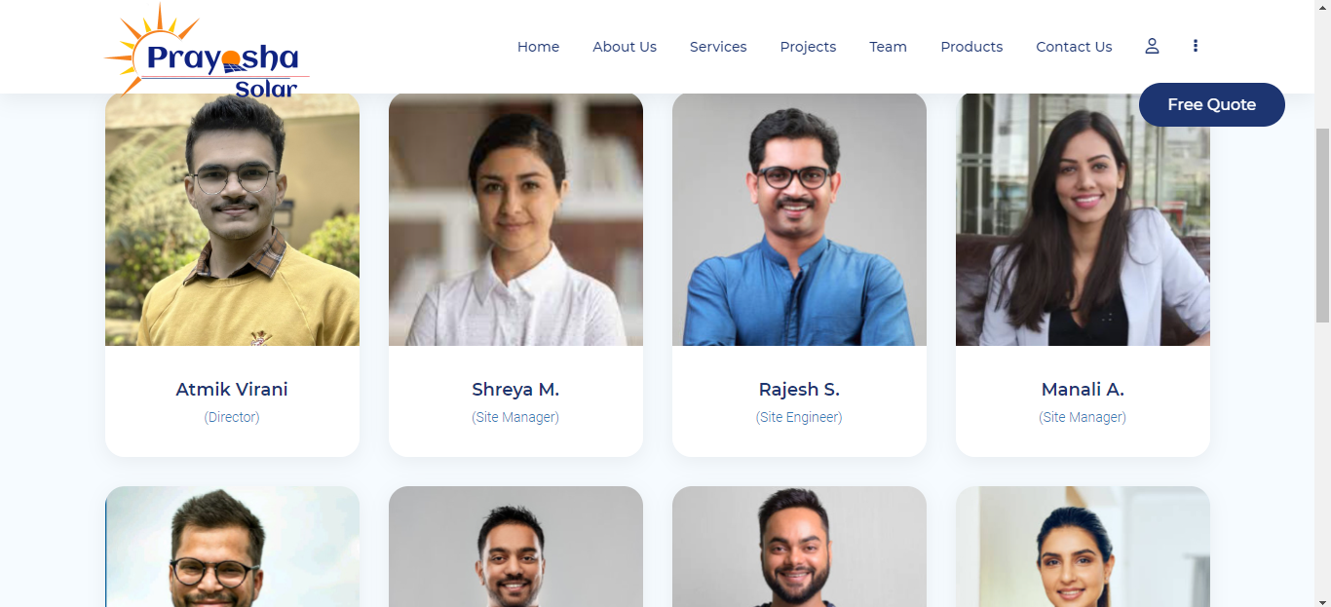
Team

Slide 23
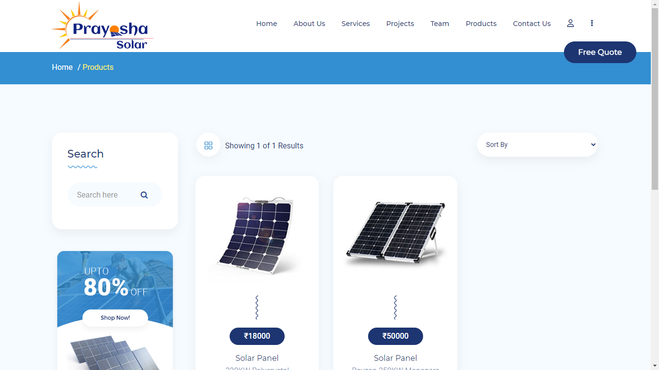
Product

Slide 24
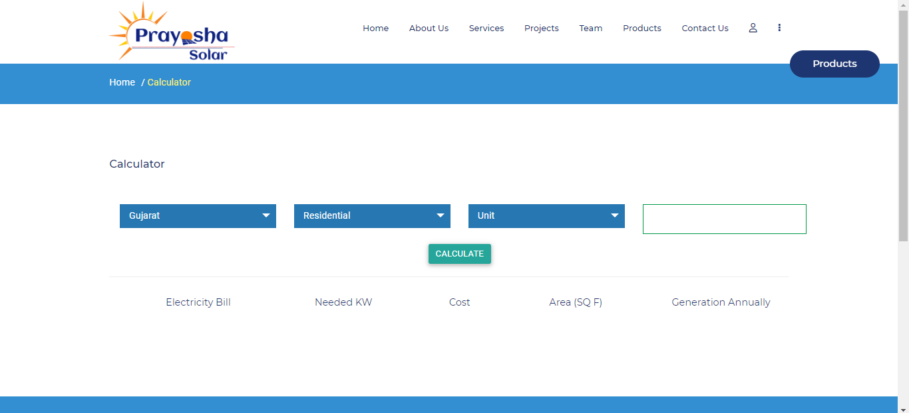
Calculator

Slide 25
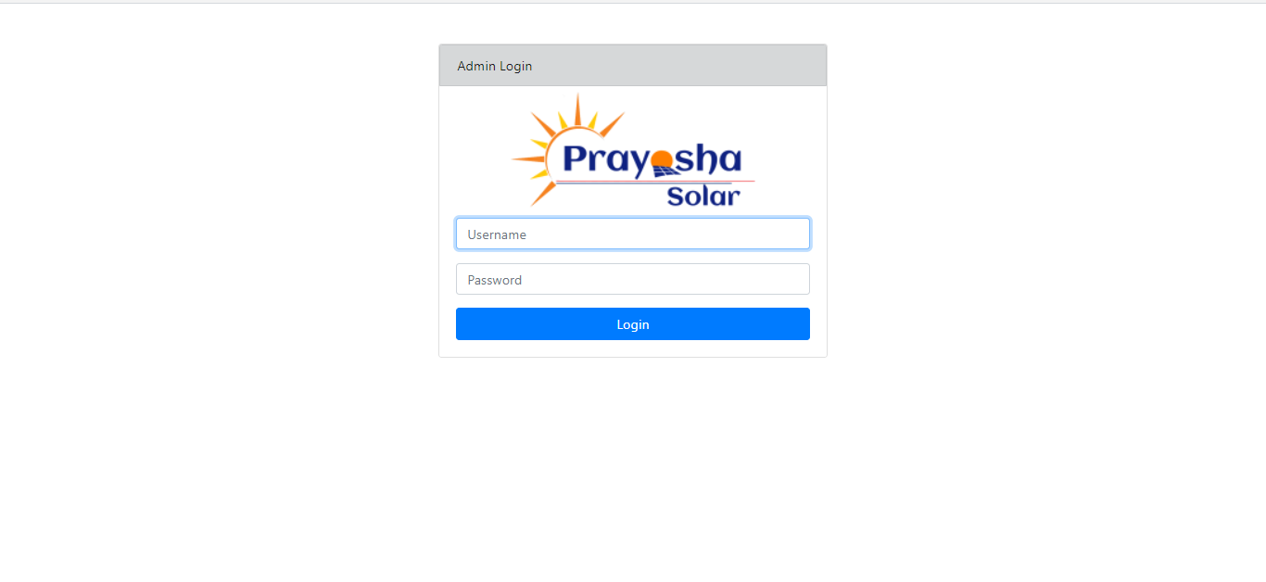
Admin Login Page

Slide 26
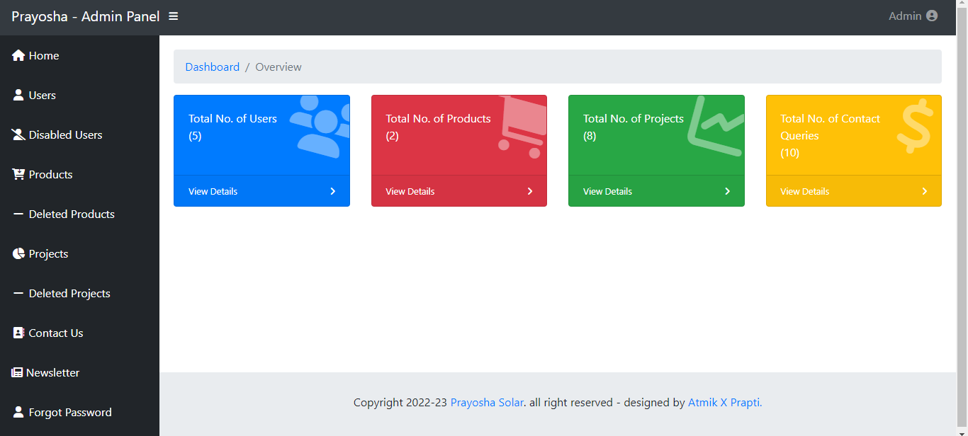
Admin side Dashboard

Slide 27
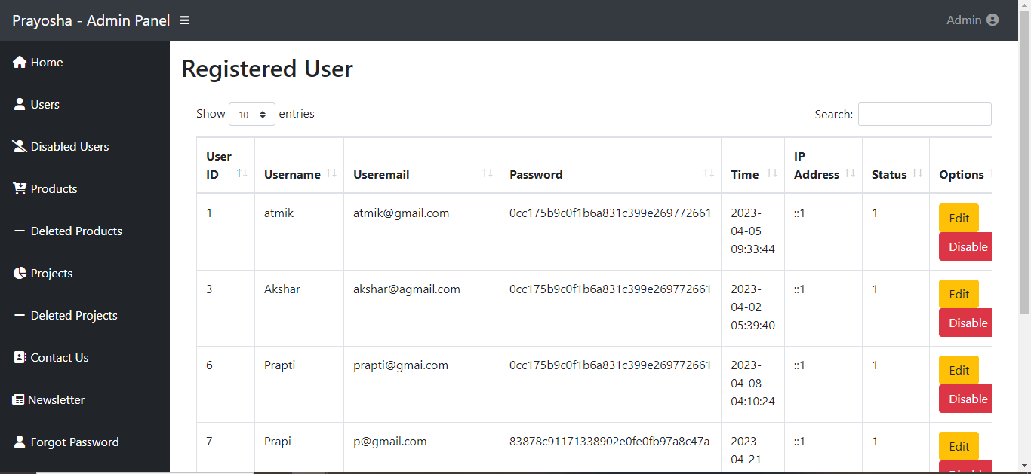
Admin side Users

Slide 28
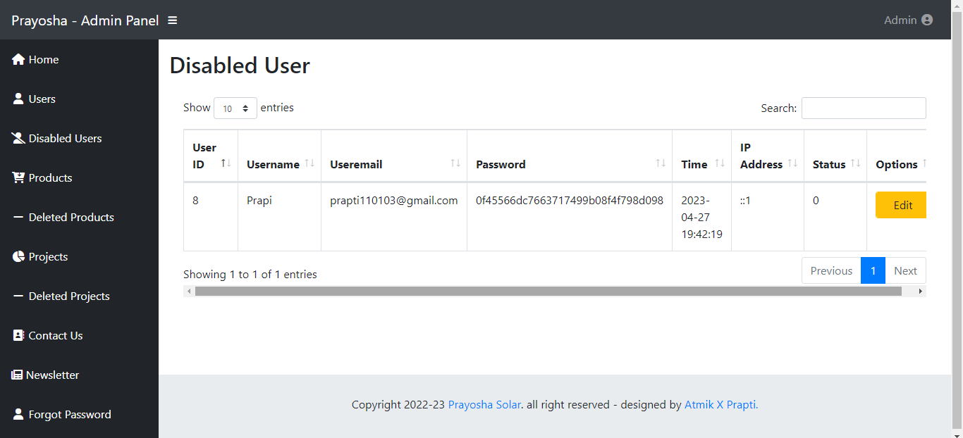
Admin side Disabled Users

Slide 29
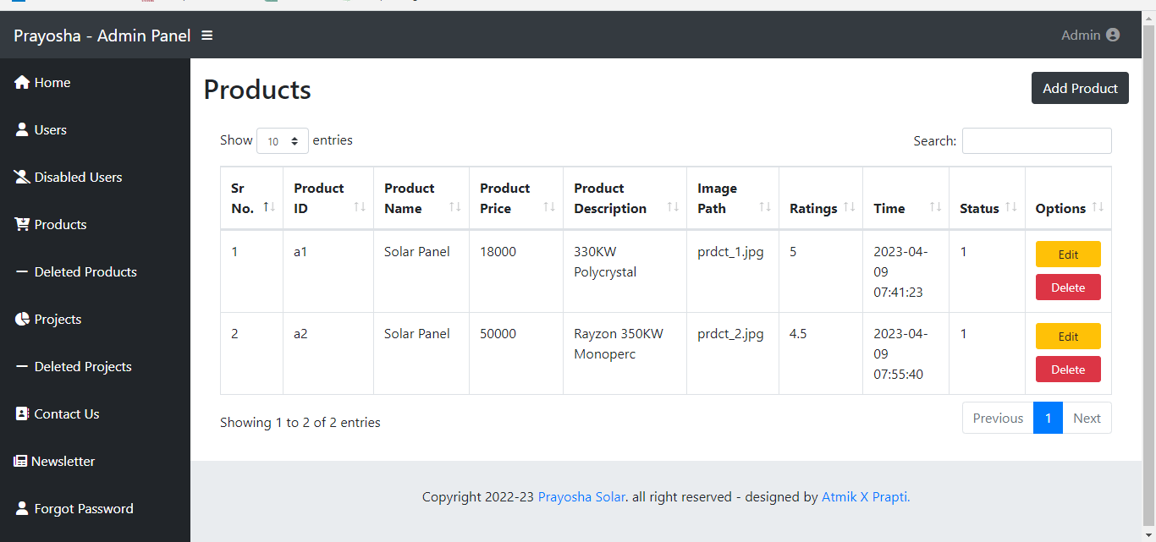
Admin side Products

Slide 30
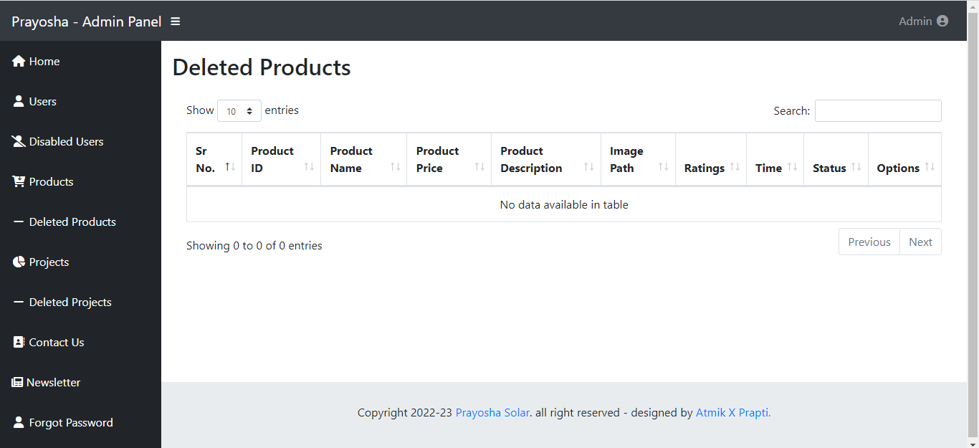
Admin side Deleted Products

Slide 31
Admin side Projects

Slide 32
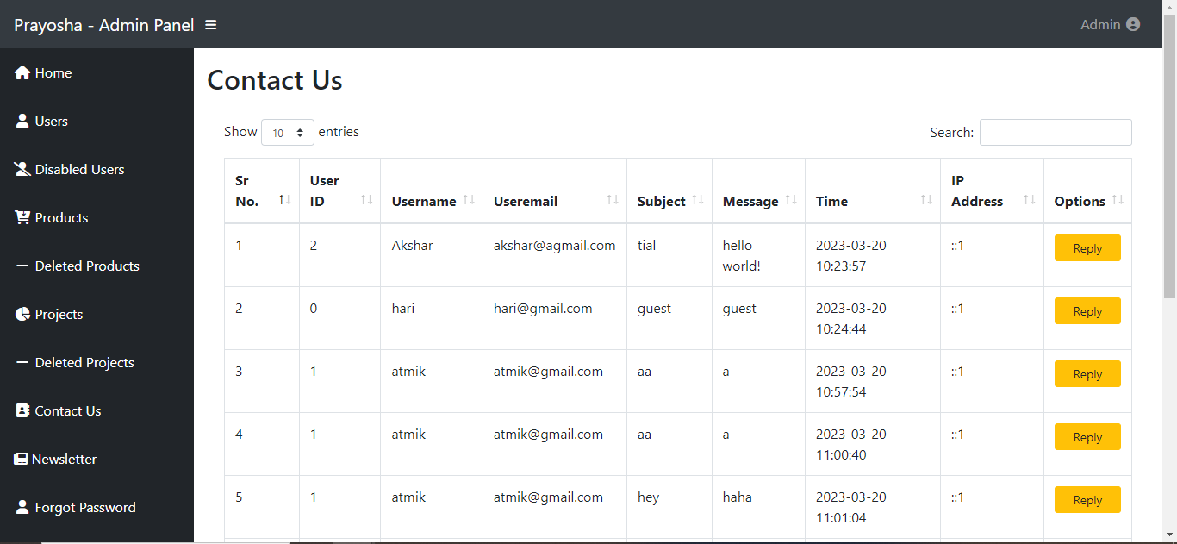
Admin side Contact Us

Slide 33
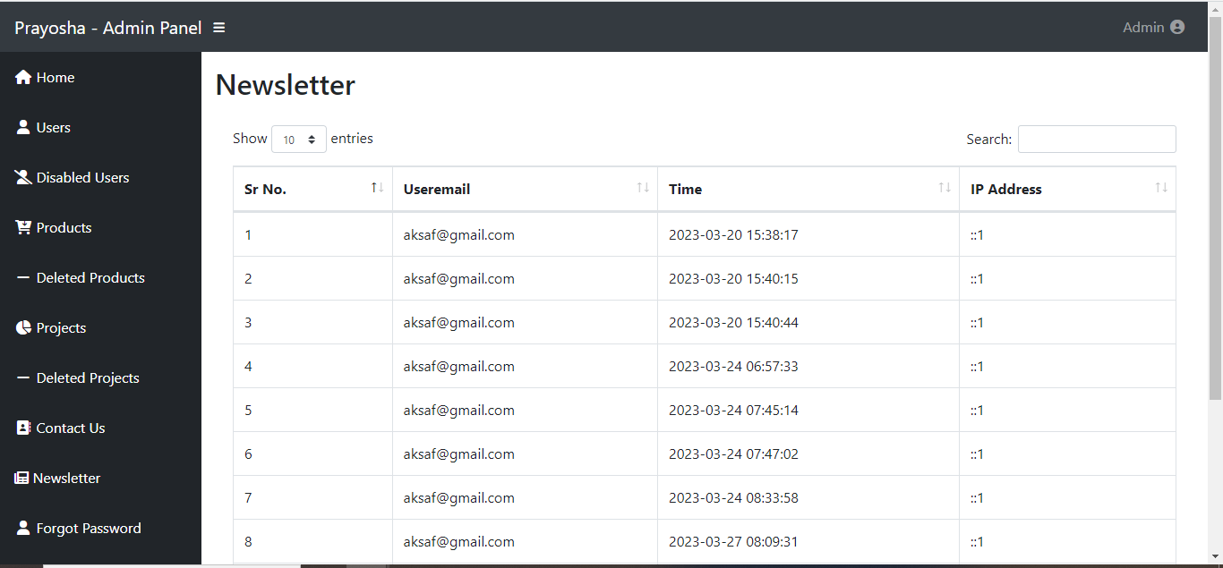
Admin side Newsletter

Slide 34
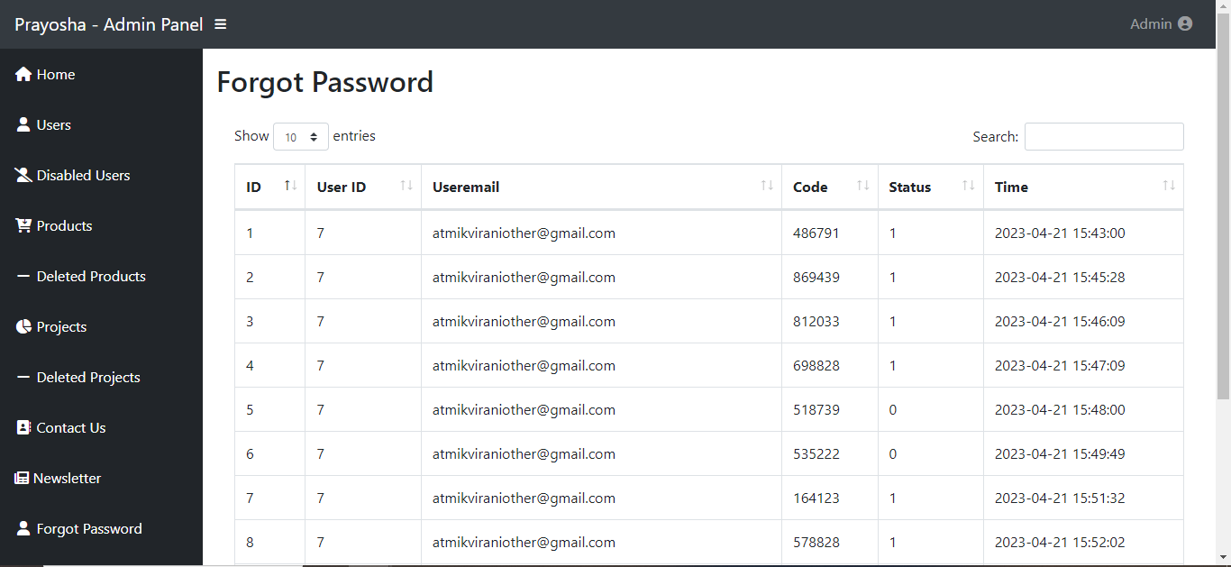

Admin side Forgot Password

Slide 35
FUTURE ENHANCEMENTS

Slide 36
Information regarding solar power generation is given
Virtual solar system design and visualisation are provided.
integrated energy storage
Monitoring and analysing energy consumption
Included were social aspects and gaming mechanisms.
Providing troubleshooting and remote oversight
Offering personalised energy-saving guidance
the incorporation of smart home technologies
enhanced customer support and chatbot assistance available
Analytics and report generating are offered to solar installations.

Slide 37
Thank You

