Slide 1

Prayosha
20BCA019 Prapti Patel
20BCA021 Atmik Virani

Slide 2

PROJECT PROFILE
PROJECT NAME : Prayosha
TYPE OF APPLICATION : E-Commerce Web Application
PROJECT DESCRIPTION: Prayosha is a feature-rich online application for managing leads, customers, and projects for solar companies. Prayosha equips solar firms with the tools they need to fulfil their sustainability goals, including a flexible design, safe operations, and efficient procedures.
TEAM SIZE: 2

Slide 3

TECHNOLOGIES USED
FRONT-END: HTML, CSS, JavaScript
BACK-END: PHP, MySQL
TOOLS: VS CODE, XAMPP

Slide 4

FRONT-END TOOLS
HTML: HyperText Markup Language (HTML) is a shorthand for this language. Markup language is used to develop websites online.
CSS: The style sheet language CSS (Cascading Style Sheets) is used to apply styles to web sites.
JavaScript: The most popular lightweight, interpreted written computer language is JavaScript (JS). Both client-side and server-side programming are possible with it. An web site programming language is called JavaScript.

Slide 5

BACK-END TOOLS
PHP: PHP is a popular server-side programming language for databases, e-commerce, and dynamic content. With Java support in PHP4, it supports well-known databases and protocols, has forgiving syntax, and allows n-tier development.
MySQL: Popular open-source RDBMS for PHP called MySQL. Quick, trustworthy, and simple to use. supports a variety of operating systems and languages, huge databases, and conventional SQL.

Slide 6

SYSTEM STUDY
EXISTING SYSTEM
Web applications may suffer from challenges including poor user experiences, technological difficulties, security breaches, and data loss. Users may become irritated by challenging navigation, a crowded layout, sluggish loading times, and unresponsiveness. Performance and user confidence can be affected by bugs, crashes, and security breaches. It could take a long time and cost a lot of money to fix security problems in an established online project.

Slide 7

Scope of the System
Strong defences against data breaches and theft.
Comprehensive features that guarantee ease of use for solar firms.
Navigation across the UI is quick and simple.
For optimum operation, ongoing assistance and maintenance are required.
Sophisticated security measures for sensitive data.
Scalable and adaptable to changing business requirements.

Slide 8

Aim of System
The admin controls user profiles, permissions, and user accounts. Additionally, the admin handles user reporting and invoice creation. plays a critical role in user happiness and system administration.
After login in or registering, users may use the web application to see products, edit their profiles, contact admin online, add things to carts, and complete transactions. Easy-to-use features for a seamless online shopping experience.

Slide 9
SYSTEM ANALYSIS

Slide 10
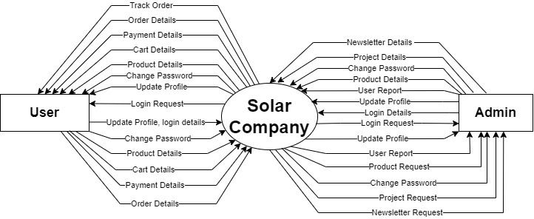
Data Flow Diagram
Context Level

Slide 11
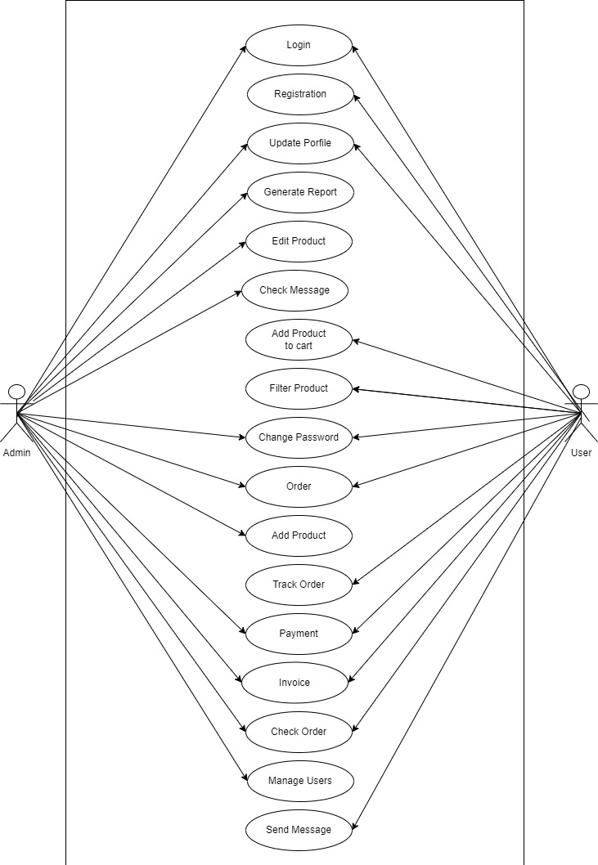
Use Case Diagram

Slide 12
SCREEN LAYOUTS

Slide 13
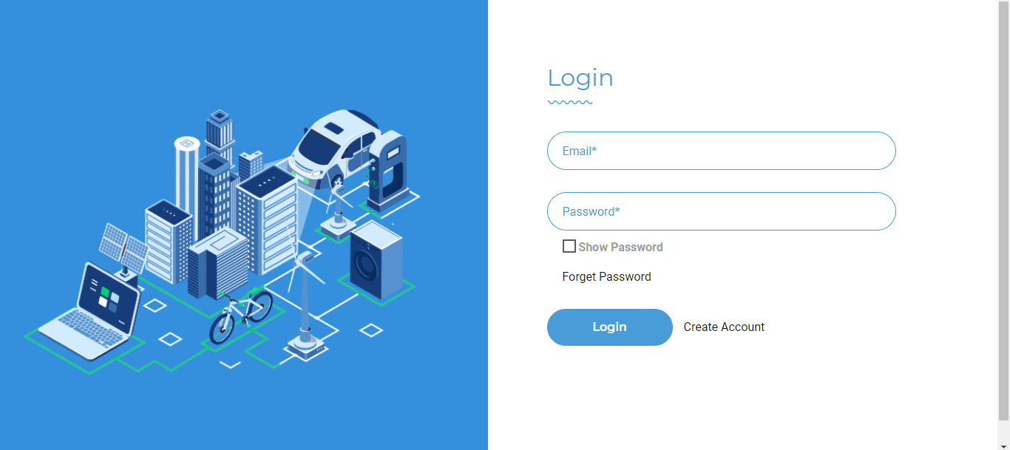
Login

Slide 14
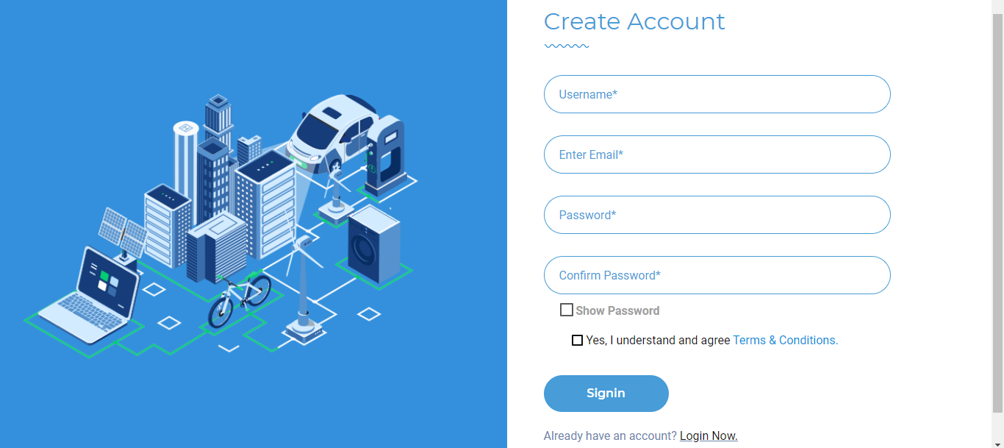
Registration

Slide 15
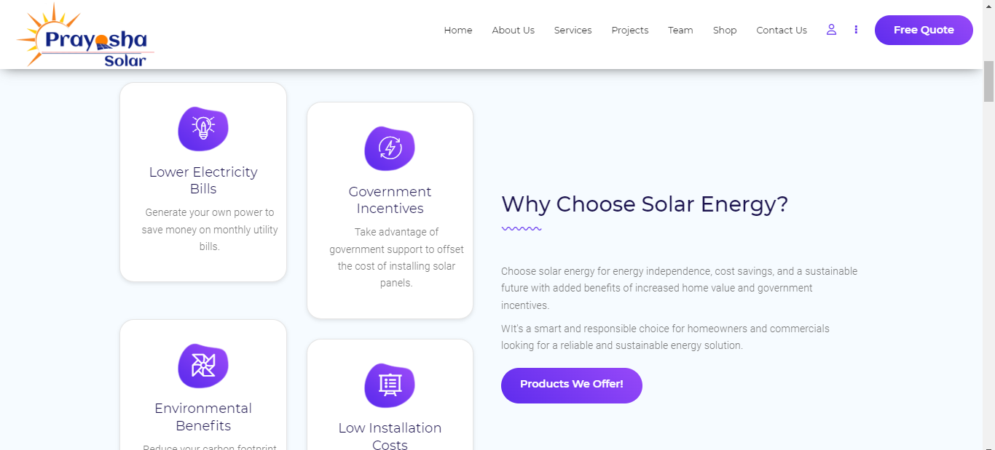
Home Screen

Slide 16
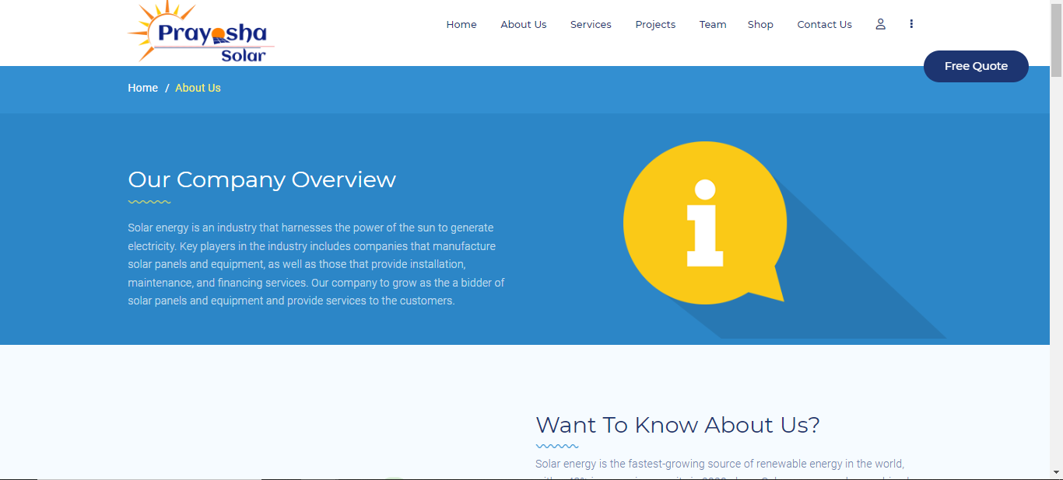
About Us

Slide 17
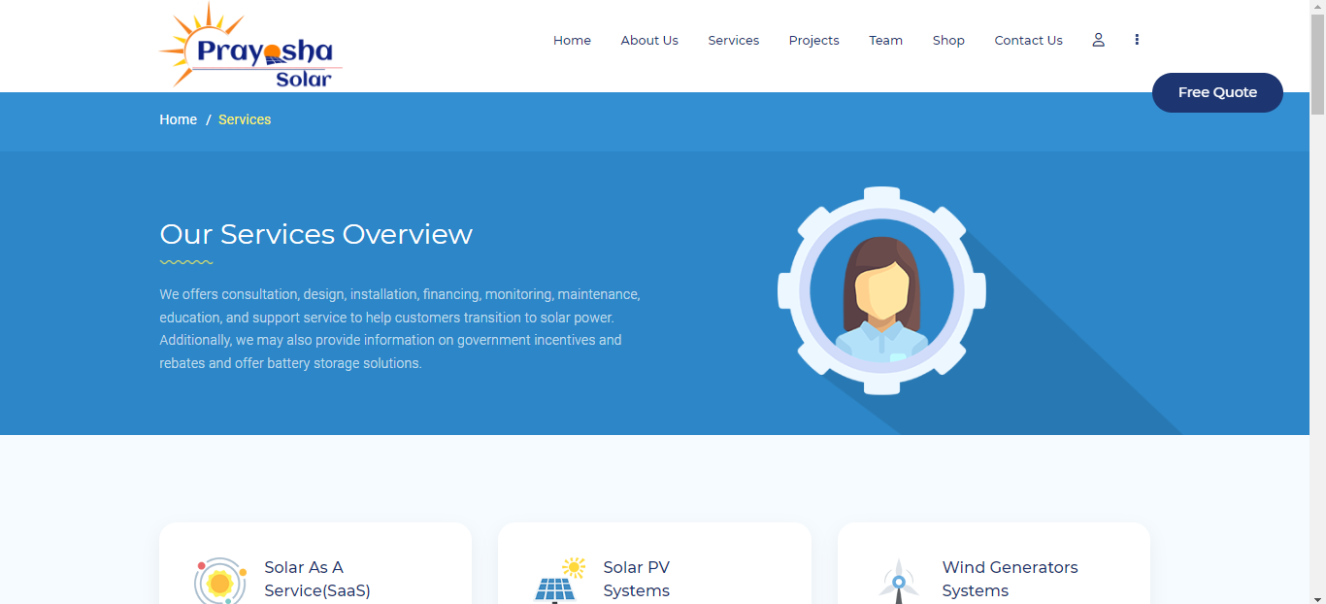
Services

Slide 18
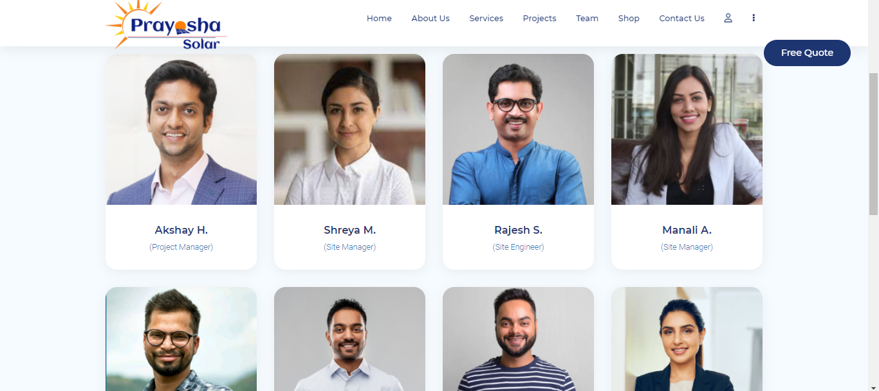
Team

Slide 19
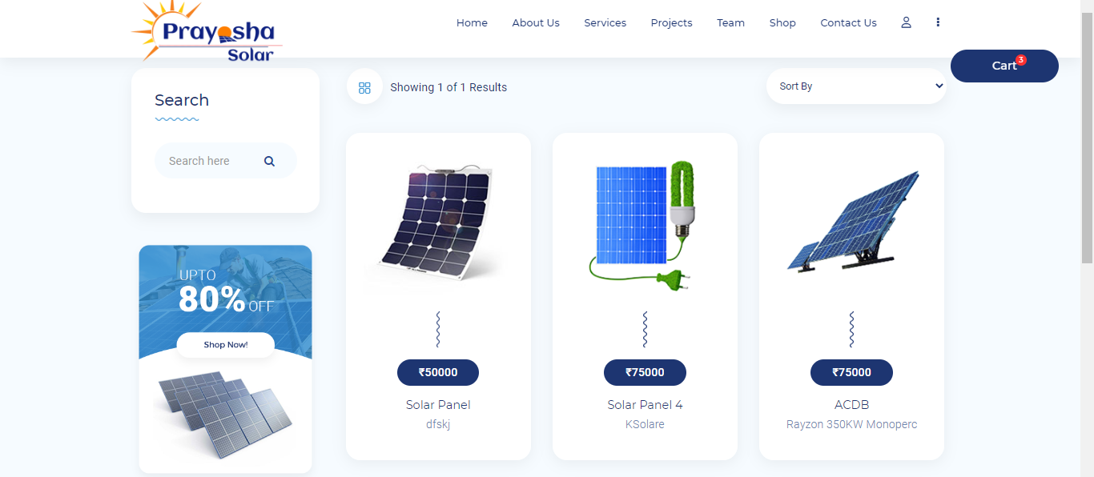
Shop

Slide 20
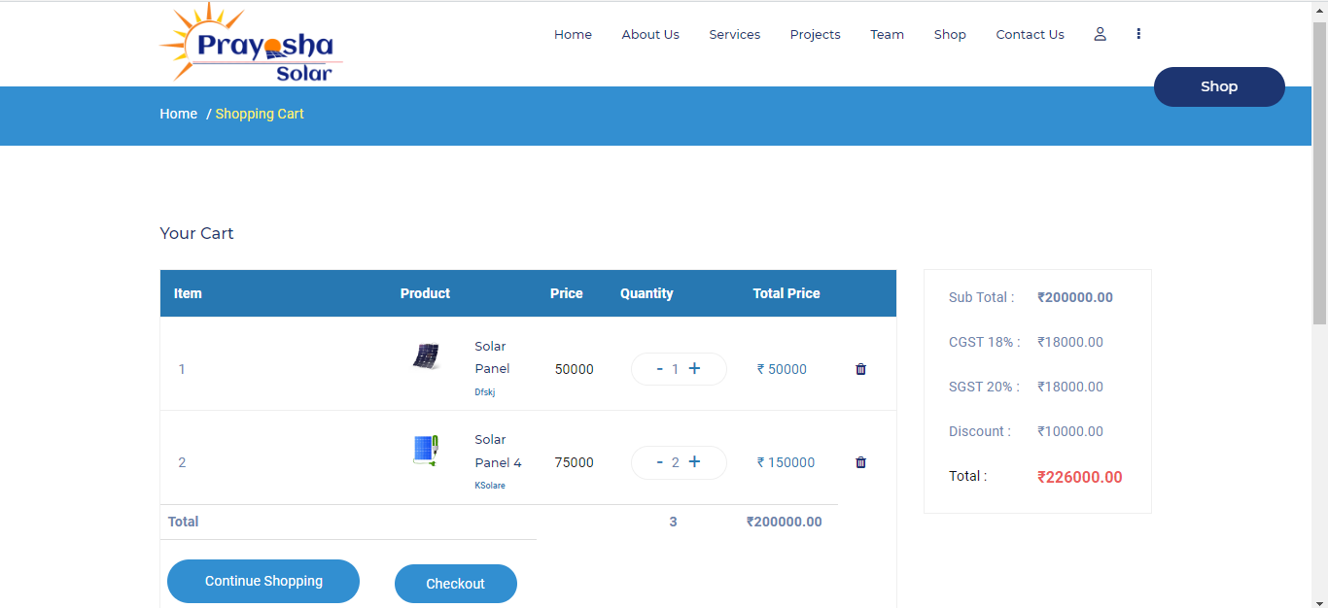
Cart

Slide 21
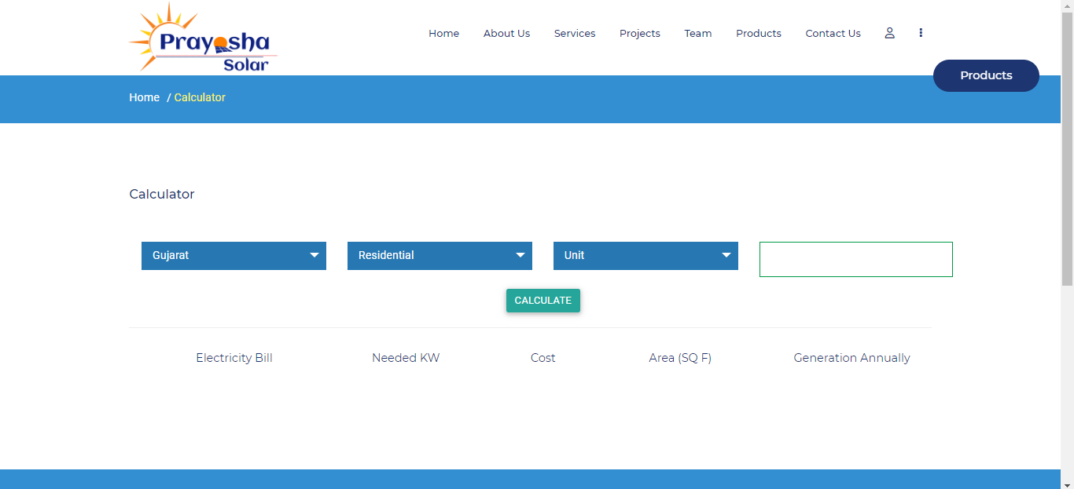
Calculator

Slide 22
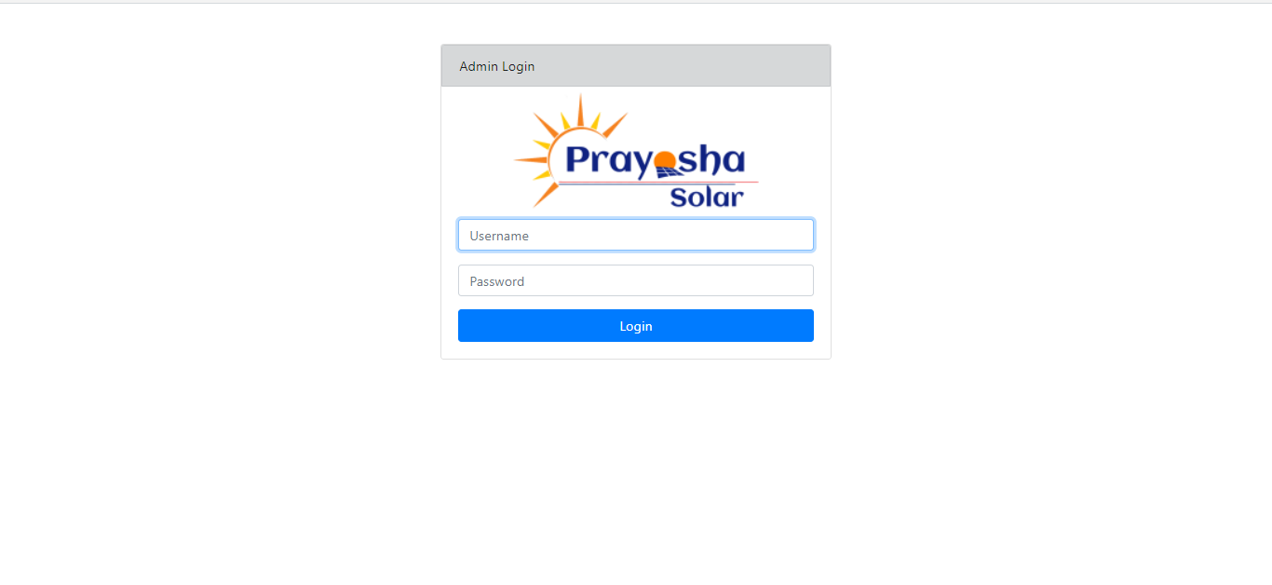
Admin Login Page

Slide 23
Admin side Dashboard

Slide 24
Thank You

