Slide 1

Prevention of security breaches caused by SQL Injections
20BCA019 Prapti Patel
20BCA021 Atmik Virani

Slide 2

PROJECT PROFILE
PROJECT NAME : Prevention of Security breaches caused by SQL Injections
TYPE OF APPLICATION : E-Commerce Web Application
PROJECT DESCRIPTION: Web app for Prayosha, a solar panel company, prevents SQL Injection attacks with parameterized queries, input validations, limited privileges, updates, firewalls, and user education. Ensures secure, reliable, error-free operations.
TEAM SIZE: 2

Slide 3

TECHNOLOGIES USED
FRONT-END: HTML, CSS, JavaScript
BACK-END: PHP, MySQL
TOOLS: VS CODE, XAMPP

Slide 4

FRONT-END TOOLS
HTML: HyperText Markup Language (HTML) is a shorthand for this language. Markup language is used to develop websites online.
CSS: The style sheet language CSS (Cascading Style Sheets) is used to apply styles to web sites.
JavaScript: The most popular lightweight, interpreted written computer language is JavaScript (JS). Both client-side and server-side programming are possible with it. An web site programming language is called JavaScript.

Slide 5

BACK-END TOOLS
PHP: PHP is a popular server-side programming language for databases, e-commerce, and dynamic content. With Java support in PHP4, it supports well-known databases and protocols, has forgiving syntax, and allows n-tier development.
MySQL: Popular open-source RDBMS for PHP called MySQL. Quick, trustworthy, and simple to use. supports a variety of operating systems and languages, huge databases, and conventional SQL.

Slide 6

SYSTEM STUDY
EXISTING SYSTEM
Web apps pose security risks like SQL injections, data breaches, and data leaks, which can result in financial losses and damage to reputation. Fixing security flaws can be time-consuming and expensive, impacting business operations. Ensuring robust security measures is crucial for maintaining trust and safeguarding sensitive data in web apps

Slide 7
Scope of the System
Without SQL Injection flaws, secure design.
For data security, parameterized queries and input validation are used.
For security, routine software and database upgrades.
A user-friendly design that satisfies their needs.
Extensible and scalable for growth in the future.

Slide 8
Aim of System
Users, profiles, and permissions are managed by the admin. manages user reports, creates invoices, and oversees payroll. plays a crucial part in system administration and user satisfaction.
Users can view products, update their profiles, contact admin online, add items to carts, and make transactions using the web application after registering or logging in. Features that are simple to use for a flawless online buying experience.

Slide 9
Quotations are commonly printed as a means of inspiration and to invoke philosophical thoughts from the reader.

Slide 10
SYSTEM ANALYSIS

Slide 11
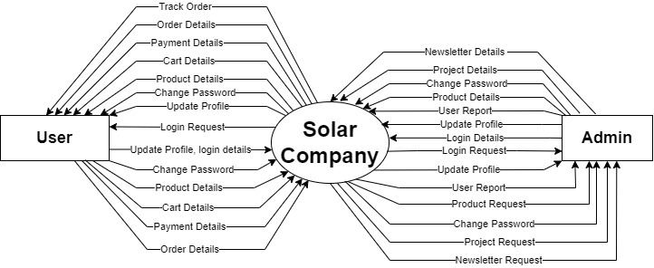
Data Flow Diagram
Context Level

Slide 12
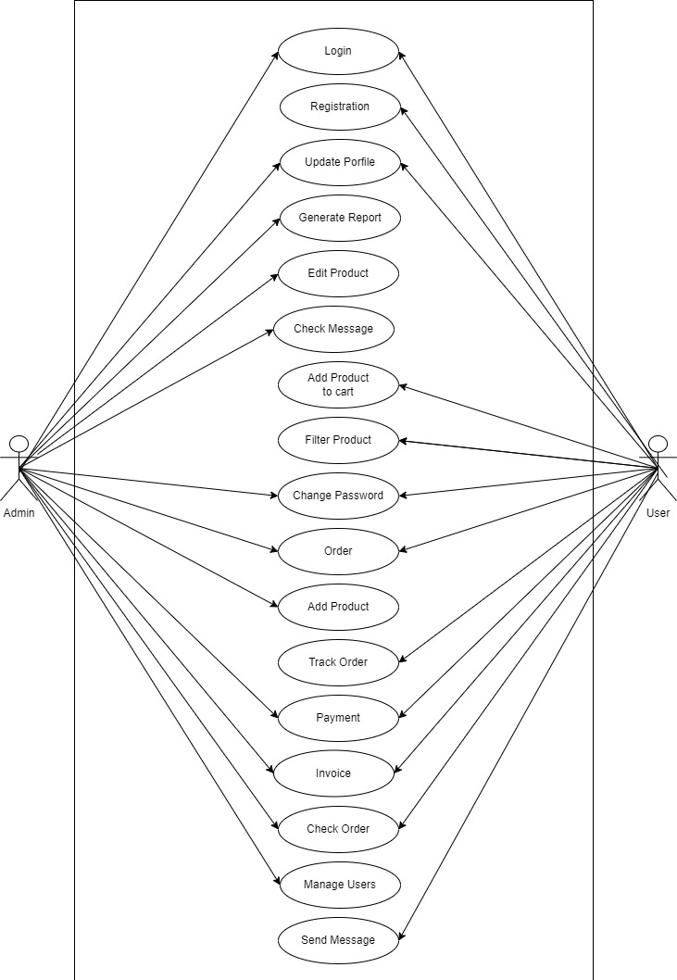
Use Case Diagram

Slide 13
SCREEN LAYOUTS

Slide 14
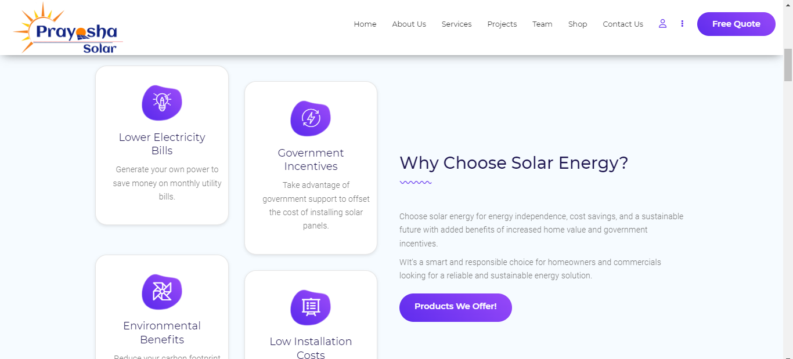
Home Screen

Slide 15
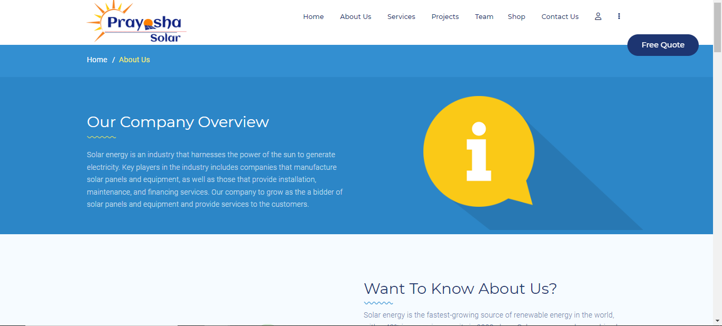
About Us

Slide 16
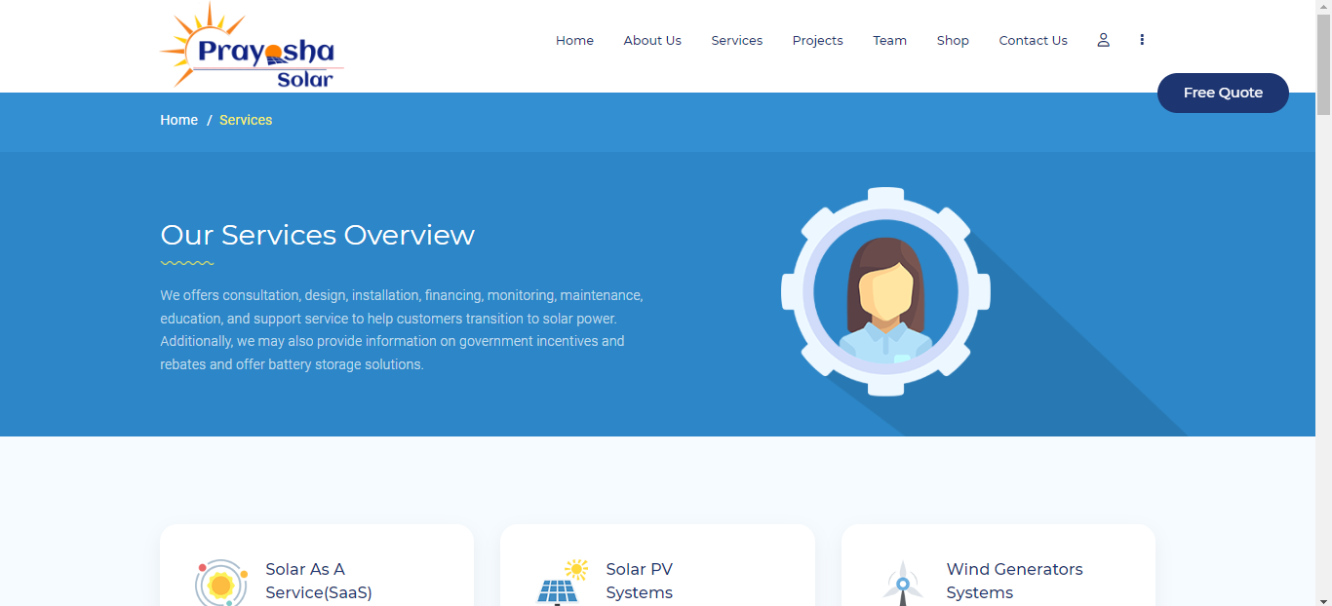
Services

Slide 17
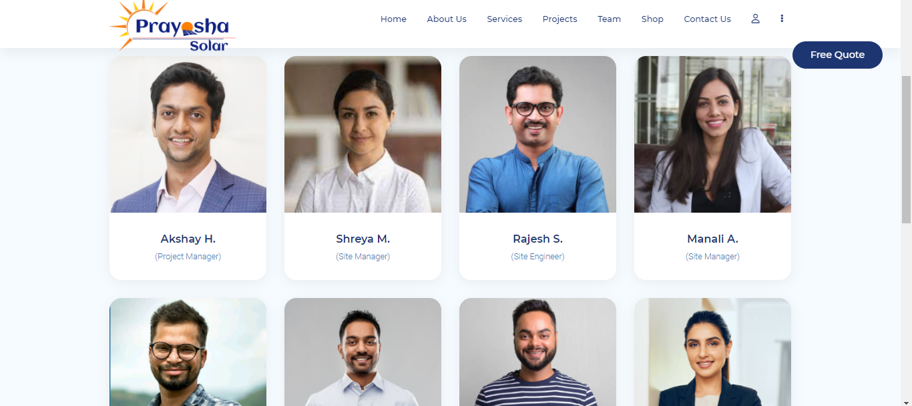
Team

Slide 18
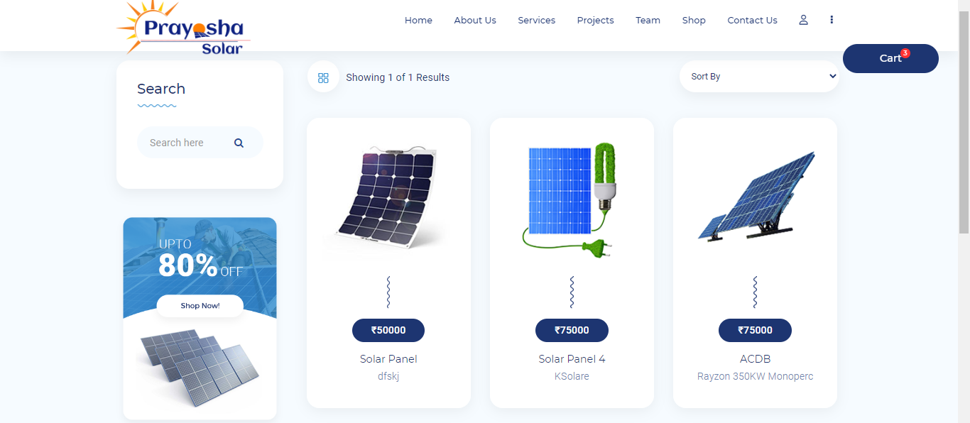
Shop

Slide 19
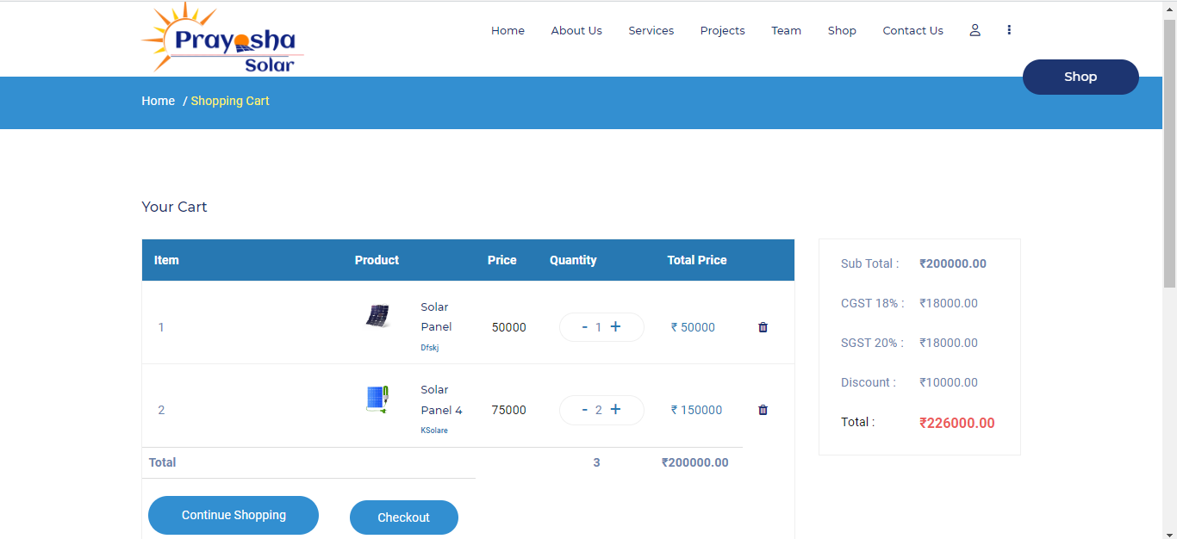
Cart

Slide 20
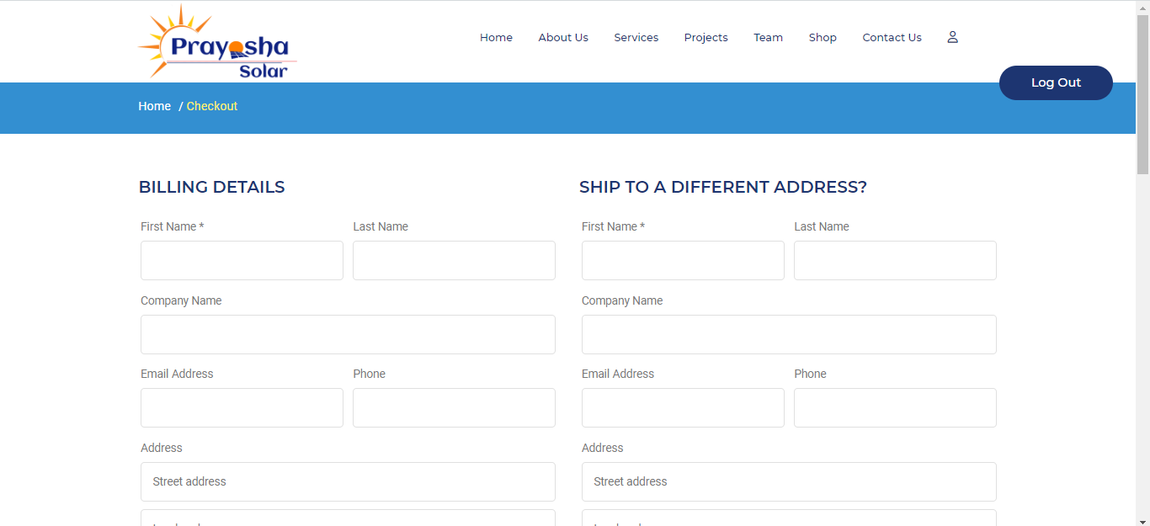
Cart

Slide 21
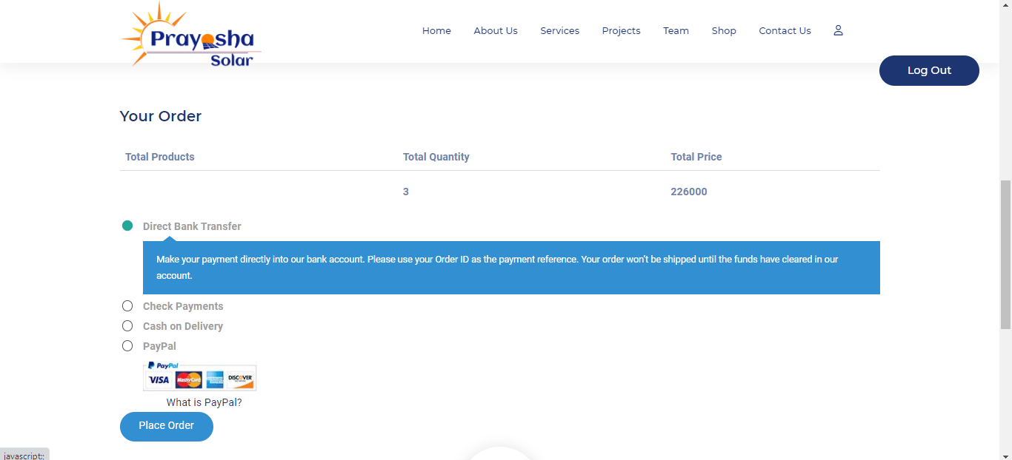
Payment

Slide 22
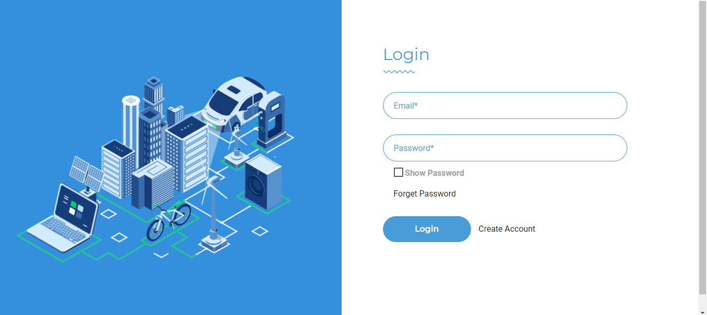
Login

Slide 23
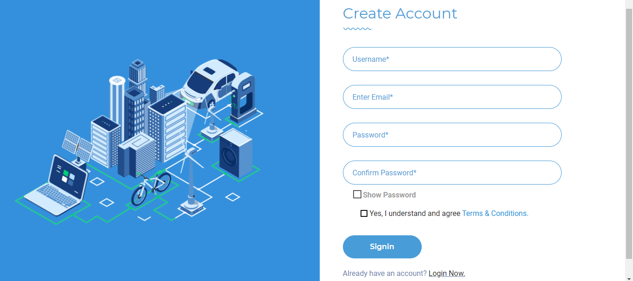
Registration

Slide 24
Thank You

