Slide 1
StoreAssist
Team Name: TeamSaaS
Akanksha Jaiswal
Jyothi H R
Manasi Sadanand Pai
Prarthana Hemanth

Slide 2
StoreAssist is an app built on AWS which would be a one stop portal for employees working at a large Store/Super Market say Target, Walmart etc.

Slide 3
Capabilities
Capability to add in customers to the store’s rewards program. Along with the basic details of the customer, a picture would be captured and stored.
Whenever a registered customer comes to the store, at the checkout counter, we would have the ability to recognize the person by clicking a picture and retrieving their reward points details. So this gives the customer the ability to redeem rewards without carrying their Rewards card.
Capability to post upcoming offers to Twitter, using a scheduled process. The employee would just have to update an excel sheet with the tweet and when it should be posted, and the rest would be handled by the system.
A chatbot which would help the employee answer frequently asked customer concerns and queries.

Slide 4

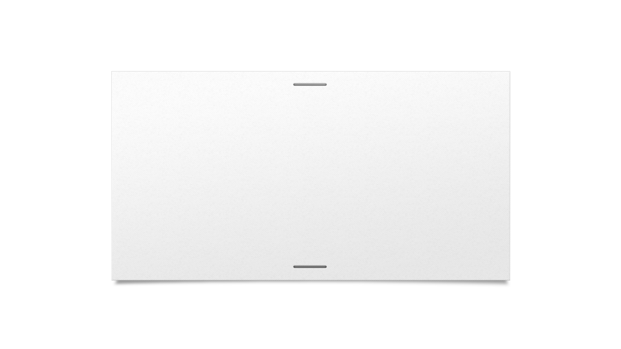
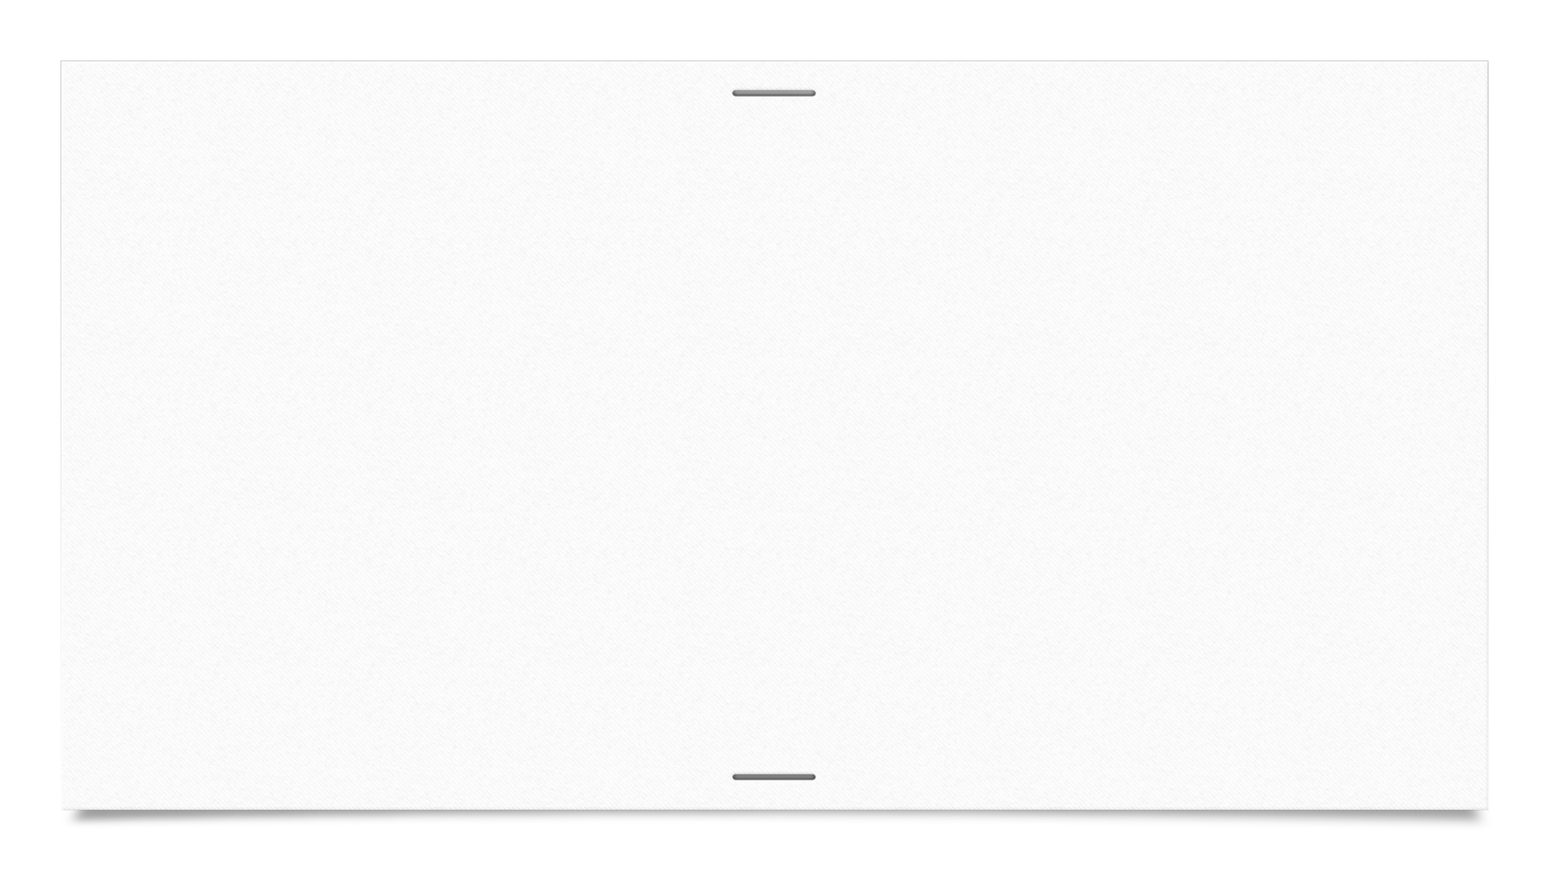


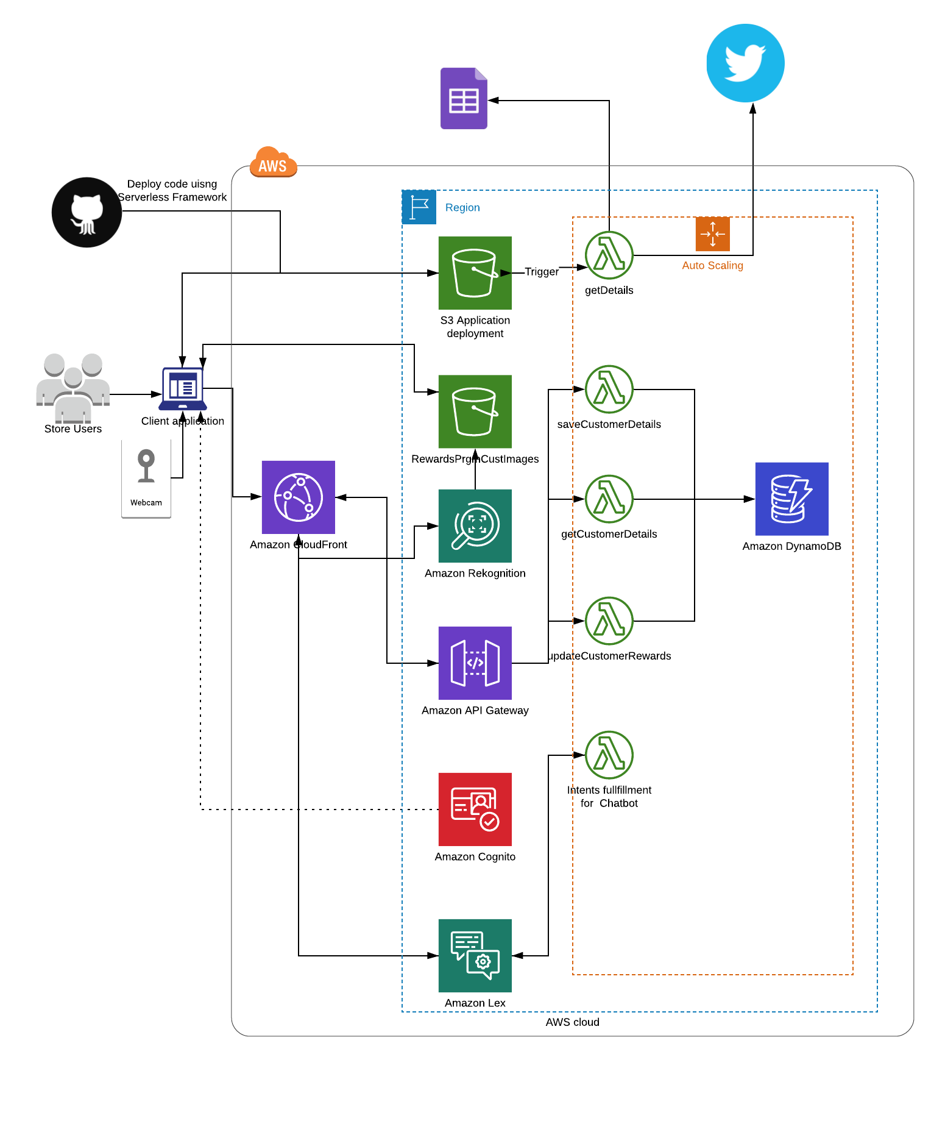
Architecture Diagram

Slide 5
Thank You!

