Slide 1
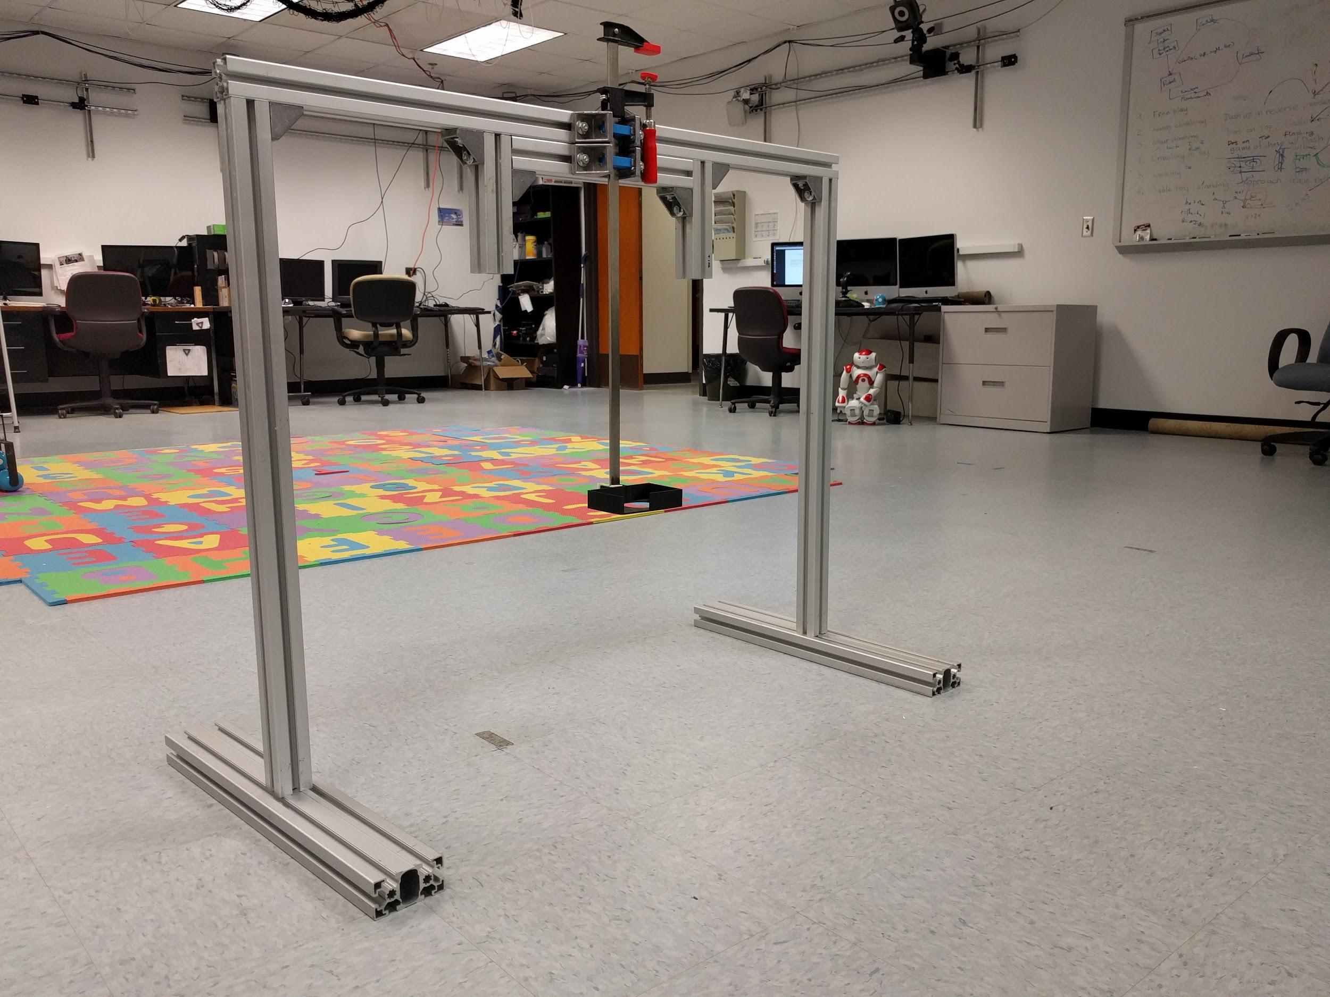
Height bar
Camera Holder
Scaffold Support

