Slide 1
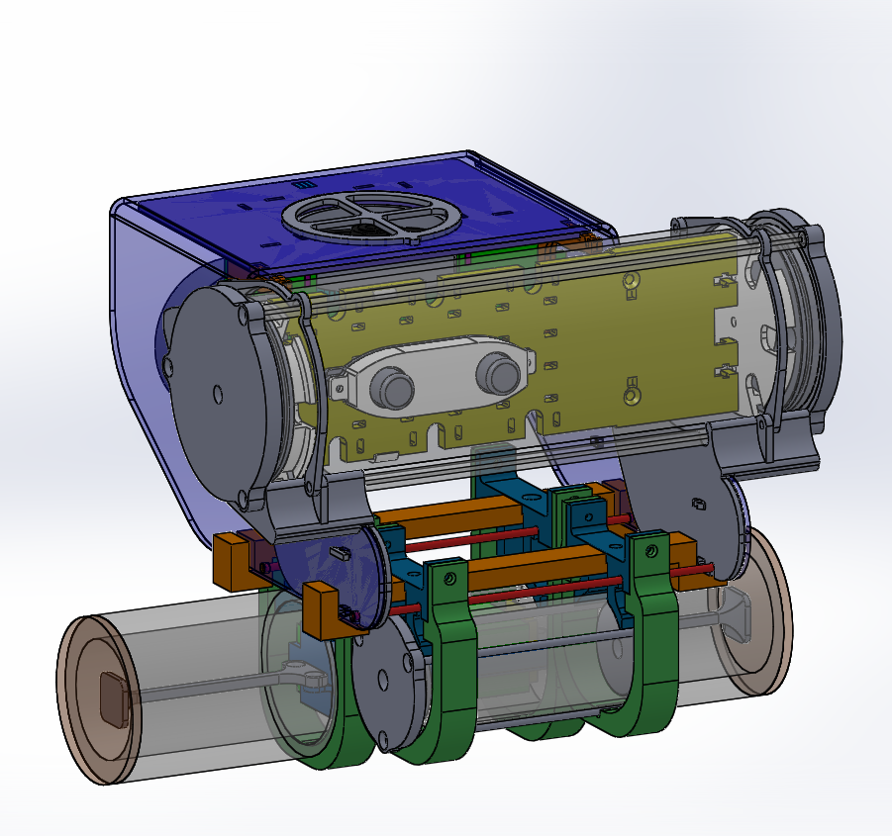
Frame
Electronics Tube
Connector Tube
Battery Tube

