Slide 1
Income Classification Prediction
CAPSTONE PROJECT
Presented By:
Prarthna Puhan - VIT Vellore - School of Electronics Engineering (SENSE)
AICTE Student ID: STU658c808d6f68b1703706765

Slide 2
OUTLINE
Problem Statement (Should not include solution)
System Development Approach (Technology Used)
Algorithm & Deployment (Step by Step Procedure)
Result
Conclusion
Future Scope(Optional)
References

Slide 3

Problem Statement
Accurately determining whether an individual's income exceeds $50K is a critical task in socio-economic analysis. Traditional methods often lack scalability and efficiency for large datasets. There is a need to automate this prediction using data-driven techniques. The challenge lies in handling diverse features and imbalanced classes. This project addresses the need for a reliable, scalable income classification approach.

Slide 4
System Approach
This system follows a structured ML pipeline to ensure accurate income classification and smooth deployment via a web interface.
1. System Requirements
Hardware: Standard laptop/PC with 4GB+ RAM
Software: Python 3.10+, Streamlit, Jupyter/IDE
OS Compatibility: Windows, Linux, macOS
2. Required Libraries
pandas, numpy – Data manipulation
matplotlib, seaborn – Visualization
scikit-learn – Model building and evaluation
xgboost – Gradient boosting classifier
imblearn – SMOTE for class balancing
joblib – Model serialization
streamlit – Web app deployment
3. Methodology
Data preprocessed and imbalanced classes handled using SMOTE
Multiple classifiers trained: Logistic Regression, Random Forest, SVM, XGBoost, etc.
Evaluation using accuracy, confusion matrix, classification report
Best model deployed in an interactive Streamlit app for real-time prediction using user input.

Slide 5
Algorithm & Deployment
Data Collection: Acquired adult.csv dataset containing demographic and socio-economic features.
Data Preprocessing: Handled missing values, encoded categorical features, and normalized data.
Class Imbalance Handling: Applied SMOTE to balance the income classes.
Model Building: Trained multiple ML classifiers (Logistic Regression, Random Forest, SVM, XGBoost etc.).
Model Evaluation: Assessed performance using accuracy, classification report, and confusion matrix.
Model Selection: Chose the best-performing model based on evaluation metrics.
Model Deployment: Developed a Streamlit web application for real-time income prediction.
Prediction Output: Accepted user input or batch CSV and generated predicted income class.
Result Comparison: Compared original and predicted outcomes for evaluation.

Slide 6
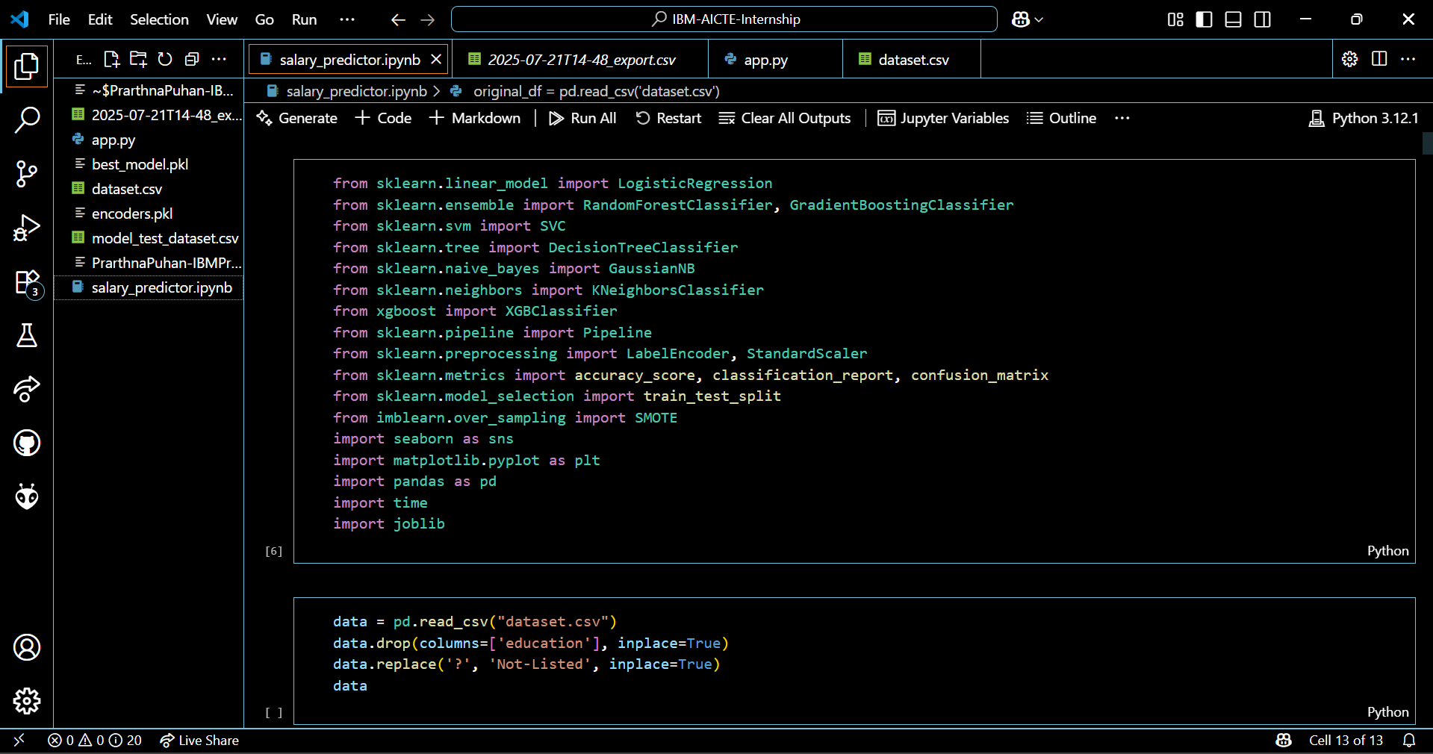
Result

Slide 7
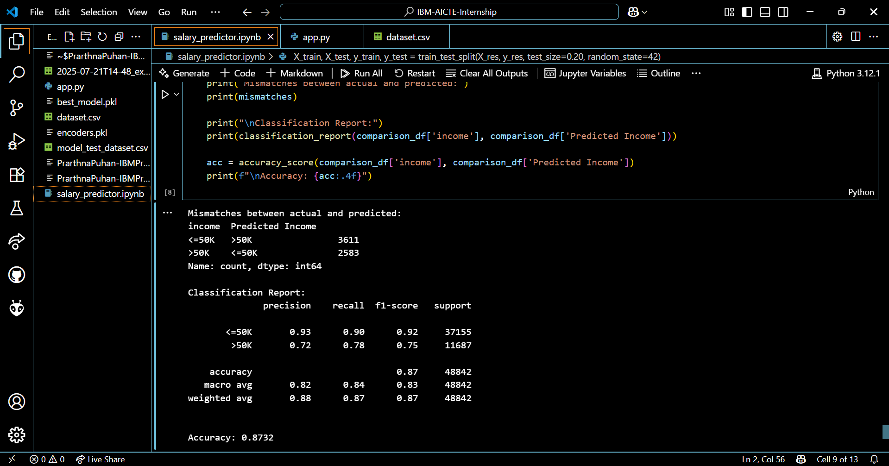
Result

Slide 8
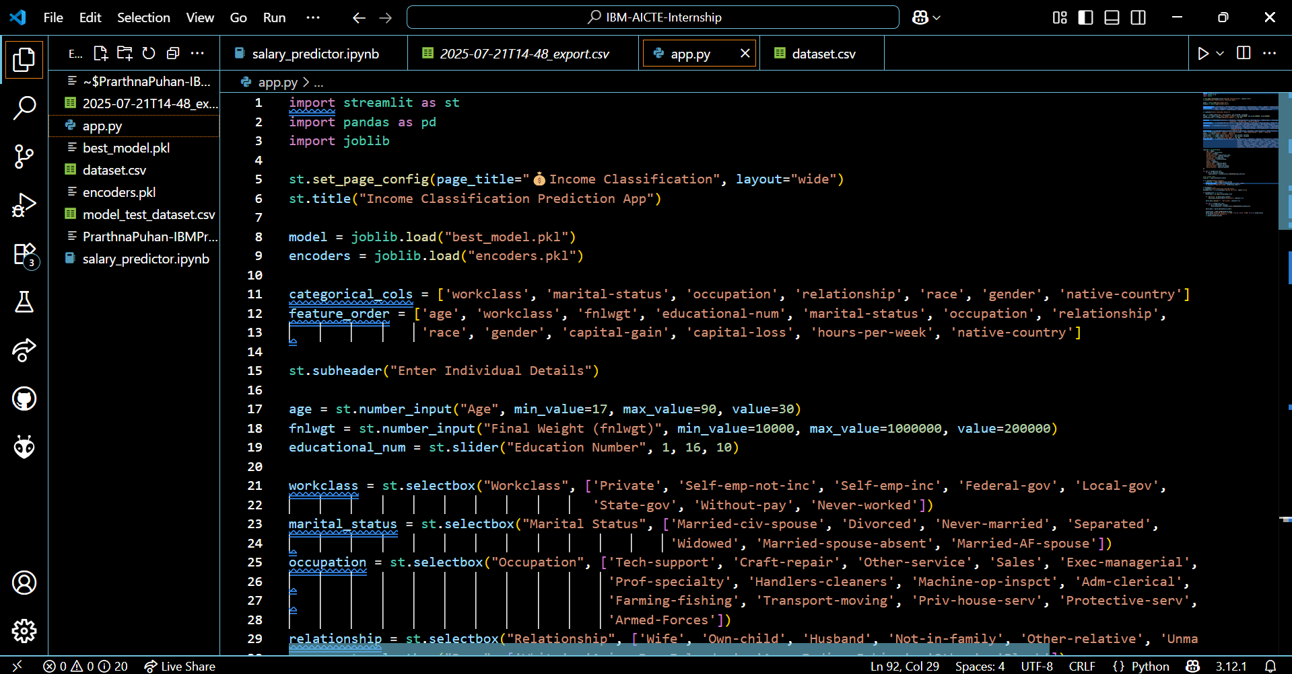
Result

Slide 9
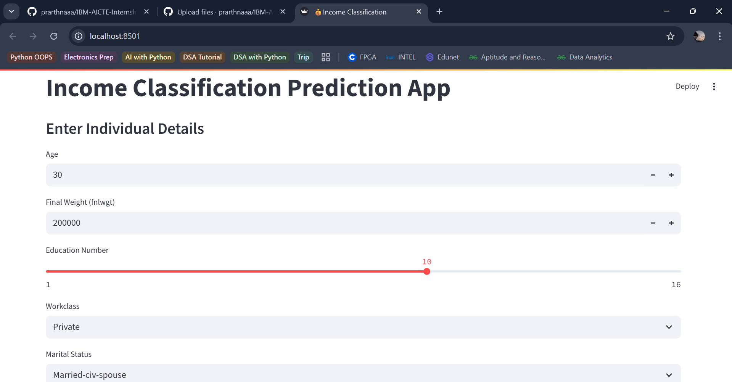
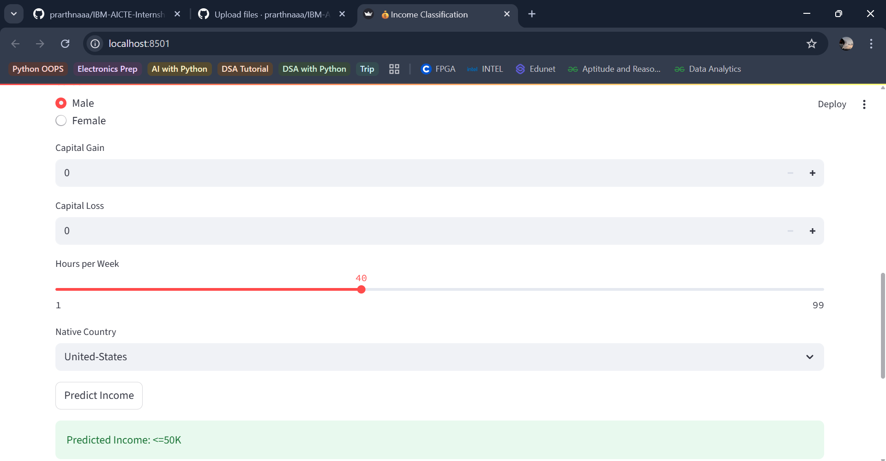
Result

Slide 10
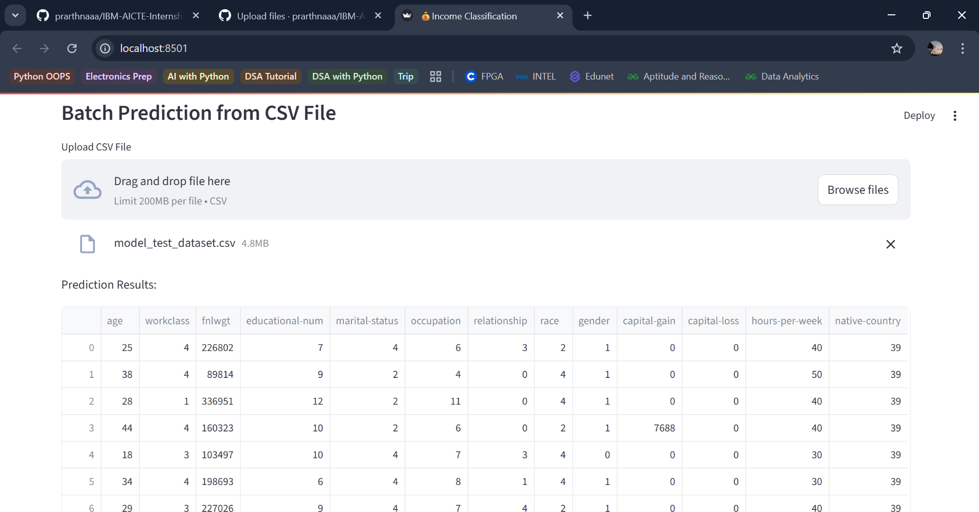
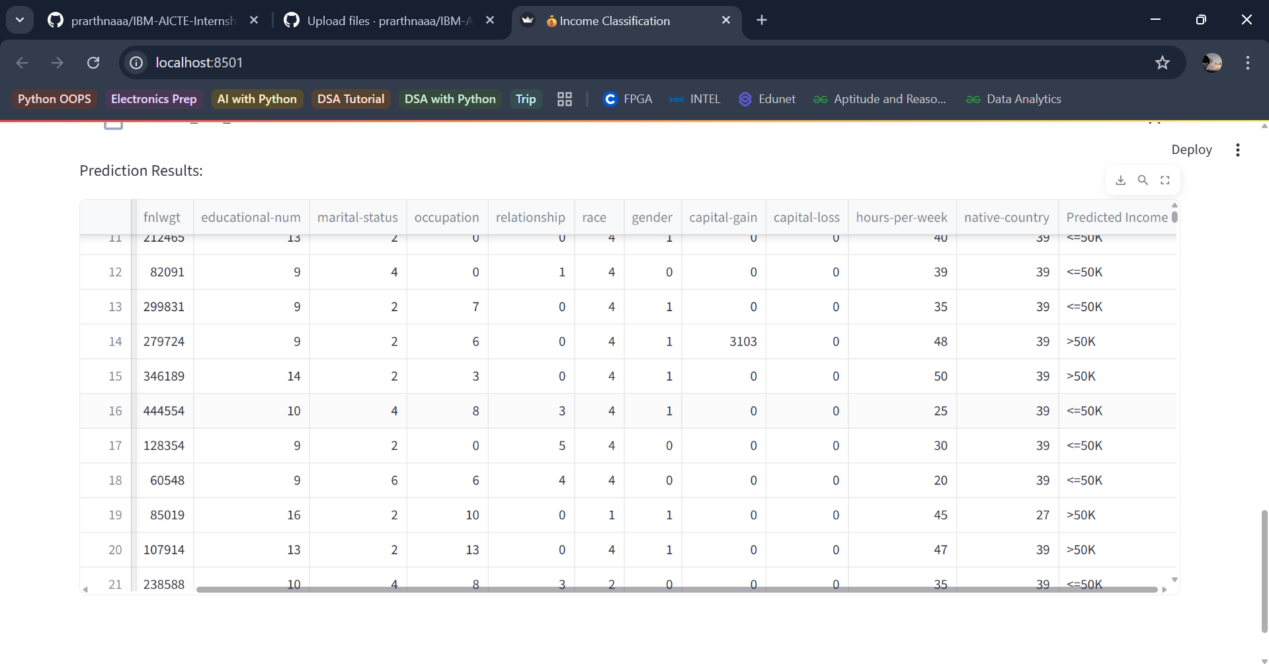
Result

Slide 11
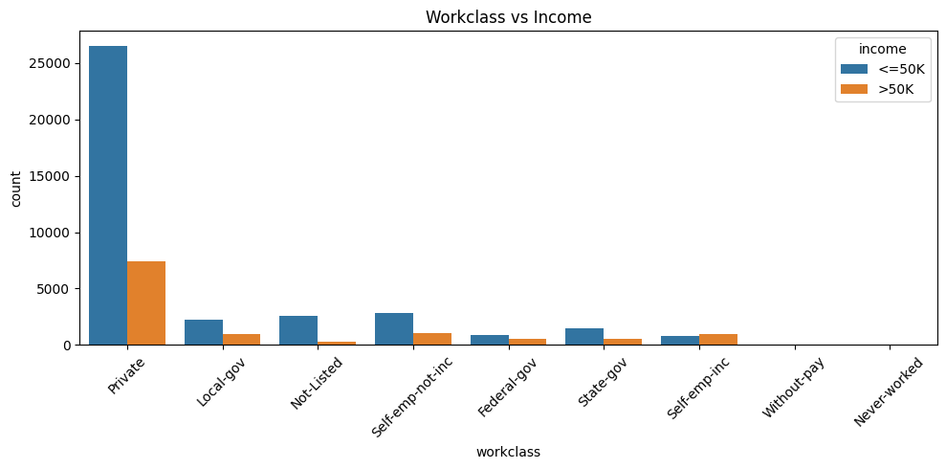
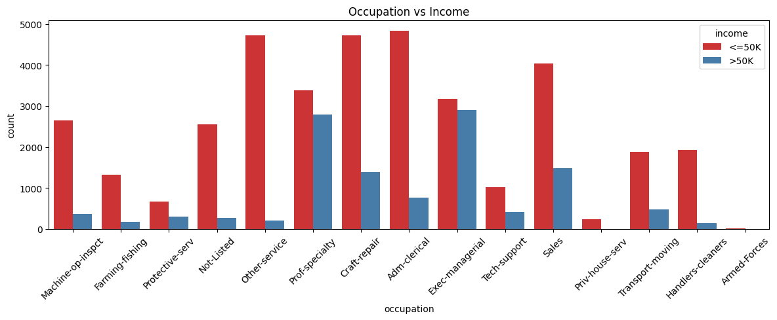
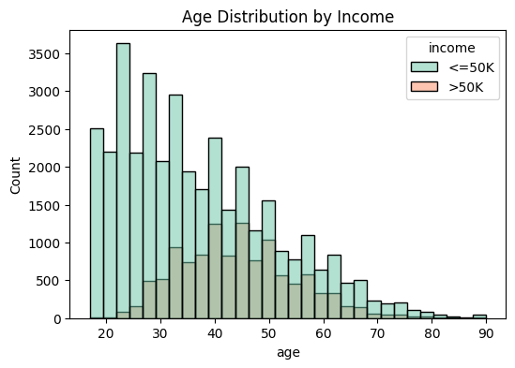
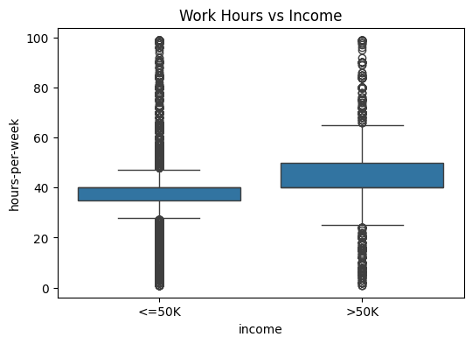
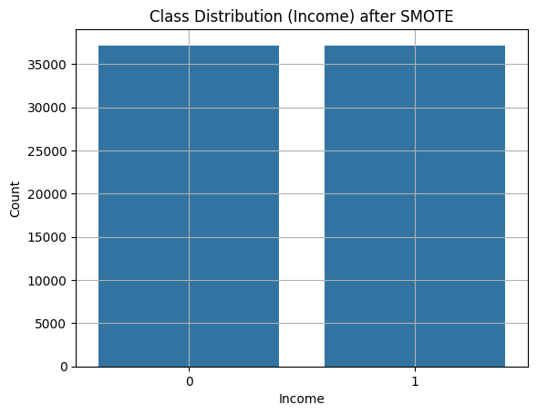
Result

Slide 12
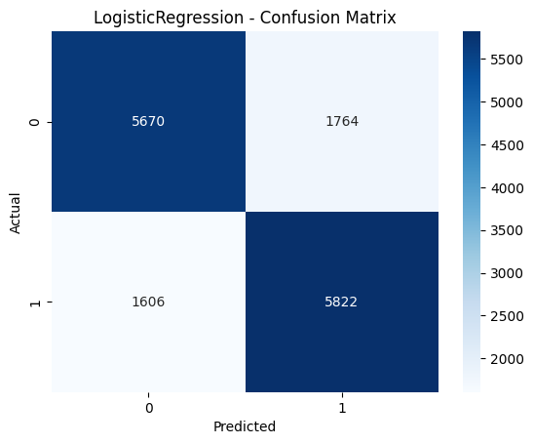
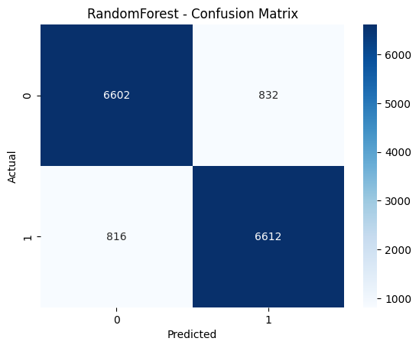
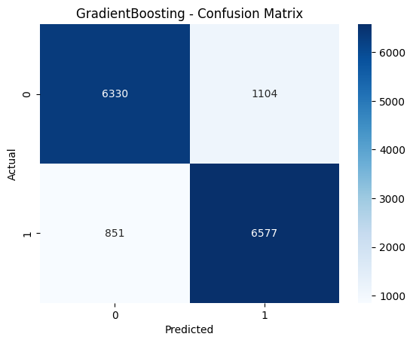
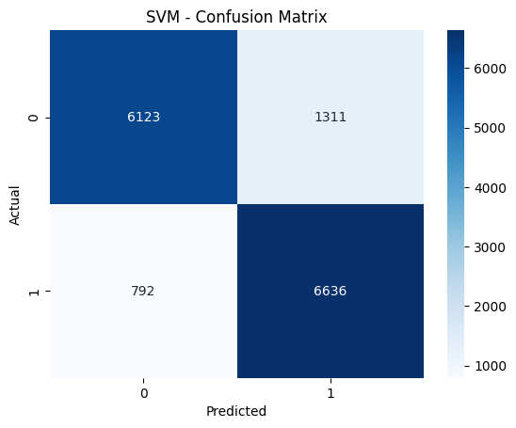
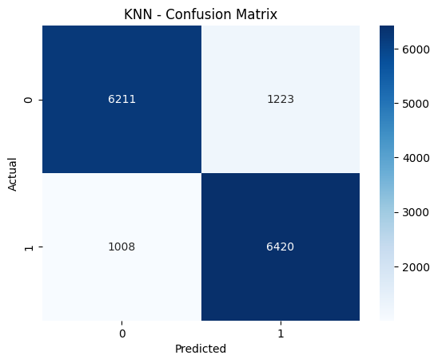

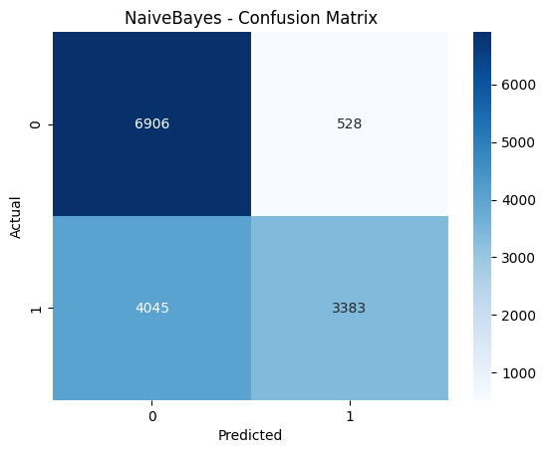

Result

Slide 13
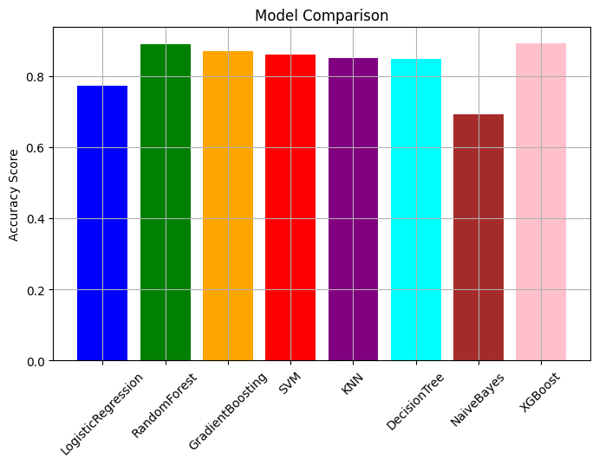
Result
Best model: XGBoost with accuracy 0.8919 Saved best model as best_model.pkl
LogisticRegression Accuracy: 0.7732
RandomForest Accuracy: 0.8891
GradientBoosting Accuracy: 0.8685
SVM Accuracy: 0.8585
KNN Accuracy: 0.8499
DecisionTree Accuracy: 0.8479
NaiveBayes Accuracy: 0.6923
XGBoost Accuracy: 0.8919
GITHUB LINK:
https://github.com/prarthnaaa/IBM-AICTE-Internship_Income-Classification-Prediction

Slide 14
Conclusion
The proposed income classification system effectively predicts whether an individual's income exceeds $50K using demographic and socio-economic data. Multiple machine learning classifiers were evaluated, with XGBoost achieving the highest accuracy of 0.8919, making it the best-performing model. It was saved as best_model.pkl for deployment.
The interactive Streamlit app allows both real-time user input and batch CSV predictions, making the solution user-friendly and practical.
Challenges Faced
Class Imbalance: Resolved using SMOTE, which improved recall and balance across classes.
Feature Mismatch Errors: Occurred during deployment due to inconsistency between training and input features.
Hyperparameter Tuning: Limited tuning due to time constraints.

Slide 15
Future scope (Optional)
Feature Engineering: Incorporate additional relevant features (e.g. education-level, employment history) to boost model performance.
Model Optimization: Apply hyperparameter tuning and ensemble techniques for better accuracy and robustness.
Explainability: Integrate SHAP or LIME for interpretability of predictions.
Cross-Validation: Implement k-fold CV to ensure model generalization.
API Integration: Deploy model via REST API for wider application usage.
Database Support: Add database connectivity for dynamic input/output handling.
Mobile Deployment: Extend the application to mobile platforms for accessibility.

Slide 16
References
Dua, D., & Graff, C. (2019). UCI Machine Learning Repository: Adult Dataset. https://archive.ics.uci.edu/ml/datasets/adult
Chen, T., & Guestrin, C. (2016). XGBoost: A Scalable Tree Boosting System. Proceedings of the 22nd ACM SIGKDD, 785–794. https://doi.org/10.1145/2939672.2939785
He, H., & Garcia, E. A. (2009). Learning from Imbalanced Data. IEEE Transactions on Knowledge and Data Engineering, 21(9), 1263–1284. https://doi.org/10.1109/TKDE.2008.239
Streamlit Inc. (2020). Streamlit Documentation – Turn Data Scripts into Shareable Web Apps. https://docs.streamlit.io
Chawla, N. V., et al. (2002). SMOTE: Synthetic Minority Over-sampling Technique. Journal of Artificial Intelligence Research, 16, 321–357. https://doi.org/10.1613/jair.953

Slide 17
THANK YOU

