Slide 1
Technologies Used
Frontend
    jQuery
    Materialize CSS
    PHP
    smoothie.js
Backend
    Shell Script

Slide 2
Ip_list
Ip u p n
BACKEND
ping_test_and_script_generation
server_health_template
shut_down_script

Slide 3
Ip_list
Ip u p n
BACKEND
ping_test_and_script_generation
Ip_status_list
Y ip u p n
N ip u p n
server_health_template
shut_down_script

Slide 4
Ip_list
Ip u p n
BACKEND
ping_test_and_script_generation
Ip_status_list
Y ip u p n
N ip u p n
server_health_template
consolidated_health_check_scripts
Ip_health_check
Ip_health_check
Ip_health_check
Ip_health_check
Ip_health_check
shut_down_script

Slide 5
Ip_list
Ip u p n
BACKEND
ping_test_and_script_generation
ip_details.json
ip_details.json
ip_details.json
ip_details.json
Ip_status_list
Y ip u p n
N ip u p n
server_health_template
ssh
consolidated_health_check_scripts
Ip_health_check
Ip_health_check
Ip_health_check
Ip_health_check
Ip_health_check
shut_down_script

Slide 6
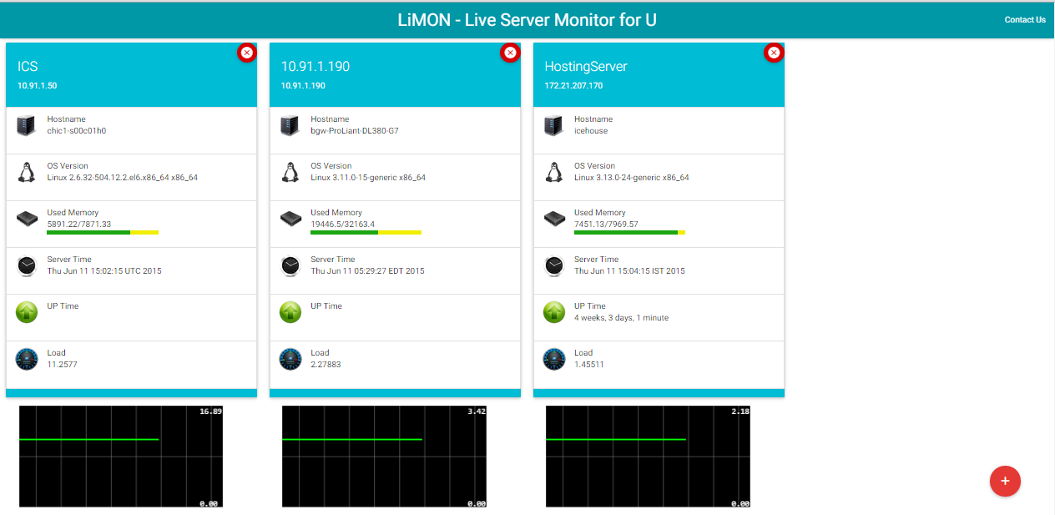
FRONTEND
ajax
ajax
ajax
ip1_details.json
ip2_details.json
ip3_details.json
Ip_list
Ip u p n

