Slide 1
Memory

Slide 2
Introduction to Memory
Embedded system – Processor, Memory and I/O.
Processing : transformation of data
Storage : retention of data for later use
Communication: transfer of data using buses.
Characteristics of memory: Area, Speed and Power.
Memory Classification:
Data Storage Mode
Volatile: SRAM, DRAM
Nonvolatile:
Read-Write: Flash, EPROM, EEPROM
Read only: Mask-Programmable ROM

Slide 3
Types of Semiconductor memories
RAM
Static RAM(SRAM)
Dynamic RAM(DRAM)
PSRAM (Pseudo-Static RAM)
NV RAM(Non-Volatile RAM)
ROM
Mask-Programmed ROM
One-Time Programmable ROM
Erasable Programmable ROM(EPROM)
Electrically Erasable and Programmable ROM(EEPROM)
Flash memory

Slide 4
Introduction to Memory Contd…
m × n memory
Stores large number of bits
m x n: m words of n bits each
k = Log2(m) address input signals
or m = 2^k words
e.g., 4,096 x 8 memory:
32,768 bits
12 address input signals
8 input/output data signals
Memory access
r/w: selects read or write
enable: read or write only when asserted
multiport: multiple accesses to different locations
simultaneously
…
m words
…
n bits per word
memory external view
r/w
2^{k} × n read and write memory
enable
A₀
…
A_{k-1}
…
Q_{n-1}
Q₀

Slide 5
Introduction to Memory Contd…
Reading a memory means to retrieve the word of a particular address.
Writing a memory means to store a word in a particular address.
Memory access means either a read or write.
Memory which requires both read and write needs a control input i.e., r/w.
According to Moore’s Law “every 18 months memory-chip bit-capacity doubles”.
ROM: a memory that a processor can only read, and which holds its stored bits even without a power source.
RAM: a memory that a processor can read and write but loses its stored bits if power is removed.
However, processor can not only read but also write to advanced ROM like EEPROM and Flash memory although the writing to this may be slow as compared to RAM.
Furthermore, advanced RAM like NVRAMs can hold their bits even when the power is removed.

Slide 6
Memory Write Ability and Storage Permanence
Write Ability – the manner and speed that a particular memory can be written.
Types of write ability:
High End Range: Processor write to memory types simply and quickly by setting such a memory’s address lines, data input bit and control lines appropriately.
Middle Range: Processor write to memory types that are slower.
Lower End Range: Memory can be written by a special equipment called a ‘programmer’. This device must apply special voltage levels to write to the memory, also known as “programming” or “burning”.
Low End Range: We have types of memory that can only have their bits stored when the memory chip itself is being fabricated.

Slide 7
Memory Write Ability and Storage Permanence
Storage Permanence – the ability of memory to hold its stored bits after those bits have been written.
Low End: Memory that begins to lose its bits almost immediately after those bits are written and must be continually refreshed.
Lower End: Memory that will hold its bits as long as power is applied to the memory.
Middle End: Memory that can hold its bits for days, months, or even years after the memory’s power source has been turned off.
High End: Memory that will essentially never loose its bits as long as the memory chip is not damaged.
Notes:
Tradeoff: Ideally we want memory with the highest write ability and the highest storage permanence. However, write ability and storage permanence tend to be inversely proportional to one another. Furthermore, highly writable memory typically requires more area and/or power than less-writable memory.

Slide 8
Memory Write Ability and Storage Permanence
permanence
Storage
Mask-programmed ROM
Ideal memory
Life of
OTP ROM
product
Tens of
EPROM
EEPROM
FLASH
years
Battery
Nonvolatile
NVRAM
life (10
years)
In-system
SRAM/DRAM
programmable
Near
Write
zero
ability
During
External
External
External
External
In-system, fast
fabrication
programmer,
programmer,
programmer
programmer
writes,
only
one time only
1,000s
OR in-system,
OR in-system,
unlimited
of cycles
1,000s
block-oriented
cycles
of cycles
writes, 1,000s
of cycles
Write ability and storage permanence of memories,
showing relative degrees along each axis (not to scale).

Slide 9
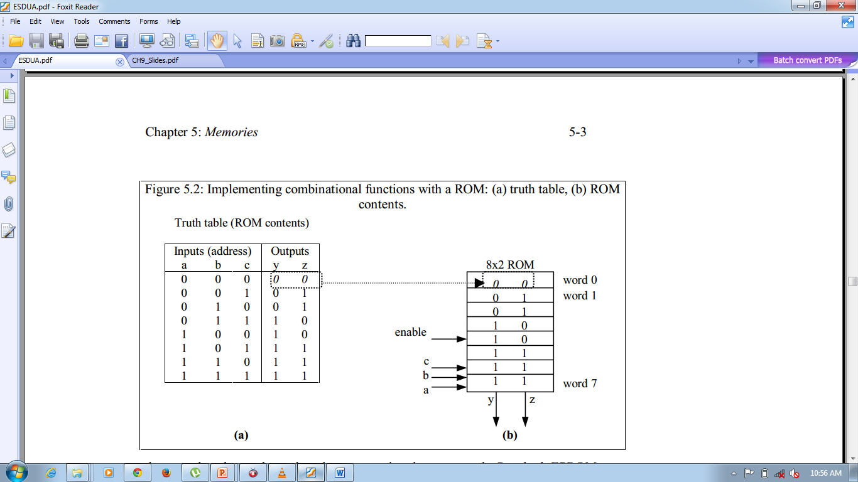
Common Memory Types
Read Only Memory – ROM
Nonvolatile memory that can be read from but not written to by a processor.
store a software program for a processor.
store constant data, like large lookup tables of strings or numbers.
to implement combinational circuit.

Slide 10
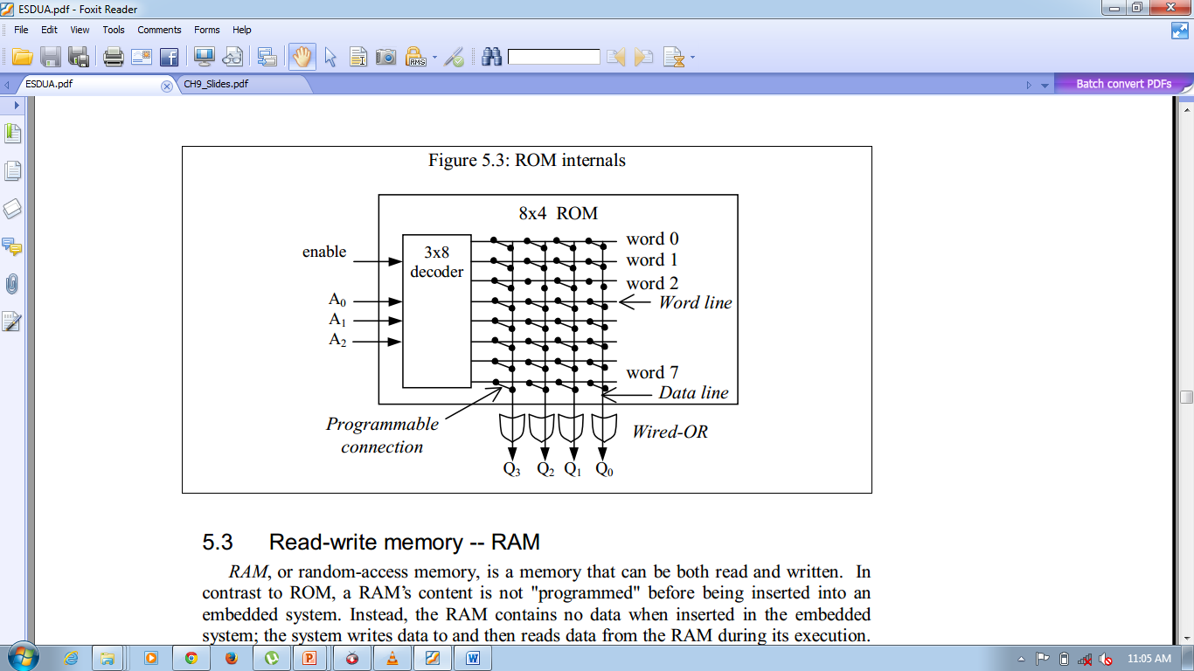
Common Memory Types Contd…
Internal View of ROM
Horizontal lines -> words.
Vertical lines -> data.
if address input is 010 then decoder sets word 2’s line to 1 Data lines Q3 and Q1 are set to 1 because there is a “programmed” connection with word 2’s line.
Word 2 is not connected with data lines Q2 and Q0.
Output is 1010.

Slide 11
Common Memory Types Contd…
ROM Memory Types:
Mask- Programmed ROM
One-Time Programmable ROM
Erasable Programmable ROM
Electrically Erasable Programmable ROM
Flash Memory

Slide 12
Mask-Programmed ROM
Connections are programmed during fabrication.
Connection is programmed when the chip is being fabricated by creating appropriate set of masks.
Write Ability:
Has extremely low write ability.
Storage Permanence:
highest storage permanence since the stored bits will never change unless the chip is damaged.
Typically used for final design of high-volume systems.

Slide 13
One-Time Programmable (OTP ROM or PROM)
Connections are programmed after manufactured by user.
To program a PROM device, the user provides a file that indicates the desired ROM contents.
A piece of equipment called a ROM programmer then configures each programmable connection according to the file.
Uses a fuse for each programmable connection.
ROM Programmer blows fuses by passing a large current wherever a connection should not exist. Once a fuse is blown connection can never be reestablished.

Slide 14
One-Time Programmable (OTP ROM or PROM)
Write Ability:
Has lowest write ability of PROMs since they can be written only once.
Storage Permanence:
. Has high storage permanence since their stored bits won’t change unless someone reconnects the device to a programmer and blows more fuses.
Commonly used in final products:
This devices are better suited to prototyping and to low-volume applications than are masked-ROM
This ROMs are also cheaper per chip than other PROMs often costing under a dollar each.

Slide 15
EPROM(Erasable Programmable ROM)
Programmable Component is a MOS transistor.
Transistor has floating gate surrounded by an insulator.
Negative charges form a channel between source and
drain storing a logic 1.
Large positive voltage(12-25) at gate causes negative charges
to move out of channel and get trapped in floating
gate storing a logic 0.
Shining UV rays on surface of floating gate causes negative
charges to return to channel from floating gate restoring the
logic 1.
An EPROM package showing quartz window through which
UV light can pass.
floating gate
0V
source
drain
(a)
+15V
(b)
source
drain
5-30 min
source
drain
(c)
(d)

Slide 16
EPROM(Erasable Programmable ROM)
Better Write Ability:
Can be erased and reprogrammed thousand of times.
Reduce Storage Permanence:
Program last about 10 years but is susceptible to radiation and electric noise.
Note: Reading an EPROM is much faster than writing, since reading does not require programming.

Slide 17
EEPROM(Electrically Erasable Programmable ROM) or E-squareds.
Programmed and erased electronically:
using higher than normal voltage.
can program and erase individual words.
more expensive than EPROM but convenient to use.
For example: EEPROM is used in telephones that can store commonly dialed phone numbers in memory for speed dialing.

Slide 18
EEPROM(Electrically Erasable Programmable ROM) or E-squareds.
Better Write Ability:
can be in-system programmable with built-in circuit to provide higher than normal voltage.
built-in memory controller commonly used to hide internal memory access details from memory user and provides a simple memory interface to user.
While read access requires only tens of nanoseconds and writes may requires tens of microseconds or more.
busy pin indicates to processor EEPROM still writing.
can be erased and programmed tens of thousands of times.
Similar storage permanence of EPROM(10 years):
can be erased and programmed tens of thousands of times before losing their ability to store data.
Far more convenient than EPROMs, but more expensive.

Slide 19
Flash Memory
Extension of EEPROM:
same floating gate principle.
same write ability and storage permanence.
Fast Erase
large blocks of memory erased at once, rather than one word at a time.
blocks typically several thousand bytes large.
Writes to single words may be slower.
Entire block must be read, word updated, then entire block written back.
Used in embedded systems storing large data items in non volatile memory.
e.g., digital cameras, TV set-top boxes, cell phones and medical monitoring equipment.
Note: Writing to a single word in flash may be slower than writing to single word in EEPROM.

Slide 20
Introduction to Read-Write Memory(RAM)
RAM – Random Access Memory that can read and write easily.
Writing to RAM is faster than reading.
Typically Volatile memory
bit are not held without power supply
Internal Structure of RAM
More complex than ROM.
A word consists of several memory
cells each storing 1-bit.
Each input and output data lines
connects to each cells in its column.
rd/wr connected to every cell.
When row is enabled by decoder
each cell has logic that stores input
data bit when rd/wr indicates write
or outputs stored bit when rd/wr indicates
read.
internal view
I₃
I₂
I₁
I₀
4×4 RAM
2×4 decoder
enable
A₀
A₁
Memory cell
rd/wr
To every cell
Q₃
Q₂
Q₁
Q₀

Slide 21
Basic Types of RAM
RAM: Static RAM
Memory cell uses flip-flop to store bit.
Requires 6 transistors.
Holds data as long as power supplied.
Typically used for high-performance parts of
of a system(e.g., cache)
High Switching Speed.
SRAM
Data'
Data
W

Slide 22
Basic Types of RAM
RAM: Dynamic RAM
MOS transistor and a capacitor to store a bit.
More compact memory than SRAM.
Refresh required due to capacitor leak
Word’s cells refreshed when read.
Refresh Rate 15.625.
Slower to access than SRAM.
DRAM
Data
W

Slide 23
RAM Variations
PSRAM: Pseudo-static RAM
DRAM with built-in memory refresh controller.
Popular low-cost high-density alternative to SRAM.
NVRAM: Nonvolatile RAM
Holds data after external power removed
Battery-backed RAM
SRAM with own permanently connected battery.
writes as fast as reads.
no limit on number of writes unlike nonvolatile ROM-based memory.
SRAM with EEPROM or flash
stores complete RAM contents on EEPROM or flash before power turned off

Slide 24
Composing memory
Memory size needed often differs from size of readily available memories.
When available memory is larger, simply ignore unneeded high-order address bits and higher data lines.
2^{m} × 3n ROM
enable
2^{m} × n ROM
2^{m} × n ROM
2^{m} × n ROM
Increase width of words
A₀
…
…
…
A_{m}
…
…
…
Q_{3n-1}
Q_{2n-1}
Q₀

Slide 25
Composing memory
Combine techniques to increase number and width of words
Increase number of words
2^{m+1} × n ROM
2^{m} × n ROM
A₀
A_{m-1}
…
…
1 × 2 decoder
A_{m}
…
2^{m} × n ROM
enable
…
…
…
Q_{n-1}
Q₀

Slide 26
Composing memory
When available memory is smaller, compose several smaller memories into one larger memory.
Connect side-by-side to increase width of words
Connect top to bottom to increase number of words
added high-order address line selects smaller memory containing desired word using a decoder.
A
Increase number and width of words
enable
outputs

Slide 27
Memory hierarchy
Want inexpensive, fast memory
Main memory
Large, inexpensive, slow memory stores entire program and data.
Cache
Small, expensive, fast memory stores copy of likely accessed parts of larger memory.
Can be multiple levels of cache.
Processor
Registers
Cache
Main memory
Disk
Tape

Slide 28
Cache
Usually designed with SRAM
faster but more expensive than DRAM
Usually on same chip as processor
space limited, so much smaller than off-chip main memory
faster access ( 1 cycle vs. several cycles for main memory)
Cache operation:
Request for main memory access (read or write)
First, check cache for copy
cache hit
copy is in cache, quick access
cache miss
copy not in cache, read address and possibly its neighbors into cache
Several cache design choices
cache mapping, replacement policies, and write techniques

Slide 29
Cache mapping
Far fewer number of available cache addresses
Are address’ contents in cache?
Cache mapping used to assign main memory address to cache address and determine hit or miss.
Three basic techniques:
Direct mapping
Fully associative mapping
Set-associative mapping
Caches partitioned into indivisible blocks or lines of adjacent memory addresses
usually 4 or 8 addresses per line

Slide 30
Direct mapping
Main memory address divided into 2 fields
Index
cache address
number of bits determined by cache size
Tag
compared with tag stored in cache at address indicated by index
if tags match, check valid bit
Valid bit
indicates whether data in slot has been loaded from memory
Offset
used to find particular word in cache line
Tag
Index
Offset
V T D
Data
=
Valid

Slide 31
Fully associative mapping
Complete main memory address stored in each cache address.
All addresses stored in cache simultaneously compared with desired address.
Valid bit and offset same as direct mapping.
Tag
Offset
Data
V T D
V T D
V T D
…
=
=
Valid
=

Slide 32
Set-associative mapping
Compromise between direct mapping and fully associative mapping.
Index same as in direct mapping.
But, each cache address contains content and tags of 2 or more memory address locations.
Tags of that set simultaneously compared as in fully associative mapping.
Cache with set size N called N-way set-associative
2-way, 4-way, 8-way are common
Tag
Index
Offset
V T D
V T D
Data
Valid
=
=

Slide 33
Cache-replacement policy
Technique for choosing which block to replace
when fully associative cache is full.
when set-associative cache’s line is full.
Direct mapped cache has no choice
Random
replace block chosen at random.
LRU: least-recently used
replace block not accessed for longest time.
FIFO: first-in-first-out
push block onto queue when accessed.
choose block to replace by popping queue.

Slide 34
Cache write techniques
When written, data cache must update main memory
Write-through
write to main memory whenever cache is written to
easiest to implement
processor must wait for slower main memory write
potential for unnecessary writes
Write-back
main memory only written when “dirty” block replaced
extra dirty bit for each block set when cache block written to
reduces number of slow main memory writes

Slide 35
Cache impact on system performance
Most important parameters in terms of performance:
Total size of cache
total number of data bytes cache can hold
tag, valid and other house keeping bits not included in total
Degree of associativity
Data block size
Larger caches achieve lower miss rates but higher access cost
e.g.,
2 Kbyte cache: miss rate = 15%, hit cost = 2 cycles, miss cost = 20 cycles
avg. cost of memory access = (0.85 * 2) + (0.15 * 20) = 4.7 cycles
4 Kbyte cache: miss rate = 6.5%, hit cost = 3 cycles, miss cost will not change
avg. cost of memory access = (0.935 * 3) + (0.065 * 20) = 4.105 cycles (improvement)
8 Kbyte cache: miss rate = 5.565%, hit cost = 4 cycles, miss cost will not change
avg. cost of memory access = (0.94435 * 4) + (0.05565 * 20) = 4.8904 cycles (worse)

Slide 36
Cache performance trade-offs
Improving cache hit rate without increasing size
Increase line size
Change set-associativity
0.16
0.14
0.12
% cache miss
0.1
1 way
0.08
2 way
4 way
0.06
8 way
0.04
0.02
0
cache size
1 Kb
2 Kb
4 Kb
8 Kb
16 Kb
32 Kb
64 Kb
128 Kb

