Slide 1
Introduction
• Definition:
- Blackboard Architecture is a software design pattern.
- Used primarily in artificial intelligence (AI).
- Integrates various specialized, independent modules to solve complex problems collaboratively.
• Historical Context:
- Conceptualized in the 1970s.
- Initially used for speech recognition systems.
- Applied to a wide range of AI problems.
• Purpose and Significance:
- Addresses the need for a flexible and robust framework.
- Facilitates collaboration among diverse problem-solving components.
- Useful in scenarios where solutions are emergent and not pre-defined.

Slide 2
Components of Blackboard Architecture
• Blackboard:
- Central data structure for communication and storage.
- Stores intermediate results, hypotheses, partial solutions, and control data.
- Enables asynchronous interaction among KSs.
• Knowledge Sources (KSs):
- Independent processing modules with specialized capabilities.
- Monitor the blackboard for relevant data changes.
- Trigger actions based on conditions met within the blackboard.
- Collaboratively work towards problem resolution.
• Control Shell:
- Oversees system operation.
- Decides which KSs to activate and in what sequence.
- Monitors blackboard state and KS activities.
- Ensures efficient coordination and avoids conflicts.
- Implements overall control strategy.

Slide 3
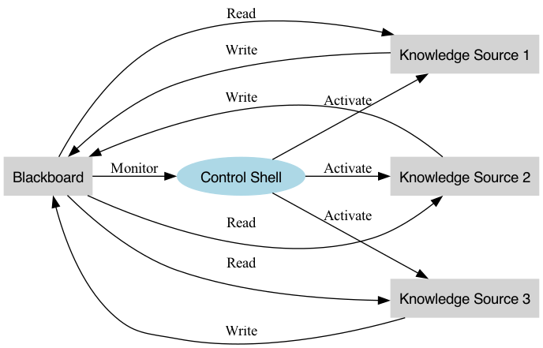
Blackboard Architecture Block Diagram

Slide 4
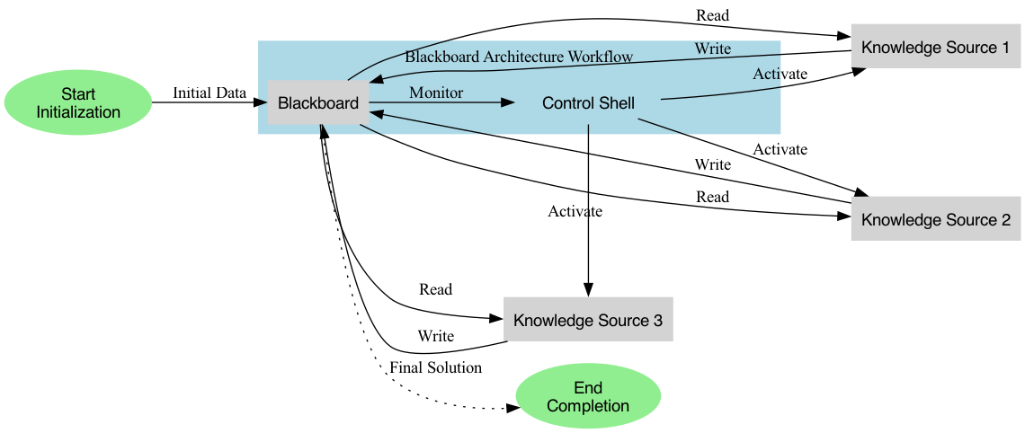
How Blackboard Architecture Works

Slide 5
How Blackboard Architecture Works
• Initialization:
- System starts with initial data or a problem statement on the Blackboard.
- Initial state includes all known information relevant to the problem.
• KS Activation:
- KSs monitor the Blackboard for changes or specific data patterns.
- Relevant data triggers appropriate KS action.
- Control Shell manages KS activation based on Blackboard state and predefined rules.
• Solution Iteration:
- KSs read data, process it, and write results back to the Blackboard.
- Blackboard accumulates contributions, updating problem state.
- Iterative process with KS activation as new data emerges.
• Completion:
- Iteration continues until a satisfactory solution is reached or a stopping criterion is met.
- Final solution available on the Blackboard for retrieval.

Slide 6
Advantages of Blackboard Architecture
• Modularity:
- Independent development and integration of KSs.
- KSs can be added, removed, or modified without affecting the overall system.
• Flexibility:
- Supports diverse problem-solving techniques.
- Different KSs employ various algorithms and methodologies.
• Parallelism:
- Multiple KSs can operate concurrently.
- Control Shell manages parallel activities for coherence.
• Incremental Problem Solving:
- Solutions built incrementally through KS contributions.
- Intermediate results continually refined on the Blackboard.
• Robustness:
- Redundancy and modularity enhance robustness.
- KSs can compensate for failures or underperformance.

Slide 7
Limitations of Blackboard Architecture
• Complexity:
- Managing interactions and dependencies between multiple KSs is complex.
- Control Shell handles intricate coordination for consistent operation.
• Performance Overhead:
- Continuous monitoring and updating of the Blackboard by KSs introduces overhead.
- Communication and synchronization can slow down the system.
• Scalability Challenges:
- Scaling for large and complex problems is difficult.
- More KSs and larger Blackboard data increase coordination and communication overhead.
• Dependency Management:
- KSs depend on specific data formats and states on the Blackboard.
- Ensuring consistent data states and resolving conflicts is challenging.
• Implementation Difficulty:
- Designing and implementing a blackboard system requires deep problem domain understanding.
- Effective partitioning of knowledge and responsibilities among KSs is critical.

Slide 8
Future Trends
• Integration with Modern AI Techniques:
- Incorporating machine learning and deep learning techniques.
• Cloud Computing Adoption:
- Leveraging cloud platforms for distributed Blackboard systems.
• IoT Applications:
- Applying Blackboard Architecture in Internet of Things (IoT) environments.
• Hybrid Approaches:
- Combining Blackboard Architecture with other paradigms, such as agent-based systems or microservices.
• Autonomous Systems:
- Development of autonomous systems utilizing Blackboard Architecture.

Slide 9
Demo

Slide 10
Thank You

