Slide 1
4TH YEAR PROJECT PRESENTATION
GROUP-19
AKASH BISHWAKARMA
SUDIPTO MONDAL
PRASHANT PRASAD
ROLL:001911001026
ROLL:001911001065
ROLL:001911001073

Slide 2




HELLO & WELCOME
TO PROJECT PRESENTATION
LETS GET STARTED

Slide 3


OUR MENTOR
"DR. KARTICK CHANDRA MONDAL"
Assistant Professor of Information Technology, Jadavpur University, Kolkata

Slide 4

PROJECT 01

Slide 5

Self-Citation
for Scholars
using google scholar api
01

Slide 6


LIST OF CONTENT
PRESENTATION
01
02
03
04
TASK ASSIGNED
TECHNOLOGY USED
ALGORITHM
OUTPUT

Slide 7
06
TASK ASSIGNED

Slide 8
1
Fetch scholars data from google scholar api

Slide 9
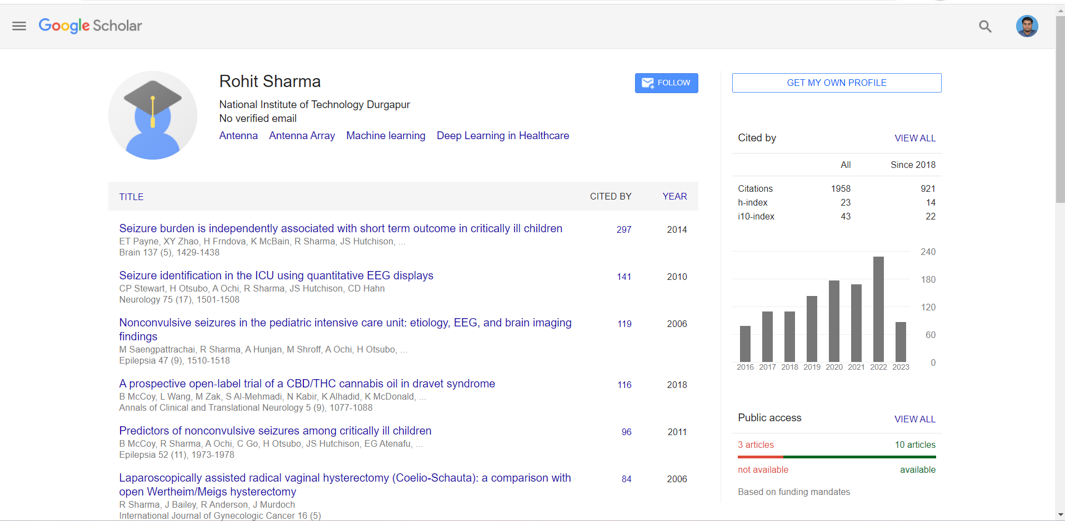

Slide 10
2
Display scholar api data in our web apps

Slide 12
3
Seperate total citation into self-citation and cited by
others

Slide 14
4
Showing bar graph after and before seperation of citation
column

Slide 15
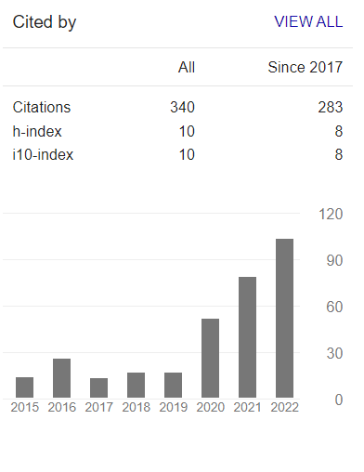

Slide 16
TECHNOLOGY USED
HTML
CSS
JAVASCIPT
NODEJS
EXPRESS JS
API

Slide 17

IMPLEMENTATION

Slide 18
SERVER SETUP:
Handling the root route ("/") For GET request
Handling the root route ("/") for POST request

Slide 19
RETRIEVING CITATION DATA:
It then constructs the required parameters for the Google Scholar Author API to fetch citation information for that article.

Slide 20
COUNTING CITATIONS:
Inside the callback function for the
citation API request, the code extracts the author names
mentioned in the citation data. It then compares these author
names with the original author's name to determine the number
of articles cited by other authors in common. A counter
variable, `finale`, is incremented for each article that is cited
by other authors. This count represents the final number of
citations.

Slide 21
RENDERING THE VIEW:
Once the citation count is calculated, the code renders the "profile" view, passing the retrieved profile data and the citation count. The view is responsible for displaying the author's profile information and the final citation count

Slide 22
STARTING THE SERVER:
THE CODE SETS THE SERVER TO LISTEN ON PORT3000. WHEN THE SERVER STARTS, A MESSAGE IS PRINTED TO THE CONSOLE, INDICATING THAT THE SERVER IS RUNNING

Slide 23
SUMMARY
THE ALGORITHM INVOLVES HANDLING DIFFERENT ROUTES, MAKING API REQUESTS TO THE GOOGLE SCHOLAR API USING THE SERPAPI LIBRARY, RETRIEVING AND PROCESSING THE RESPONSE DATA, CALCULATING CITATION COUNTS, AND RENDERING THE DATA IN THE APPROPRIATE VIEWS

Slide 24
OUTPUTS

Slide 25
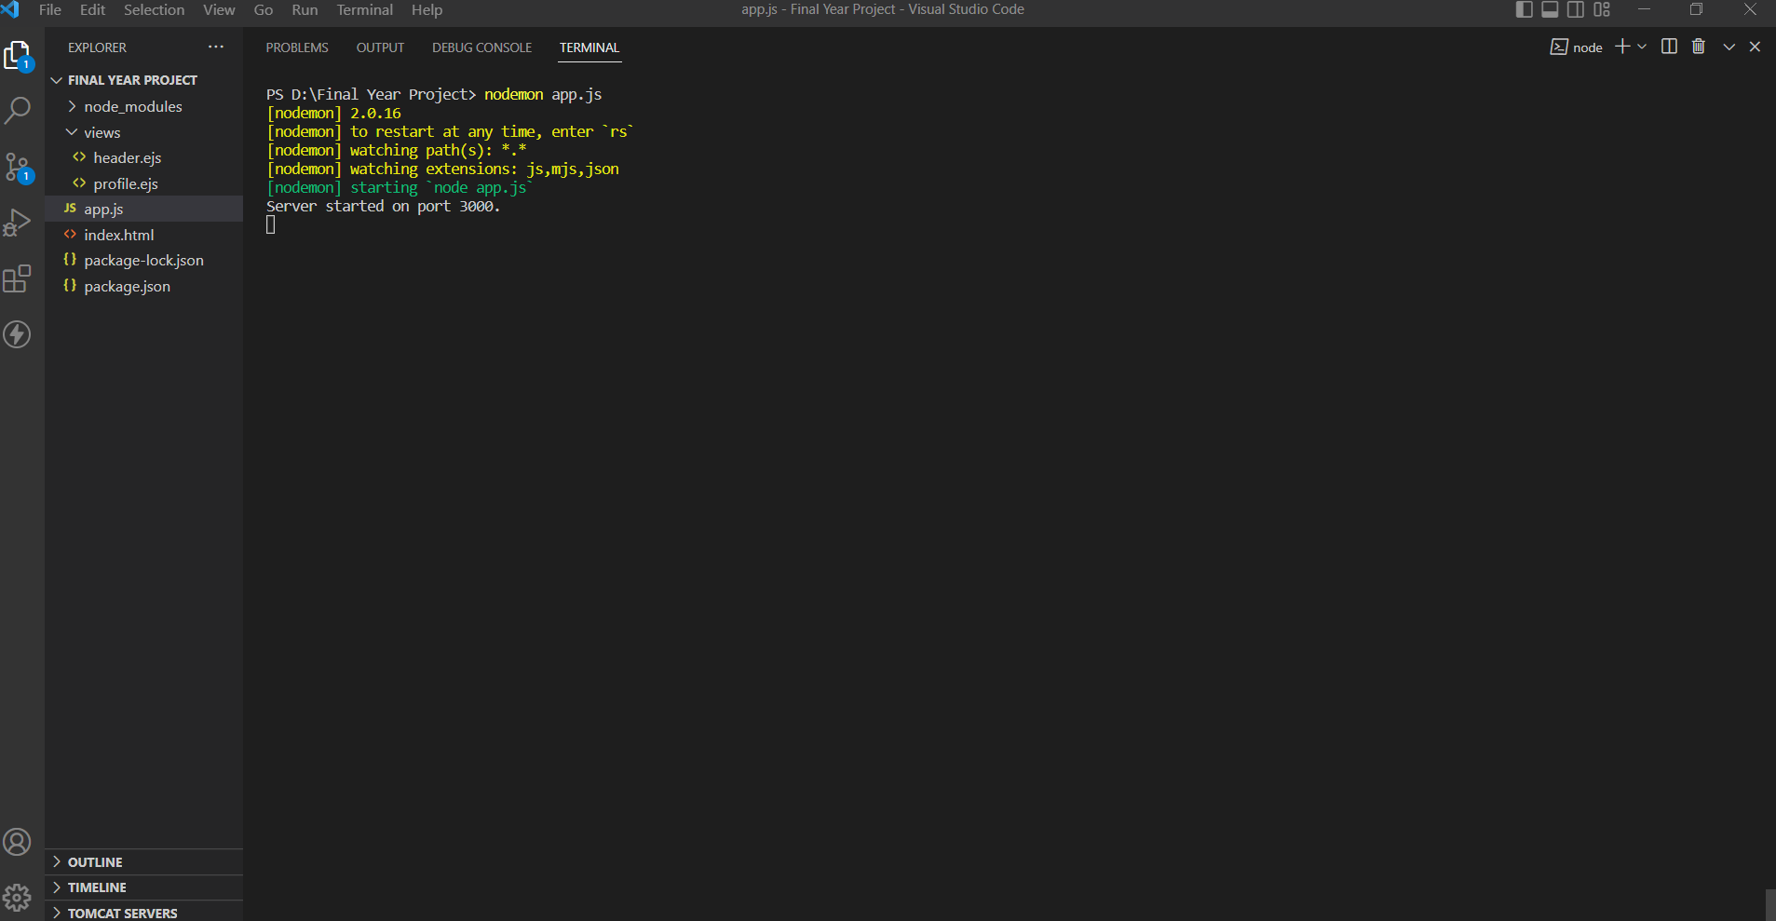

Slide 26
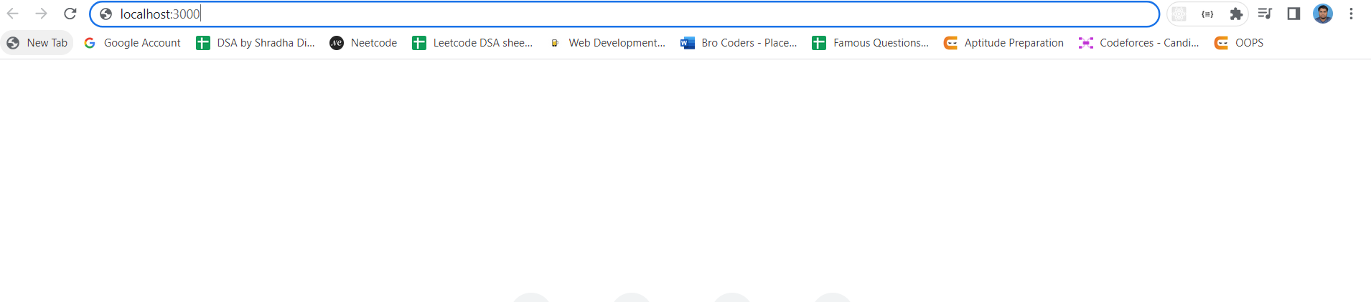

Slide 27
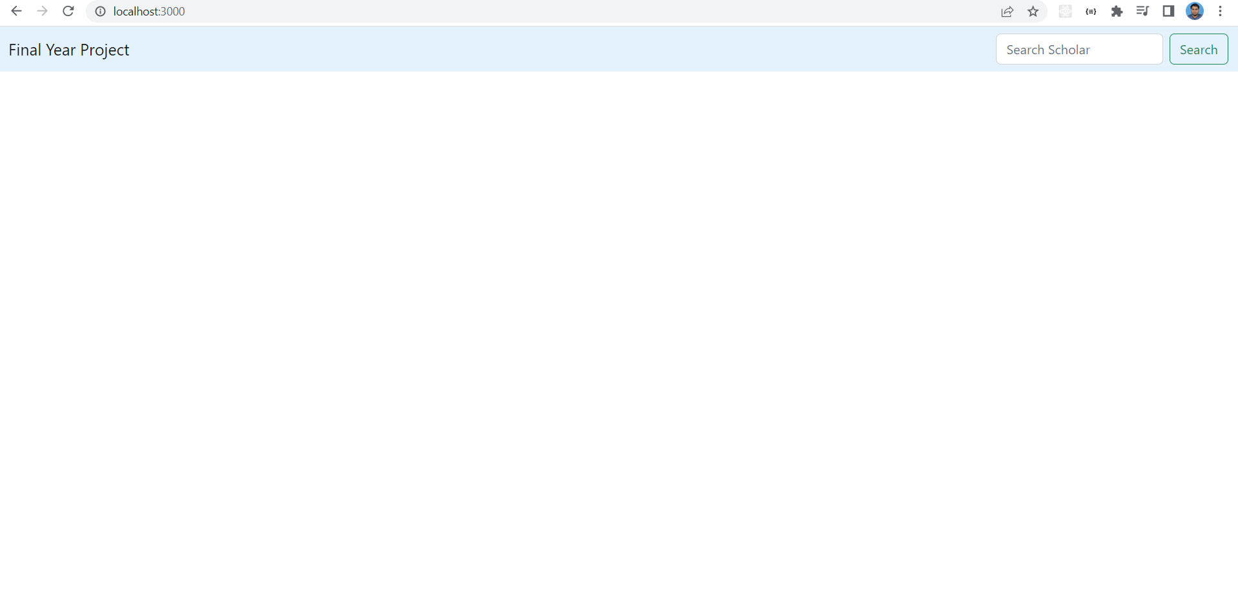


Slide 28
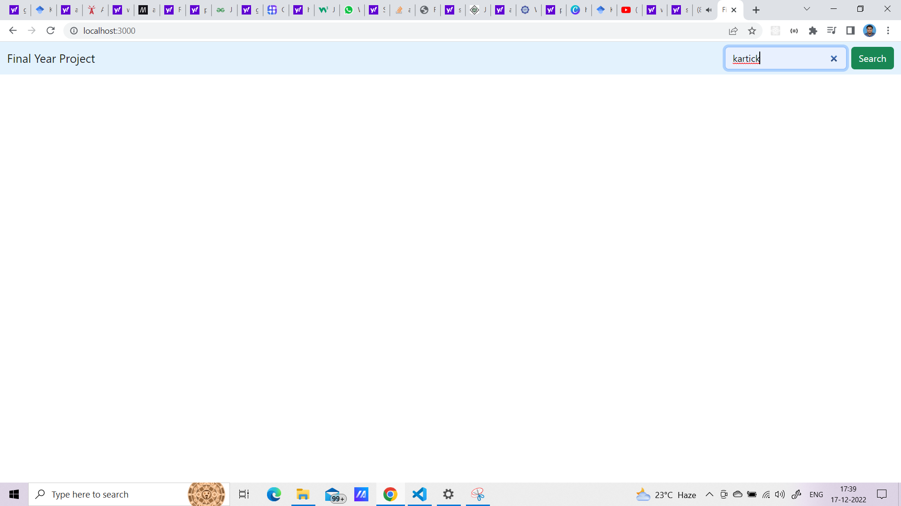


Slide 29
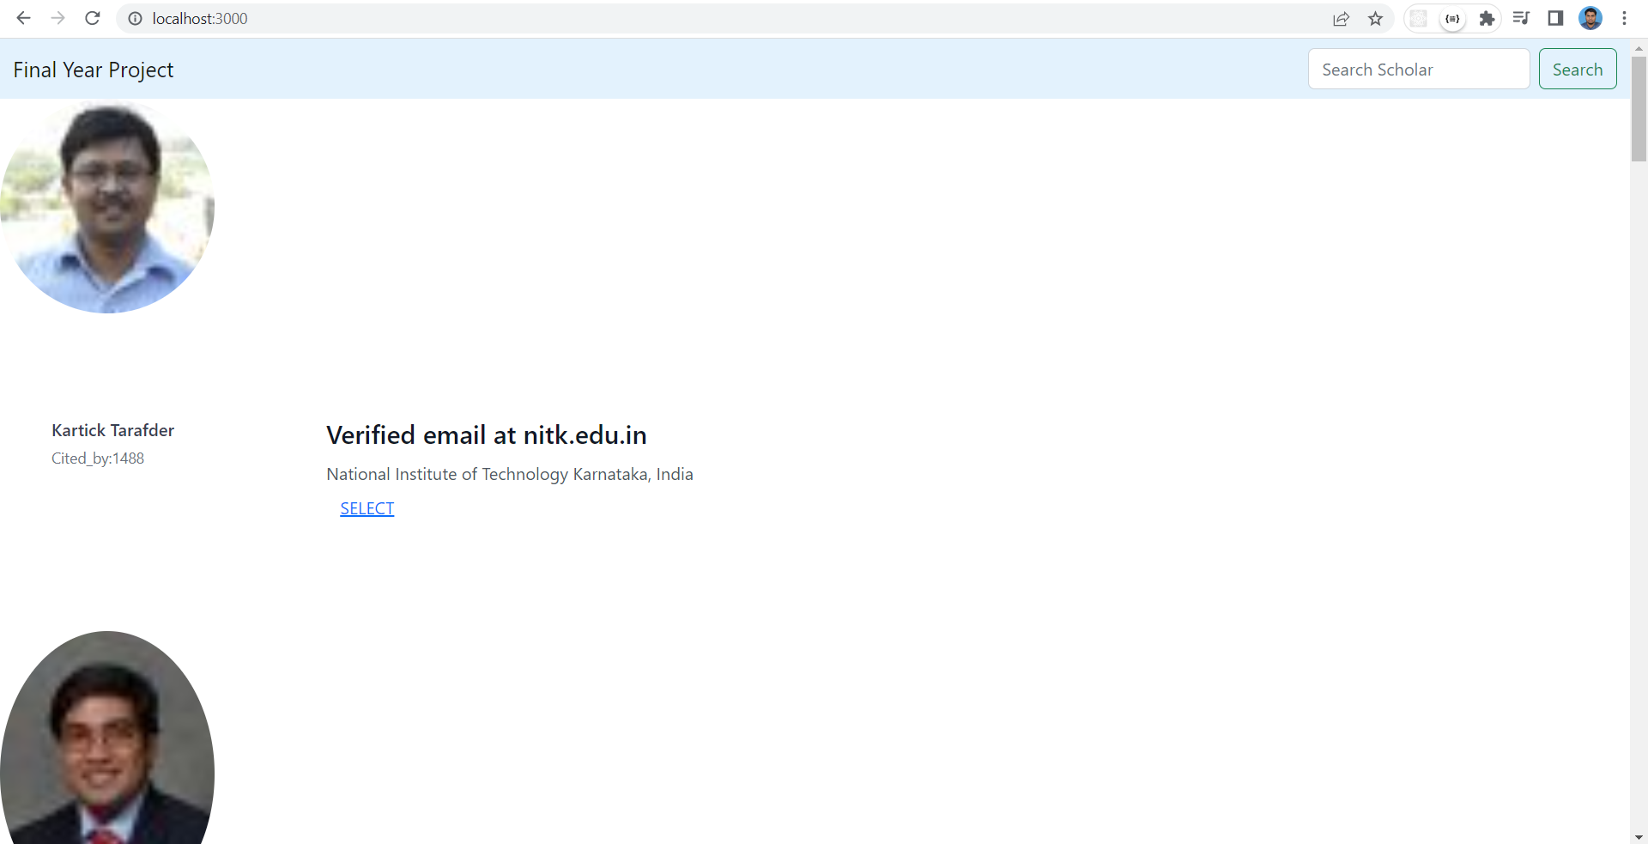

Slide 30
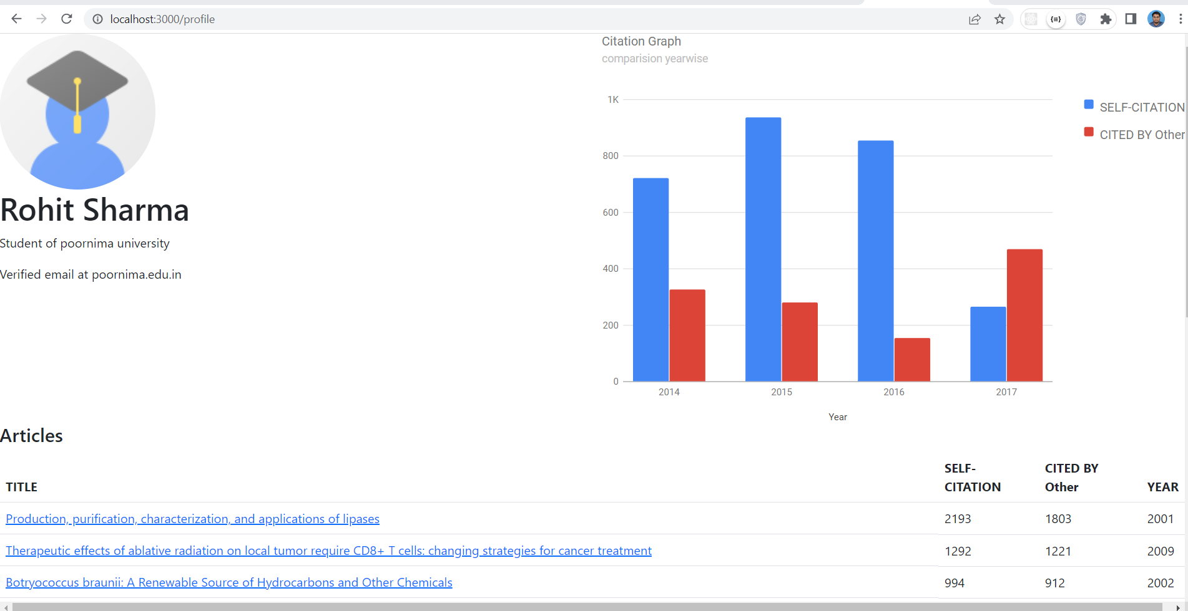

Slide 31
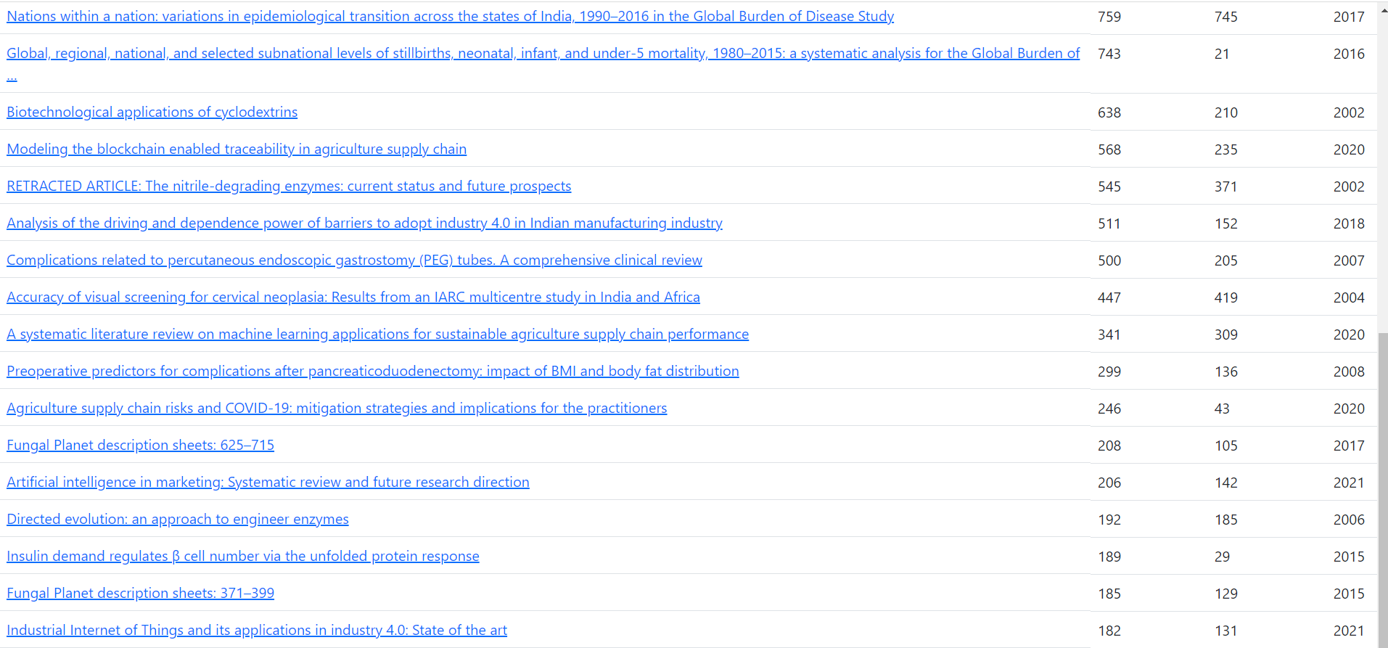

Slide 32
THANK YOU

