Slide 1
Introduction to React

Slide 2


Slide 3
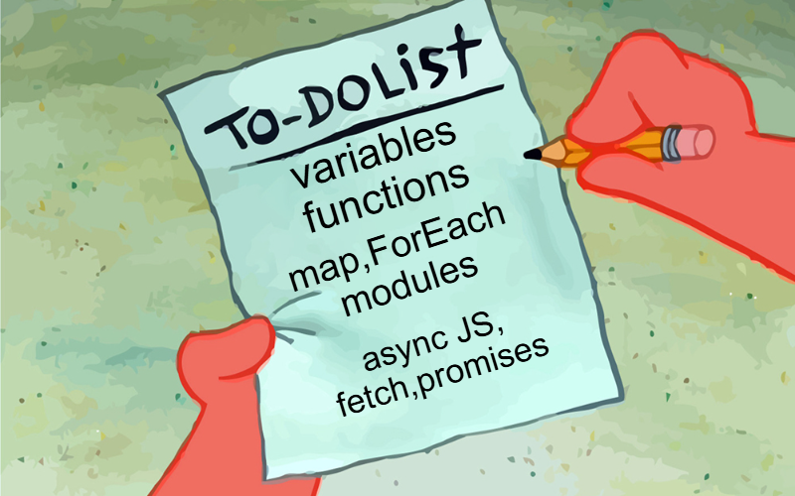

Slide 4
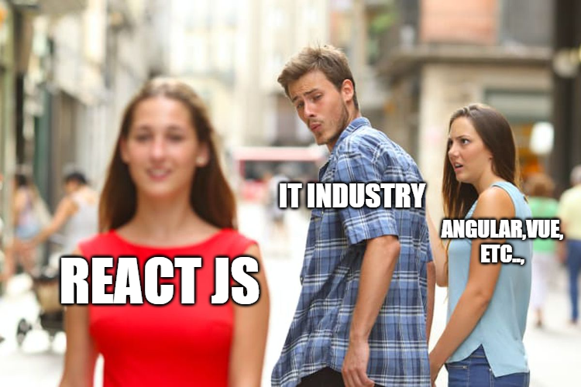
WHY REACT?

Slide 5
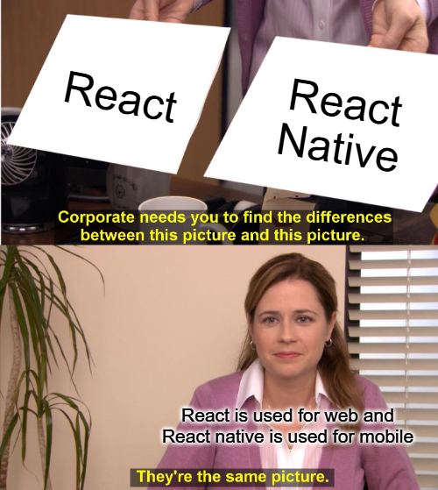
REACT vs React Native?

Slide 6


What is React?
React is a JavaScript framework
Used for front end web development
Think of jQuery, but more structured
Created and used by Facebook
Famous for implementing a virtual dom

Slide 7





Timeline of front-end JavaScript frameworks
jQuery* (2006)
AngularJS (2010)
React (2013)
Vue (2014)
Angular (2014)
* jQuery is more often considered a library than a framework

Slide 8
Common tasks in front-end development
App state User actions
Templates Routing
Data fetching
Data definition, organization, and storage
Event handlers respond to user actions
Design and render HTML templates
Resolve URLs
Interact with server(s) through APIs and AJAX

Slide 9
Fundamentals of React
JavaScript and HTML in the same file (JSX)
Embrace functional programming
Components everywhere

Slide 10



JavaScript and HTML in the same file
HTML
CSS
JS
JSX
CSS or JSS
Traditional approach
React approach

Slide 11
JSX: the React programming language
const first = "Aaron"; const last = "Smith";
const name = <span>{first} {last}</span>;
const list = (
<ul>
<li>Dr. David Stotts</li>
<li>{name}</li>
</ul>
);
const listWithTitle = (
<>
<h1>COMP 523</h1>
<ul>
<li>Dr. David Stotts</li>
<li>{name}</li>
</ul>
</>
);

Slide 12
“React is just JavaScript”

Slide 13
Functional programming
Functions are “first class citizens”
Variables are immutable
Functions have no side effects

Slide 14
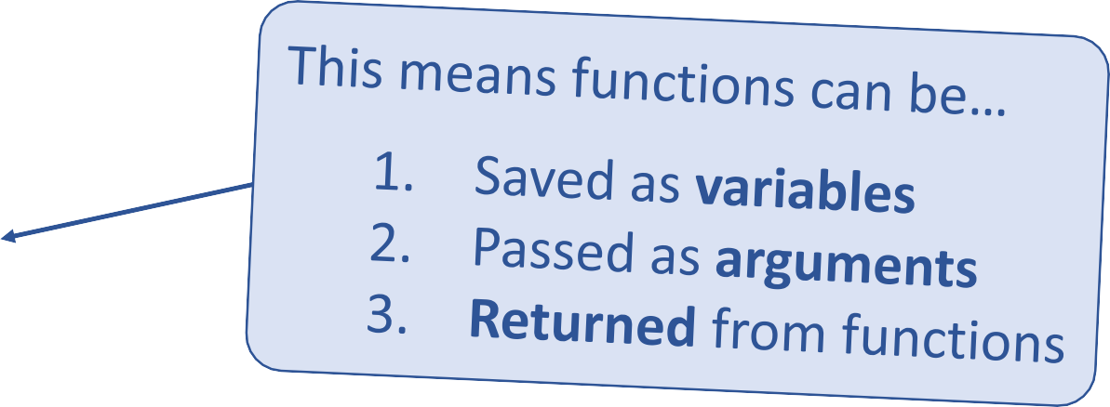
Functional programming
Functions are “first class citizens”
let add = function() { console.log('Now adding numbers'); const five = 3 + 2;
};
function foo() { return function() {
console.log('What gets printed?');
};
}
foo foo(); foo()();
function performTask(task) { task();
console.log('Task performed!');
}
performTask(add);

Slide 15
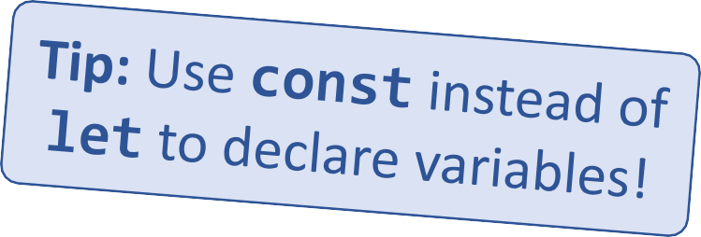
Functional programming
Variables are immutable
let a = 4;
a = 2; // Mutates `a`
let b = [1, 2, 3];
b.push(4); // Mutates `b`
let c = [...b, 4]; // Does not mutate `b`

Slide 16
Functional programming
Functions have no side effects
const b = [];
function hasSideEffects() { b = [0];
}

Slide 17
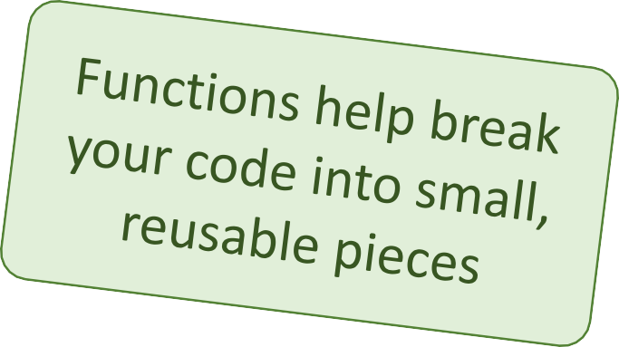
Components
Components are functions for user interfaces
Input x
Output number
Math function:
let y = f(x);
Input x
Output HTML
Component function:
let y = <FancyDiv value={x} />;

Slide 18
Anatomy of a React component
The component is just a function
Inputs are passed through a single argument called “props”
The function outputs HTML
export default function MyComponent(props) {
return <div>Hello, world! My name is {props.name}</div>;
}
const html = <MyComponent name="aaron" />;
The function is executed as if it was an HTML tag
Parameters are passed in as HTML attributes

Slide 19
Component rendering
When a component function executes, we say it “renders”
Assume components may re-render at any time
Our job is to ensure that
every time the component re-renders, the correct output is produced

Slide 20
“In React, everything is a component”

Slide 21
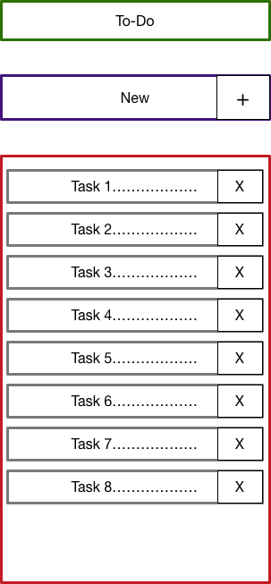
Todo application
Title
Big idea:
A digital to-do list
TodoForm
First step:
mockup / wireframe
TodoList
Todo

Slide 22
Creating a new React app
Creating a new React app is simple!
Install Node.js
Run: npx create-react-app app-name
New app created in folder: ./app-name

Slide 23
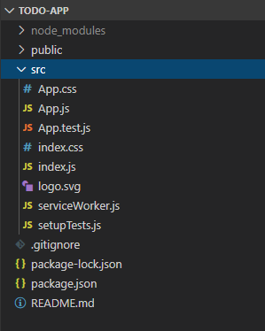
Anatomy of a new React app
public holds the initial html document and other static assets
App is a boilerplate starter component
index.js binds React to the DOM
package.json configures npm dependencies

Slide 24
Component Hierarchy
Title
TodoForm
App
Title
TodoList
TodoForm
TodoList
Todo
Todo
Todo
Todo

Slide 25
Special list key property
Situation: Display a dynamic array of elements
Must specify a special “key” property for each element
The key of an item uniquely identifies it
Used by React internally for render optimization
Can be any unique value (string or number)

Slide 26
What are hooks?
Hooks: Special functions that allow developers to hook into state and lifecycle of React components.
Built-in hooks:
useState
We will cover these today
useEffect
State: One or more data values associated with a React component instance.
useReducer
We will not cover
these today
useMemo
Lifecycle: The events associated with a React component instance (create, render, destroy, etc).
useRef
useCallback

Slide 27
First React hook: useState
Purpose:
Remember values internally when the component re-renders
Tell React to re-render the component when the value changes
Syntax:
const [val, setVal] = useState(100);
The current value
A setter function to change the value
The initial value to use

Slide 28
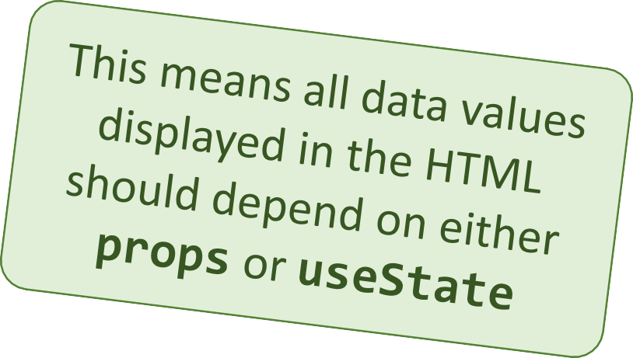
Predicting component re-rendering
A component will only re-render when…
A value inside props changes
– or –
A useState setter is called

Slide 29
Second React hook: useEffect
Purpose:
Act as an observer, running code in response to value changes
Syntax:
useEffect(() => {
console.log(`myValue was changed! New value: ${myValue}`);
}, [myValue]);
A list of values such that changes should trigger this code to run
The code to run when values change

Slide 30
Building a React project
When you’re ready to launch your app, run this command:
npm run build
This bundles your app into CSS/JS/HTML files and puts them in the
/build folder
These files can be served from an AWS S3 bucket

Slide 31
3rd party components and libraries
React-Router
Redux
Material-UI
Bootstrap
Font-Awesome
SWR

