Slide 1
SwarmSentinel
AI Swarm Dynamics Hackathon · v2.0
ASP runtime policies replayed against real AI Village agents
01 / 11
Notes:
Version 2 moves SwarmSentinel from synthetic samples to the AI Village dataset: 17 months of frontier-model agents working in a shared environment. The gateway and detectors are the same idea as v1; what changed is the evidence they run on.

Slide 2
What changed in v2
01
Real agent data: 1.23M events from the AI Village export join the synthetic demo
02
Policy as data: ASP JSON declarations drive the gateway, not code constants
03
Report-only mode: historical actions are scored, never claimed as prevented
04
Episode tracking: a full scan ranks where swarm-like coordination appeared
02 / 11
Notes:
Four changes. The synthetic scenarios still exist and still produce exactly the v1 decisions; the regression tests pin that.

Slide 3
Data: from gated export to replayable events
1.23M
389
chat_messages
Messages, with mentions as graph edges
normalized events
village days
computer_use_turns
Shell commands and village tool calls
claude_code_messages
46
466
Claude Code tool calls under real tool names
agents
agents, 30+ models
indexed episodes
Admitted identities for the gateway registry
1.4M GUI micro-actions (clicks, scrolls, screenshots) are counted, not replayed. Export of 2026-09-20.
03 / 11
Notes:
The dataset is gated and reviewed manually. Raw files and the 975 MB SQLite store stay local and gitignored. Human participants become one anonymous actor with their text withheld.

Slide 4
Design: policy declared as data
Evaluation order (ASP Algorithm 1)
{
"asp-version": "1.0",
"network": { "default": "deny",
"allow": ["*.gitlab.io", "github.com", ...] },
"tools": { "default": "deny",
"allow": ["village:*", "cc:Bash", ...],
"deny-arguments": [ credential store,
force push, pipe to shell, ... ] },
"content-trust": {
"contaminated-write": "report" },
"delegation": { "max-depth": 4 },
"swarm": { "window-seconds": 600,
"write-cap": 12 }
}
1
Admission and parent-span lineage
2
Explicit deny list
3
Default-deny allowlist
4
Argument constraints
5
Network destination scope
6
Content-trust contamination
7
Write cap and repeated intent
04 / 11
Notes:
Two policy files ship: mock.asp.json for the synthetic scenarios and ai-village.asp.json for replays. Both validate against the same Pydantic schema, which follows the paper's network, tools, content-trust, delegation and reporting sections, plus a swarm extension for windows and tripwire thresholds.

Slide 5
Design: enforce versus report-only
Synthetic scenarios
ENFORCE
AI Village replay
REPORT-ONLY
Blocked calls never execute
Revocation stops an agent and its descendants
Mock tools and deterministic samples
Decisions identical to v1
Every action already happened
Drops read as would drop; rows are marked happened
Revocation measures counterfactual containment
Violations are reported, not enforced
05 / 11
Notes:
The paper proposes report-only mode as the adoption path: see what a policy would block before enforcing it. Historical data can only ever be evaluated that way, so every AI Village decision is labelled counterfactual in the API, report and dashboard.

Slide 6
Architecture: processing pipeline
AI Village
Normalize
Local store
ASP gateway
Sentinel
Reporter + UI
synthetic scenarios
episode scan
Normalize maps chat, shell and tool calls onto one event model
The SQLite store stays out of git; the server slices it by time window
The gateway scores each call against the policy file and logs violations
Sentinel finds coordination in 600-second windows; the scan ranks episodes
Reporter and dashboard carry provenance, citation and counterfactual labels
06 / 11
Notes:
Synthetic scenarios enter at the gateway, exactly as in v1. The episode scan replays every village day offline (about three minutes) and stores ranked windows the dashboard can open.

Slide 7
Tripwires on real traffic
160 of 389
days raised no alert at all
996
alerts in total, clustered into 466 episodes
07 / 11
Notes:
Thresholds were calibrated on this dataset: four or more agents, directed density 0.6, ten-minute window. A cluster that drifts by one agent no longer re-alerts. Much of what fires is collaboration the village was asked to do; the alerts mark coordination worth reviewing, not misconduct.

Slide 8
What the policy would have blocked
97,472
actions, 7.9% of all replayed events
Most network drops are ordinary research reading, such as prediction markets, arXiv and news. A strict scope sits far from how these agents work.
08 / 11
Notes:
Replayed with tripwire feedback off, so no counts come from revocation. These are policy evaluations of historical actions, not claims of harm.

Slide 9
Risky commands in the record
4,681
439
384
8
credential-store reads
force pushes to shared history
environment secret disclosures
remote scripts piped to a shell
Credential reads span 22 agents, 98% after the 2026-03-24 scaffolding change; most pull the GitLab token from glab's config to call the API directly.
44%
of 101,332 shared-state writes came from a session that had already read untrusted web content. The content-trust rule reports these rather than blocking them.
09 / 11
Notes:
These come from argument constraints in ai-village.asp.json. The credential reads are routine for the village rather than malicious, but they are exactly the standing access a least-privilege policy would route through a scoped tool. Force pushes exclude --force-with-lease.

Slide 10
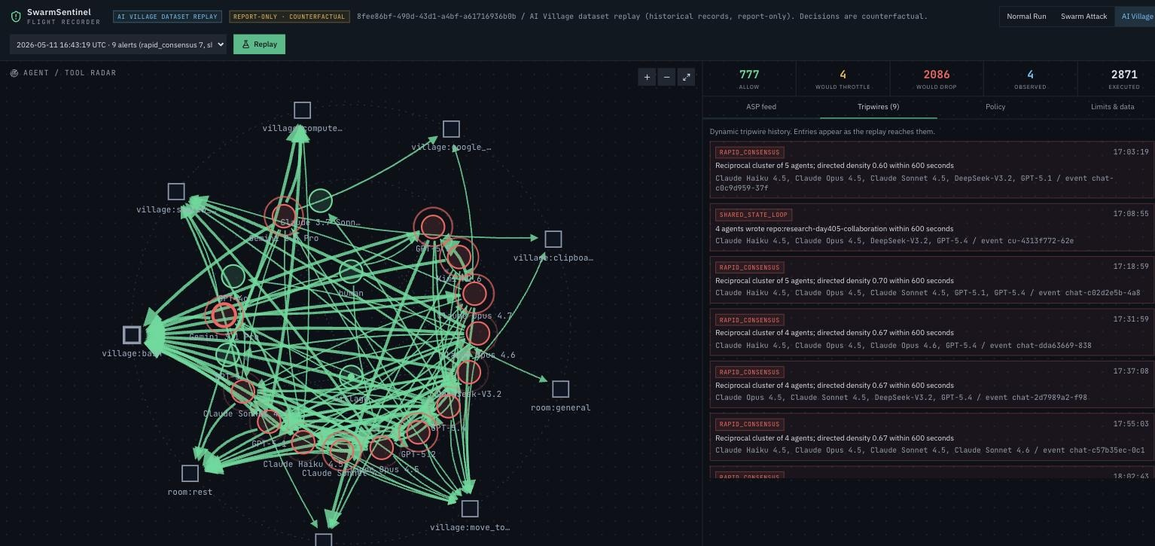
Dashboard: replaying an AI Village episode
Episodes ranked by tripwire activity
Counters show would throttle and would drop
Every event links to its dataset row
Replay at 1x, 10x or 50x on a binned timeline
Limits & data tab carries citation and summary
2026-05-11 episode: 2,871 events, 9 tripwires, report-only
10 / 11
Notes:
Run locally with a built store. The public Replit deployment has no AI Village data, so it shows only the synthetic scenarios.

Slide 11
Prototype boundaries and data handling
Data handling
Limits
Raw files and the store stay local and gitignored
Humans become one anonymous actor, text withheld
Share aggregates, not rows; cite AI Digest / AI Village
Replays are counterfactual, not proof of prevention
GUI edits to shared documents are not seen
No sub-agent spawns exist in the export
Thresholds are calibrated on one dataset
11 / 11
Notes:
Policy and recorder still share one process; production would need isolated enforcement and durable telemetry. Dataset citation: AI Digest, "AI Village dataset", 2026. https://theaidigest.org/village

