Slide 1
SwarmSentinel
AI Swarm Dynamics Hackathon
ASP-inspired runtime policies + a multi-agent incident flight
recorder
SwarmSentinel
01 / 08

Slide 2
Problem: runaway coordination
01
Recursive delegation expands
02
Repeated consensus messages
the number of active agents
reinforce execution loops
03
Shared resources receive
04
Per-agent logs make system-level
duplicate or excessive writes
patterns hard to
reconstruct
SwarmSentinel
02 / 08

Slide 3
Approach: containment with evidence
02
• Evaluate in-band calls before simulated execution
• Observe shared-state activity outside the gateway
• Detect coordination patterns across the interaction graph
• Feed tripwire decisions back into runtime policy
• Preserve a forensic record of actions and interventions
SwarmSentinel
03 / 08

Slide 4
Design: runtime policy gateway
03
• Admit agent identities and validate parent-span lineage
• Default recursion-depth cap: 4 hops
• Throttle the fifth matching intent and target across at least 3
agent IDs within 10 seconds
• Default mock-write cap: 6 writes per target per 10 seconds
• Deny tools outside the explicit mock allowlist
SwarmSentinel
04 / 08

Slide 5
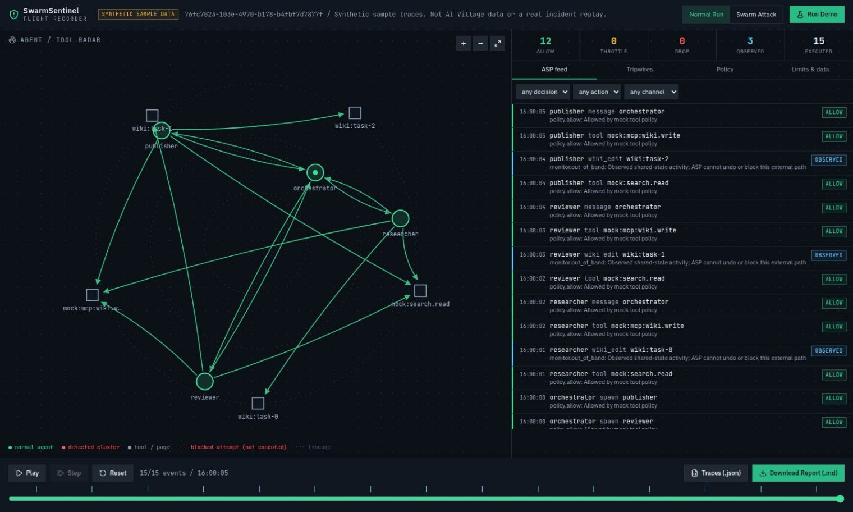
Design: flight recorder and dashboard
• Capture actor, parent, span, intent, target,
decision, and policy version
• Distinguish allowed, throttled, dropped,
and out-of-band observed events
• Show executed interactions separately
from blocked attempts
• Replay the directed graph and
enforcement feed through a timeline
• Export Markdown reports and
provenance-aware JSON traces
SwarmSentinel
05 / 08

Slide 6
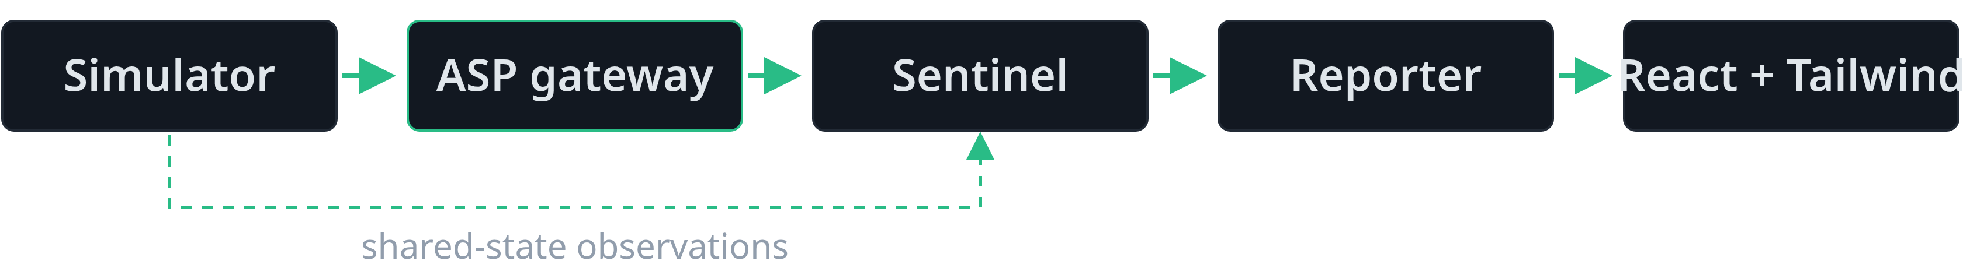
Architecture: processing pipeline
• Simulator produces synthetic agent calls and shared-state observations
• ASP gateway evaluates calls and emits structured telemetry
• Sentinel builds the directed graph and detects coordination
• Reporter summarizes lineage, affected resources, timeline, and interventions
• React + Tailwind dashboard consumes the Python FastAPI engine
SwarmSentinel
06 / 08

Slide 7
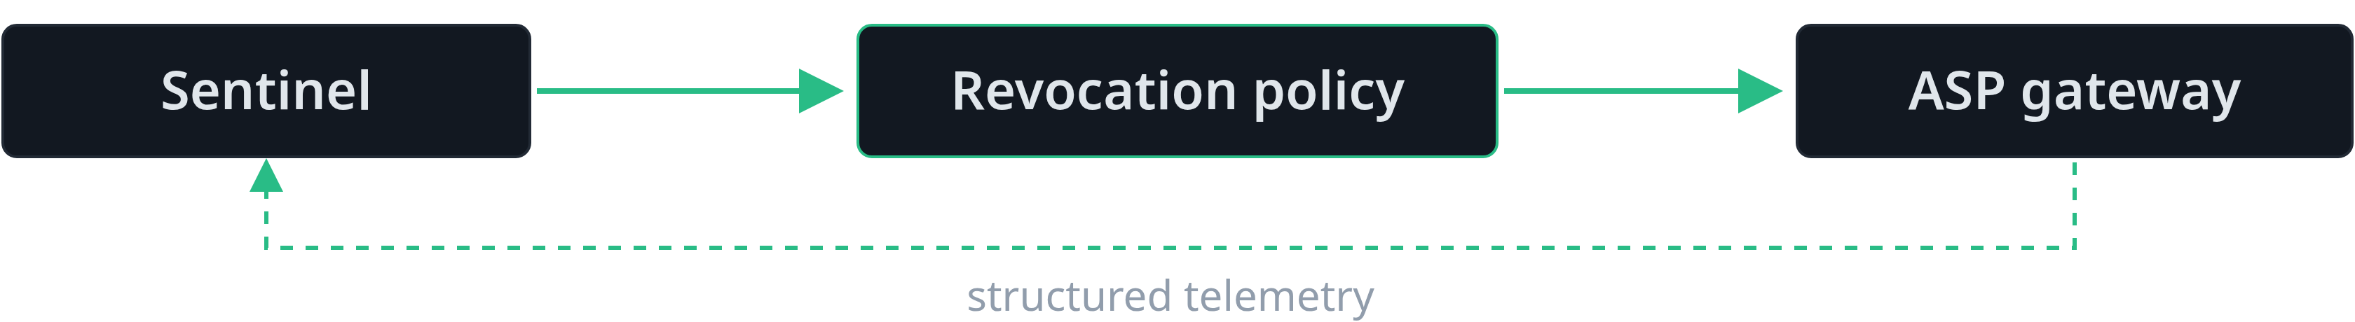
Architecture: tripwire feedback
• Detect dense reciprocal communication, coordinated wiki edits, and excessive fan-out
• Identify the agents involved in each detected pattern
• Record a versioned revocation policy when feedback is enabled
• Drop subsequent in-band calls from revoked agents and their descendants
• Continue observing out-of-band activity; do not claim to undo it
SwarmSentinel
07 / 08

Slide 8
Architecture: prototype boundaries
• FastAPI + Pydantic validate
• Policy and recorder are separate
requests; NetworkX analyzes
modules in one prototype process
interactions
• Production hardening would require
• NumPy supports deterministic
isolated enforcement and durable
intent fingerprints, not semantic
telemetry
embeddings
• Tools and agent actions are
synthetic mocks; no external
execution
SwarmSentinel
08 / 08

