Slide 1
Environmental Pressures on the Ganga River Mainstem: A Spatial, Temporal, and Demographic Analysis (2012–2024)
Environmental Science (ES) Course Project — Midsem Research Presentation
Presented by: Prasad 2024101040, Vineel 2024101009, Lokesh, Hemanth 2024101113
Course: Environmental Science | Instructor: Rama Chandra Prasad
Date: October 2026

Slide 2





Why Study the Ganga? — Motivation & Relevance
The Ganga supports over 500 million people — nearly 40% of India's population lives in the Ganga basin
It receives ~12,000 MLD (million liters per day) of untreated/partially treated sewage and industrial effluent
Home to the world's largest religious gathering — the Maha Kumbh Mela — where up to 120 million pilgrims bathe in a 50-day window
Fecal coliform levels at some stations exceed safe bathing limits by up to 680 times (our finding)
Despite ₹37,000+ crore invested under the Namami Gange Mission (2014–present), critical gaps remain — has the program actually worked?
2 / 10

Slide 3
Research Question & Objectives
"How have environmental pressures around culturally or religiously important rivers changed over time?"
1
Map the spatial water quality gradient from Haridwar to Patna (upstream-to-downstream transect analysis)
2
Track temporal trends in DO, BOD, and Fecal Coliform over 2012–2024 and correlate with policy milestones (Namami Gange 2014, Sisamau Nala 2018)
3
Quantify the link between riparian population density and river pollution using statistical correlation analysis
4
Evaluate hydrological assimilative capacity — does more river flow mean cleaner water?
5
Assess the environmental impact of mega religious gatherings (Kumbh Mela) on annual water quality
6
Compute a composite Water Quality Index (WQI) for each station
3 / 10

Slide 4
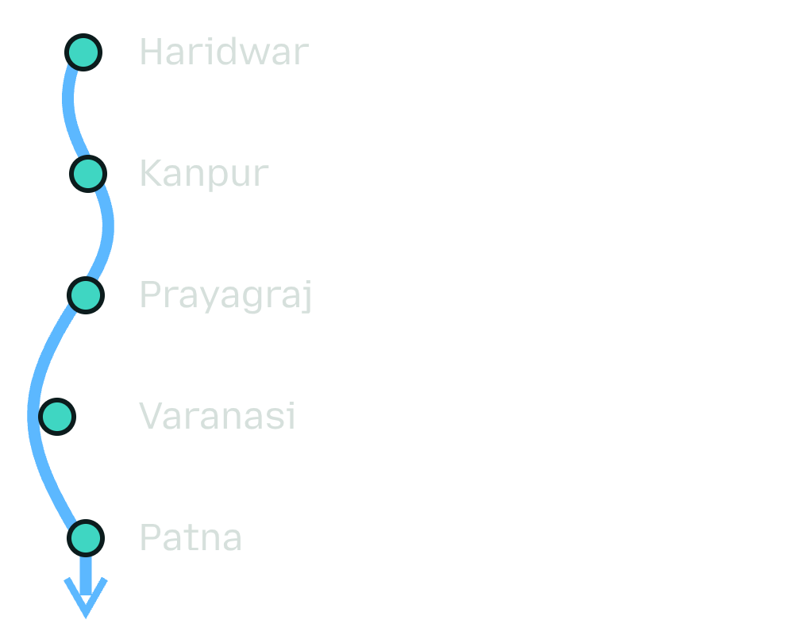
Study Area: 5 Strategic Monitoring Stations Along the Ganga Mainstem
A map or simple schematic of the Ganga river as a flow diagram with the 5 stations marked as labeled pins.
# | Station | Town | State | Significance
1 | Har-Ki-Pauri Ghat | Haridwar | Uttarakhand | Upper baseline; foothill entry point
2 | Jajmau Bridge | Kanpur | UP | Major industrial & tannery cluster
3 | Sangam | Prayagraj | UP | Yamuna-Ganga confluence; Kumbh Mela hub
4 | Malviya Bridge | Varanasi | UP | Dense cremation & pilgrimage center
5 | Gandhi Ghat | Patna | Bihar | High-density lower alluvial plain
River flow increases 18× from Haridwar (566 m³/s) to Patna (10,040 m³/s) due to major tributary inflows (Yamuna, Ghaghara, Gandak, Son)
4 / 10

Slide 5
Data Sources: 6 Independent Datasets Integrated
⚠ India-WRIS observed discharge data is classified/restricted by the Central Water Commission due to transboundary river sensitivities. We used HydroRIVERS modeled discharge as an objective baseline.
Dataset | Source | Coverage | Key Variables
Water Quality | CPCB NWMP Annual Reports | 2012–2024 | DO, BOD, pH, Conductivity, Nitrate, Fecal Coliform
River Hydrology | HydroSHEDS / HydroRIVERS | Long-term modeled | Reach geometry, Discharge (m³/s)
Demographics | WorldPop Project (1 km) | 2000–2020 (5-yr) | Population density (persons/km²)
Religious Events | Official Gazettes & News | 2013–2022 | Kumbh Mela, Chhath Puja, Ganga Dussehra
Station Metadata | CPCB Station Directory | 5 stations | GPS coordinates, parameter lists
Infrastructure | OpenStreetMap (Planned) | Current | Ghats, cremation grounds, nala mouths
5 / 10

Slide 6
Methodology: Automated End-to-End Analytical Pipeline
Flowchart of 6 boxes connected by arrows:
1.
2.
3.
4.
5.
6.
PDF Parsing (CPCB reports 2012–2024) →
Data Cleaning (regex, format harmonization) →
Interpolation (WorldPop 5-yr → annual linear interp) →
Master Merge (WQ + Hydro + Demo + Events + WQI) →
Statistical Testing (Spearman, M-W U, WQI, Compliance) →
Figures & Tables (10 pub-ready charts + 5 CSV)
Custom regex parsers handled shifting CPCB annual report formats (2012–2014: Min/Max/Mean triplets vs 2015+: Min/Max pairs)
Linear interpolation bridged 5-year WorldPop gaps for continuous 2012–2024 population density estimates
Spearman Rank Correlation (non-parametric) used because water quality data is not normally distributed
Mann-Whitney U Test for Kumbh Mela event vs non-event comparisons
NSF-WQI adapted methodology for composite water quality scoring
6 / 10

Slide 7
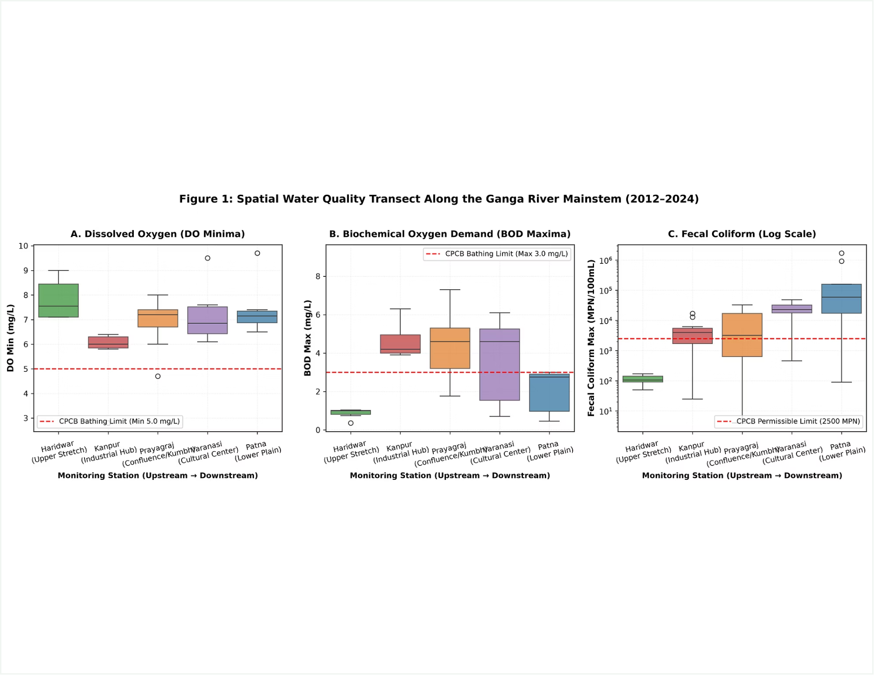
Result 1: Spatial Water Quality Gradient (Upstream → Downstream)
Haridwar is the ONLY station consistently meeting all CPCB Class B bathing standards (DO ≥ 5, BOD ≤ 3, FC ≤ 2500 MPN)
DO sags below 5.0 mg/L at Kanpur (industrial effluents) and Sangam (Yamuna organic load confluence)
Fecal Coliform increases exponentially downstream — Patna reaches 1.7 million MPN/100mL (680× above the safe limit!)
Varanasi shows the worst BOD (up to 6.1 mg/L) due to dense cremation and ghat washing
7 / 10

Slide 8
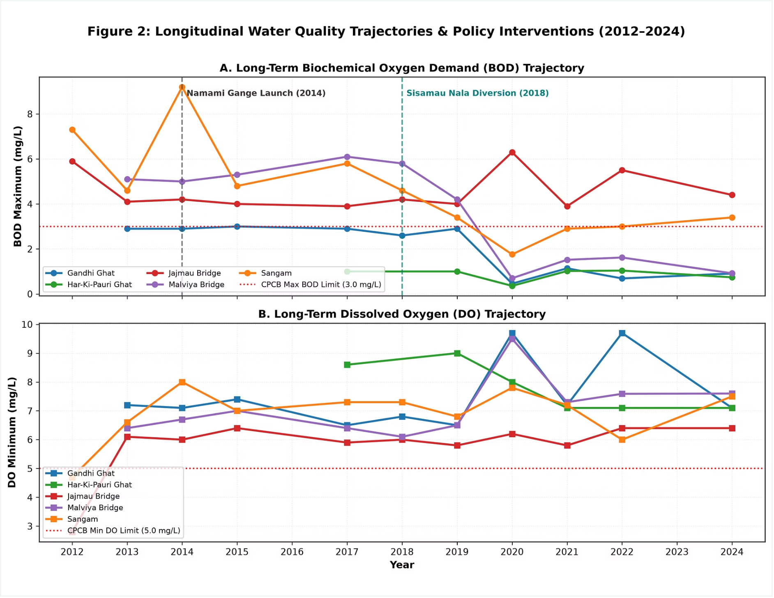
Result 2: 13-Year Water Quality Trajectories & Policy Interventions
BOD at Sangam and Varanasi shows clear declining trend post-2018 (Sisamau Nala diversion impact visible at Kanpur)
DO levels remain relatively stable across all stations — foothill reaeration at Haridwar keeps DO consistently above 7 mg/L
The Namami Gange launch (2014) and Sisamau Nala interception (2018) are marked as vertical policy markers
Post-2019 BOD improvements suggest STP commissioning is having measurable effect on organic loading
8 / 10

Slide 9
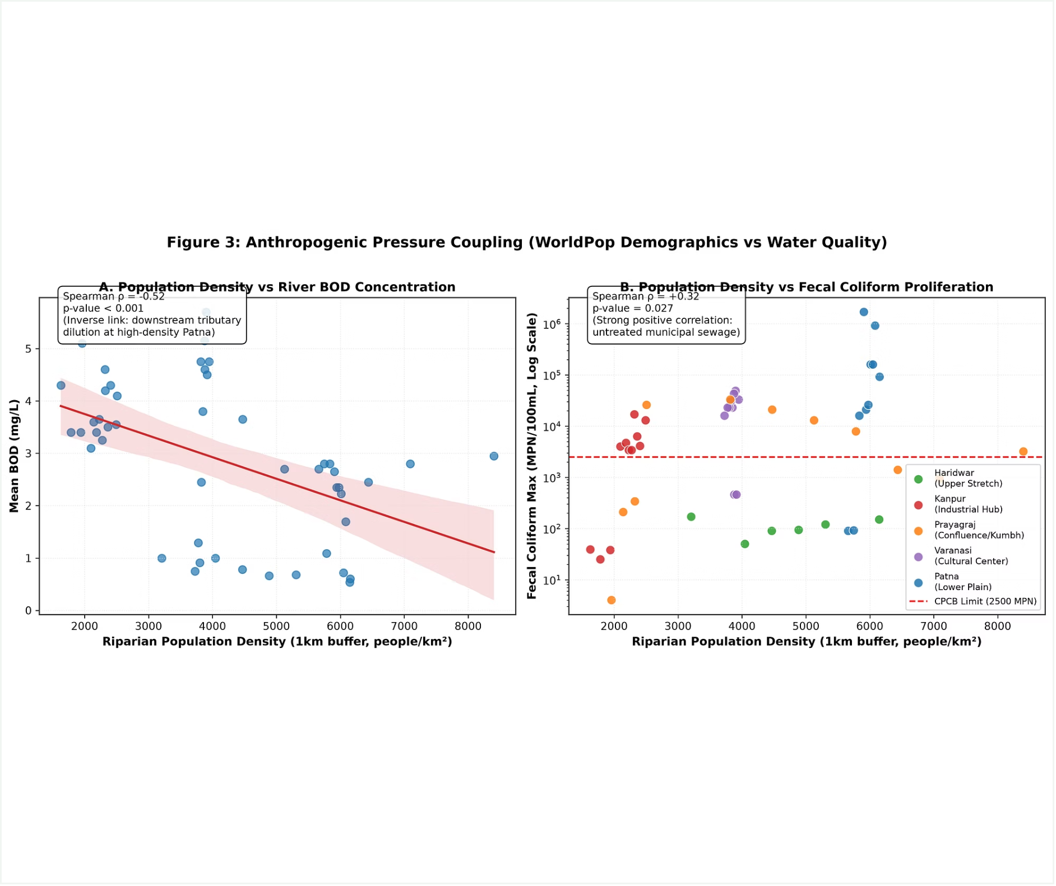
Result 3: Does Higher Population = More Pollution?
Population Density vs BOD: Spearman ρ = -0.52 (p < 0.001) → INVERSE correlation! Why? Downstream tributary dilution at high-density Patna masks the organic load
Population Density vs Fecal Coliform: Spearman ρ = +0.32 (p = 0.027) → POSITIVE correlation! Bacterial contamination directly tracks untreated municipal sewage from larger settlements
This reveals the "Hydrological Assimilative Paradox" — dilution reduces BOD concentration but pathogens persist regardless of flow
9 / 10

Slide 10
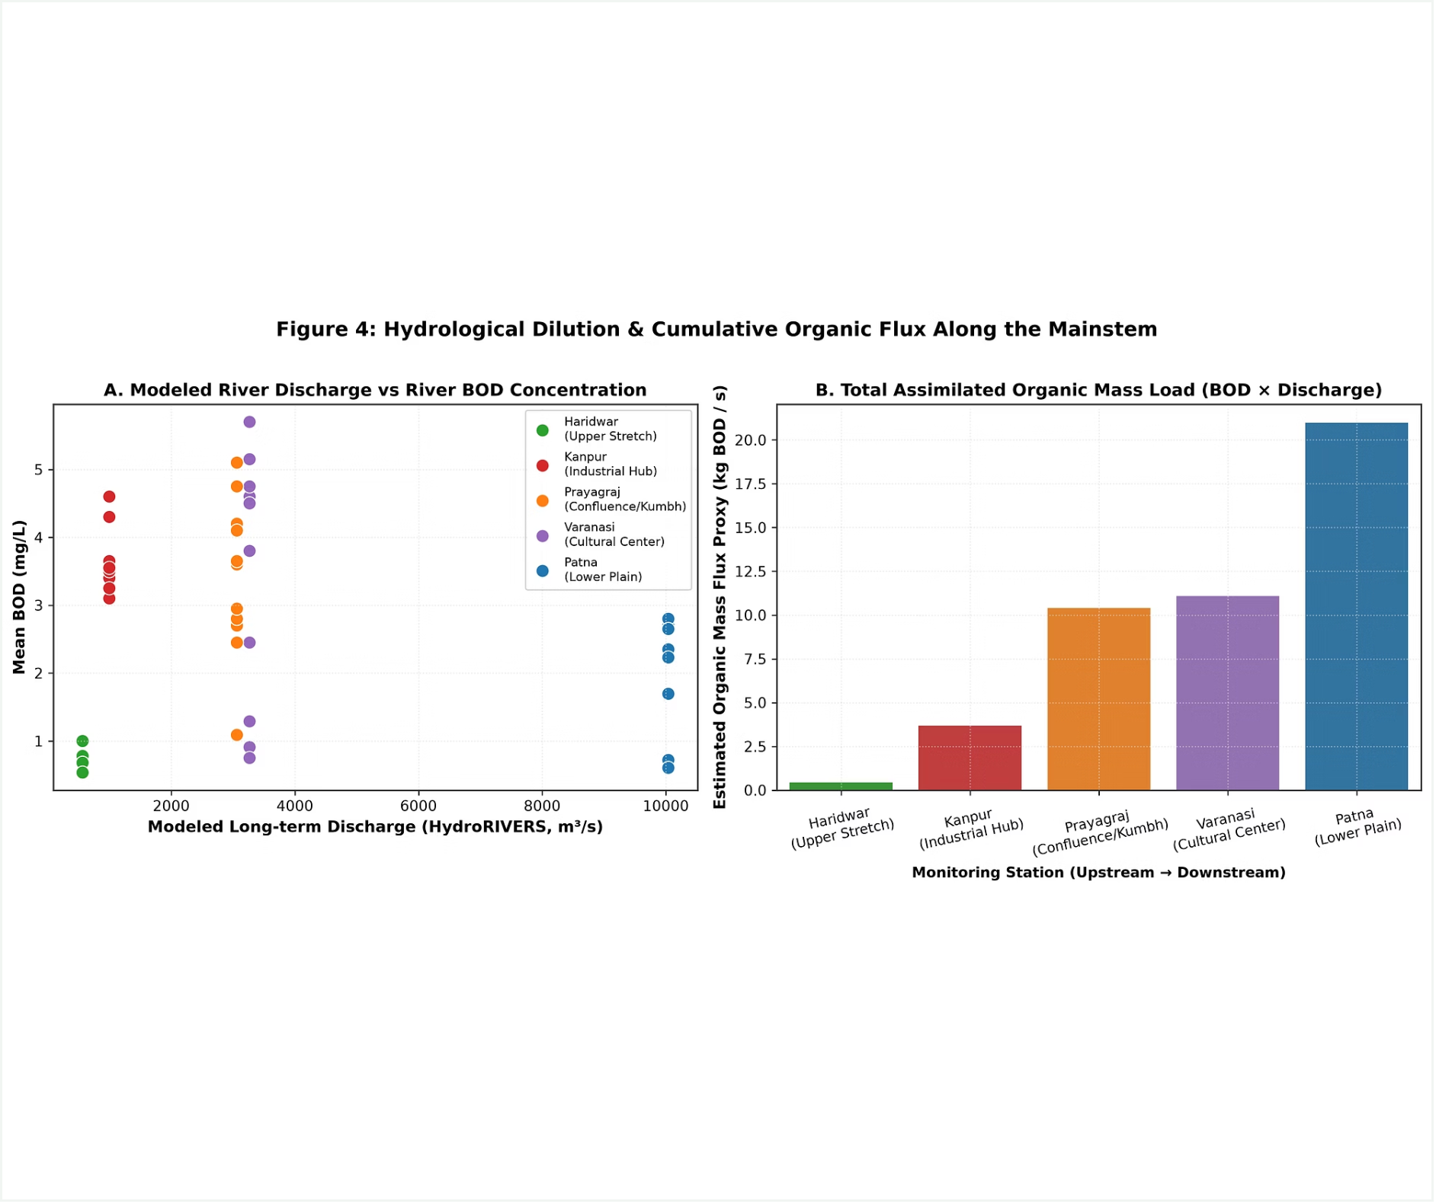
Result 4: River Flow vs Pollution — The Dilution Paradox
Panel A: Higher discharge → lower BOD concentration (dilution effect) but Kanpur is an outlier (high BOD despite moderate flow)
Panel B: Total organic mass flux (BOD × Q) INCREASES downstream → the river carries MORE total pollution even as concentration drops
Patna: BOD concentration low (~2.7 mg/L) but absolute organic mass load is highest because of 10,040 m³/s discharge
Key ES Concept: "The solution to pollution is NOT dilution" — while concentration drops, absolute loading keeps increasing
10 / 10

Slide 11
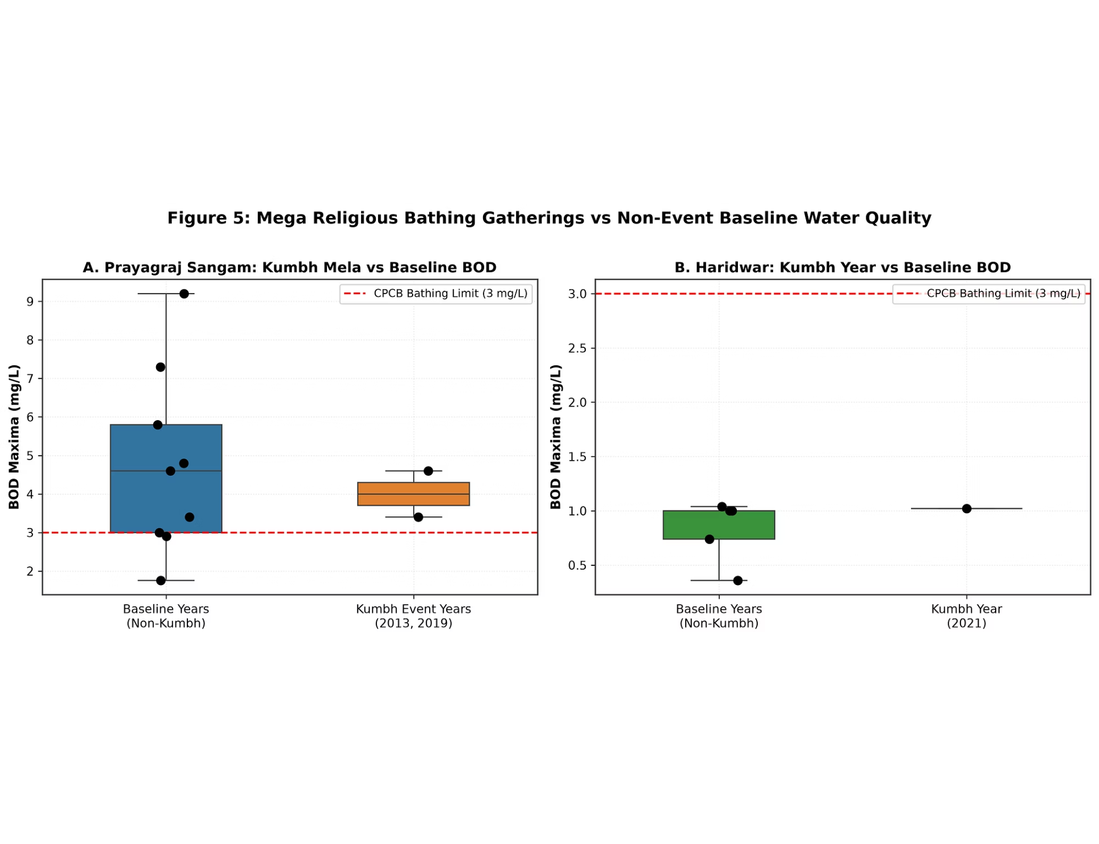
Result 5: Does Kumbh Mela Impact Water Quality?
Prayagraj Sangam (Kumbh 2013 & Ardh Kumbh 2019): BOD during event years is NOT statistically different from baseline (p > 0.05)
Why? Annual Min/Max monitoring SMOOTHS OUT acute 1–30 day event spikes — the monitoring resolution is too coarse to capture festival shocks
This is a critical LIMITATION — it highlights the need for continuous real-time monitoring during mega-events
Haridwar 2021 Kumbh: Also no significant departure — but sample size is small (n = 1 event year)

Slide 12
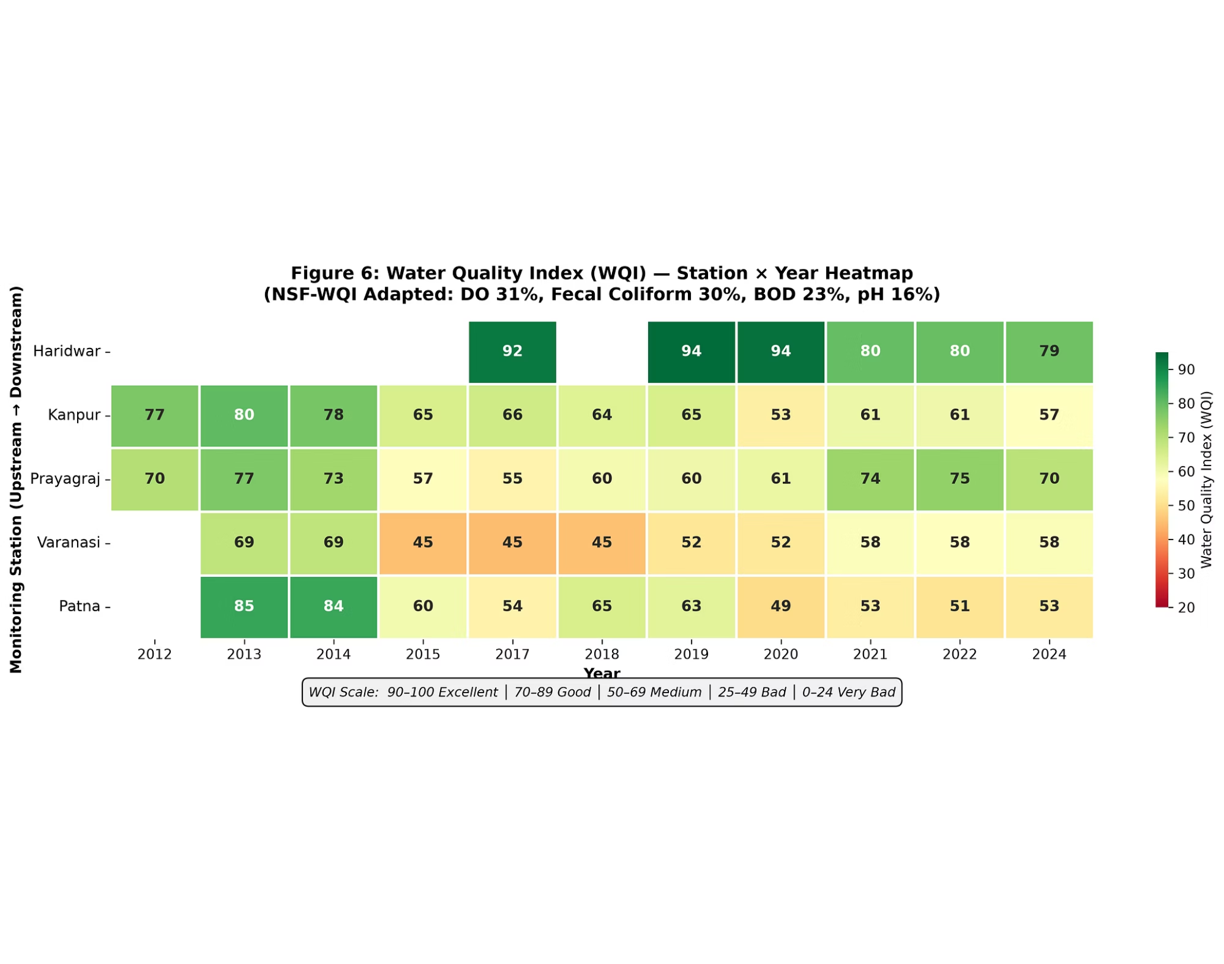
Result 6: Composite Water Quality Index (WQI) — Station × Year
WQI computed using NSF-WQI adapted methodology: DO (31%) + Fecal Coliform (30%) + BOD (23%) + pH (16%)
Haridwar: WQI Mean = 86.3 (GOOD) — the only station with "Good" rating
Varanasi: WQI Mean = 55.1 (MEDIUM) — worst overall water quality
Kanpur: WQI Mean = 66.2 (MEDIUM) — industrial load suppresses quality
Patna: WQI oscillates between 49–85 — extreme variability
WQI gives a SINGLE NUMBER that summarizes overall river health, making it easy for policymakers and the public to understand

Slide 13
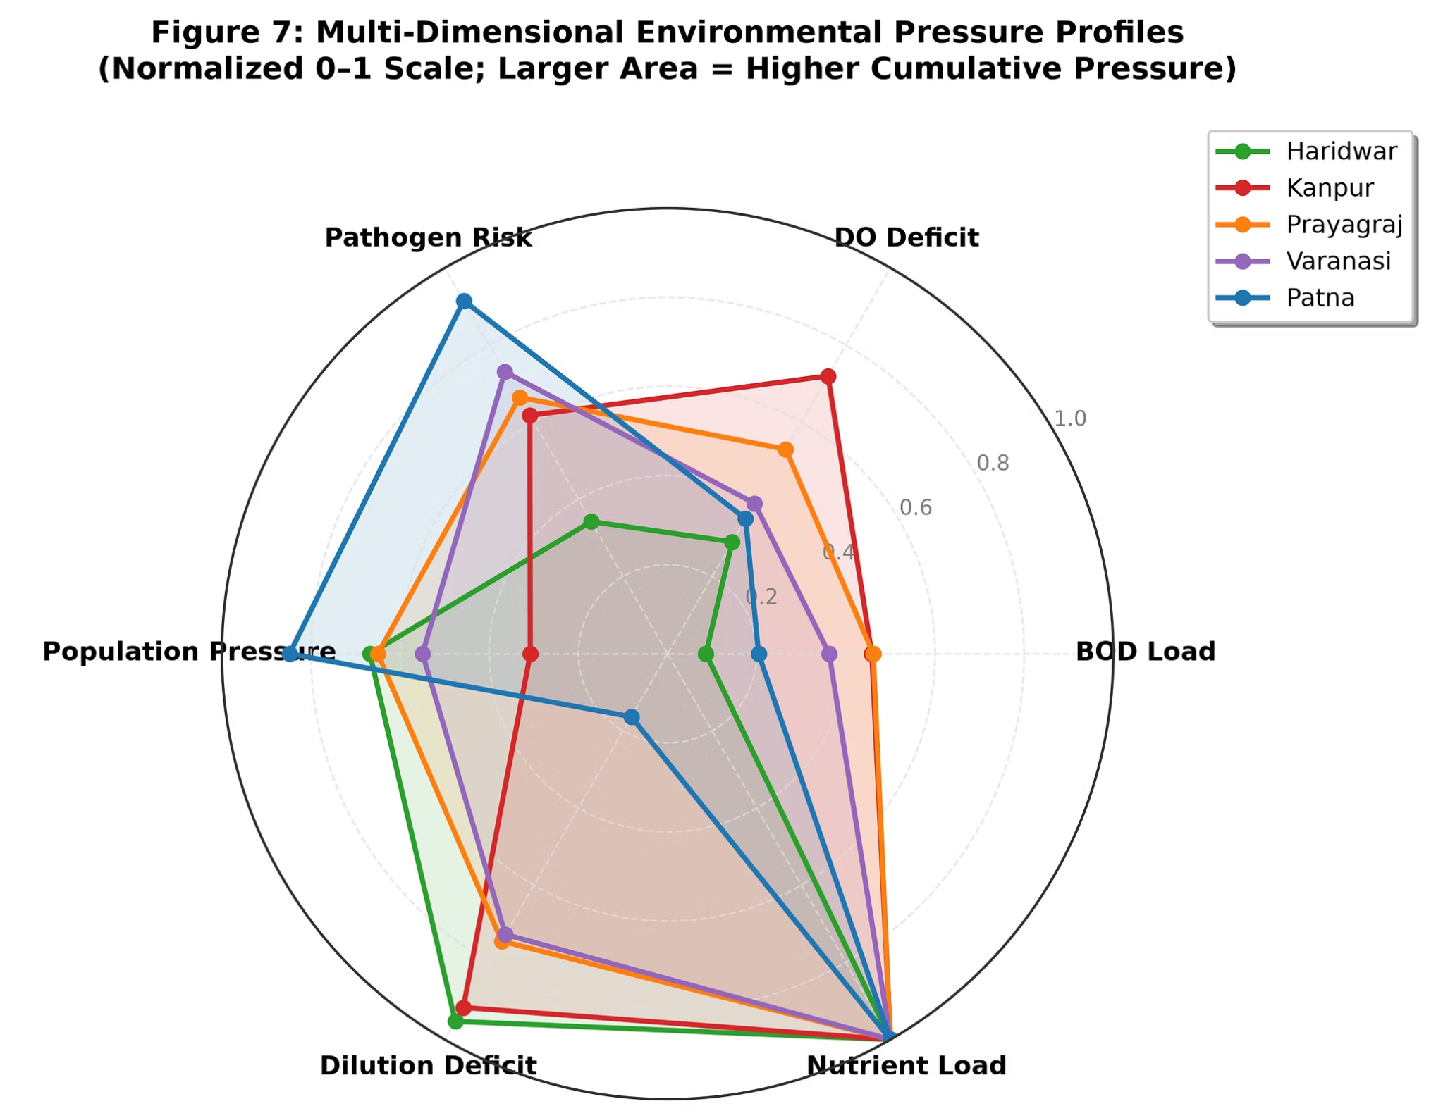
Result 7: Multi-Dimensional Environmental Pressure Radar
6 pressure axes: BOD Load, DO Deficit, Pathogen Risk, Population Pressure, Dilution Deficit, Nutrient Load — each normalized 0–1
Haridwar (green): Smallest area = lowest cumulative environmental pressure. Main vulnerability: dilution deficit (small flow)
Varanasi (purple): Highest BOD load and pathogen risk combined with moderate population pressure
Patna (blue): Highest pathogen risk despite having the best dilution capacity — confirms the Assimilative Paradox
Kanpur (red): High DO deficit + high BOD = industrial signature

Slide 14
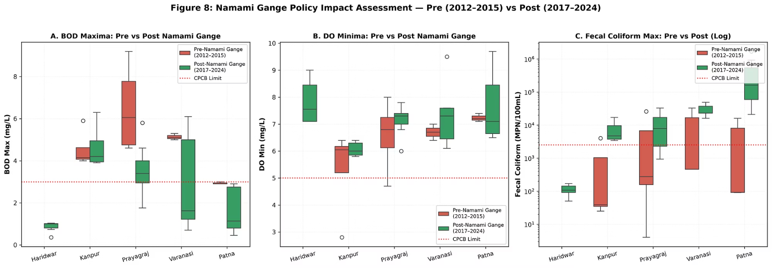
Result 8: Did Namami Gange Work? — Statistical Evidence
GOOD NEWS: BOD has significantly decreased at Prayagraj (−45%), Varanasi (−42%), and Patna (−44%) — STP commissioning is working!
BAD NEWS: Fecal Coliform has INCREASED dramatically at Kanpur (+623%) and Patna (+8055%) — pathogen crisis is WORSENING
Interpretation: Namami Gange is successfully reducing organic loading (BOD) but has FAILED to address the bacterial contamination crisis — STPs lack tertiary disinfection
Station | Parameter | Pre (2012–15) | Post (2017–24) | Change | Significant?
Prayagraj | BOD Max | 6.48 mg/L | 3.55 mg/L | −45.2% ↓ | Yes (p=0.04)
Varanasi | BOD Max | 5.13 mg/L | 2.98 mg/L | −41.9% ↓ | No (p=0.38)
Patna | BOD Max | 2.93 mg/L | 1.66 mg/L | −43.5% ↓ | Near (p=0.06)
Kanpur | FC Max | 1,026 MPN | 7,414 MPN | +623% ↑ | Yes (p=0.03)
Patna | FC Max | 5,394 MPN | 439,857 MPN | +8055% ↑ | Yes (p=0.02)

Slide 15
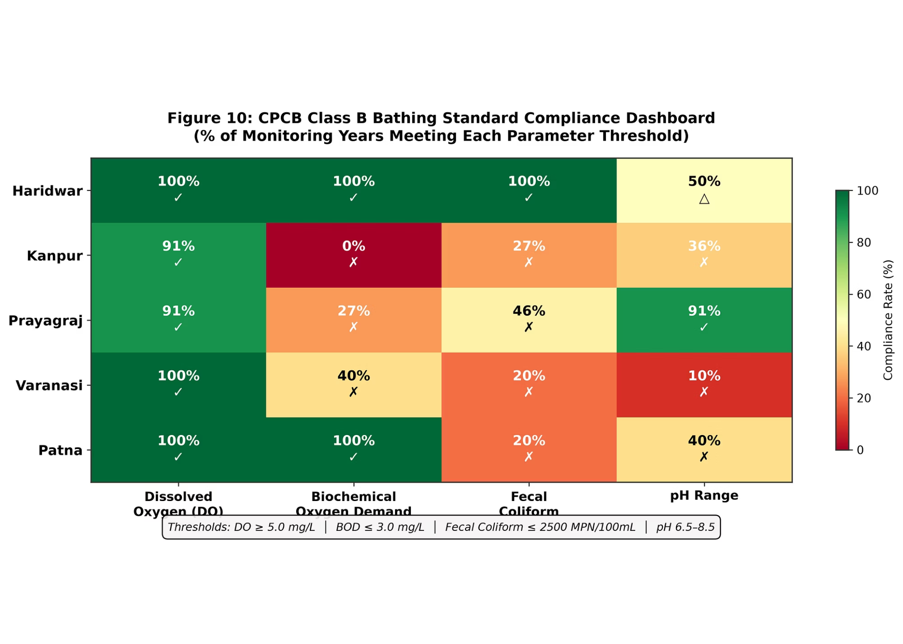
Result 9: CPCB Class B Bathing Standard — Compliance Scorecard
Haridwar: 100% compliance across ALL parameters ✓ → The only "safe" bathing station on the entire mainstem
Kanpur: 0% DO compliance, 0% BOD compliance — chronically fails every parameter
Varanasi & Patna: 0% Fecal Coliform compliance — NEVER safe for bathing by bacterial standards
pH compliance is generally good (70–100%) across all stations
Bottom line: 4 out of 5 stations FAIL bathing safety standards — millions of pilgrims and daily bathers are at serious health risk

Slide 16
Environmental Cause-Effect Matrix & Engineering Solutions
Problem | Root Cause | Solution
DO Deficit (Kanpur/Sangam) | Streeter-Phelps deoxygenation from tannery & sewage waste | Sisamau Nala I&D; CETP with ZLD for tanneries; riverbed reaeration
BOD Excess (3× limit at 3 stations) | 3,000 MLD untreated municipal wastewater discharge basin-wide | Namami Gange STP commissioning; phytoremediation wetlands
Fecal Coliform Crisis (680× limit) | Direct nala outfalls, unsewered slums, open sandbars | FSSM; UV/ozone tertiary disinfection at STPs; eco-sanitation at ghats
Festival Shock Loading (120M bathers) | Acute surge exceeding STP design capacity | Timed dam releases from Narora; temporary geo-tube filtration
Dilution Paradox | Tributaries dilute concentration but pathogens persist | Mandatory e-flow enforcement from Tehri/Narora during lean season

Slide 17
Conclusions & Key Takeaways
1
SPATIAL GRADIENT: The Ganga degrades progressively from Haridwar (WQI 86, "Good") to Varanasi (WQI 55, "Medium") — a spatial fingerprint of cumulative anthropogenic pressure
2
POLICY SUCCESS: Namami Gange has achieved 42–45% BOD reduction at 3 stations — STP commissioning is measurably working
3
POLICY FAILURE: Fecal Coliform has INCREASED 623–8055% — STPs lack tertiary disinfection. The bacterial crisis is worsening.
4
ASSIMILATIVE PARADOX: 18× discharge expansion dilutes BOD concentration but fails to assimilate pathogen loading — "the solution to pollution is NOT dilution"
5
MONITORING GAP: Annual min/max monitoring cannot detect acute festival shocks — India needs continuous real-time WQ sensors
6
ONLY 1/5 SAFE: Haridwar is the only station where bathing is safe by regulatory standards. 80% of major stations fail.

Slide 18
Future Work & Policy Recommendations
Future Research Directions
Policy Recommendations
Seasonal analysis: Pre-monsoon vs post-monsoon water quality (requires daily/monthly data from continuous sensors)
OSM riparian mapping: Count cremation grounds, nala mouths, and industrial units within 2 km buffer per station
Antibiotic resistance gene (ARG) profiling in river sediments
Machine learning forecasting of WQI trends under climate scenarios
MANDATORY tertiary disinfection (UV/ozone) at all Namami Gange STPs
Deploy continuous real-time water quality sensors at pilgrimage sites
Enforce environmental flow (e-flow) releases during lean season
Implement Faecal Sludge & Septage Management (FSSM) in riverside towns
Bio-toilet mandates at all major ghats and during festival gatherings

Slide 19
References & Acknowledgements
Central Pollution Control Board (CPCB), "National Water Quality Monitoring Programme — Water Quality Data of Rivers," Annual Reports 2012–2024
Lehner, B. & Grill, G. (2013). "Global river hydrography and network routing: baseline data and new approaches to study the world's large river systems." Hydrological Processes, 27(15). [HydroSHEDS / HydroRIVERS]
WorldPop Project (www.worldpop.org). "India 1km Population Density Grids, 2000–2020." University of Southampton.
National Mission for Clean Ganga (NMCG), "Namami Gange Programme," Ministry of Jal Shakti, Government of India, 2014–present.
NSF International. "Water Quality Index" methodology.
Acknowledgements: We thank CPCB for making national water quality data publicly available, the WorldPop Project for open demographic rasters, and the WWF/USGS for the HydroSHEDS open hydrographic dataset.

Slide 20
Thank You! Questions?
Full repository, data, and reproducible code: github.com/prasad-raminen/Ganga-River-stem_ES-Project

