Slide 1

Intruder Detection
Minor Project
Prasad Shembekar
Siddhesh Kalamkar
Ankita jogi

Slide 2
Today's Workstation Environment
More Prone to have intruder attack on sensitive information
Require human assistance to detect the unauthorised activities Whatever happen they just sit and watch and even do not notice malicious attacks
Nowadays Secured workstation system is need of an hour

Slide 3
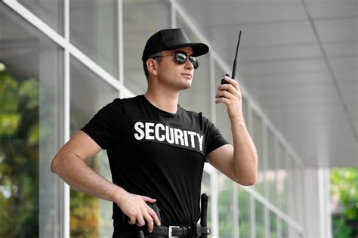
Intruder Detection
Simply put it’s like a Security Guard which has sense to respond.

Slide 4

What Intruder Detection can do ?
Monitoring the motion
Taking the look on movements of object
Motion identification
24*7 Recording of workstation environment

Slide 5
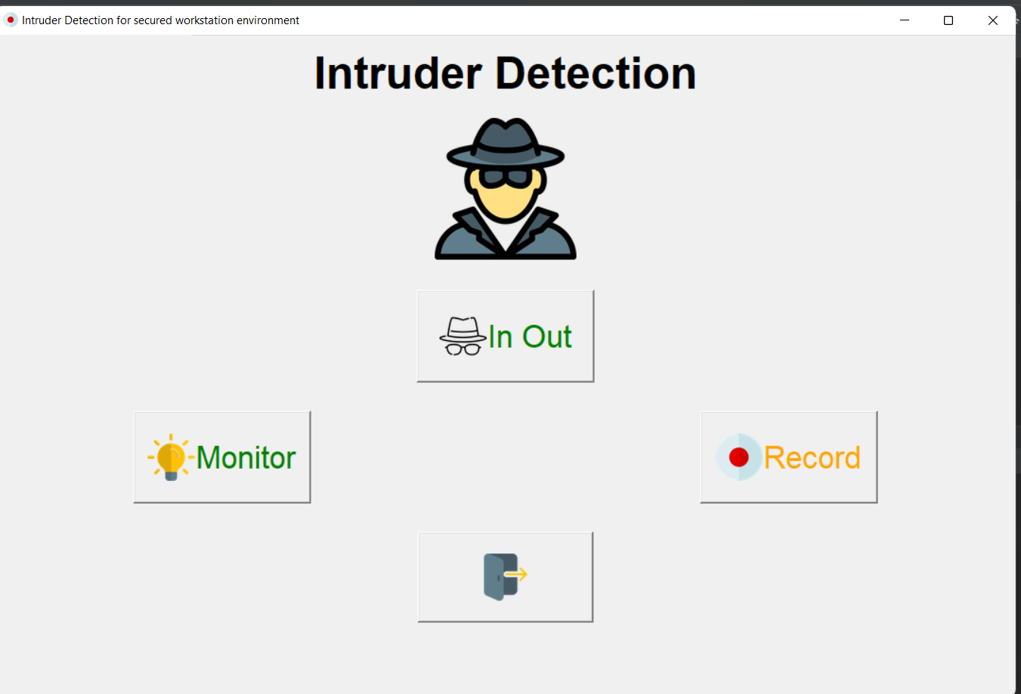

Slide 6


Who entered and exit ?
It just detect motion in two ends {left, right}.
And follow the motion.
Click its picture and save ...

Slide 7
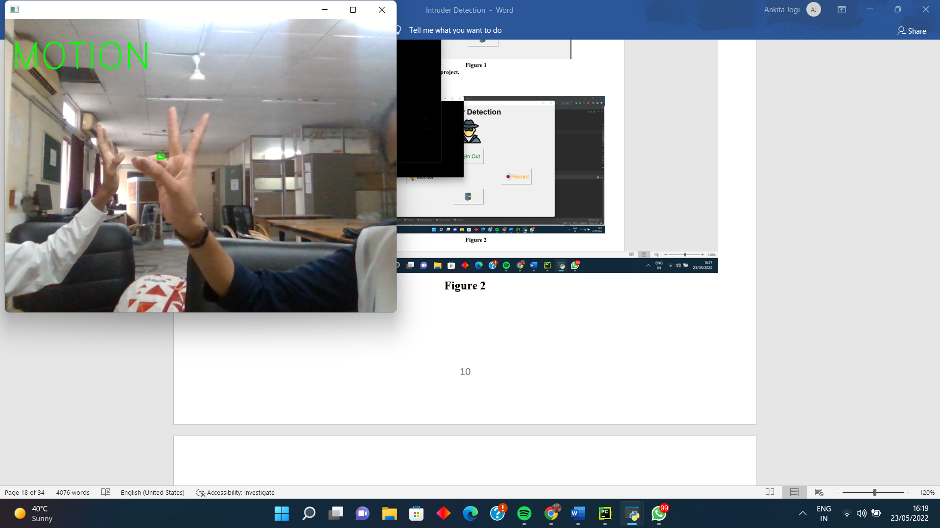

Slide 8
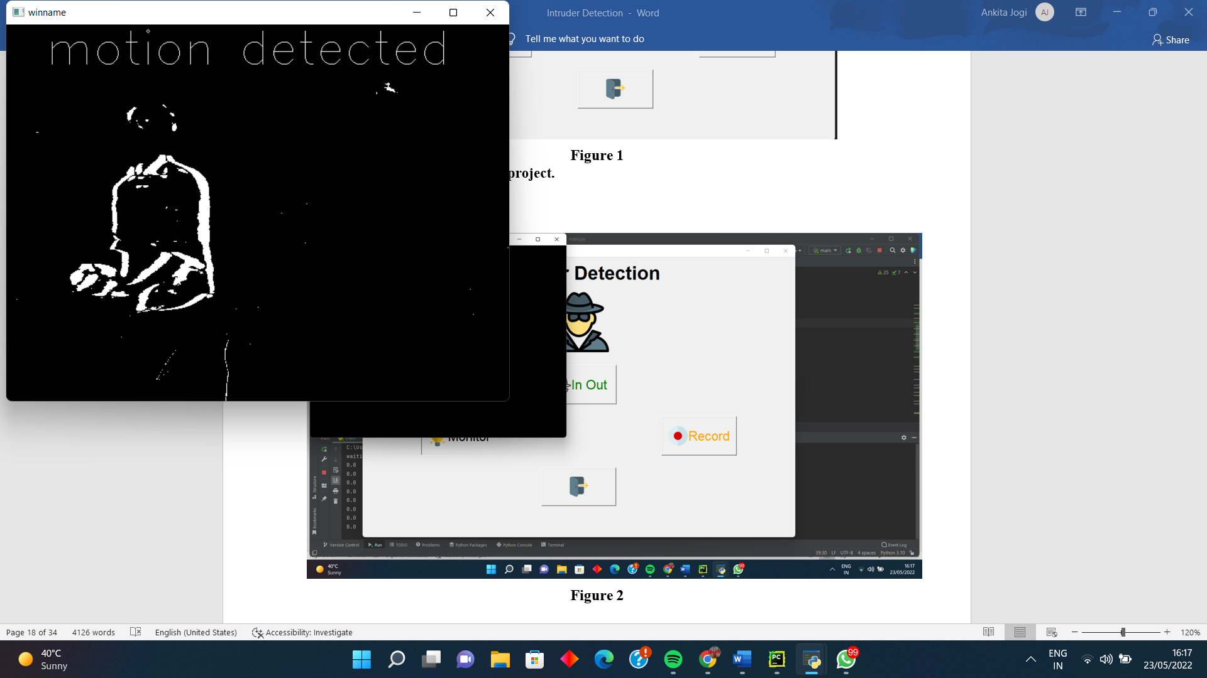

Slide 9
Working
Basically it just detect for motion.
And then checks the side of moiton either left or right.
If motion from left then it will check if motion ends towards right and it just captures the image
Similarly done for right side also.

Slide 10
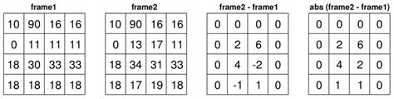
Working
It basically do absolute difference between two consecutive frames.
From that diff we detect for contours/boundaries.
If boundries are 0 then no motion and vice-versa.

Slide 11
Thank You !!

