Slide 1

BLOOD BANK MANAGEMENT SYSTEM
JANHAVI - 23107125
PRASAD - 23107097
LAXMI - 23107140
DHANASHREE - 23107107
Project Guide
Ms. HARSHA ZOPE

Slide 2
Contents
Introduction
Objectives
Scope
Features / Functionality
Project Outcomes
Technology Stack

Slide 3
1. Introduction
We have seen many cases where people need blood but could not find at the right time.
So to find a solution, we have created an application of blood bank management which will help the users to find the required blood in time.
Also this application will be having details of blood camps so that people can donate blood.

Slide 4
2. Objectives
To create donor records.
To allow individuals for camp search and camp request.
Manage and schedule blood donation appointments.
To allow users to search for required blood components.
Users can register for blood donation camp.

Slide 5
3. Scope
Can be used in hospitals for storing data of blood .
Also it can be used by individuals willing for organizing blood donation camps.
Can be used by every individual at the time of crisis or if anyone needs blood urgently.
Used in schools or colleges for organizing blood donation camps for students.

Slide 6
4. Feature /Functionality
Tracks donor information eligibility and donor history.
Record blood collection details including types and amount.
Real-time tracking of blood stock (types and components). Alerts for low inventory or expiring units.
Ensures authorised access and data security.

Slide 7
5. Outcome of Project
User can find their interest in-
Blood donation – Efficient donation process.
Blood requirement – Quickly matches blood request with available blood units.
Blood camp organisation – simplifies planning promotion and execution of blood donation camp.

Slide 8
6. Technology Stack
For front end we will use java
For backend we will use MYSQL.

Slide 9
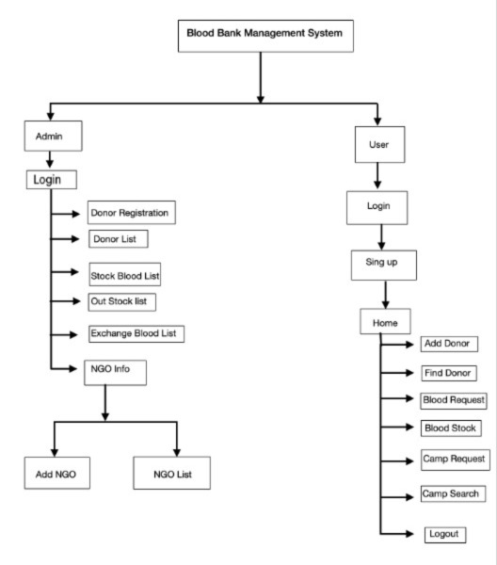
BLOCK DIAGRAM :

Slide 10
Thank You...!!

