Slide 1
DIGITAL_INTEGRATED MANAGEMENT SYSTEM
Master List
Document Change Request
User Name
Password
Internal Audit
Login
QPI
MRM

Slide 2

STEP : 1 Auto Generation of DCR Reference Number
When a user logs in to the DCR page, the DCR Reference Number shall be automatically generated by the application. The reference number shall be system-controlled and non-editable by the user.
The DCR Reference Number shall follow the format YYYY_NNN, where:
First four digits (YYYY): Current year, updated automatically by the application.
Next three digits (NNN): Sequential running number, starting from 001.
The running sequence shall be maintained automatically for each new DCR. In the event of DCR rejection, the rejected DCR Reference Number shall remain unchanged, and the next DCR shall be assigned the next number in the running sequence. Rejected DCR numbers shall not be reused.

Slide 3

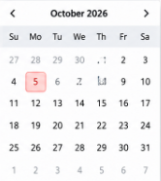
STEP : 2 Date of DCR Creation
The Date field shall follow the format specified in Fig. 1
Fig.1

Slide 4

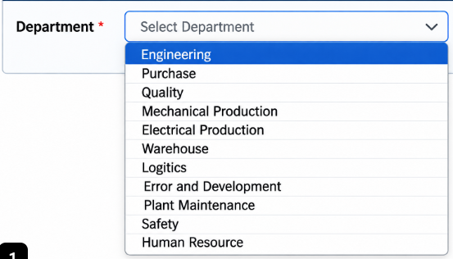
STEP : 3 Select The Department
The system shall provide authorized administrators with the option to add, edit, or update the department list whenever a new department is introduced, or an existing department name is changed.
Any updates shall be reflected automatically in the Department drop-down list for users.
The Department field shall be mandatory, and users shall be allowed to select only from the available options.

Slide 5

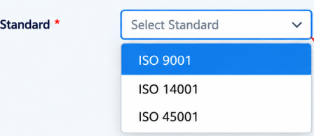
STEP : 4 Select the Standard
The Standard Selection field shall be provided as a drop-down list, allowing users to select the applicable standard from the following options
ISO 9001
ISO 14001
ISO 45001

Slide 6
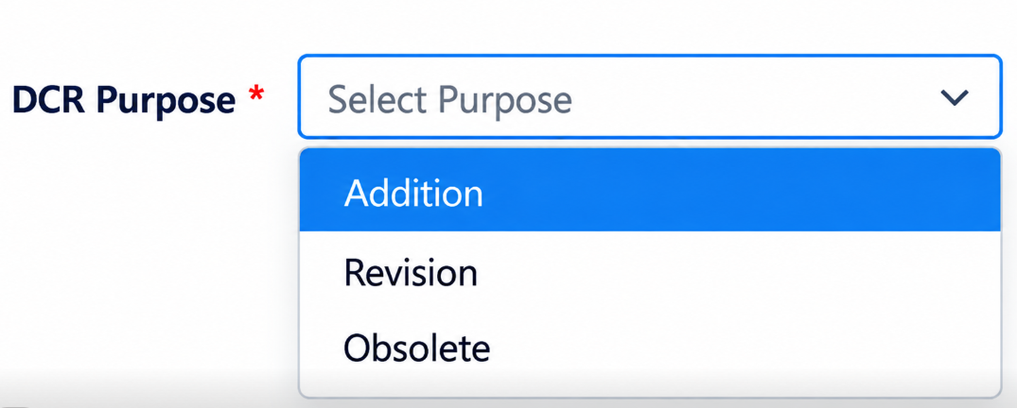
STEP : 5 Select The Purpose of DCR
The DCR Purpose field shall be provided as a drop-down list, allowing users to select the applicable purpose for creating the DCR from the following options;
Addition
Revision
Obsolete
The field shall be mandatory, and users shall select the appropriate option based on the purpose of the document change request.

Slide 7

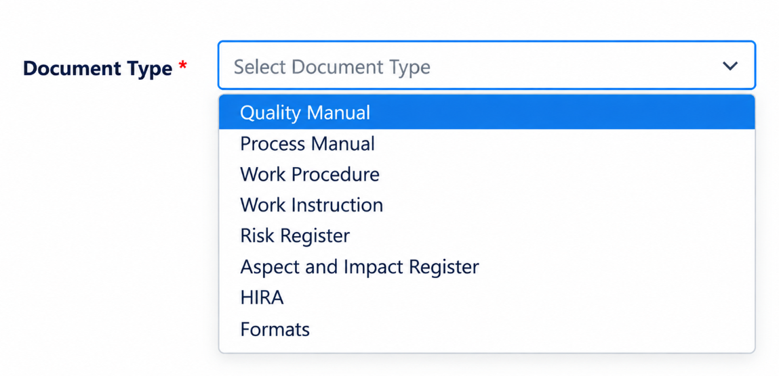
STEP : 7 Select the Document Type
The Document Type field shall be provided as a drop-down list, allowing users to select the applicable type of document they intend to address in the DCR.
The field shall be mandatory, and users shall select the appropriate document type from the available options.
The system shall provide authorized administrators with the option to add, edit, or update the document type list whenever required.

Slide 8

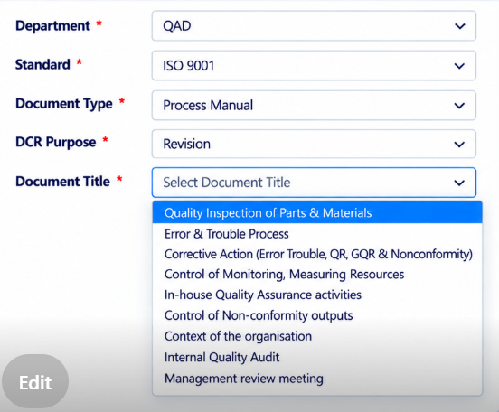
STEP : 8 Select the Document Title
The Document Title field shall operate as follows
For Revision and Obsolete: The application shall automatically display a drop-down list of existing document titles retrieved from the Master List, based on the user's selections in Step 3 and Step 7.
For Addition: When the user selects Addition in Step 5 (DCR Purpose), the Document Title field shall be enabled for manual entry, allowing the user to enter the title of the new document to be released.
The application shall dynamically control the Document Title field based on the selected DCR Purpose and retrieve existing document titles from the Master List wherever applicable.

Slide 9
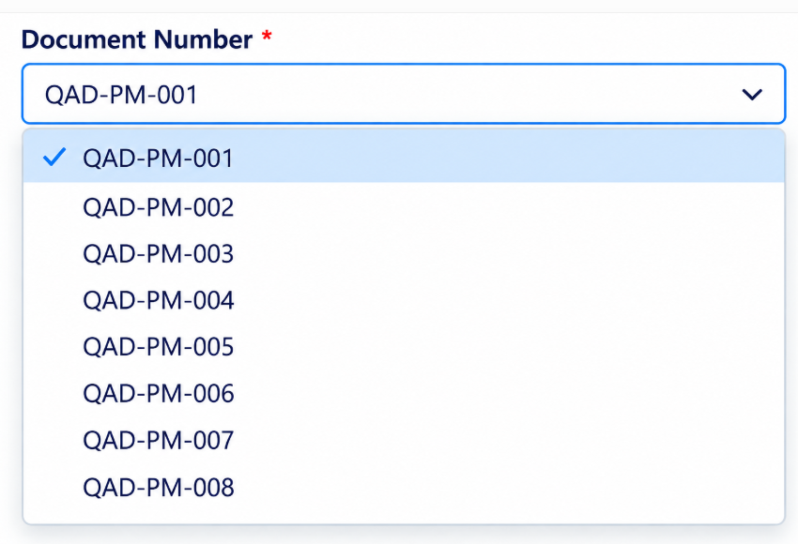
STEP : 9 Select the Document Number and Revision Number
The Document Number and Revision fields shall operate as follows:
For Revision and Obsolete: Once the user selects the Document Title in Step 8, the application shall automatically generate the corresponding Document Number and current Revision Number from the existing Master List.
These fields shall be non-editable by the user.
For Addition: When the user selects Addition under DCR Purpose, the Document Number field shall be enabled for manual entry, allowing the user to enter the next available Document Number in the sequence.
Duplicate Document Number Validation: The application shall validate the entered Document Number against the existing Master List.
If the entered number already exists, the system shall prevent submission and display an appropriate error message. Only a unique Document Number shall be accepted for a new document.

Slide 10
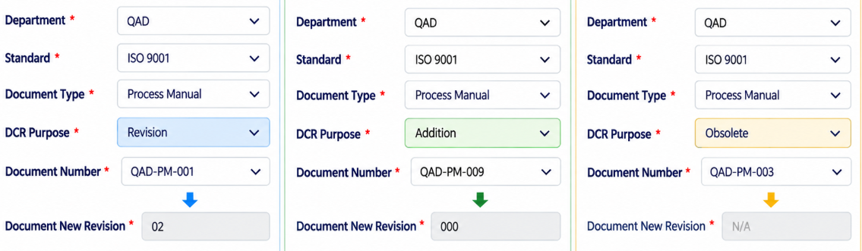
STEP : 10 Auto Generation of New Revision Number
The Document New Revision field shall operate as follows:
Revision: Based on the selections made in Step 5 (DCR Purpose) and Step 8 (Document Number), the application shall automatically assign the next revision number based on the existing revision recorded in the Master List.
Addition: If the user selects Addition in Step 5 (DCR Purpose), the application shall automatically Gneerate the Document New Revision field with 000.
Obsolete: If the user selects Obsolete in Step 5 (DCR Purpose), the application shall automatically populate the Document New Revision field with N/A.
The Document New Revision field shall be system-controlled and non-editable by the user.

Slide 11
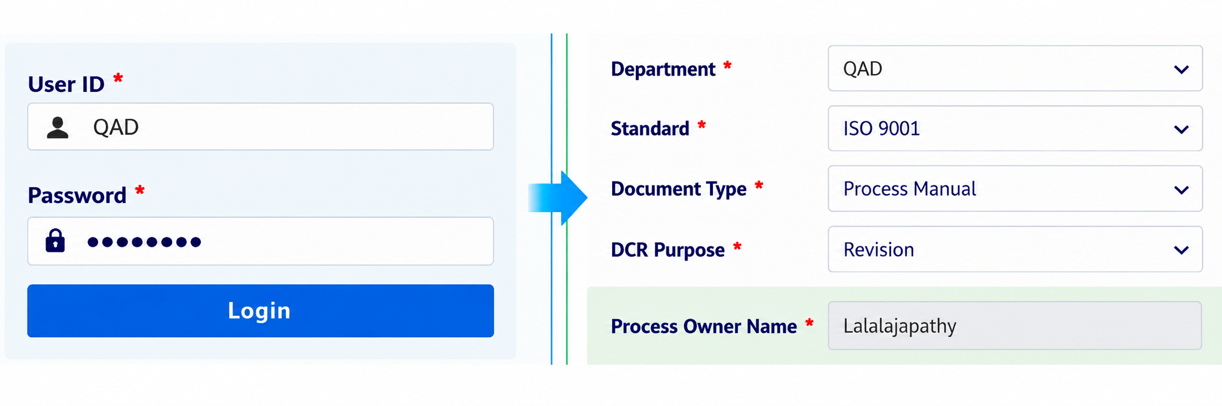
The Process Owner Name field shall be automatically Generate by the application based on the logged-in user's ID. The field shall be displayed automatically when the user accesses the DCR Creation page and shall not require manual entry.
STEP : 11 Auto Generation of Process Owner Name

Slide 12
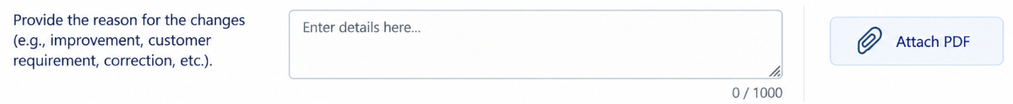
STEP : 12 Change Description
The following three fields shall be provided on the DCR Creation page:
Describe Before Changes: An editable text field shall be provided for users to describe the existing condition before the proposed changes.
Describe After Changes: An editable text field shall be provided for users to describe the proposed condition after the changes.
Reason for Changes: An editable text field shall be provided for users to explain the reason for the proposed changes.
Each field shall allow a maximum of 1,000 characters.
The application shall also provide an option to attach the relevant supporting document in PDF format to revision field

Slide 13
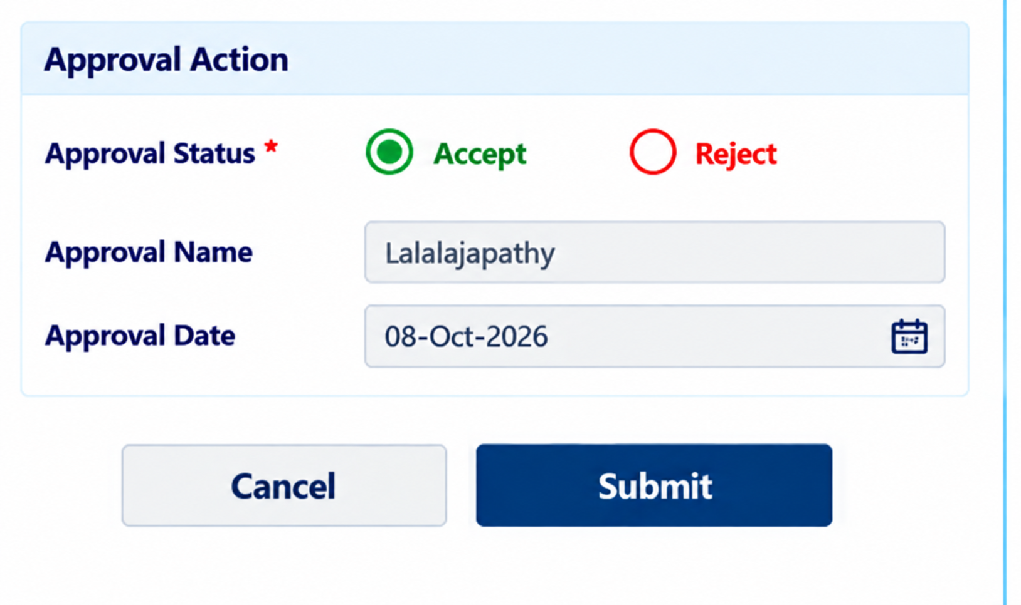
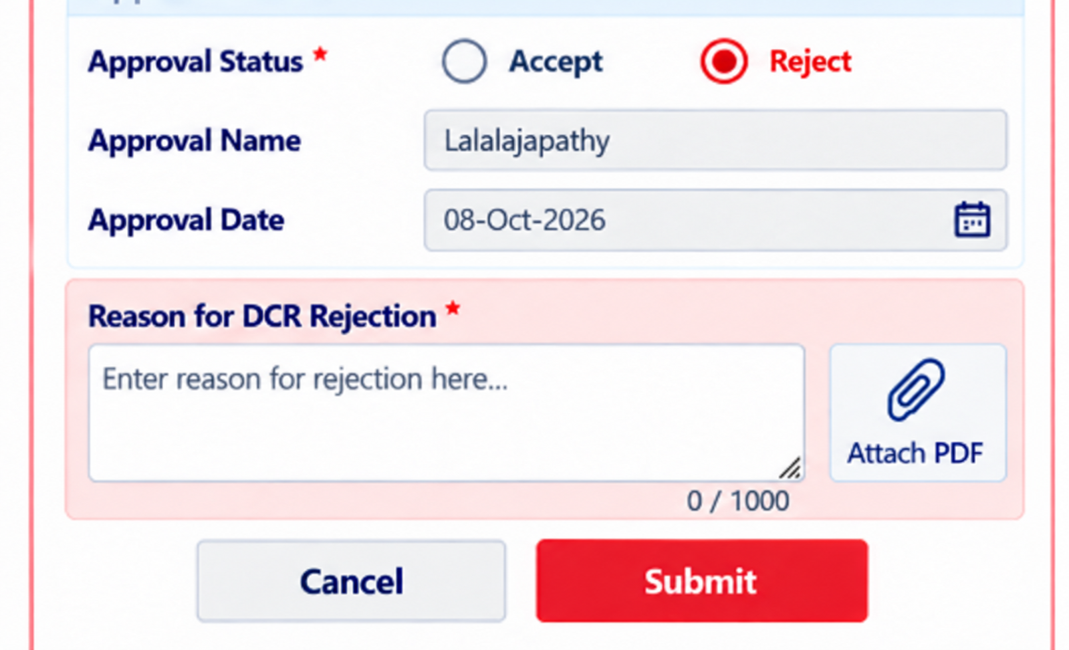
STEP : 13 DCR Approval
Once the user completes all mandatory fields and clicks the Submit button, the application shall automatically forward the DCR to the concerned approval authority based on the predefined Standard Approval Matrix.
The approval authority shall review the submitted DCR and select one of the following options:
Accept: If the approval authority accepts the DCR, the application shall automatically record the concerned approval authority's name against the approval status.
Reject: If the approval authority rejects the DCR, the application shall provide a mandatory editable text box for the authority to enter the reason for rejection. The rejection reason shall be recorded against the corresponding DCR for reference and traceability.
The application shall maintain the DCR status, approval authority details, and rejection remarks, wherever applicable, for future reference and tracking.

Slide 14
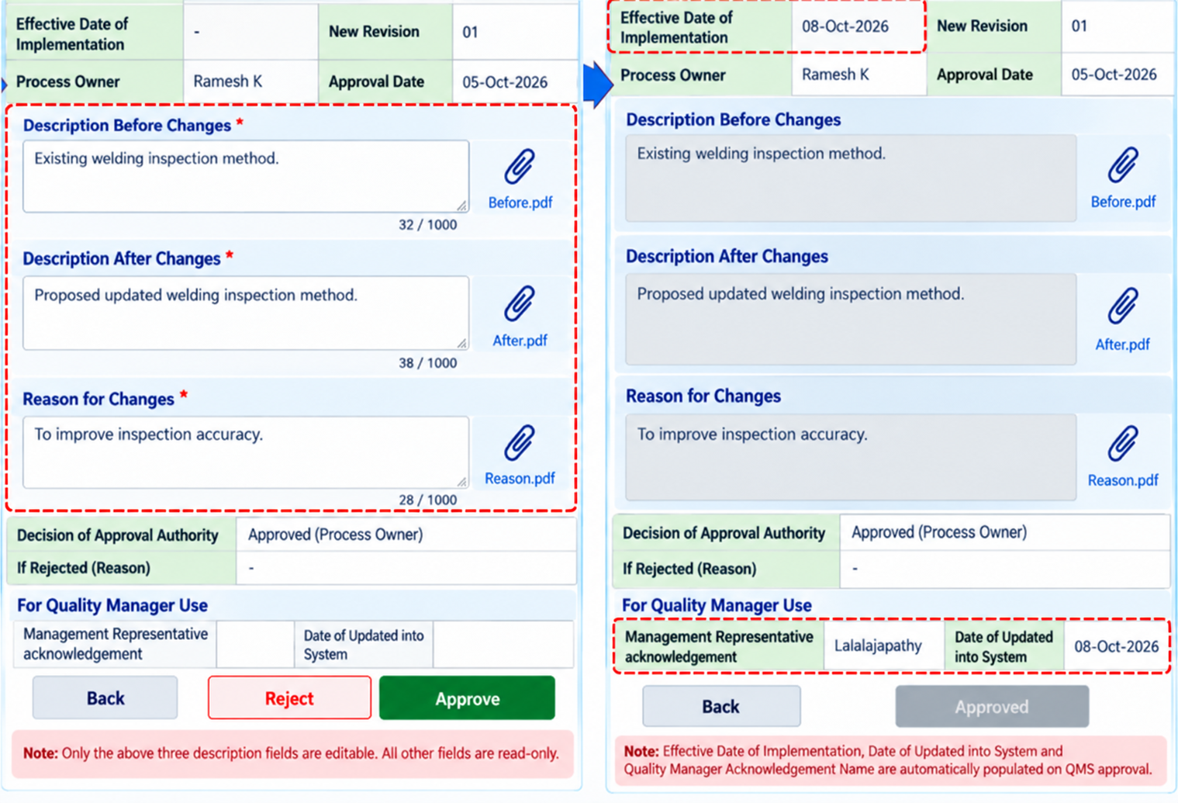
STEP : 14 DCR Acknowledgement
Once all the previous steps are completed, the application shall automatically transfer the approved DCR to the QMS user for review and approval.
The QMS user shall be permitted to edit only the following three fields:
Description Before Changes
Description After Changes
Reason for Changes
Once the QMS user approves the DCR, the application shall automatically populate the following field
Date of Uploaded into System: The current date.
The Effective Data Field ,Provide the option to manually fill by QMS
Date of Updated into System: The current date.
Quality Manager Acknowledgement Name: (default value for all DCRs).

Slide 15
STEP : 15 Auto Updating of Master List
Once the QMS user approves the DCR, the application shall automatically update the Master List accordingly.
NOW THE DCR IS CLOSED

Slide 16
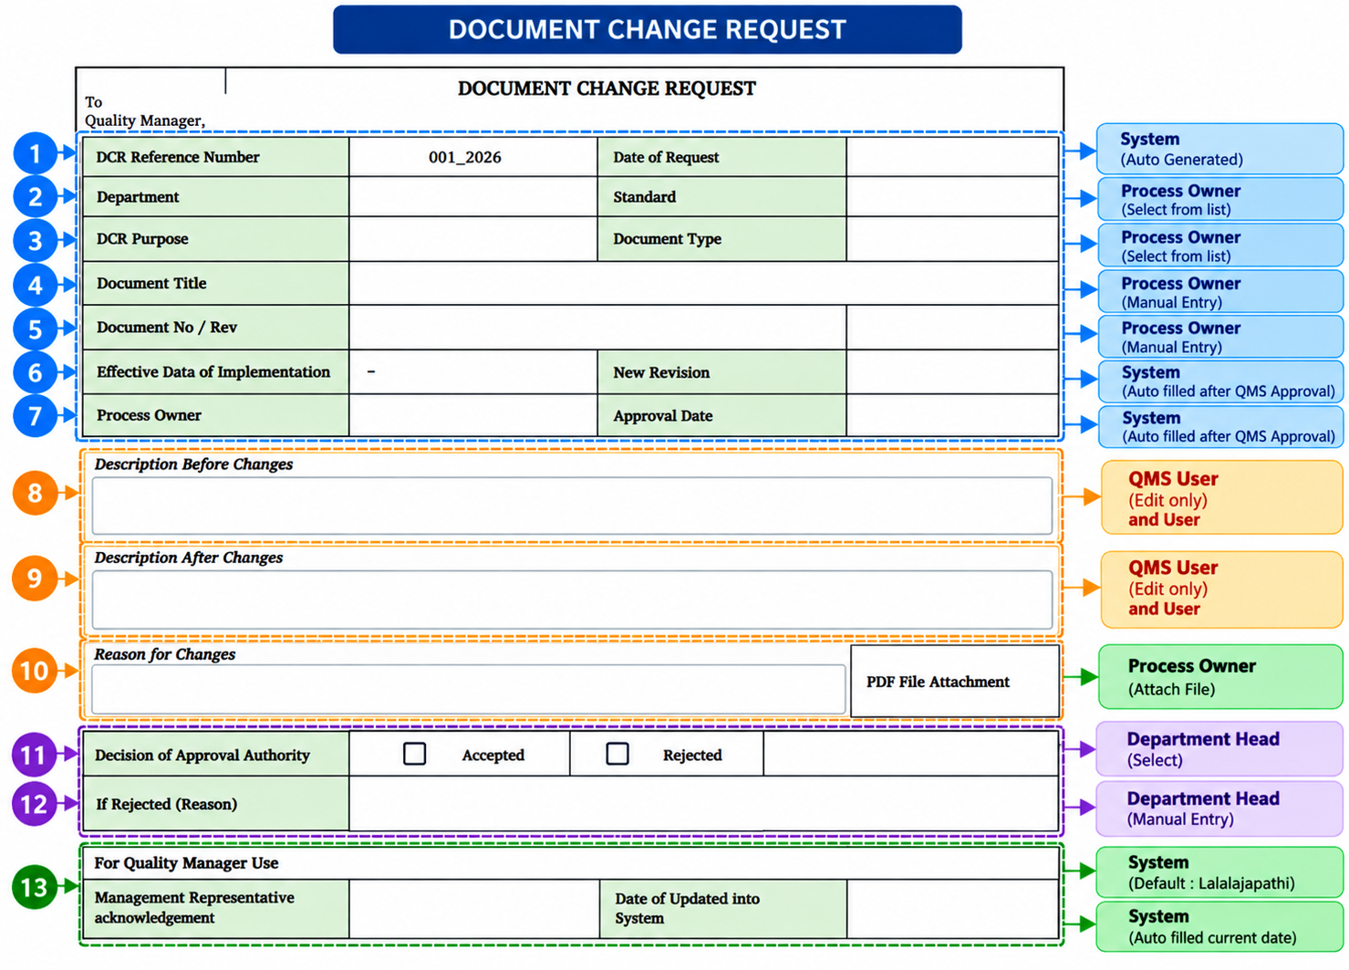

Slide 17
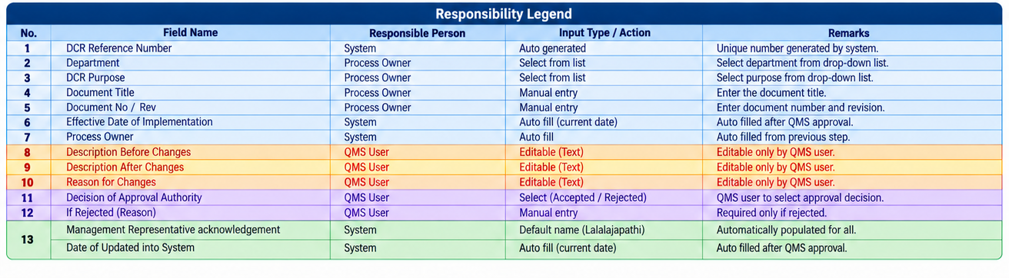

Slide 18
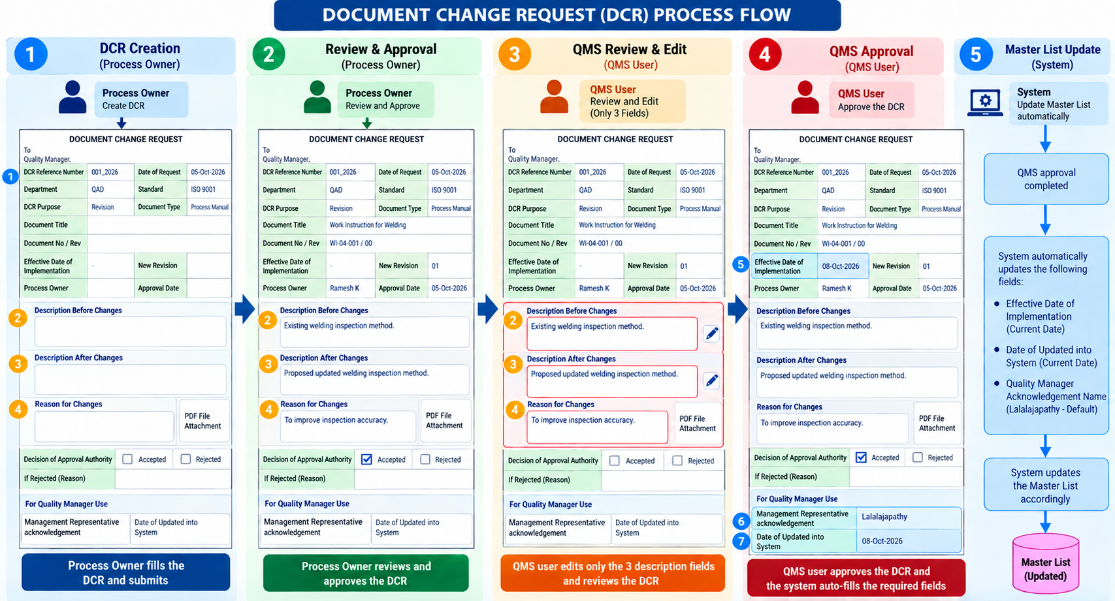

Slide 19


