Slide 1
Auto-scaling

Slide 2
Auto-scaling introduction:
A characteristic of cloud computing called auto scaling automatically modifies the quantity of processing resources in response to shifting workloads.
By scaling resources up or down according to predetermined factors like CPU use, network traffic, or other indicators, it enables systems to effectively accommodate variations in demand.
This ensures optimal performance, cost-effectiveness, and reliability without manual intervention, enabling organizations to adapt to varying workload demands in their cloud infrastructure seamlessly.
Importance of Auto Scaling:
Auto Scaling is crucial for several reasons:
Optimized Performance: Without compromising speed, auto scaling makes sure your system can manage fluctuating workloads or traffic volumes.
Cost Efficiency: By dynamically scaling resources up when demand rises and down during times of low demand, it helps in cost optimization.
Improved Reliability: By distributing workloads among several instances or servers, auto scaling lowers the possibility of system outages or malfunctions.
Scalability: With auto scaling, you can easily manage unexpected increases in workload or abrupt spikes in traffic by allowing your system to grow or shrink elastically in response to demand.

Slide 3
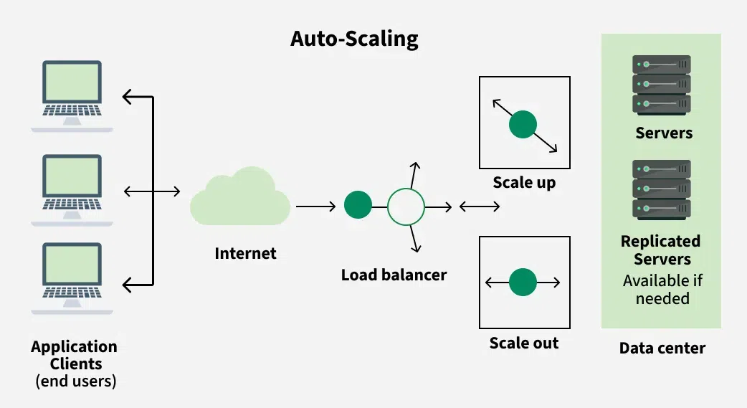
Auto-scaling Architecture

Slide 4
Two types of scaling
Horizontal and Vertical scaling
Horizontal scaling:
The increasing or decreasing the number of VM instances. It auto-scales horizontally and sometimes called as Scale-out or Scale in scaling.
Vertical scaling:
In this, we keep the same numbers of VMs but make VM more or less powerful. Power is measured as memory, CPU speed, disk space, etc. It is limited by the availability of larger hardware within the same region and usually requires a VM to start and stop. This is sometimes called Scale up or scale downscaling. Below are the steps to achieve vertical scaling.
Setup Azure automation account
Import the Azure Automation Vertical scale runbooks into our subscriptions.
Add a webhook to our network.
Add an alert to our Virtual Machine.

Slide 5
Key Components of Auto Scaling:
Launch Configuration: This sets the guidelines for the instances that Auto Scaling will launch. It includes details like the Amazon Machine Image (AMI), instance type, key pair, security groups, and block device mapping.
Auto Scaling Groups (ASG): ASGs are groups of instances that Auto Scaling manages together. They specify the minimum, maximum, and desired number of instances, along with the scaling policies that dictate how to adjust the number of instances.
Scaling Policies: These rules determine when and how Auto Scaling should add or remove instances in an ASG based on certain metrics, such as CPU usage, network traffic, or custom metrics from CloudWatch.
Scaling Cooldowns: Cooldown periods help prevent sudden changes in the number of instances by imposing a waiting period between scaling actions. This stabilizes the system and minimizes unnecessary adjustments.
Health Checks: Auto Scaling conducts health checks on instances to make sure they are operating correctly. If an instance fails a health check, it is terminated and replaced with a functioning one.

Slide 6
Awscli:
AWS CLI (Amazon Web Services Command Line Interface) is a unified tool provided by Amazon Web Services (AWS) to manage AWS services and resources from the command line. It allows users to interact with AWS services directly through their terminal or command prompt, providing a powerful alternative to the AWS Management Console for performing various tasks.
Key Features of AWS CLI:
Command-Line Access:
AWS CLI provides command-line tools for managing and interacting with various AWS services such as EC2 (Elastic Compute Cloud), S3 (Simple Storage Service), IAM (Identity and Access Management), Lambda, and more.
Automation:
It helps automate AWS service management by scripting commands and integrating AWS actions into CI/CD pipelines. For example, you can create, manage, and terminate instances, upload files to S3, or manage IAM users and policies—all using simple CLI commands.
Cross-Platform:
AWS CLI is available for multiple platforms, including macOS, Linux, and Windows, making it widely accessible.

Slide 7
Configuration:
After installation, the AWS CLI requires configuration, where you set up access keys, region, and output format to interact with AWS resources. This can be done via the aws configure command, which will prompt you to enter:
AWS Access Key ID
AWS Secret Access Key
Default region name
Default output format (e.g., JSON, text, or table)
Multi-Service Support: The AWS CLI provides access to a large number of AWS services, enabling operations on:
Compute (e.g., EC2)
Storage (e.g., S3, EBS)
Networking (e.g., VPC)
Security (e.g., IAM, Secrets Manager)
Machine Learning (e.g., SageMaker)
Databases (e.g., RDS, DynamoDB)
And many more
Interactive Commands: The AWS CLI allows for interactive shell usage, where you can issue commands one by one and get immediate results. Additionally, it supports batch commands for automating tasks like backups or updates across multiple resources.
AWS CLI v2: The latest version (AWS CLI v2) includes features like better performance, improved installation experience, and support for additional services such as AWS SSO (Single Sign-On) and Session Manager.

Slide 8
KUBECTL:
kubectl is the command-line interface (CLI) tool for interacting with and managing Kubernetes clusters. Kubernetes is an open-source platform for automating the deployment, scaling, and management of containerized applications. kubectl is the primary tool for controlling and managing Kubernetes clusters and resources.
Key Features of kubectl:Cluster Management:
You can use kubectl to connect to a Kubernetes cluster and manage its resources, such as pods, deployments, services, and more.
Resource Management: kubectl allows you to create, view, update, and delete Kubernetes resources. It works with a wide range of Kubernetes objects, including:
Pods
Deployments
Services
Config
Maps
Secrets
Namespaces
Ingresses
Volumes

Slide 9
Declarative and Imperative Commands:
Imperative Commands:
These are direct commands to create, delete, or manage resources. For example, you can use kubectl run or kubectl delete.
Declarative Commands:
These involve managing resources by defining their desired state in YAML or JSON files, which can be applied to the cluster using kubectl apply.
Context Management:
kubectl allows you to configure access to multiple Kubernetes clusters. You can switch contexts (cluster configurations) and namespaces to work with different environments.
Easy Integration:
kubectl integrates seamlessly with other Kubernetes features and tools like Helm, Kustomize, and other CI/CD tools.

Slide 10
EKS(ELASTIC KUBERNETES SERVICE)
Amazon EKS (Elastic Kubernetes Service) is a fully managed service by AWS (Amazon Web Services) that makes it easy to run Kubernetes clusters on AWS without needing to install and operate your own Kubernetes control plane or nodes. EKS handles tasks like the provisioning, management, and scaling of Kubernetes clusters, making it easier to focus on deploying and managing containerized applications.
Key Features of Amazon EKS:
Fully Managed Kubernetes Control Plane: EKS automatically manages the Kubernetes control plane, including the API server, etcd (the key-value store), and scheduler. This means you don’t have to worry about setting up or maintaining the Kubernetes master nodes.
Highly Available and Scalable: EKS is designed to be highly available, with automatic distribution of the control plane across multiple availability zones (AZs). It also supports scaling, allowing you to easily add or remove worker nodes to match your application’s needs.
Integration with AWS Services: EKS integrates seamlessly with a wide range of AWS services, including:
IAM (Identity and Access Management) for secure authentication and authorization.
ELB (Elastic Load Balancer) for load balancing across your pods.
ECR (Elastic Container Registry) for storing Docker container images.
CloudWatch for monitoring logs and metrics.
Auto Scaling to dynamically scale your node groups based on resource requirements.

Slide 11
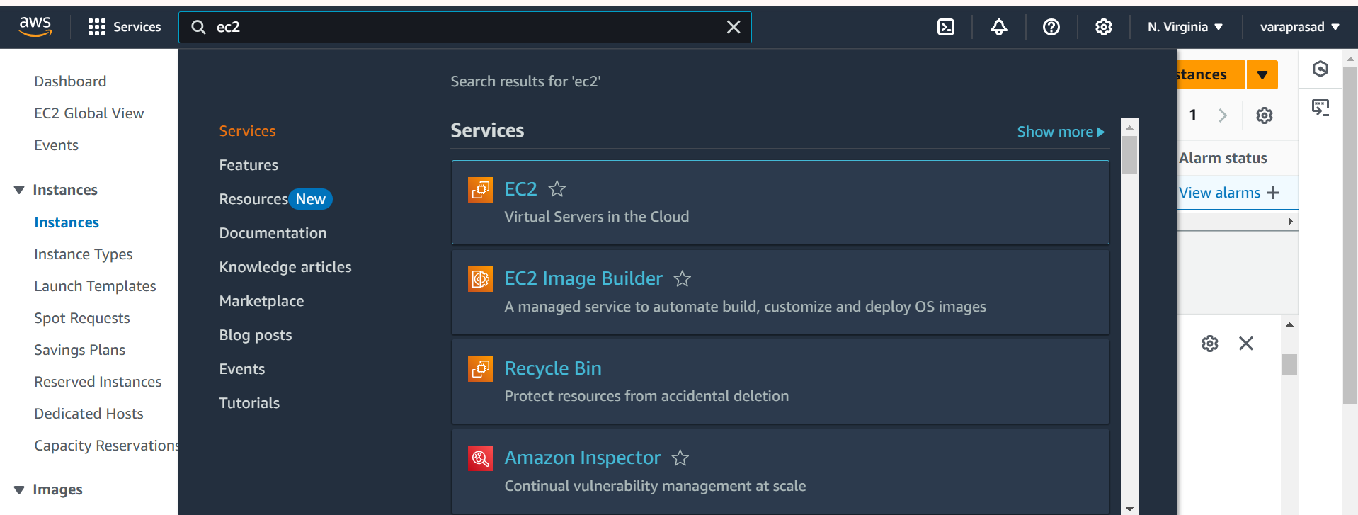
installing and Set Up EKS Cluster on AWS EC2:-​
1. AWS Account:​
Sign up for an AWS account: If you don’t already have one, create an AWS account at aws.amazon.com.​
2. AWS EC2 Instance:​
Launch an EC2 instance:​

Slide 12
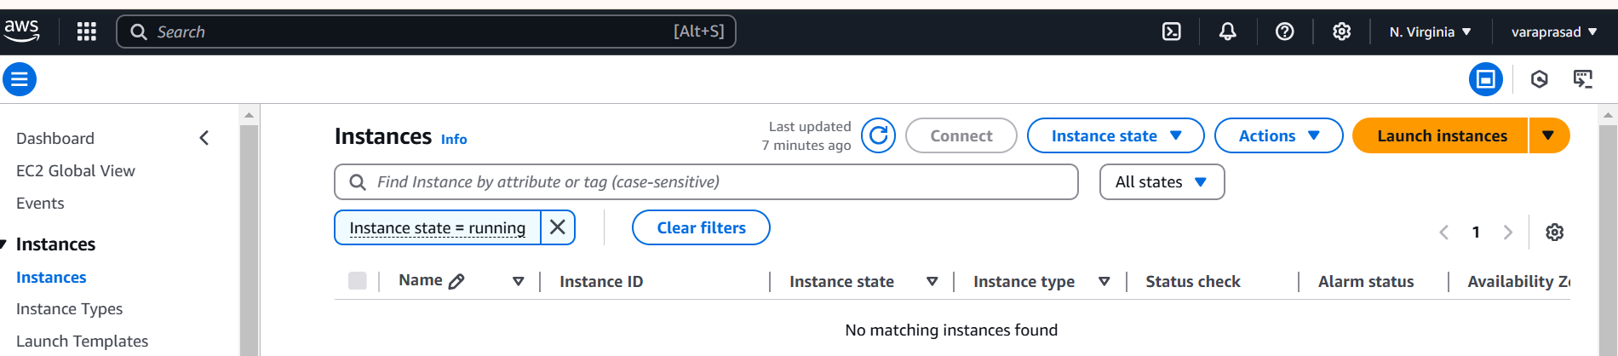
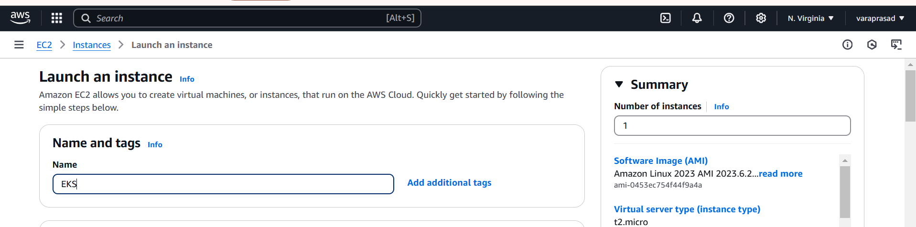
Next click on launch instance
Give to the name and tags and give name (any)

Slide 13
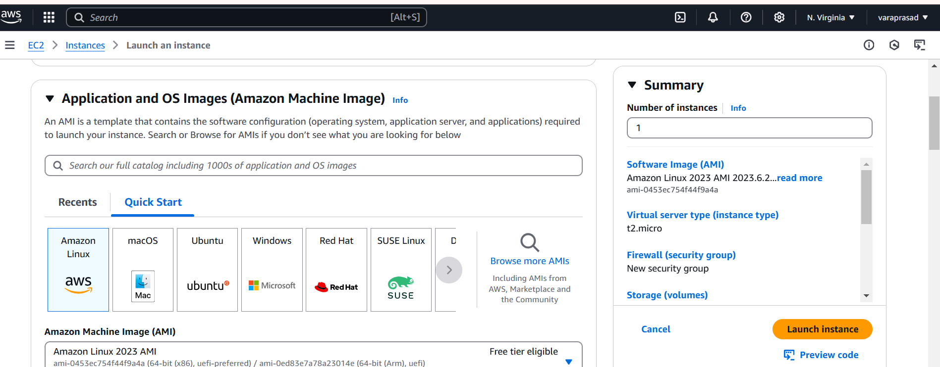
Operating System: Amazon Linux 2 AMI (HVM) - Kernel 5.10, SSD Volume Type (64-bit x86)​

Slide 14
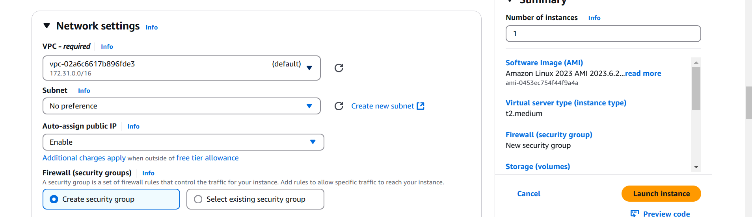
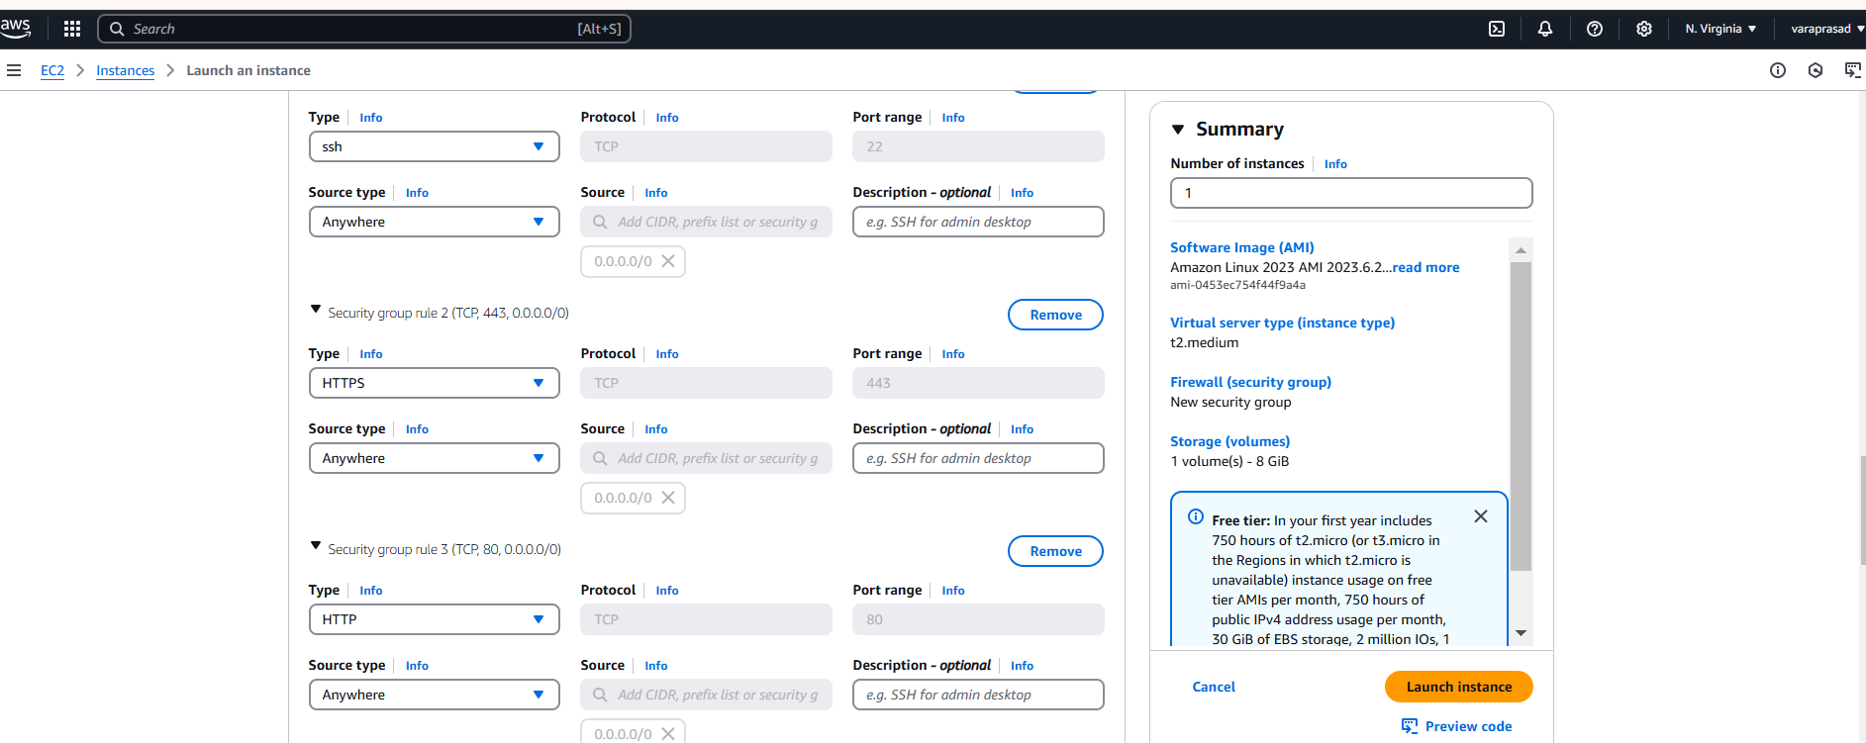
Security Group: network settings edit the auto-assign public IP as Enable. and then Allow the HTTP & HTTPS then click on Edit then add security group with All TCP then All traffic click on Launch Instance.​

Slide 15
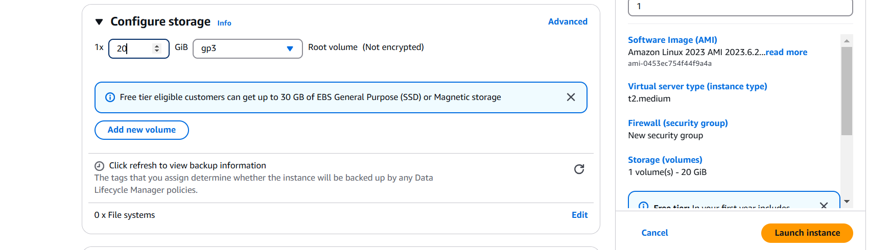
configure storage : 20 gb
And after launch instance​

Slide 16
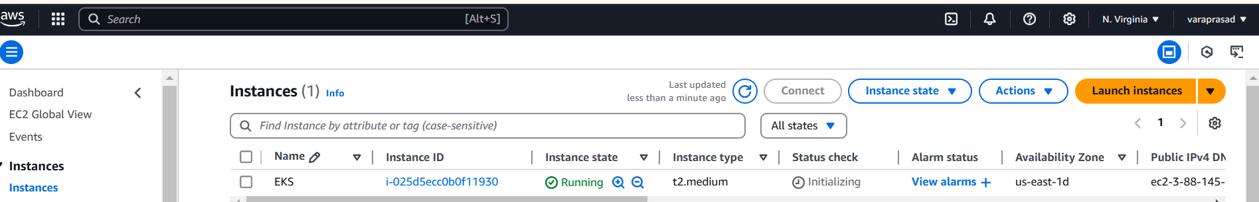
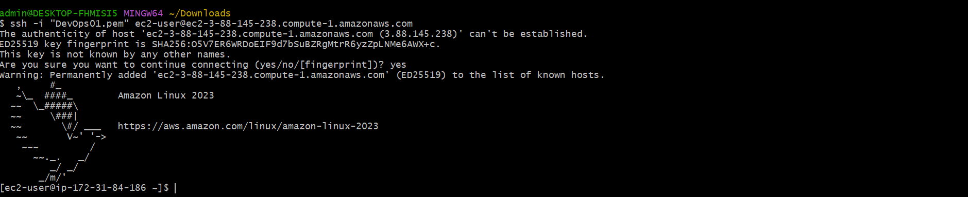
Instance has been created
Connect to instance on gitbash/mobaxterm

Slide 17
Step2: install awscli,kubectl and eksctl
Here we use this below commands
# installing AWSCLI
sudo yum update -y curl "https://awscli.amazonaws.com/awscli-exe-linux-x86_64.zip" -o "awscliv2.zip" sudo apt install unzip unzip awscliv2.zip sudo ./aws/install
Here awscli installation is successful is shown below
Configure AWS CLI
After installing AWS CLI, configure it with your AWS credentials using the following command:
Create IAM user with Administrator Access:​
You need to create an IAM user with AdministratorAccess policy.​
Go to AWS console, IAM, click on user. create a user​

Slide 18
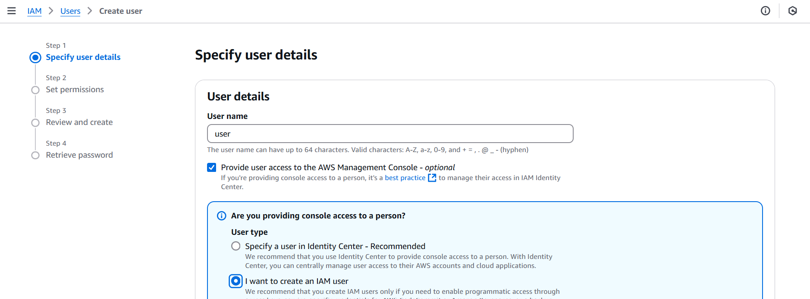
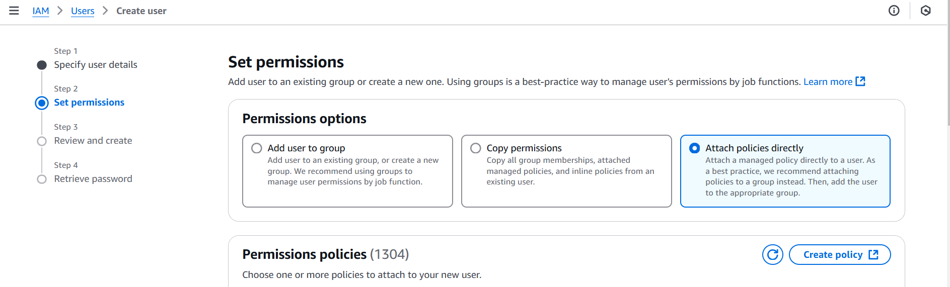
Create user give (name)
Attach policies directly

Slide 19
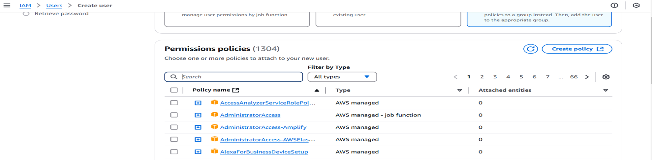
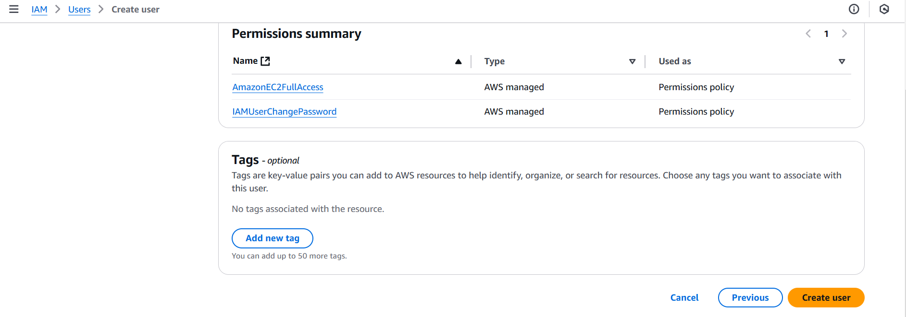
Give permissions policies (any)
Create user

Slide 20
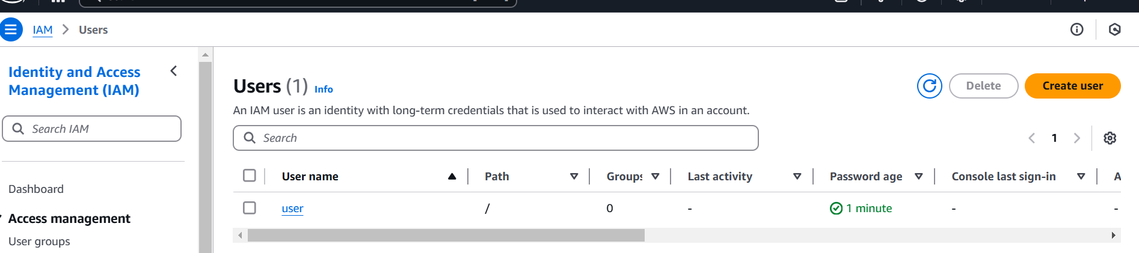
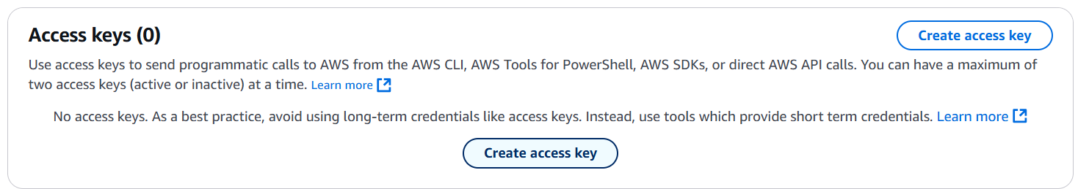
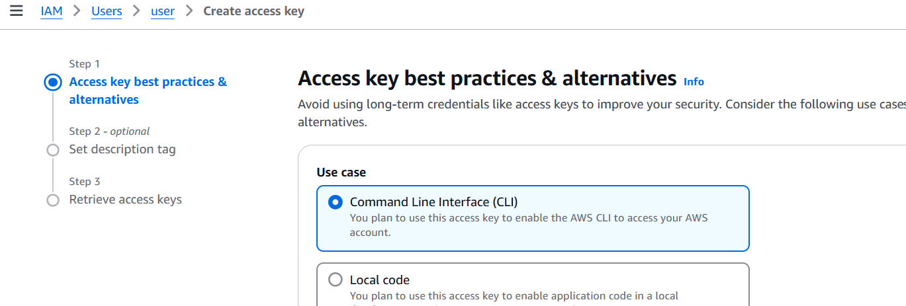
User has been created
Configure AWS CLI
Create access key awscli go to user security credentials ,create access key.
Select command line interface

Slide 21
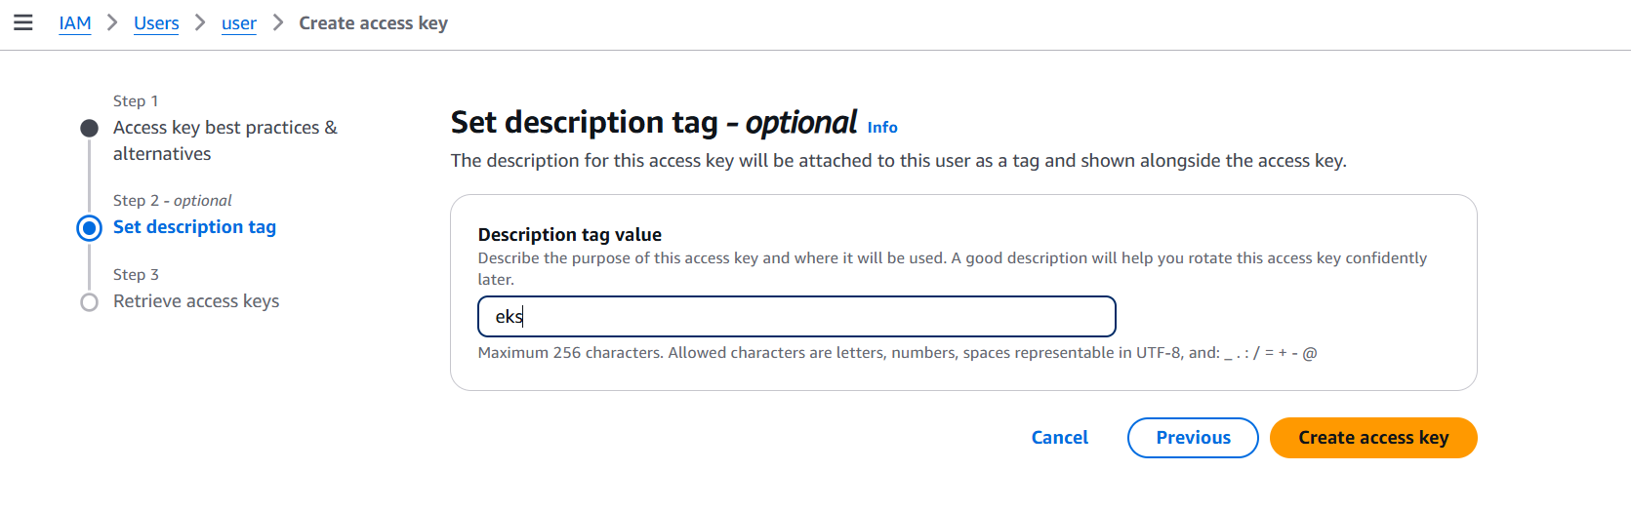
Create access key
After create a access key
Configure AWS CLI on gitbash give credentials:
Follow the below process
aws configure
AWS access key: past the first access key
AWS secret access key: paste the first secret access key
Default region name: give region where ec2 instance created
Default output format [None]: enter

Slide 22
# installing KUBECTL use below commands curl -o kubectl https://amazon-eks.s3.us-west-2.amazonaws.com/1.19.6/2021-01-05/bin/linux/amd64/kubectl chmod +x ./kubectl sudo mv ./kubectl /usr/local/bin kubectl version --short –client
Kubectl version has been installing
# installing EKSCTL use below commands curl --silent --location "https://github.com/weaveworks/eksctl/releases/latest/download/eksctl_$(uname -s)_amd64.tar.gz" | tar xz -C /tmp sudo mv /tmp/eksctl /usr/local/bin eksctl version
Eksctl has been created

Slide 23
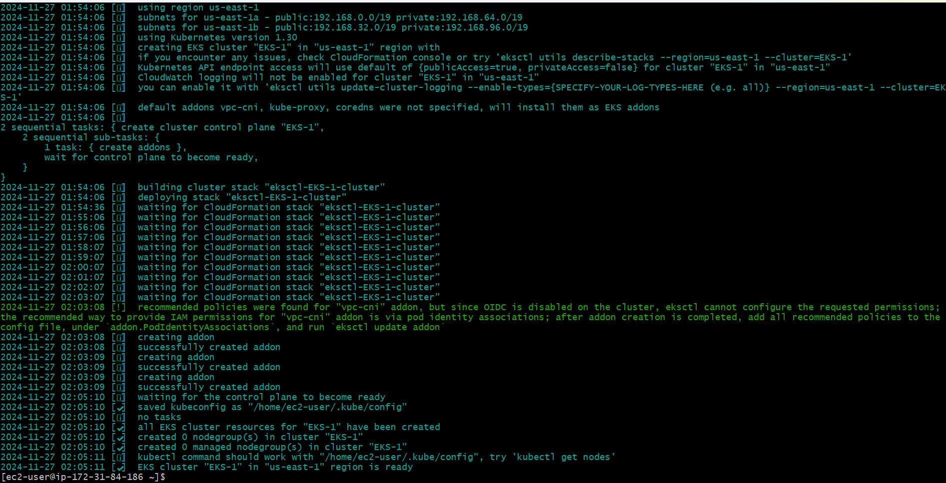
Create a eks cluster
Give the below command
eksctl create cluster --name=EKS-1 --region=us-east-1 --zones=us-east-1a,us-east-1b --without-nodegroup
the above command should create a EKS cluster in AWS, it might take 15 to 20 mins. The eksctl tool uses CloudFormation under the hood, creating one stack for the EKS master control plane and another stack for the worker nodes. ​

Slide 24
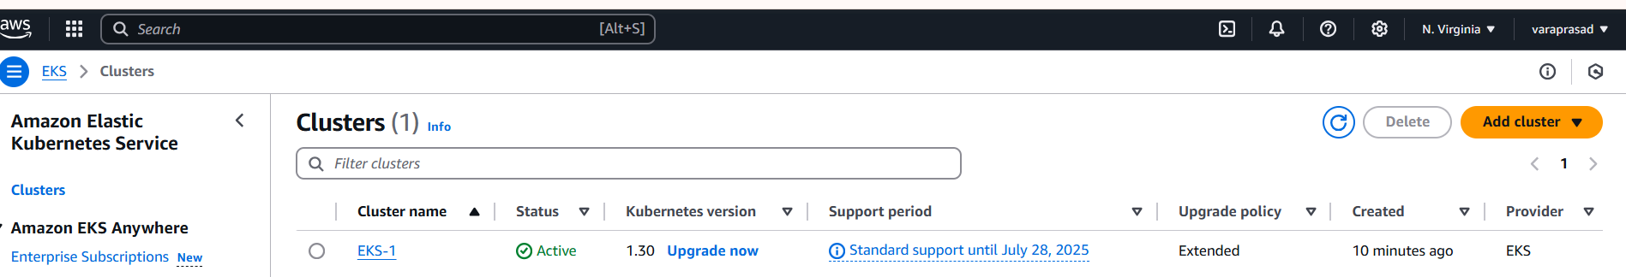
Go to the aws console and search for the EKS(elastic kubernetes service).​
select the EKS and create the cluster.​
The below image shows that the cluster is successfully created.​

Slide 25
Create IAM OIDC Provider
We associate this with EKS cluster because the service account that we are going to create within the EKS cluster can understand IAM rules
Give the below command
eksctl utils associate-iam-oidc-provider --region us-east-1 --cluster EKS-1 –approve
IAM OIDC provider has been approved has shown below

Slide 26
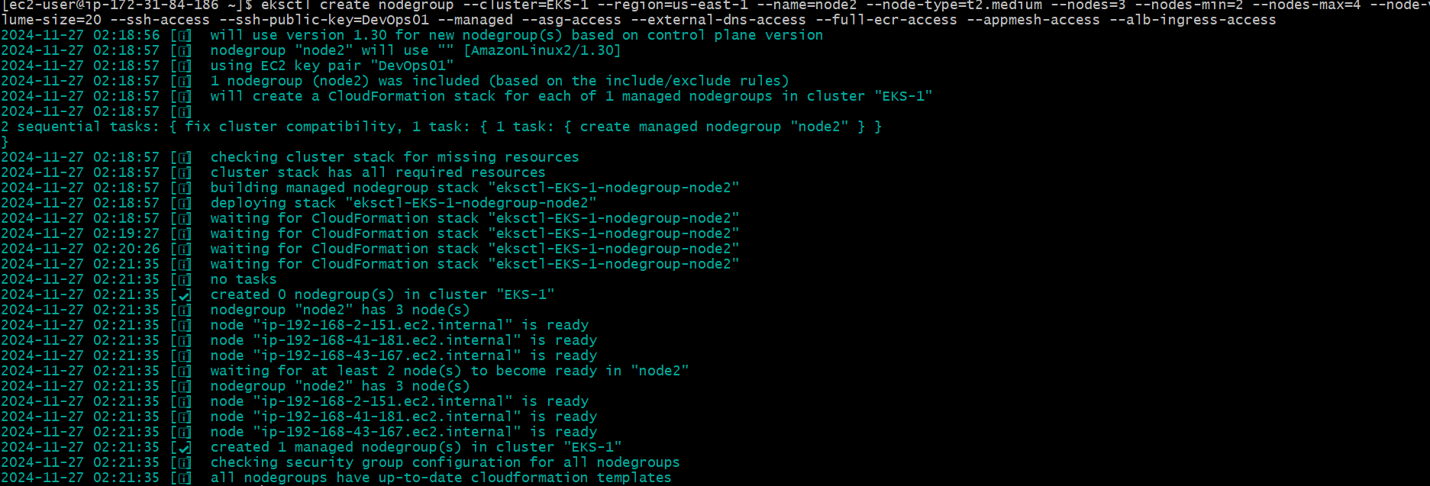
Create Node Group and Enable Auto Scaling
give the below command
eksctl create nodegroup --cluster=EKS-1 --region=us-east-1 --name=node2 --node-type=t3.medium --nodes=3 --nodes-min=2 --nodes-max=4 --node-volume-size=20 --ssh-access --ssh-public-key=mahesh-aws --managed --asg-access --external-dns-access --full-ecr-access --appmesh-access --alb-ingress-access
After running the above command:
The node group will be created, and you can check its status by using eksctl get nodegroup --cluster=EKS-1 --region=us-east-1.
Once the node group is up, you can manage the resources like any other Kubernetes node within the cluster.
As shown below

Slide 27
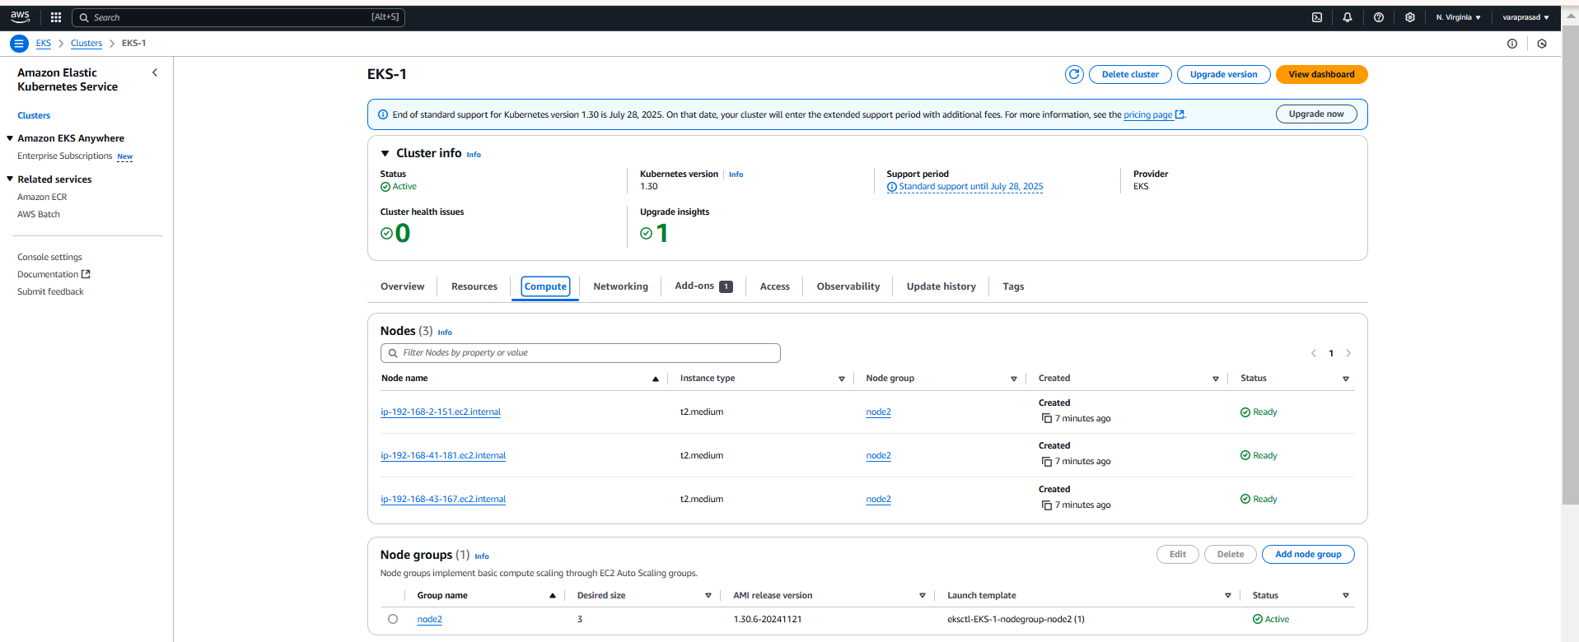
Node group has been created

Slide 28
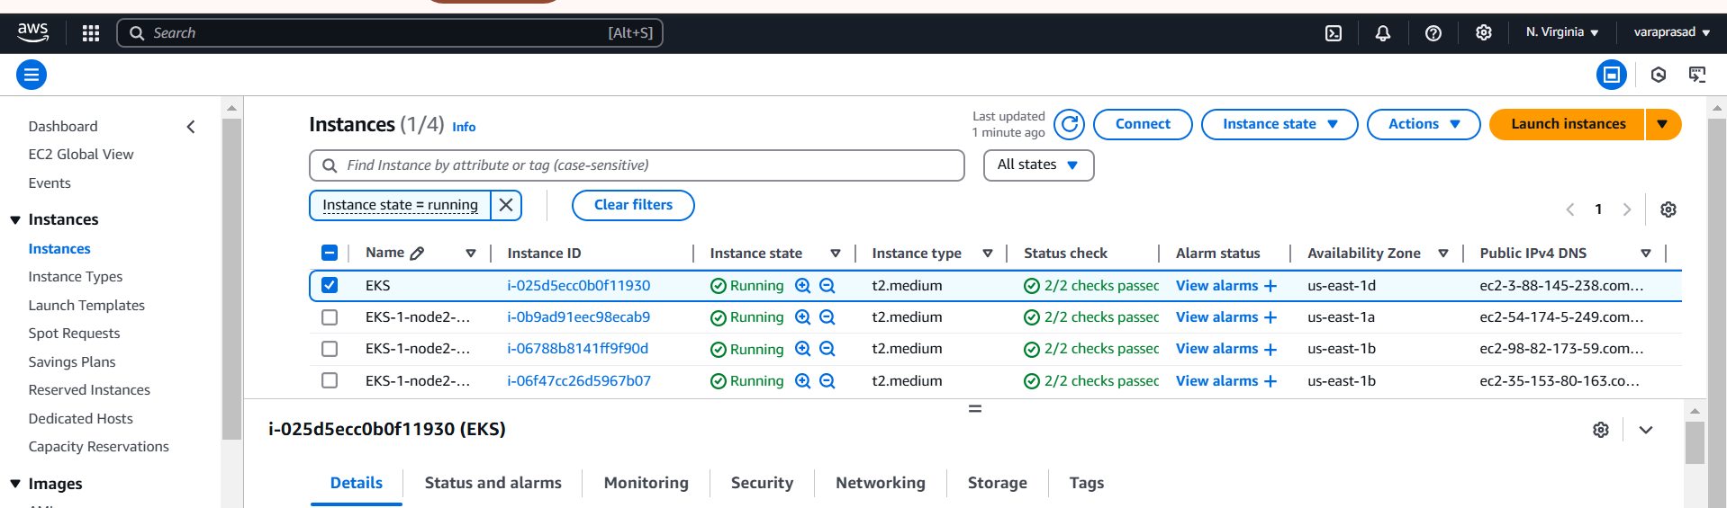
After auto-scaling instances has been created

Slide 29
Conclusion :
This combination of CLI tools empowers you to efficiently manage your AWS resources, interact with Kubernetes clusters, and create and maintain EKS clusters with ease.

Slide 30


