Slide 1

Green & More An Agricultural Website

Slide 2
Team Member
Shubham Hiraman Bharambe
Saurabh Sanjay Gade
Shailesh Ramchandra Patil
Prasad Dilip Bhandare
Under Guidance of
Ms. Yogita Chittoria
Mr. Nimesh Dagur

Slide 3
Introduction
Welcome to Green And More – your premier online agricultural marketplace, connecting farmers directly with consumers for a seamless and sustainable exchange! At Green And More, we are dedicated to revolutionizing the way you buy and sell fresh vegetables and fruits. Our platform is designed to empower farmers, providing them with a direct avenue to showcase their produce, while offering consumers the opportunity to access a wide array of locally grown, farm-fresh delights. Explore our virtual marketplace to discover a diverse selection of high-quality vegetables and fruits sourced directly from the fields of passionate farmers. Whether you're a farmer looking to reach a broader audience or a consumer seeking the freshest and most nutritious options, Green And More is your trusted hub for a direct, transparent, and mutually beneficial agricultural experience.
Our Green & More website is for farmers which will provide an opportunity to farmers to sell their produce. Farmers will not have to worry about sales, marketing, shipping, payment collection, quality, logistics, warehouse management etc.

Slide 4
Problem
Farmers often face the challenge of limited access to a wider customer base and fair pricing for their agricultural products. The involvement of middlemen and commission agents in the traditional supply chain results in reduced profits for farmers. Additionally, the lack of a direct connection with consumers hinders farmers from reaching a broader market, limiting their economic opportunities.

Slide 5
Solution
To address these challenges, the Green & More website presents a solution. This platform facilitates direct interaction between farmers and customers, eliminating the need for intermediaries. Farmers can showcase their products, set fair prices, and reach a larger audience. Customers, on the other hand, benefit from affordable prices and the assurance of purchasing directly from the source. The website's administrative features empower farmers to manage their orders and products efficiently, providing a transparent and equitable marketplace for agricultural transactions.

Slide 6
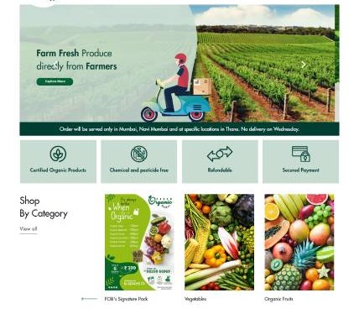
Objective
The main Purpose of the Project is to manage the details of Grocery, Customer, Order, Stock, Vegetable Item. It manages all the information about Grocery, Address, Vegetable Item, Grocery. The purpose of the project is to build an application program to reduce the manual work for managing the Grocery, Customer, Address, Order. It tracks all the details about the Order, Stock, Vegetable Item.

Slide 7
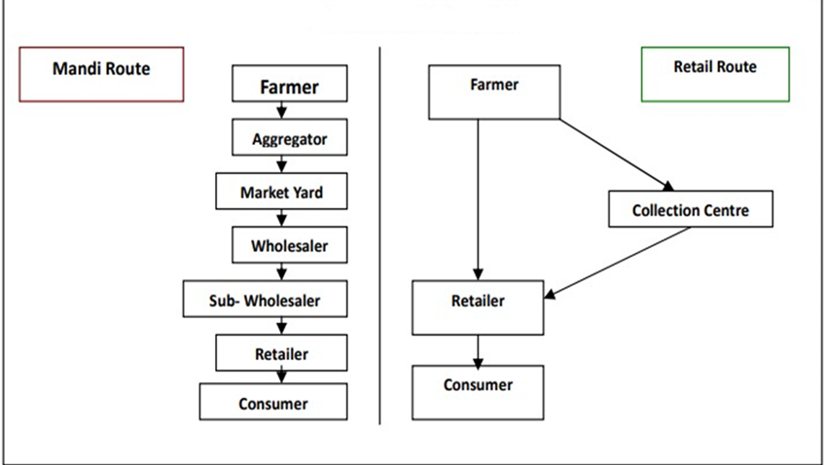
Diagram Shows How Our Project make Difference:

Slide 8
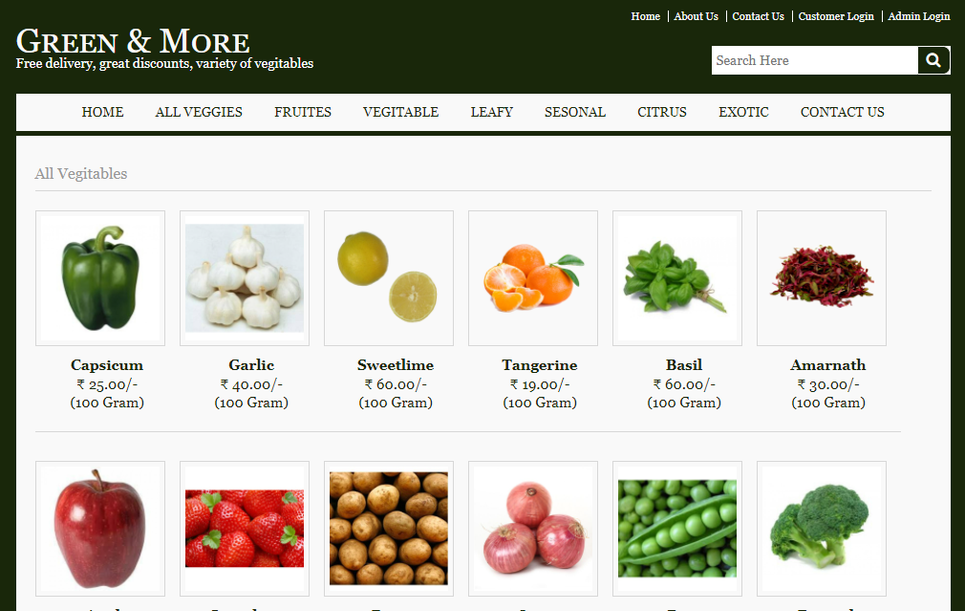
Key Features
1. Product Listings and Descriptions

Slide 9
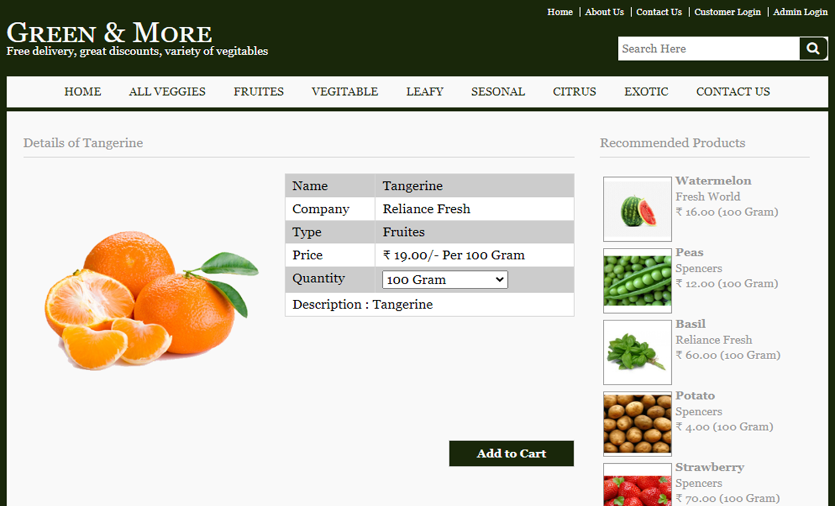

Slide 10
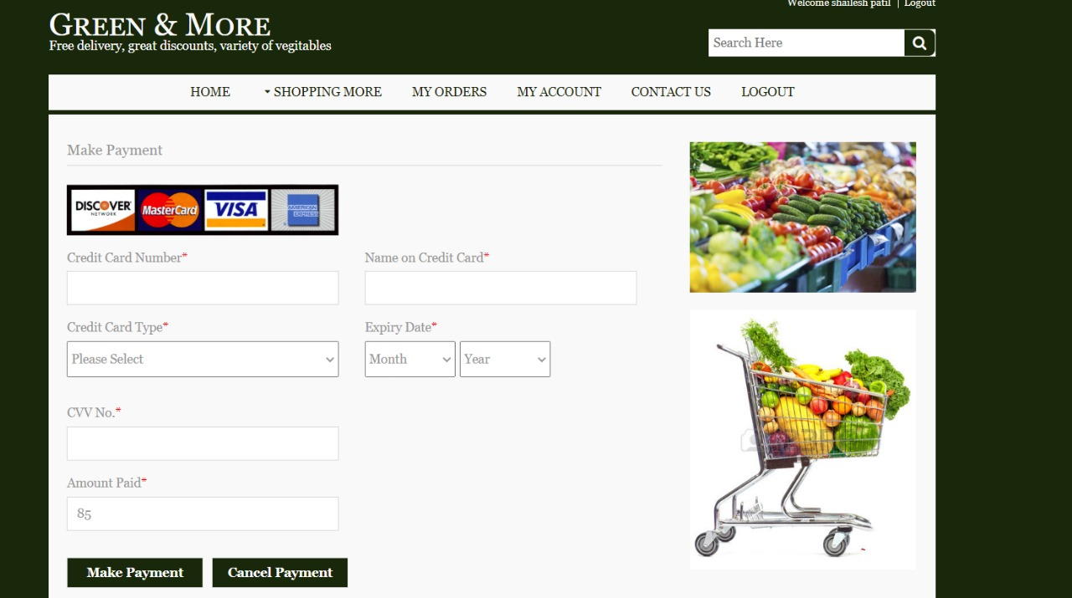
2. Online Ordering and Payment

Slide 11
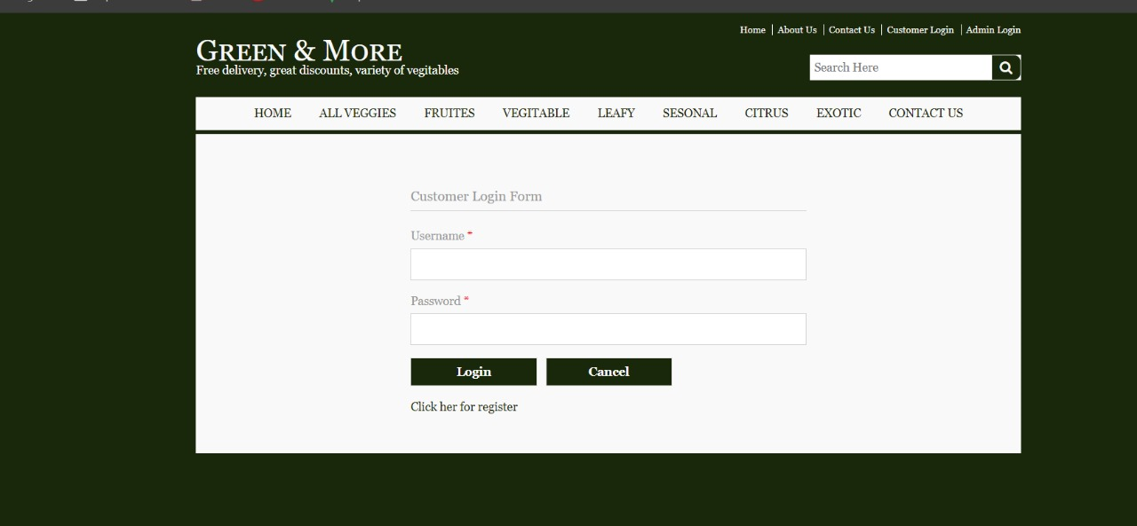
3. Admin and Customer Login

Slide 12
Secure and Efficient Delivery
feedback and suggestions
Accuracy in work.
Easy & fast retrieval of information

Slide 13
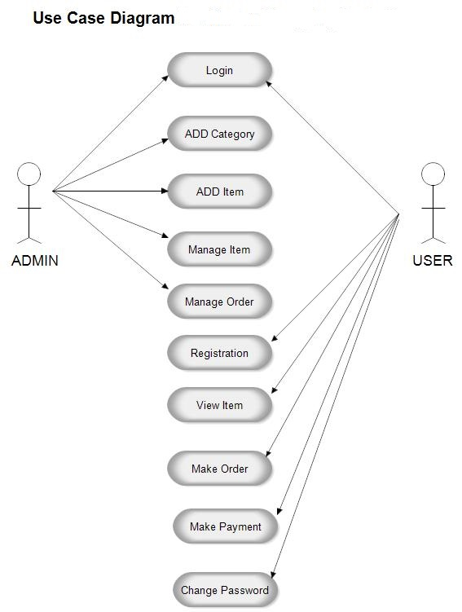
Use Case Diagram

Slide 14
Technology Used :
HTML: Page layout has been designed in HTML
CSS: CSS has been used for all the designing part
JavaScript: All the validation task and animations has been developed by JavaScript
JSP: All the front-end logic has been written in JSP
Java: All the business logic has been written in Java
MySQL: MySQL database has been used as database for the project
Tomcat: Project will be run over the Tomcat server

Slide 15
Benefits
1. Increased Market Access for Farmers
2. Convenient Purchasing for Buyers
3. Transparency and Trust in Transactions
4. Promoting Sustainable and Local Agriculture

Slide 16
Future Scope
In a nutshell, it can be summarized that the future scope of the project circles around maintaining information regarding:
We can give more advance software for our website including more facilities
We will host the platform on online servers to make it accessible worldwide
Integrate multiple load balancers to distribute the loads of the system
Implement the backup mechanism for taking backup of codebase and database on regular basis on different servers

Slide 17
Conclusion
It is possible to build an Web Site that would enable direct communication between farmers and merchants. However, such an Web Site would require a significant amount of development work and would need to be carefully designed to ensure that it is user-friendly and easy to use. Furthermore, it is important to consider the potential security risks associated with any direct communication between farmers and merchants

Slide 18

Thank You

