Slide 1




CONSTITUENCY
ACCOUNTABILITY
PLATFORM
  Team Genzet
  Durgaprasad V
  Raghuram K
  Divakar K
TEAM GENZET

Slide 2









CIVICLENS
Constituency Accountability & Civic Transparency
Connects Problems to Authorities
Full Resolution Journey
Public Accountability

Slide 3













The Broken Civic Journey
RESPONSIBILITY?
WHERE SENT?
WHO WORKING?
WHY DELAYED?
ACTUALLY FIXED?
MONEY SPENT?
Core Issue: Existing grievance systems enable complaint registration, but the complete journey from problem → responsibility → action → resolution → public accountability remains fragmented and opaque.

Slide 4










Design Thinking Approach
01
02
03
04
05
EMPATHIZE
DEFINE
IDEATE
PROTOTYPE
TEST
Understand citizens, officers, field workers & public representatives deeply.
Identify exact failure points where the civic-resolution journey breaks down.
Design smart routing, live tracking, citizen verification & performance scoring.
Build citizen app, department authority workflow & executive oversight dashboards.
Measure real usability, routing clarity & transparency across test zones.

Slide 5








Stakeholder Personas & Needs
Citizen
Low-Digital Citizen
Needs: Fast reporting + clear ownership
Needs: Assisted + local language UI
Pain: Doesn't know whom to contact
Pain: Overwhelmed by complex forms
Field Worker
Department Officer
Needs: Precise location & instructions
Needs: SLA visibility & prioritised workload
Pain: Unstructured / duplicate tasks
Pain: High volume + incomplete info
Person with Disability
Representative Office
Needs: Accessible reporting tools
Needs: Hotspot & escalation tracking
Pain: Severe accessibility barriers
Pain: Hard to spot recurring issues

Slide 6


End-to-End Solution Journey
1. REPORT
2. GIS EVIDENCE
3. CLASSIFY
4. ROUTE
5. PRIORITIZE
6. ACTION
7. LIVE STATUS
8. VERIFY
9. ESCALATE
10. ANALYTICS
Representative Oversight
Projects & Expenditure
Real-time constituency dashboards for MLAs/MPs
Link civic issues to public infrastructure funding

Slide 7












Smart Routing & Priority Model
Smart Jurisdiction Engine
Impact-Based Priority Radar
Real Example:
CRITICAL PRIORITY

Slide 8

Authority Performance Score
Civic Cases
Authority Action
Citizen Verification
Appraisal Input
Performance Factor | Weight | Impact Area
SLA Compliance Rate | 25% | Resolution within mandatory timeframe
Resolution Rate | 20% | Total closed cases vs assigned volume
Citizen-Verified Outcomes | 20% | Positive confirmation from affected citizens
Reopened / Recurring Cases | 15% | Deducted for improper initial fixes
Response Time & Status Compliance | 20% | Evidence upload & first response speed
* Safeguard Policy: The Authority Score serves as an objective, evidence-based input to formal performance appraisal — not an automatic promotion generator.

Slide 9






Citizen Verification Loop
Conventional System
CivicLens System
Authority fixes problem or claims work done.
Authority marks issue as resolved with photo proof.
No citizen feedback required. High rate of fake closures and unresolved complaints.

Slide 10
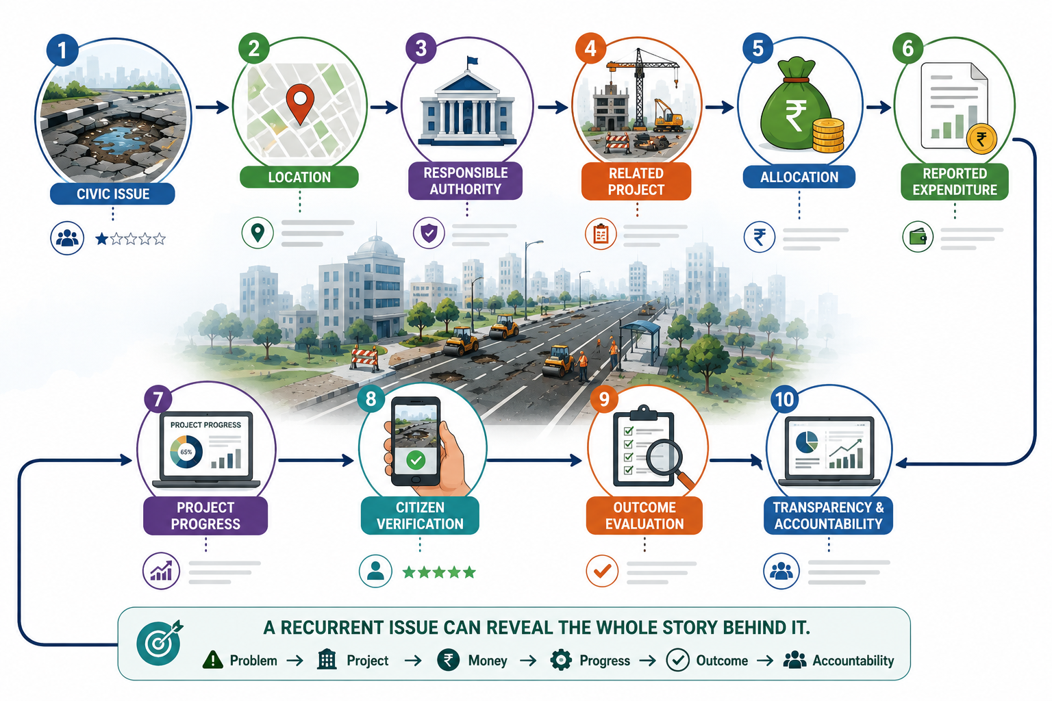
Follow Problem to Money

Slide 11


