Slide 1

Evaluating and Enhancing Flipkart Customer Experience: Strategic Insights from Feedback for Boosting Satisfaction and Repurchase Rates
Venkata Durga Prasad

Slide 2
Objective of the Analysis
Objective
The primary objective of this study is to analyze the Flipkart dataset to predict customer repurchase intentions and extract sentiment from reviews and ratings.
The analysis seeks to answer the following questions:
1
Can customer reviews and ratings predict their likelihood of repurchasing a product?
2
What is the overall sentiment of customers towards the products they purchased?
3
How do these insights inform business strategies for Flipkart?
2

Slide 3
Understanding Data
Data points and KPIs considered in the analysis
KPIs in Database
Column Name | Column Type | Details
Product Name | - | The name of the product along with some descriptive attributes.
Product Price | - | The retail price of the product.
Rate | - | The rating given by a customer.
Review | Input | A short text provided by a customer expressing their opinion about the product.
Summary | Input | A brief summary of the customer's review, possibly a headline.
Sentiment | Target | The sentiment classification of the review, categorized by the analysis.
Product Name & Type Considered
Product Type | Sandal | Cooler | Storage Drive | Home Theatre | Perfume
Product Name | Men's Black Sandals | Crompton 75 L Desert Air Cooler | Seagate Portable 2 TB External Hard Disk Drive | PHILIPS Convertible 80 W Bluetooth Home Theatre | Bella Vita Unisex 4x20ml
 | Grey Clogs Sandals | MAHARAJA WHITELINE 65 L Desert Air Cooler | Seagate Portable 1 TB External Hard Disk Drive | I Kall IK22 40 W Bluetooth Home Theatre | ENVY Men 60ml
3

Slide 4
Men's Black Sandals

Slide 5
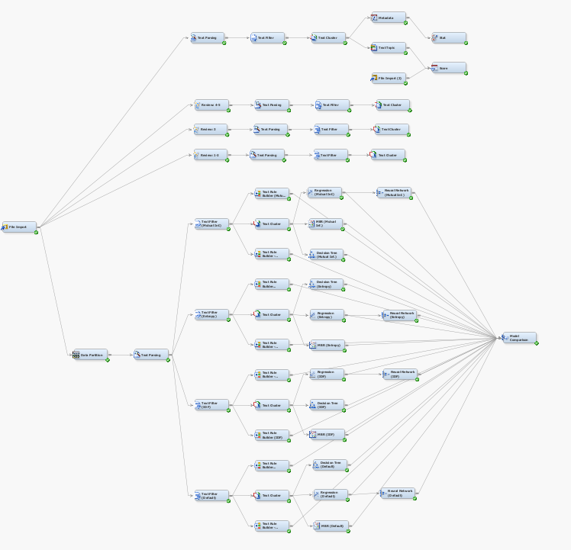
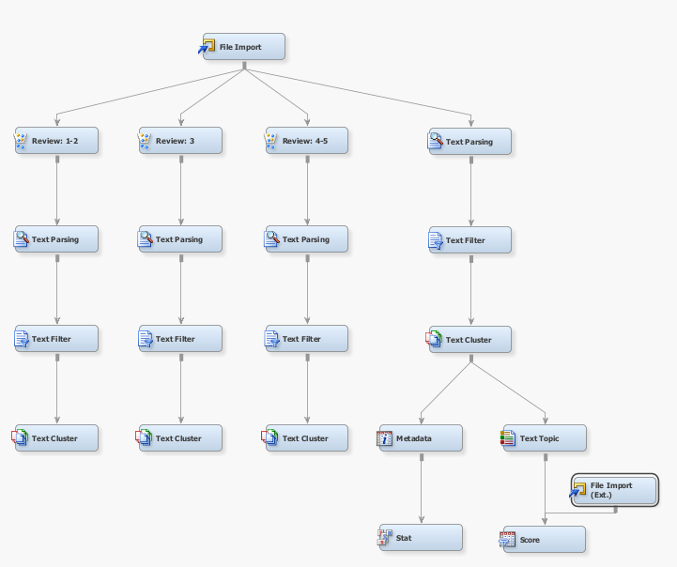

Unsupervised Modeling
Men's Black Sandals: Both supervised and unsupervised models were utilized to extract significant insights from customer reviews.
Complete Flow Diagram with Supervised and Unsupervised model
Segment of Flow Diagram with Unupervised model
5

Slide 6
Unsupervised Modeling
Men's Black Sandals: Lower ratings indicate widespread customer dissatisfaction, frequently citing the sandals' inferior or low-quality construction.
Cluster ID | Descriptive Terms
1 | +quality +dont buy 'bad quality' item 'low quality' +'product dont' +expect 'dont buy' +break +side purchase 'poor quality' +waste money
2 | good cheap +'cheap quality' +worth +look 'at all' material +sandal comfortable +minute +wear +month bad +worst +quality
3 | +product +good +'bad product' +'worst product' +bed 'good product' size 'waste product' useless bad +worst +show waste +month +damage
Review: 1-2
(n = 404)
Cluster ID | Descriptive Terms
1 | 'good product' 'heavy weight' heavy weight size good +nice comfortable +product +average
2 | +quality +look low +sandal week +average +product comfortable +bad +nice good
3 | +bad
Review: 3
(n = 94)
Cluster ID | Descriptive Terms
1 | +nice +'nice product' 'best product' amazing gud supar wow +awesome +price +product +best excellent +sandal worth beautiful
2 | +bad +price +good +product
3 | +good good +quality +super +'good product' comfortable +delivery 'good i' boy design stylish thanks 'good quality' nice item
Review: 4-5
(n = 378)
6

Slide 7
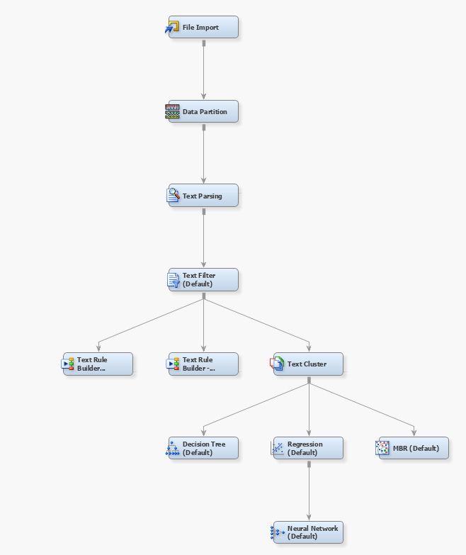
Supervised Modeling
Men's Black Sandals: Both supervised and unsupervised models were utilized to extract significant insights from customer reviews.
Complete Flow Diagram with Supervised and Unsupervised model
Segment of Flow Diagram with Supervised model
7

Slide 8
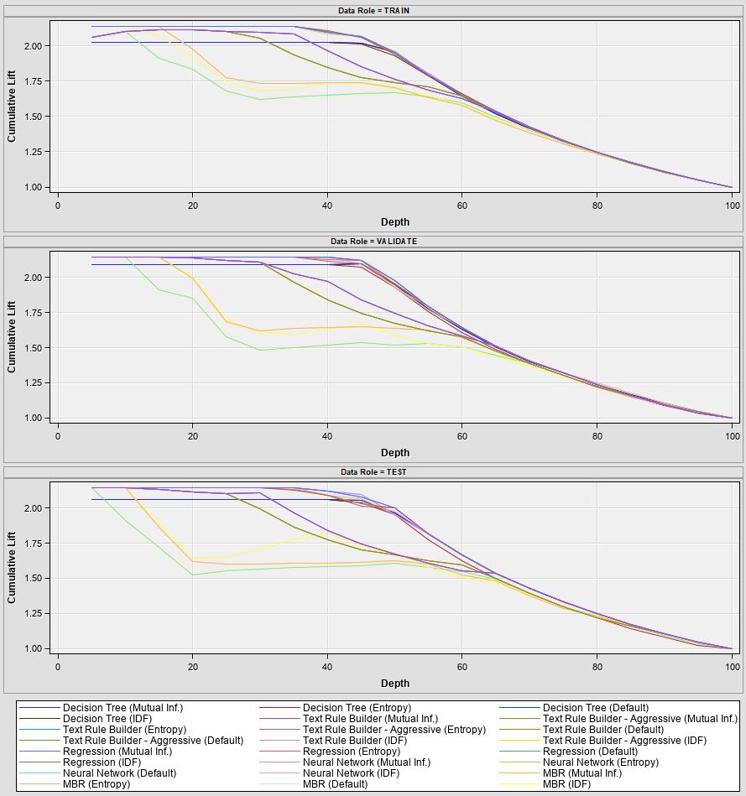
Supervised Modeling
Men's Black Sandals: Among all constructed models, the neural network and regression models demonstrated superior accuracy, reaching 92.1%
Lift Curve
 |  | Miscalculation Rate |  |  | ROC
Model | Model Description | Train | Valid | Test | Train | Valid | Test
Neural2 | Neural Network (Default) | 9.4% | 6.3% | 7.9% | 99.1% | 98.7% | 99.5%
Neural4 | Neural Network (Mutual Inf.) | 9.4% | 6.3% | 7.9% | 99.1% | 98.7% | 99.5%
Reg2 | Regression (Default) | 8.8% | 5.7% | 7.9% | 99.0% | 98.7% | 99.5%
Reg4 | Regression (Mutual Inf.) | 8.8% | 5.7% | 7.9% | 99.0% | 98.7% | 99.5%
Neural3 | Neural Network (Entropy) | 8.2% | 7.4% | 8.4% | 99.1% | 98.3% | 99.3%
Reg3 | Regression (Entropy) | 8.4% | 8.0% | 8.4% | 99.1% | 98.4% | 99.2%
Reg | Regression (IDF) | 8.4% | 8.5% | 9.0% | 99.0% | 98.4% | 99.1%
Neural | Neural Network (IDF) | 7.7% | 8.0% | 9.6% | 99.2% | 98.8% | 99.0%
Tree2 | Decision Tree (Default) | 8.2% | 7.4% | 7.9% | 96.8% | 97.5% | 98.1%
Tree4 | Decision Tree (Mutual Inf.) | 8.2% | 7.4% | 7.9% | 96.8% | 97.5% | 98.1%
Tree | Decision Tree (IDF) | 9.4% | 6.8% | 9.6% | 96.6% | 97.5% | 98.0%
Tree3 | Decision Tree (Entropy) | 7.5% | 7.4% | 9.6% | 96.8% | 96.4% | 95.8%
TextRule2 | Text Rule Builder (IDF) | 18.6% | 21.0% | 21.3% | 95.3% | 94.1% | 92.9%
TextRule4 | Text Rule Builder (Default) | 18.6% | 21.0% | 21.3% | 95.3% | 94.1% | 92.9%
TextRule6 | Text Rule Builder (Entropy) | 18.6% | 21.0% | 21.3% | 95.3% | 94.1% | 92.9%
TextRule8 | Text Rule Builder (Mutual Inf.) | 18.6% | 21.0% | 21.3% | 95.3% | 94.1% | 92.9%
TextRule | Text Rule Builder - Aggressive (IDF) | 16.1% | 20.5% | 19.7% | 94.1% | 91.9% | 91.3%
TextRule3 | Text Rule Builder - Aggressive (Default) | 16.1% | 20.5% | 19.7% | 94.1% | 91.9% | 91.3%
TextRule5 | Text Rule Builder - Aggressive (Entropy) | 16.1% | 20.5% | 19.7% | 94.1% | 91.9% | 91.3%
TextRule7 | Text Rule Builder - Aggressive (Mutual Inf.) | 16.1% | 20.5% | 19.7% | 94.1% | 91.9% | 91.3%
MBR | MBR (IDF) | 20.1% | 23.9% | 21.9% | 89.1% | 85.6% | 87.3%
MBR2 | MBR (Default) | 20.9% | 21.6% | 21.9% | 89.4% | 86.8% | 84.9%
MBR4 | MBR (Mutual Inf.) | 20.9% | 21.6% | 21.9% | 89.4% | 86.8% | 84.9%
MBR3 | MBR (Entropy) | 20.3% | 22.7% | 21.3% | 87.5% | 82.5% | 83.7%
8

Slide 9
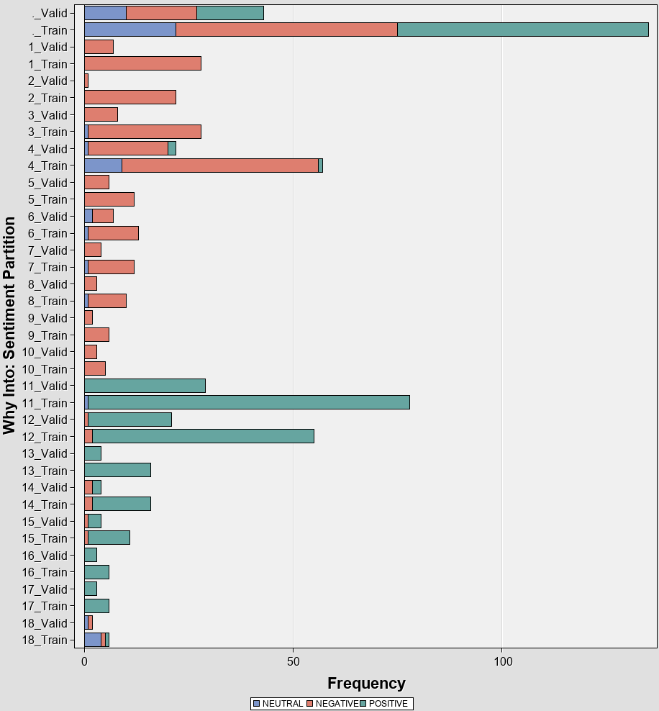
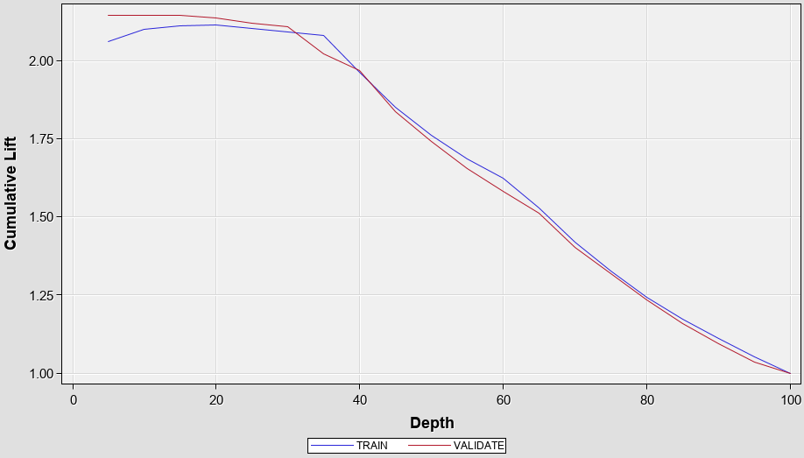
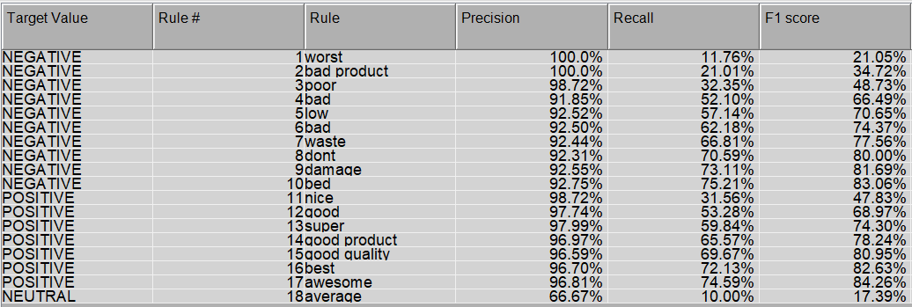
Supervised Modeling – Text Rule Builder
Men's Black Sandals: Text Builder Model with Inverse Document Frequency Configuration
Rule Success Graph
Cumulative Lift
Rules Obtained
Rule no. 11, 12, 13 and 14 are the best rules classifying reviews as positive
9

Slide 10
PHILIPS MMS8085B/94 Convertible 80 W Bluetooth Home Theatre

Slide 11
Unsupervised Modeling
PHILIPS MMS8085B/94 Convertible 80 W Bluetooth Home Theatre: Higher positive ratings indicate widespread customer satisfaction, frequently citing the sound quality
Cluster ID | Descriptive Terms
1 | +low +sound good bass poor +satisfy quality +product bad sound
2 | +buy working worst flipkart +speaker 'bad product' 'worst product' +day philips +product money waste +satisfy service bluetooth ..
3 | sound quality' sound quality 'bad sound quality' buy poor dont bad bluetooth service good waste bass money +sound
Review: 1-2
(n = 165)
Cluster ID | Descriptive Terms
1 | sound 'sound quality' +high cable +expect +month +option poor remote +connection best high increase issue low
2 | 'good sound' awesome 'good product' nice music good +product +speaker +feature +satellite average normal +sound bass audio
3 | +compare bad loud memory value money small good +lack +mention +satellite +setting bluetooth buy dont
Review: 3
(n = 77)
Cluster ID | Descriptive Terms
1 | nice +'nice product' superb gud happy +'nice sound' +amaze super +love best bad +satisfy +product performance great
2 | good awesome money value excellent +'awesome product' 'excellent product' 'best value' worth delivery clear +effect dont range +buy
3 | +good quality sound +'good product' 'sound quality' +speaker +'good sound' 'good quality' +theater home bass +system clarity music bluetooth
Review: 4-5
(n = 989)
11
Source: Flipkart Product reviews with sentiment Dataset (kaggle.com)

Slide 12
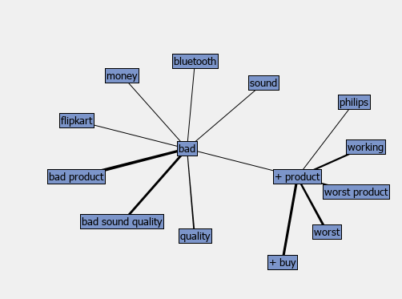
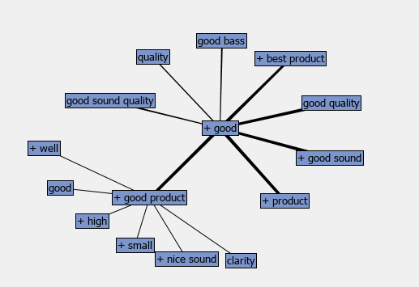
Supervised Modeling
PHILIPS MMS8085B/94 Convertible 80 W Bluetooth Home Theatre: Concept Links
For ratings 1 & 2
For ratings 4 & 5
12
Source: Flipkart Product reviews with sentiment Dataset (kaggle.com)

Slide 13
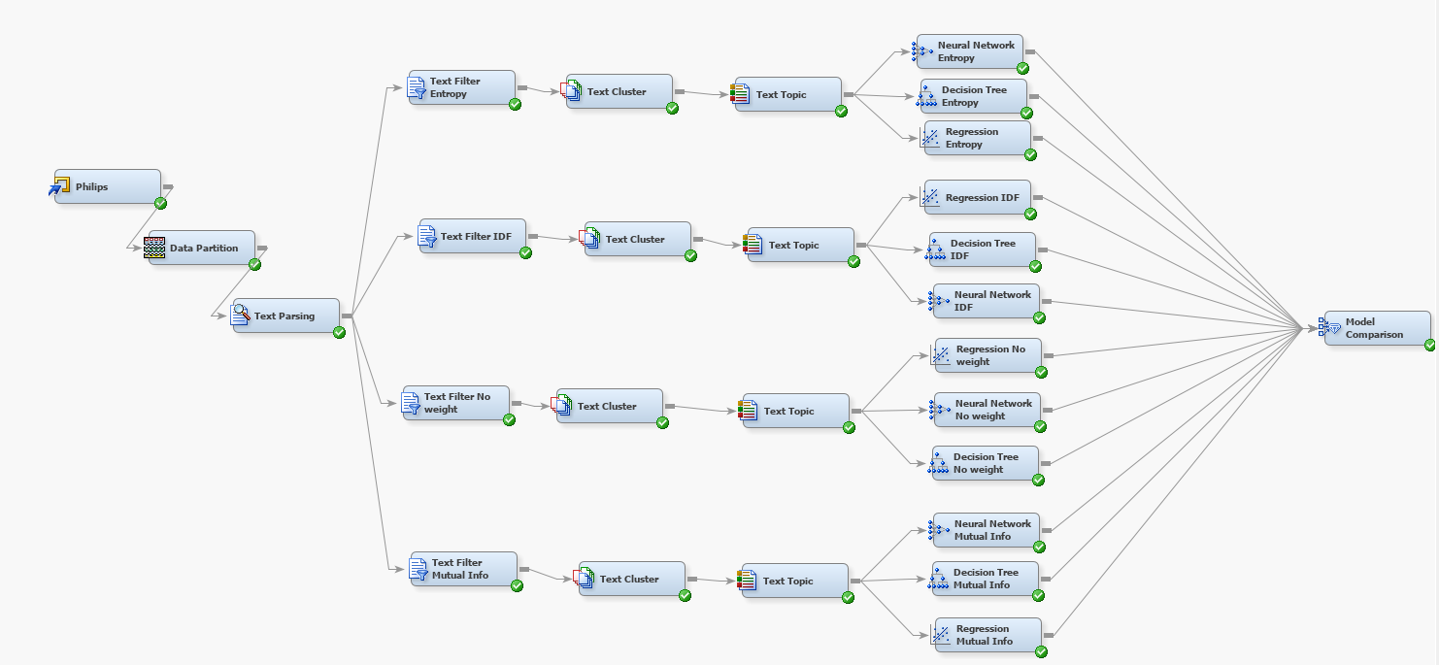
Supervised Modeling
PHILIPS MMS8085B/94 Convertible 80 W Bluetooth Home Theatre: Supervised Modelling.
13

Slide 14
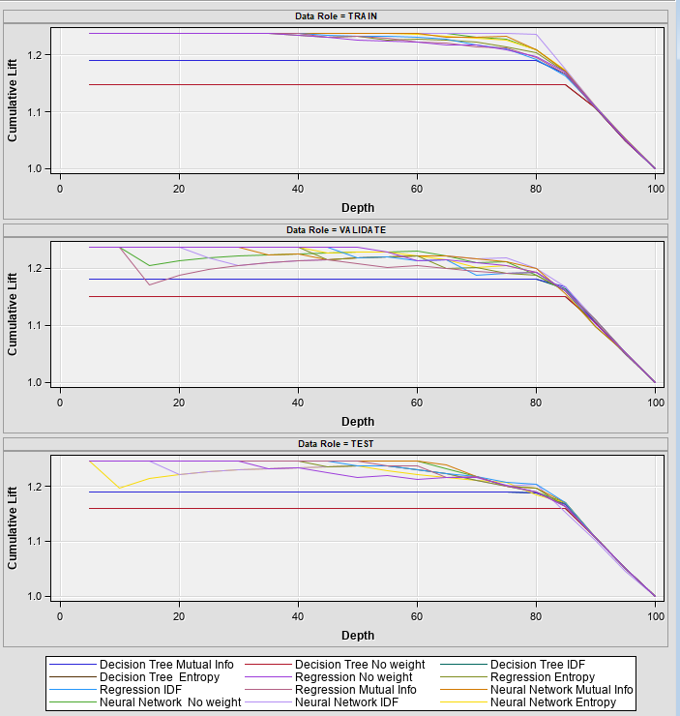
Supervised Modeling
PHILIPS MMS8085B/94 Convertible 80 W Bluetooth Home Theatre : Among all constructed models, the neural network with no weights demonstrated superior accuracy, reaching 93.15%
Lift Curve
 |  | Miscalculation Rate |  |  | ROC
Model | Model Description | Train | Valid | Test | Train | Valid | Test
Neural4 | Neural Network Mutual Info | 5.83% | 6.94% | 7.26% | 98.90% | 96.10% | 97.40%
Neural3 | Neural Network No weight | 4.88% | 6.53% | 6.85% | 99.00% | 96.00% | 97.30%
Reg2 | Regression IDF | 7.45% | 6.94% | 8.47% | 97.30% | 95.70% | 96.80%
Reg | Regression Mutual Info | 6.78% | 6.94% | 7.66% | 97.00% | 93.20% | 96.70%
Reg3 | Regression Entropy | 6.64% | 6.94% | 8.47% | 97.40% | 95.30% | 96.50%
Neural2 | Neural Network IDF | 3.79% | 7.35% | 10.48% | 99.90% | 96.00% | 95.30%
Reg4 | Regression No weight | 7.18% | 7.35% | 7.66% | 96.70% | 96.60% | 95.10%
Neural | Neural Network Entropy | 5.56% | 8.57% | 8.47% | 98.80% | 96.70% | 95.00%
Tree4 | Decision Tree Mutual Info | 6.64% | 6.53% | 7.66% | 91.20% | 89.60% | 90.10%
Tree2 | Decision Tree IDF | 6.10% | 6.12% | 7.66% | 91.20% | 89.60% | 90.10%
Tree | Decision Tree Entropy | 7.59% | 6.94% | 7.26% | 83.20% | 83.80% | 84.70%
Tree3 | Decision Tree No weight | 7.59% | 6.94% | 7.26% | 83.20% | 83.80% | 84.70%
14

Slide 15
Maharaja 65L Cooler

Slide 16
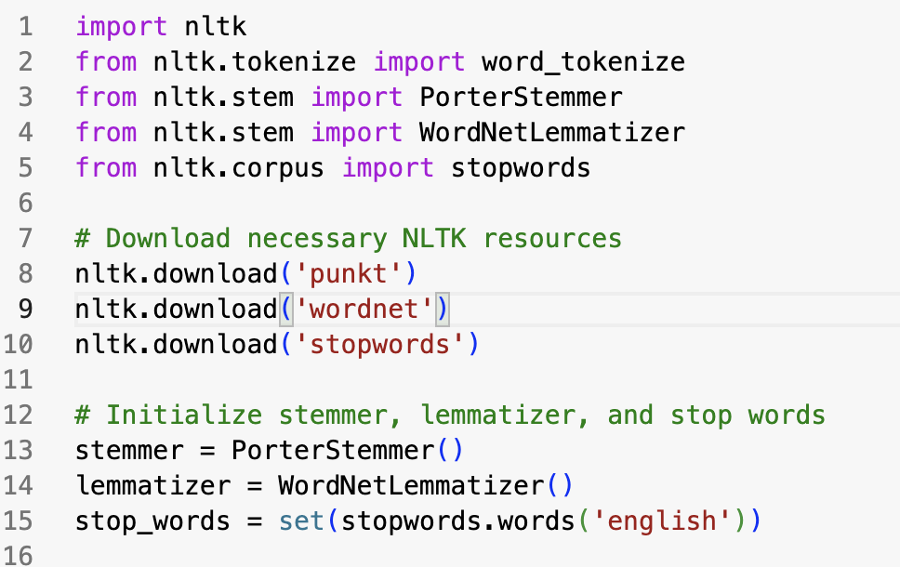
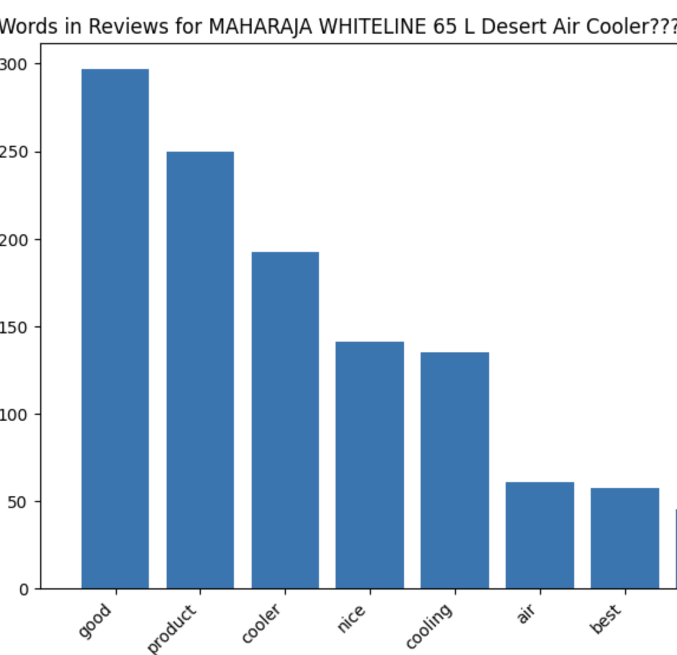
Data Processing
Pre-Processing and Exploration of Data
1. Tokenize
2. Stemming
3. Lemmatizing
4. Stop Words
16
Notes:
Used Data cleaning and Exploration through Python.
Cleaned the data ,Which consist of removal of Numbers and special character.
Using NLTK Library we can
Tokenize: splitting up a larger body of text into smaller lines, words or even creating words for a non-English language.
Port Stemmer: Remove the suffixes from an English word and obtain its stem.
Lemmatization is the process of grouping together the different inflected forms of a word so they can be analyzed as a single item.
Stop words: Provided Our own stop words if required.
Right side is the words frequency in Cooler:
Words like Good Product, Nice
We can also create a dictionary to specify words like: Not Bad: Which is a positive word.

Slide 17
Unsupervised Modeling
Maharaja 65L Cooler: Lower ratings indicate disappointment with Product and Customer experience.
Cluster ID | Descriptive Terms
1 | +replace +issue bu dont automatically problem swing cant +dav +product receive +retur worst care defective
2 | +cooler review room cool +cool air +pad honey fan bad +lot +recommend +experience +disappoint +month
3 | speed delivery +service quality money +work waste good flow pump poor back low crompton properly
Review: 1-2
(n = 156)
Cluster ID | Descriptive Terms
1 | body front +write problem summer good quality average better hot motor +month cool fan noise
2 | +clean sound upto properly difficult high +big fine +wheel +work speed +finish buy design dont
3 | +look bad +expect +receive +satisfy color time water flipkart value +place +room flow money air
Review: 3
(n = 114)
Cluster ID | Descriptive Terms
1 | good +product nice +cool happy perfect +swing fantastic superb +sound awesome super plastic great capacity
2 | quality +little flow desert wheel noisy +big bit tank crompton water overall better superb +dav
3 | +cooler deliver buv flipkart +deliver money best +satisf excellent cool +work +throw awesome ventilation +value
Review: 4-5
(n = 913)
17
Notes:
Low : Bad customer experience, Fan, Noise are some keywords which focus on the Product issues.
Neutral: Average, Better words ware showing up more
Good: Awesome Ventilation, Satisfy

Slide 18
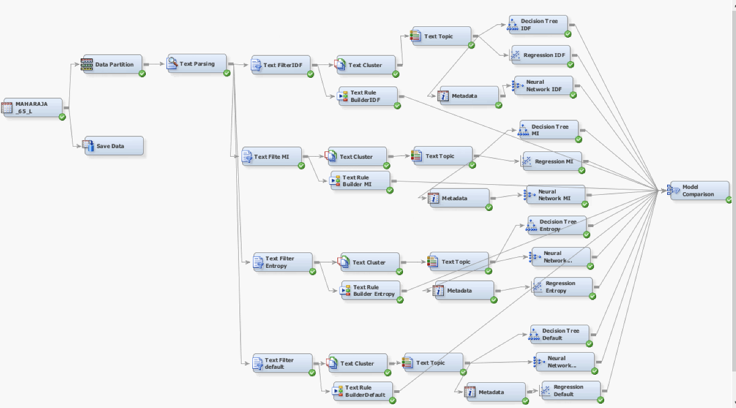
Supervised Modeling
Maharaja 65 L Cooler: Supervised Modelling
18
Notes:
Zepf Plot: when observations (e.g., words) are ranked by their frequency, the frequency of a particular observation is inversely proportional to its rank, Frequency ∝ 1 Rank
We have used the corpus file from the python and run the model:
1.Data Partitionoing 50,30,20
2.Our target variable is Sentiment and we have used Text filter IDF, Mutual information, Entropy and Default

Slide 19
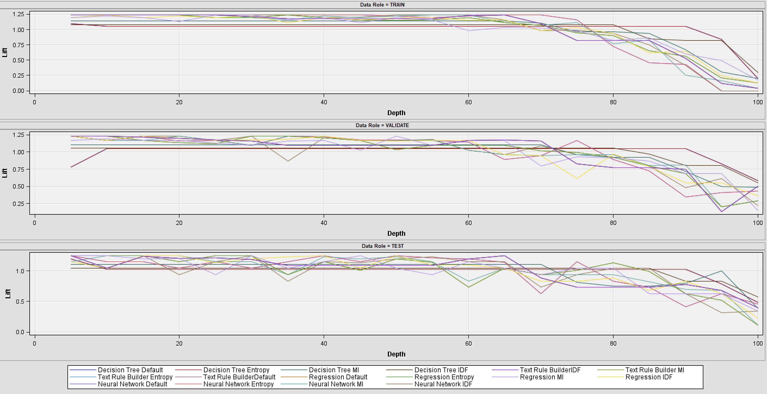
Supervised Modeling
Maharaja 65 L Cooler: Among all constructed models, regression model with entropy configuration demonstrated highest accuracy, reaching 84.5%
Lift Curve
 |  | Miscalculation Rate |  |  | ROC
Model | Model Description | Train | Valid | Test | Train | Valid | Test
Reg5 | Regression Entropy | 15.48% | 9.32% | 15.54% | 80.70% | 91.30% | 85.30%
Reg6 | Regression Default | 16.74% | 13.39% | 13.56% | 80.70% | 91.30% | 85.30%
Neural2 | Neural Network MI | 16.74% | 13.39% | 13.56% | 80.30% | 94.30% | 84.50%
Reg | Regression IDF | 17.15% | 15.42% | 15.82% | 79.50% | 88.30% | 84.80%
Reg4 | Regression MI | 17.57% | 10.51% | 16.38% | 78.40% | 84.90% | 79.80%
Neural | Neural Network IDF | 18.83% | 13.22% | 16.95% | 78.40% | 96.10% | 83.40%
Neural3 | Neural Network Entropy | 19.25% | 17.29% | 18.08% | 78.10% | 97.80% | 85.40%
Neural4 | Neural Network Default | 19.25% | 15.93% | 18.36% | 78.10% | 97.80% | 85.40%
TextRule2 | Text Rule BuilderDefault | 19.25% | 15.93% | 18.36% | 77.80% | 93.10% | 84.10%
TextRule3 | Text Rule Builder Entropy | 19.67% | 9.83% | 14.41% | 77.80% | 93.10% | 84.10%
TextRule4 | Text Rule Builder MI | 19.67% | 9.83% | 14.41% | 77.80% | 93.10% | 84.10%
TextRule5 | Text Rule BuilderIDF | 20.08% | 10.34% | 15.54% | 77.80% | 93.10% | 84.10%
Tree4 | Decision Tree MI | 20.08% | 10.34% | 15.54% | 69.00% | 80.00% | 72.10%
Tree5 | Decision Tree Entropy | 20.08% | 10.34% | 15.54% | 60.70% | 63.40% | 54.70%
Tree6 | Decision Tree Default | 20.08% | 10.34% | 15.54% | 60.70% | 63.40% | 54.70%
Tree | Decision Tree IDF | 20.08% | 13.39% | 16.95% | 59.50% | 66.90% | 62.30%
19

Slide 20
Recommendations & Conclusions

Slide 21
Focus Areas
Product Analysis & Recommendations
Area and Products to Focus:
Product Type #1 | Product Name | Average Rating | Product Price | Focus Areas
Sandal | Men's Black Sandals | 2.9 | ₹299.00 | Poor Product Quality, Heavy Weight
 | Grey Clogs Sandals | 4.12 | ₹519.00 | Fitting issue
Product Type #2 | Product Name | Average Rating | Product Price
Cooler | Crompton 75 L Desert Air Cooler | 4.24 | ₹9,999.00 | Bad Quality, Motor, Service
 | MAHARAJA WHITELINE 65 L Desert Air Cooler | 4.06 | ₹7,999.00 | Bad Customer experience, Fan Nosie
Product Type #3 | Product Name | Average Rating | Product Price
Storage Drive | Seagate Portable 2 TB External Hard Disk Drive | 4.3 | ₹5,599.00 | §Data corruption, Connectivity issue.
 | Seagate Portable 1 TB External Hard Disk Drive | 3.8 | ₹4,449.00 | Transfer speed, Expensive
Product Type #4 | Product Name | Average Rating | Product Price
Home Theatre | PHILIPS Convertible 80 W Bluetooth Home Theatre | 4.2 | ₹6,999.00 | §Connectivity Issue
 | I Kall IK22 40 W Bluetooth Home Theatre | 3.6 | ₹1,549.00 | Deliver, Sound Quality
Product Type #5 | Product Name | Average Rating | Product Price
Perfume | Bella Vita Unisex 4 x 20ml | 4.25 | ₹577.00 | Bad Quality, not long lasting
 | ENVY Men 60ml | 4.31 | ₹361.00 | Bad Fragrance
21
Notes:
Good [morning/afternoon/evening], everyone. Thank you for joining me today. This slide presents our detailed product analysis and the strategic recommendations based on text modeling from our extensive review dataset obtained from Flipkart.
Let's dive into the findings category by category:
Product Type #1: Sandals
We start with our range of sandals. Our analysis indicates that the "Men's Black Sandals" received an average rating of 2.9, pointing towards concerns about poor product quality and discomfort due to heaviness. Conversely, the "Grey Clogs Sandals" fared better with a rating of 4.12, but we identified a fitting issue that requires our attention.
Recommendation: For sandals, our focus should be on improving material quality to enhance comfort and addressing sizing guidelines to ensure a better fit.
Product Type #2: Coolers
Moving on to air coolers, our models identify that the "Crompton 75 L Desert Air Cooler" and "MAHARAJA WHITELINE 65 L Desert Air Cooler" show satisfactory ratings of 4.24 and 4.06, respectively. However, we've pinpointed problems such as perceived quality, motor functionality, service, and fan noise.
Recommendation: For coolers, we recommend a rigorous quality check before dispatch, improvement in customer service responsiveness, and noise reduction technology enhancement.
Product Type #3: Storage Drives
In the storage drive category, "Seagate Portable 2 TB External Hard Disk Drive" shows a strong rating of 4.3 but is flagged for issues related to data corruption and connectivity. The "Seagate Portable 1 TB" version has a slightly lower rating and feedback about transfer speed and cost.
Recommendation: For storage drives, we suggest enhancing the data integrity checks and improving the connectivity interfaces. It's also essential to optimize the cost to make it competitive.
Product Type #4: Home Theatre
The "PHILIPS Convertible 80 W Bluetooth Home Theatre" has received a favorable rating of 4.2, with connectivity issues being a minor setback. The "I Kall IK22 40 W Bluetooth Home Theatre" falls behind with a rating of 3.6, with customer concerns focusing on delivery and sound quality.
Recommendation: In home theatre systems, we aim to streamline the delivery process and invest in advanced sound engineering to enhance user experience.
Product Type #5: Perfume
Lastly, in the perfume segment, "Bella Vita Unisex 4 x 20ml" and "ENVY Men 60ml" have excellent ratings of above 4.25. Yet, the feedback indicates issues with longevity and fragrance quality.
Recommendation: For perfumes, we need to focus on ensuring that the scent profile is long-lasting and adheres to our brand's quality standards.
To summarize, our text modeling has provided us with valuable insights into specific areas that need our immediate attention. By focusing on these targeted improvements, we can enhance customer satisfaction, reduce negative feedback, and improve our overall market standing. Our commitment to quality and responsiveness to customer feedback is pivotal in our journey towards excellence.

Slide 22
Next Steps and Business Use Cases
Next step and recommendations
Based on these insights, here are potential business use cases:
1
Product Improvement and Development: Analyzing low-rated products and negative sentiments to identify areas for product improvement and innovation.
2
Customer Segmentation: Segmenting customers based on their review sentiments and purchasing behaviors to offer personalized recommendations and promotions.
3
Targeted Marketing Campaigns: Using positive reviews and high-rated products in marketing campaigns to boost sales and brand image.
4
Competitive Analysis: Comparing sentiment and rating distributions with competitors to identify strengths and weaknesses in the market.
5
Model Integration to Flipkart System/App: Integrate the supervised text mining model into the Flipkart system to monitor product review sentiments and facilitate proactive actions based on customer feedback.
22
Notes:
As we look towards the future, it's crucial to translate our insights into tangible actions. On this slide, we outline the business use cases that can revolutionize the way Flipkart, and companies alike, operate and interact with customers.
Business Use Case #1: Product Improvement and Development Our data-driven approach uncovers the need for a renewed focus on product quality. By closely analyzing customer feedback on low-rated products, we can identify specific areas needing refinement, leading to innovation and enhancement of our product lineup.
Business Use Case #2: Customer Segmentation Understanding our customers' sentiments and purchasing patterns allows us to segment our audience effectively. This enables us to craft personalized recommendations and promotions, improving customer experience and loyalty.
Business Use Case #3: Targeted Marketing Campaigns The positive reviews are not just compliments; they are assets. By showcasing high-rated products and the glowing sentiments they've received, we can design marketing campaigns that resonate with potential customers, thereby boosting sales and enhancing our brand image.
Business Use Case #4: Competitive Analysis Our analysis does not stop within the confines of our catalog. By comparing our products' sentiment and rating distributions with those of our competitors, we can gain a competitive edge by highlighting our strengths and addressing any weaknesses.
Business Use Case #5: Model Integration to Flipkart System/App Lastly, we plan to integrate our supervised text mining model directly into the Flipkart system. This integration will allow real-time monitoring of product reviews, offering us the agility to respond proactively to customer feedback.
In conclusion, these business use cases form the bedrock of our strategic plan moving forward. By implementing these, we not only enhance customer satisfaction but also streamline our operational effectiveness and market presence.
Thank you for your attention, and I am now open to any questions or discussions you would like to engage in.

Slide 23
Thank you!

