Slide 1
W A L M A R T
OPIM 5671 – Data Mining and Business Intelligence
Team #2
Walmart Sales Prediction: Strategic Forecasting for Enhanced Retail Performance

Slide 2
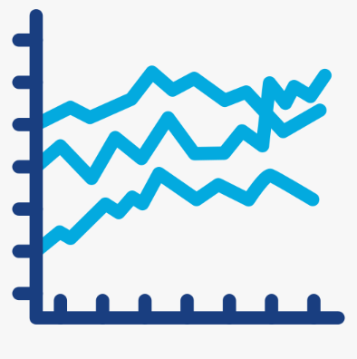


Objective of the Analysis
Executive Summary
1
Develop a sophisticated forecasting model, aiming for improved accuracy in sales predictions.
2
Assessing the Impact of Store Type and Size on total or weekly sales.
3
Identify the Key Performance Indicators (KPIs) with the most significant impact on Walmart sales.
4
Develop strategic promotional tactics tailored to the top three stores, leveraging forecasted sales data.
Temperature
Holiday
Fuel Price
Promotions
Unemployment
CPI
2

Slide 3
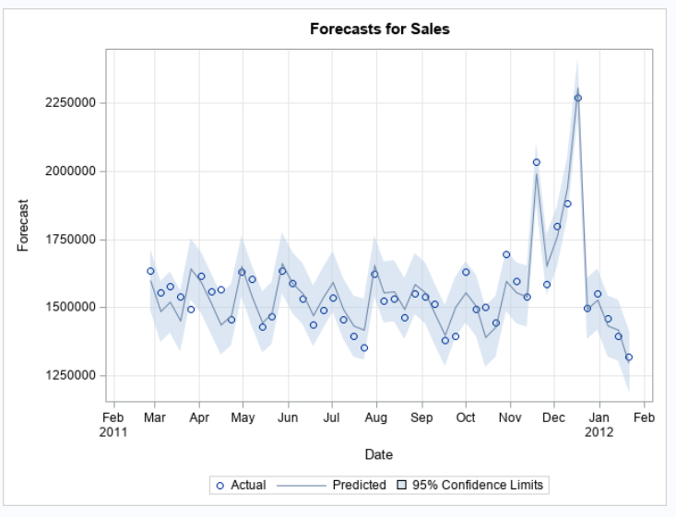



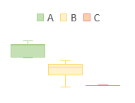
Executive Summary
Executive Summary
1
Develop a sophisticated forecasting model, aiming for improved accuracy in sales predictions.
2
Assessing the Impact of Store Type and Size on total or weekly sales.
Metric | Value
AIC | 874.1
SBC | 882.4
MAPE* | 1.21%
Monthly Sales by Store Type | Size by Store Type
3
Identify the Key Performance Indicators (KPIs) with the most significant impact on Walmart sales.
4
Develop strategic promotional tactics tailored to the top three stores, leveraging forecasted sales data.
Store A | Store B | Store C
Promotions | Promotions | CPI¹
 | Temperature
Observations | Recommendations
Bigger the size of the store, higher the sales. However, smaller stores have better “Sales per Store Size” than the larger stores. | Optimize Store Layout. Enhance customer experience. Targeted promotions. Use larger stores as community hubs for events.
3
*MAPE: Mean Absolute Percentage Error; 1: CPI: Consumer Price Index

Slide 4
Understanding Data
List of KPIs considered in the forecasting analysis
Independent X Variables
KPI Type | KPI Name | Details
Other KPIs | Temperature | The average weekly temperature at the location of the specified store.
 | Fuel_Price | The average weekly price of fuel at the location of the specified store.
 | IsHoliday | 1/0 Flag to indicate if the given week has a holiday.
 | CPI | The consumer price index.
 | Unemployment | The unemployment rate.
Promotion Based KPIs | Promotion1 | Promotional campaign run by Walmart – Type 1
 | Promotion2 | Promotional campaign run by Walmart – Type 2
 | Promotion3 | Promotional campaign run by Walmart – Type 3
 | Promotion4 | Promotional campaign run by Walmart – Type 4
 | Promotion5 | Promotional campaign run by Walmart – Type 5
More details on the data:
Time period:
Start Date: Fri, 5th Feb 2010
End Date: Fri, 27th Jan 2012
Number of Walmart Stores: 45
Number of Walmart Type: 3 (A, B, C)
Number of Walmart Stores selected in the forecasting project: 8
Dependent Y Variable
KPI Type | KPI Name | Details
Sales based KPI | Weekly Sales (in $) | Weekly sales of the given store in dollar ($)
4
Source: Walmart Sales Forecast (kaggle.com)

Slide 5
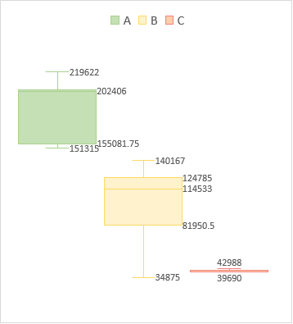
Descriptive Analysis
Type A stores are both the largest in size and have the highest number among all store types.
Monthly Avg. Sales by Store Type
Avg. Sales by Store Type & Holiday Status
Store Size by Store Type
Type A and B stores exhibit seasonality, whereas stores C shows no seasonal patterns.
Avg Weekly Sales in Dollar $
Not a Holiday | Holiday
$41,740.34 | $44,388.11
# Stores
A | B | C
22 | 17 | 6
5
Source: Walmart Sales Forecast (kaggle.com)

Slide 6
Modeling Summary
Stores 1, 11, 3, and 12 showcased the best model performance, achieving the lowest AIC and SBC scores among all stores evaluated.
 |  |  |  | Model Accessing KPIs
Type | Store No. | Model Spec. | # Independent Variables ​ | AIC | SBC | MAPE | MAE | MSE | RMSE
A | Store 1 | ARIMAX (0,0,0) (0,1,0) | 4​ | 1,144.6 | 1,153.8 | 1.24% | 19,298.7 | 1,335,866, 328.7 | 36,549.5
 | Store 11 | ARIMAX (1,0,0) (0,1,0) | 2​ | 1,107.4 | 1,114.5 | 1.60% | 21,730.7 | 1,762,922,711.1 | 41,987.2
 | Store 24 | ARIMAX (1,0,0) (0,1,0) | 1 | 1,332.2 | 1,342 | 5.21% | 74,177.1 | 9,312,309,680.6 | 96,500.3
B | Store 3 | ARIMAX (0,0,0) (0,1,0) | 4​ | 874.1 | 882.35 | 1.21% | 4,773.6 | 91,887,920 | 9,585.82
 | Store 12 | ARIMAX (0,0,0) (0,1,0) | 5​ | 1,262.5 | 1,274.2 | 1.41% | 14,522.38 | 813,792,157.29 | 28,527.1
 | Store 22 | ARIMAX (3,0,3) (0,1,0) | 9​ | 1,318.8 | 1,349.9 | 3.32% | 36,890.3 | 2,093,070,161.7 | 45,750.1
C | Store 37 | ARIMAX (4,0,4) (0,1,0) | 1​ | 1,341.5 | 1,435.2 | 5.12%​ | 1958.30​ | 14,044,815.72​ | 3,747.64​
 | Store 43 | ARIMAX (1,0,3) (0,1,0) | 1​ | 1,388.7 | 1,401.8 | 3.92%​ | 17790.91​ | 1,278,566,366.3​ | 35,757.05​
Incorporating a seasonal difference of one (D=1) at the outset significantly enhanced the performance of most models.
6
Source: Walmart Sales Forecast (kaggle.com)

Slide 7
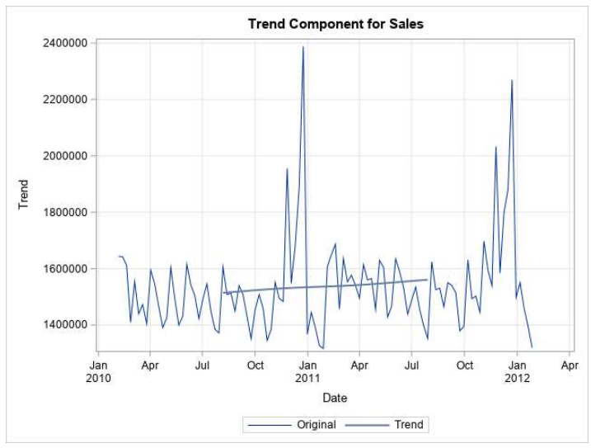
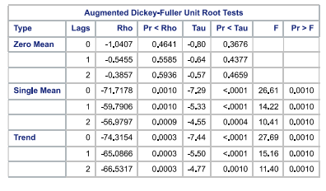
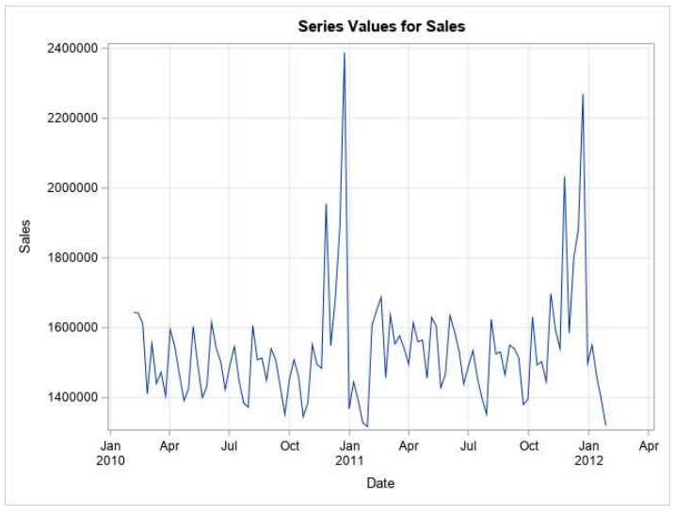
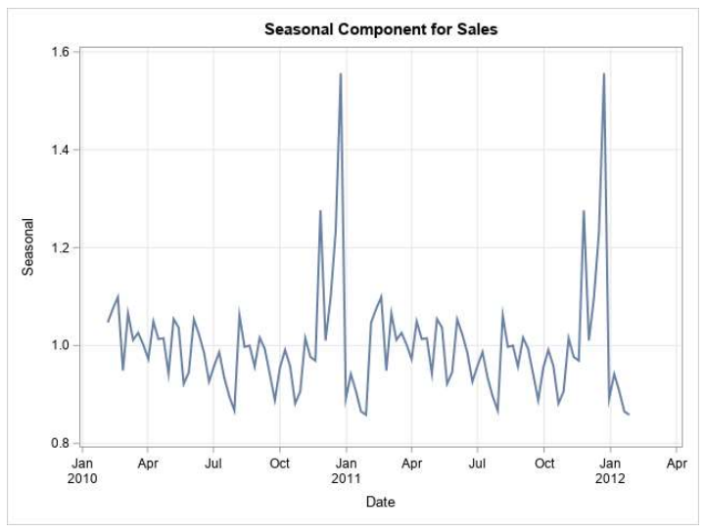
Store 1: The given time series has seasonal component, but no trend component.
Store 1: Component Analysis
Trend Component
Overall Time Series
Under the 'Trend’ and “Single Mean type”, the p-values for both Rho and Tau are less than 0.05 at all lag lengths. This suggests that once a trend is accounted for, the time series is stationary.
Seasonal Component
Walmart sales for stores 1 peaked at point instances: one during Thanksgiving week and another during Christmas holidays.
7
Source: Walmart Sales Forecast (kaggle.com)

Slide 8
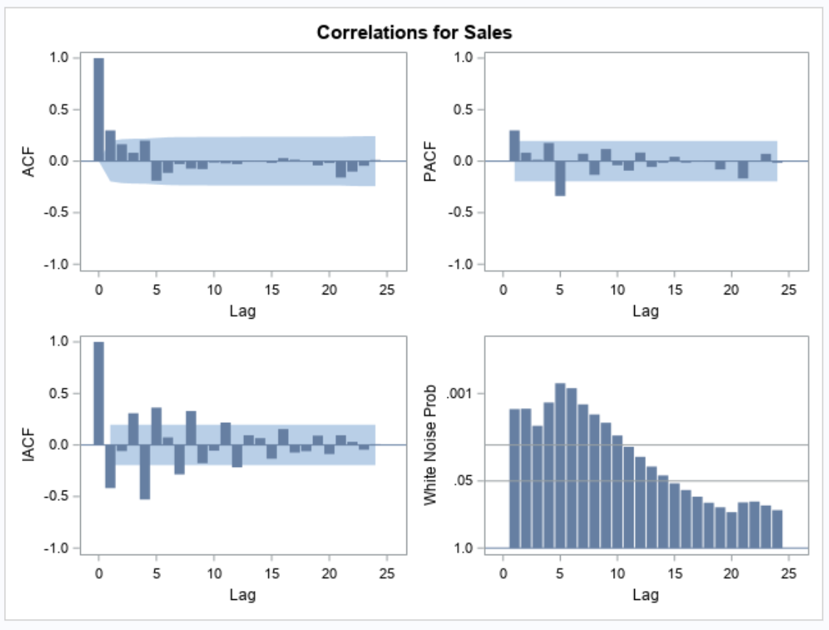
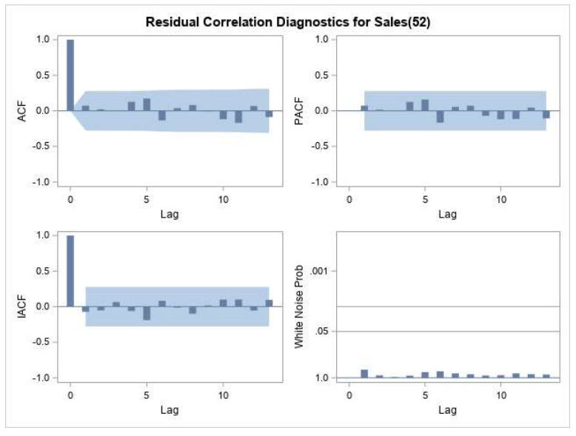
ARIMA Model: For Store 1, model performance peaked with Seasonal differencing order (D) = 1.
Store 1: ARIMA
ARIMA (0, 0, 0) (0, 1, 0)
Metric: | AIC | SBC | MAPE | MAE | MSE | RMSE
Value: | 1,293.4 | 1,295.3 | 1.50% | 23,712.15 | 1,785,525,236 | 42,255.48
8
Source: Walmart Sales Forecast (kaggle.com)

Slide 9
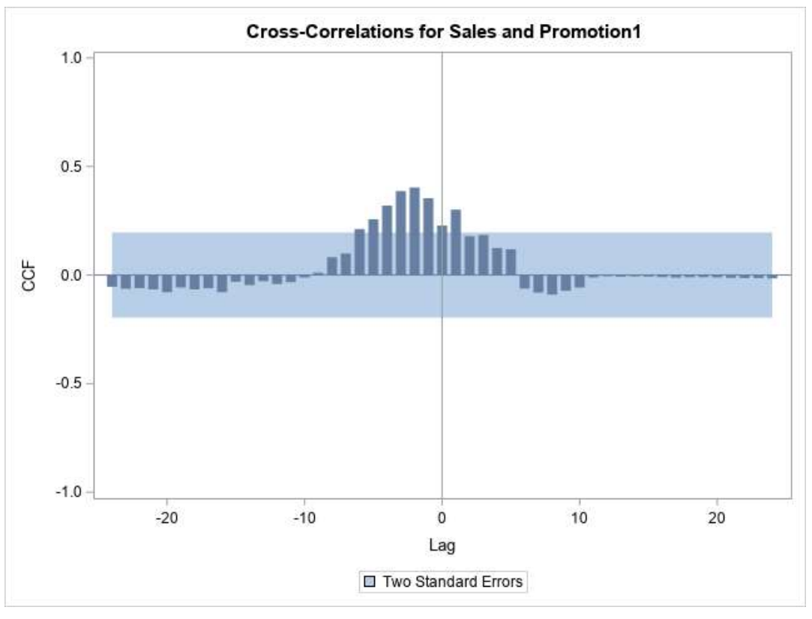
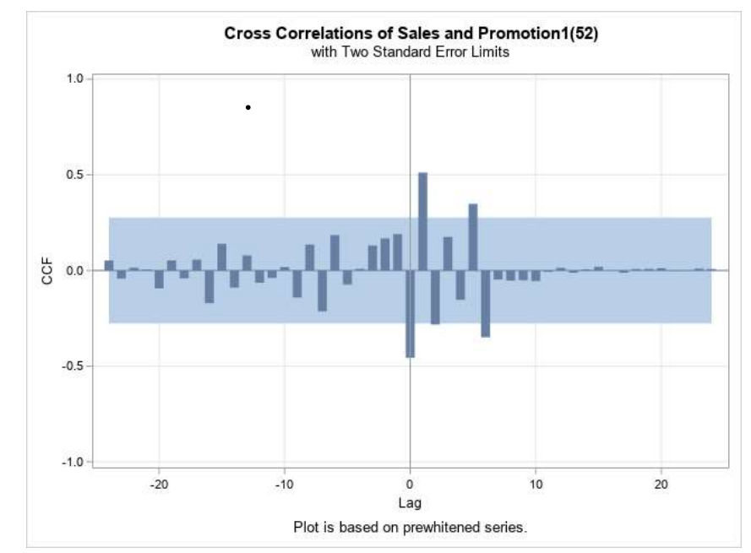
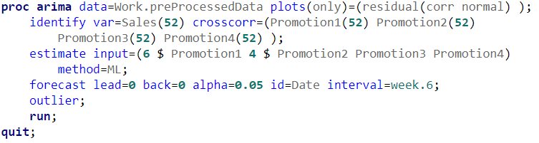
ARIMAX Model: The lagged cross-correlation indicates a potential delayed impact of Promotion1 on Weekly Sales, peaking at a lag = 6.
Store 1: ARIMAX
Cross Correlation Analysis:
Step 1: Prewhitening (Example: Promotion1)
X Variable | Cross Correlation with Sales | Prewhitining & Lag
IsHoliday | Okay | Not a time series
Size | Not Good | -
Temperature | Not Good | -
Fuel Price | Not Good | -
Promotion1 | Good | Lag at 6
Promotion2 | Good | Lag at 4
Promotion3 | Good | Lag at 0
Promotion4 | Good | Lag at 0
Promotion5 | Not Good | -
CPI | Not Good | -
Unemployment | Not Good | -
Prewhitening
Lag of 6
Step 2: Adjusting the lag effect in the modeling code
9
Source: Walmart Sales Forecast (kaggle.com)

Slide 10
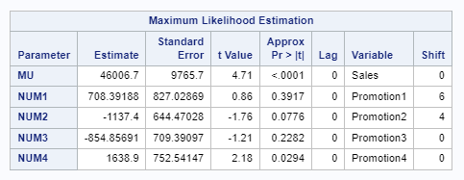
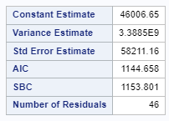

ARIMAX Model: Most of the predicted value of the given model falls under the 95% confidence interval.
Store 1: ARIMAX
The ARIMAX model exhibited significant enhancements across all key performance metrics — including AIC, SBC, MAPE, MAE, MSE, and RMSE — when compared to the ARIMA model.
10
Source: Walmart Sales Forecast (kaggle.com)

Slide 11
Highest sales (12W) is forecasted for Store 1 while lowest is forecasted for store 3.
Recommendations
Forecasted Sales KPIs by Store Number
Key Observations
Even though the size of Store 11 is higher than store 1, sales for former is lower than the latter.
Also, smaller stores seems to have better “Sales per Store Unit Size”. This might be due to:
Space Utilization Efficiency
Better Customer Experience (Like personalized service)
Recommendations
Optimize Store Layout for bigger stores.
Enhance customer experience in larger stores
Develop targeted promotions based on customer purchase history and local buying trends.
Use larger stores as community hubs for events, classes, and local gatherings.
Leverage larger stores as fulfillment centers for online orders, offering services like click-and-collect and same-day delivery.
Store Type | A |  |  | B |  |  | C
Store No | 1 | 11 | 24 | 3 | 12 | 22 | 37 | 43
Store Size (Units) | 151,315 | 207,499 | 203,819 | 37,392 | 112,238 | 119,557 | 39,910 | 41,062
Key Drivers | Promotion | Promotion | Promotion | Promotion, Temp. | Promotion | Promotion, Temp. | CPI | CPI
11
Source: Walmart Sales Forecast (kaggle.com)

Slide 12

Thank you

