Slide 1
PPT Presentation Link :-
https://drive.google.com/drive/folders/1OFeUbzzEY7KUxo3skNfo41E_Fzf57_cj?usp=sharing

Slide 2
E-COMMERCE SALES DASHBOARD
Created By:- Prasad Nawale
1. This Dataset taken from “Kaggle Dataset”.
2. This dataset consist of E-commerce Sales performance in All Countries.
3. Source:-https://www.kaggle.com/akavinashk07/sales-dataset

Slide 3
1.Sales Information by Product Category.
2.Product Wise Sales information.
3.Monthly growth Information of measures.
4.Measures Info. Over Region by using Treemap Chart.
5.Dynamic Map for Showing Country,State & Citywise info. of Sales.
6.By Using Filters,we can easily find particular country sales
whichever we want.
7.Create Parameters for different measure field & Includes
All the measures into it.
8. We can easily access measures field by Parameter & Calculation field
9.Shipmode Wise Info over Segment.
10.Sales by Order Priority
11.We Can easily find Top N Customers By Measures using Parameters.

Slide 4
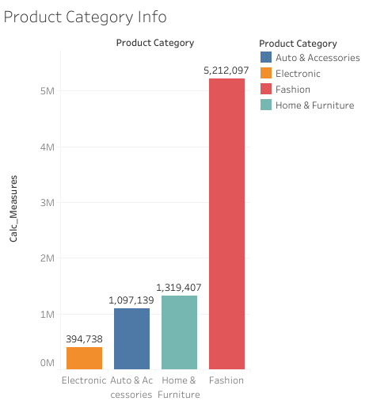
1. Sales Information by Product Category.
.

Slide 5
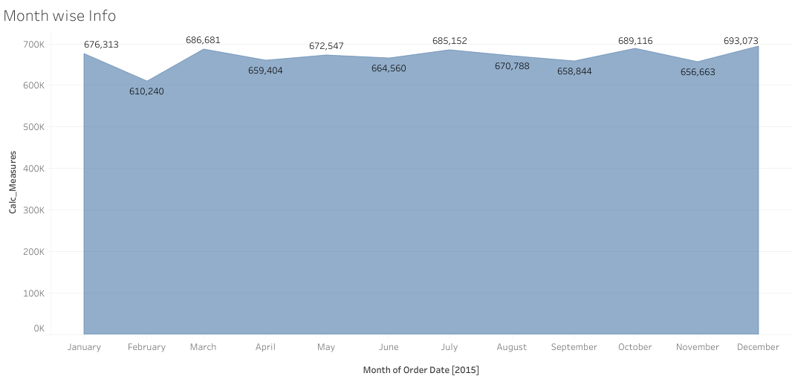
2.Monthly growth Information of measures.

Slide 6
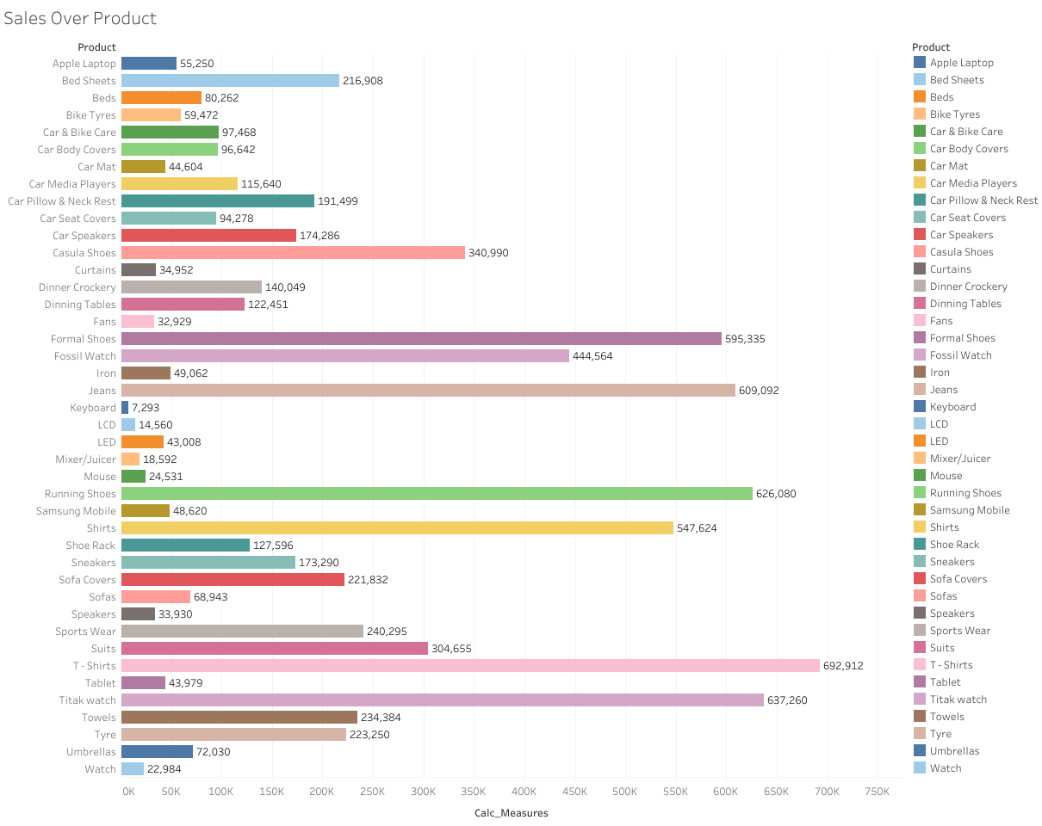
3.Product Wise Sales information.

Slide 7
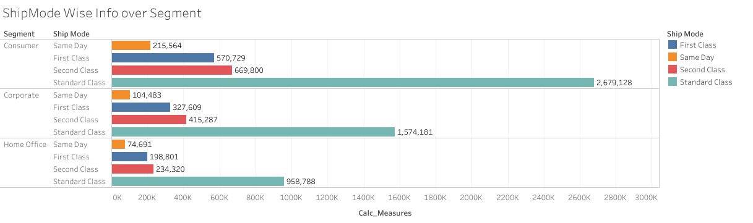
4.Shipmode Wise Info over Segment.

Slide 8
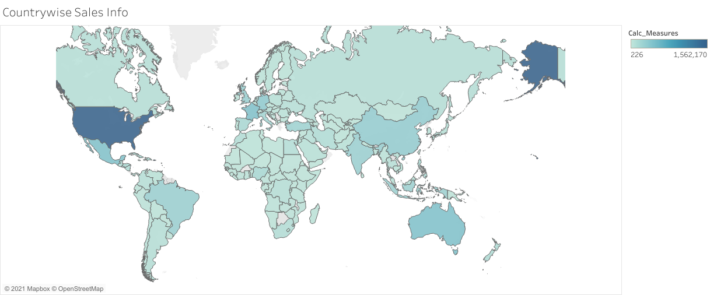
5.Dynamic Map for Showing Country,State & Citywise info. of Sales.
6.By Using Filters,we can easily find particular country sales
whichever we want.
.

Slide 9
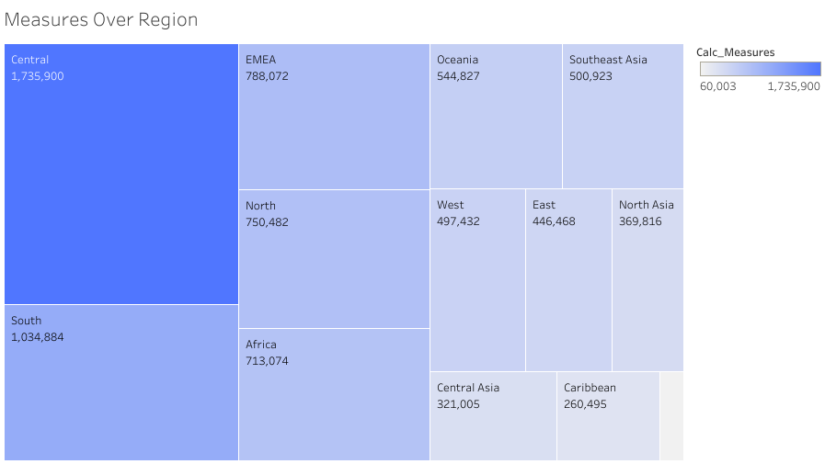
7. Measures Info. Over Region by using Treemap Chart.

Slide 10
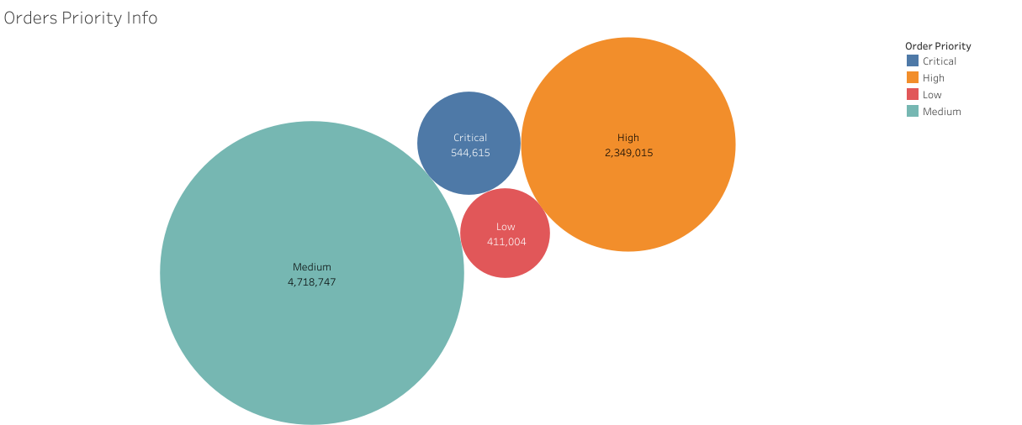
8. Sales by Order Priority.

Slide 11
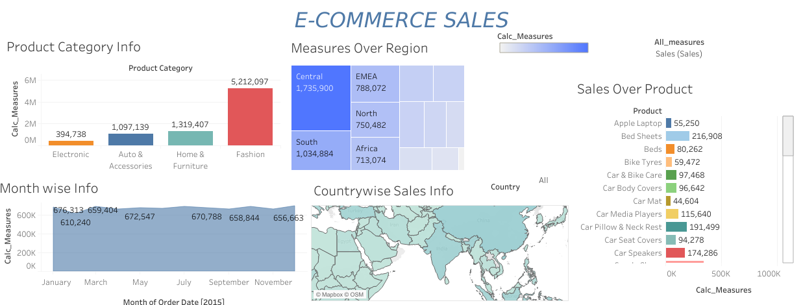

Slide 12
CONCLUSION
This Dashboard gives you any type of Sales Information of “E-Commerce Sales” very easily.
By using Parameters , We can easily creates a charts dynamically.
We can access for a single measure information like Sales, Profit, Discount, Iging
etc. Even in a very huge amount data it is easily accessible because of this
Dashboard.

