Slide 1

Task-1
HR DATA ANALYSIS
Name :- Prasad Vinay Nawale
Email :- prasadnawale8055@gmail.com

Slide 2
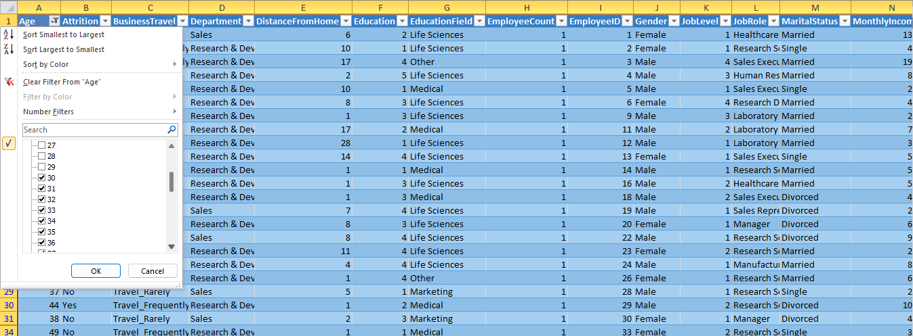
Using Excel, how would you filter the dataset to only show
employees aged 30 and above?
In Excel, we can filter the dataset by converting it into tables and at the column
name “Age” we can see filter option. After clicking on filter option, we can select
the ages which are greater than and equal to 30.

Slide 3
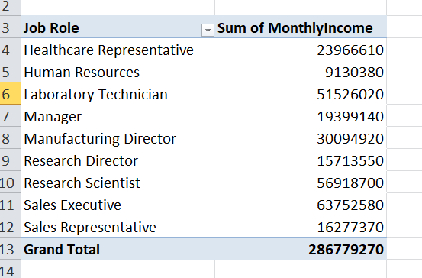
Create a pivot table to summarize the average Monthly Income by Job Role.

Slide 4
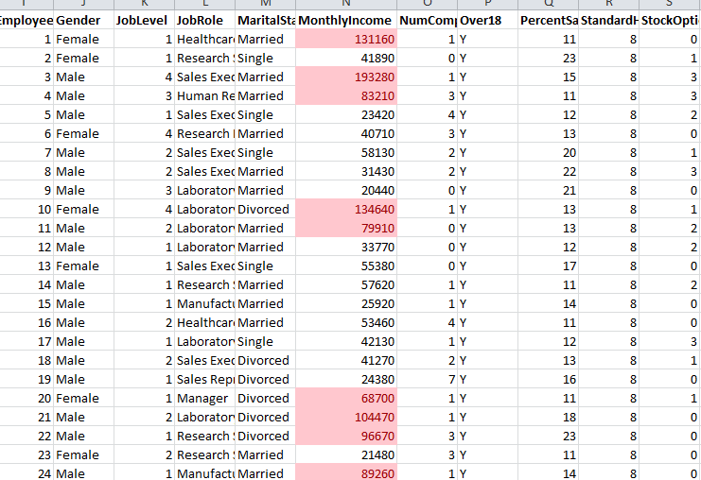
Apply conditional formatting to highlight employees with Monthly
Income above the company's average income.
In this problem, firstly we have to calculate company’s average income by
using average() function. Then we can put that average value into conditional
formatting for highlighting employees who has monthly Income above the
average company’s income as shown below

Slide 5
Create a bar chart in Excel to visualize the distribution of employee ages.

Slide 6
Identify and clean any missing or inconsistent data in the "Department" column.
Answer:- In the “Department” Column, there is no any missing or inconsistent
Data present because it is already cleaned and consistent but to clean the data there
Are various ways in excel using pivot tables, filters, conditional formatting etc.

Slide 7
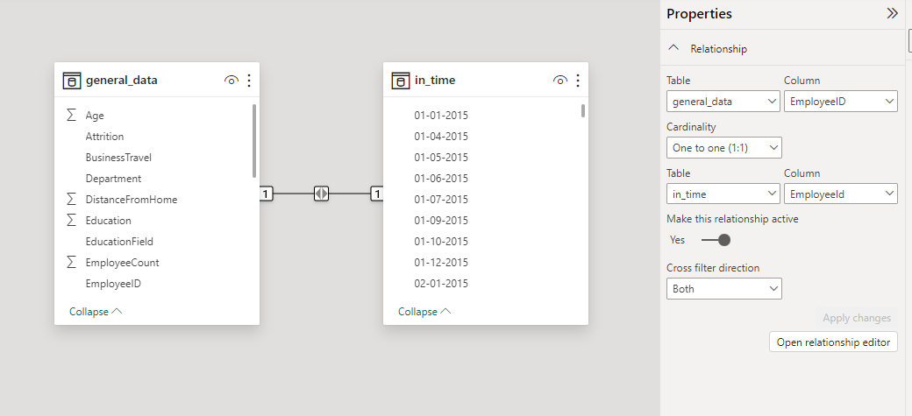
In Power BI, establish a relationship between the "EmployeeID" in the employee
data and the "EmployeeID" in the time tracking data.

Slide 8
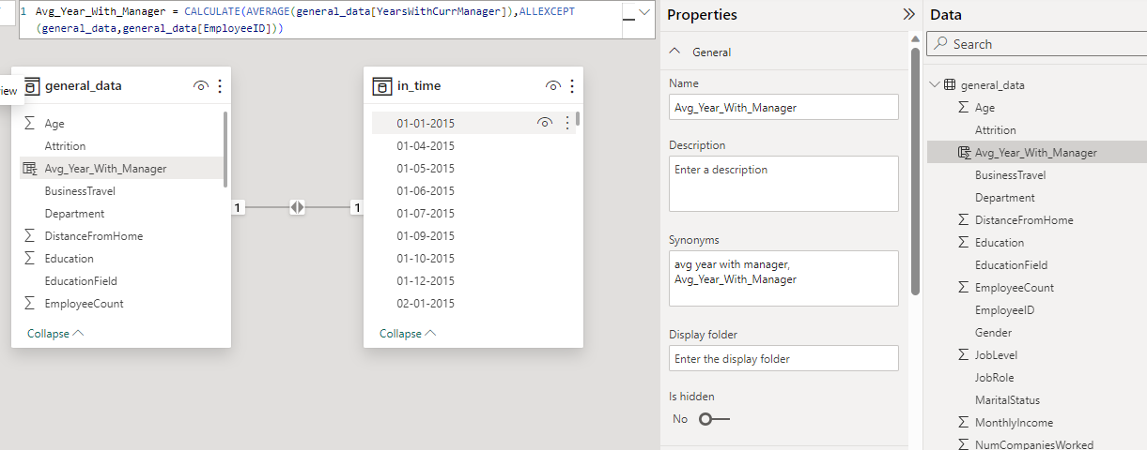
Using DAX, create a calculated column that calculates the average years an
employee has spent with their current manager.

Slide 9
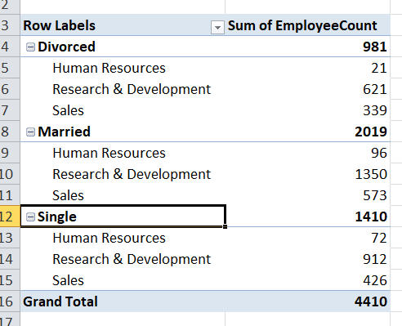
Using Excel, create a pivot table that displays the count of employees in
each Marital Status category, segmented by Department.

Slide 10
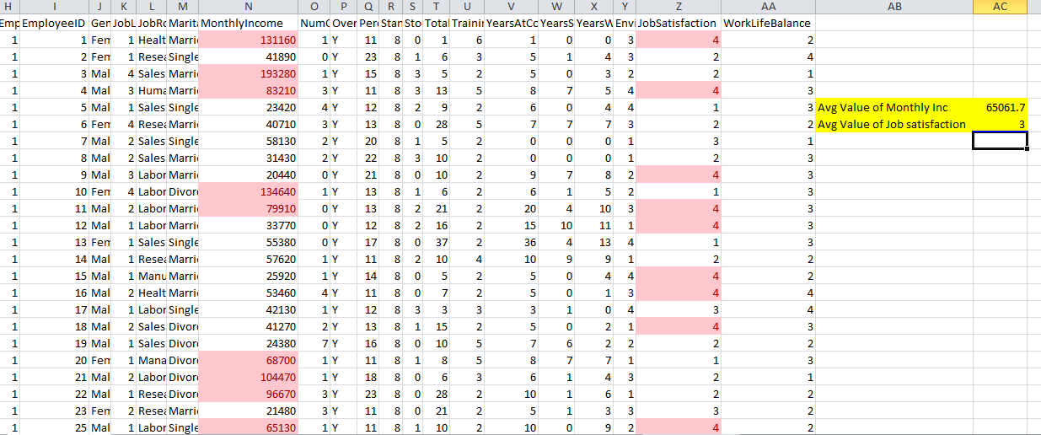
Apply conditional formatting to highlight employees with both above-average
Monthly Income and above-average Job Satisfaction.
Job satisfaction field is in the another csv file so firstly we need to combine both files
on the basis of common column i.e. primary key column (Employee id) and then we
can apply conditional formatting to highlights employees.

Slide 11
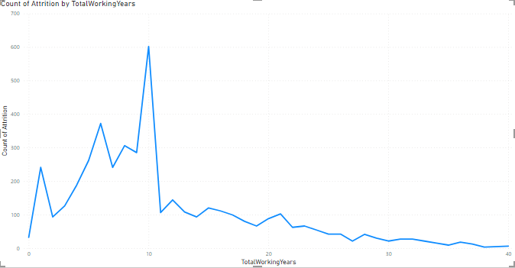
In Power BI, create a line chart that visualizes the trend of Employee Attrition
over the years.

Slide 12
Describe how you would create a star schema for this dataset, explaining the benefit
of doing so.
Answer:- Fact Table: General Data:
Primary key: Employee ID
Columns: Age, Percent Salary Hike, Standard Hours, Stock Option Level, Total
Working Years, Training Time Last Year, Year at Company, Years Since Last
promotion, Years with Current Manager
Dimension Tables: EmpSurveyData:
Primary key: Employee ID
Columns: Enviornment Satisfaction, Job Satisfaction, Work Life balance
Benefits of Using a Star Schema:
Simplicity
Query Performance
Scalability
Ease of maintainance

Slide 13
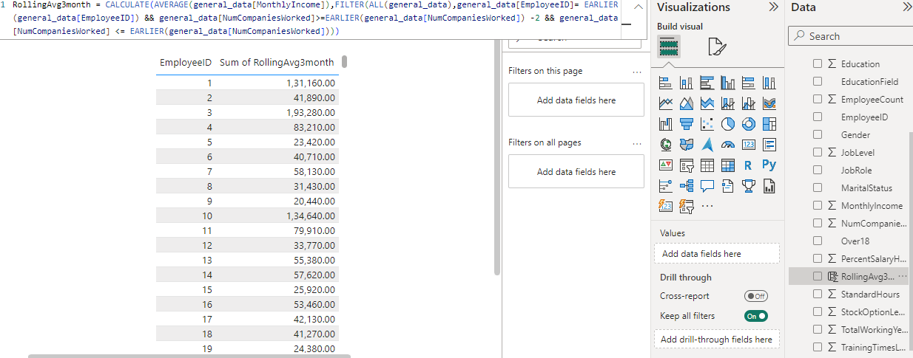
Using DAX, calculate the rolling 3-month average of Monthly Income for
each employee.

Slide 14
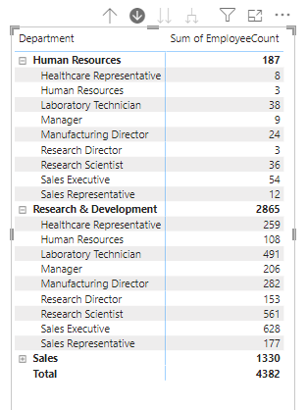
Create a hierarchy in Power BI that allows users to drill down from Department to
Job Role to further narrow their analysis.

Slide 15
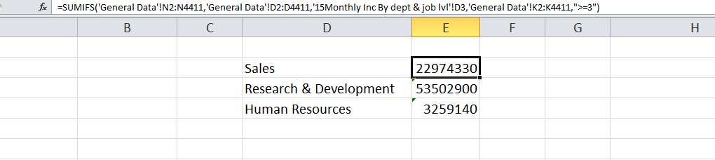
In Excel, calculate the total Monthly Income for each Department, considering
Only The employees with a Job Level greater than or equal to 3.

Slide 16
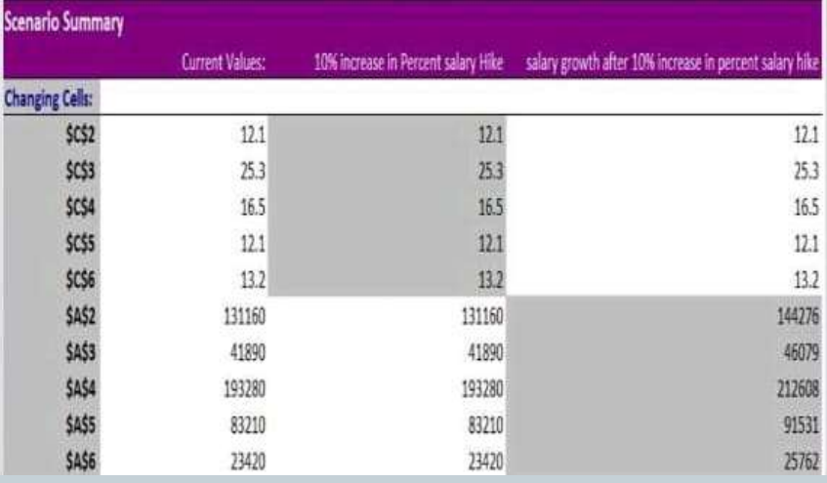
Explain how to perform a What-If analysis in Excel to understand the impact
of a 10% increase in Percent Salary Hike on Monthly Income.

Slide 17
Verify if the data adheres to a predefined schema. What actions would you take if
you find inconsistencies?
Answer:- Verifying if the data adheres to a predefined schema is an important step I
ensuring data quality and accuracy. Here are actions you can take if you find
Inconsistencies in the data:
1. Define Predefined Schema:
Clearly define the expected schema for your data. This includes specifying the expected
data types, formats, and relationships between tables.
2. Check Data Types:
Ensure that the data types for each column align with the predefined schema.
3. Identify Duplicate Records:
Look for duplicate records in the dataset. Duplicate records can introduce errors and
may need to be resolved.
4. Implement Data Cleaning:
Apply data cleaning techniques to rectify inconsistencies. This may involve correcting
typos, standardizing formats, or filling missing values based on predefined rules.

