Slide 1
Sentiment Analysis
A.K.A Opinion mining

Slide 2
Phases of Project
1. Data Gathering
2. Splitting Data
3. Data Extraction
4. Tagging Data
5. Token Scoring
6. Feature Extraction
7. Training Classifier
8. Sentiment Prediction
Sentiment Analysis

Slide 3
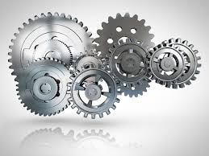
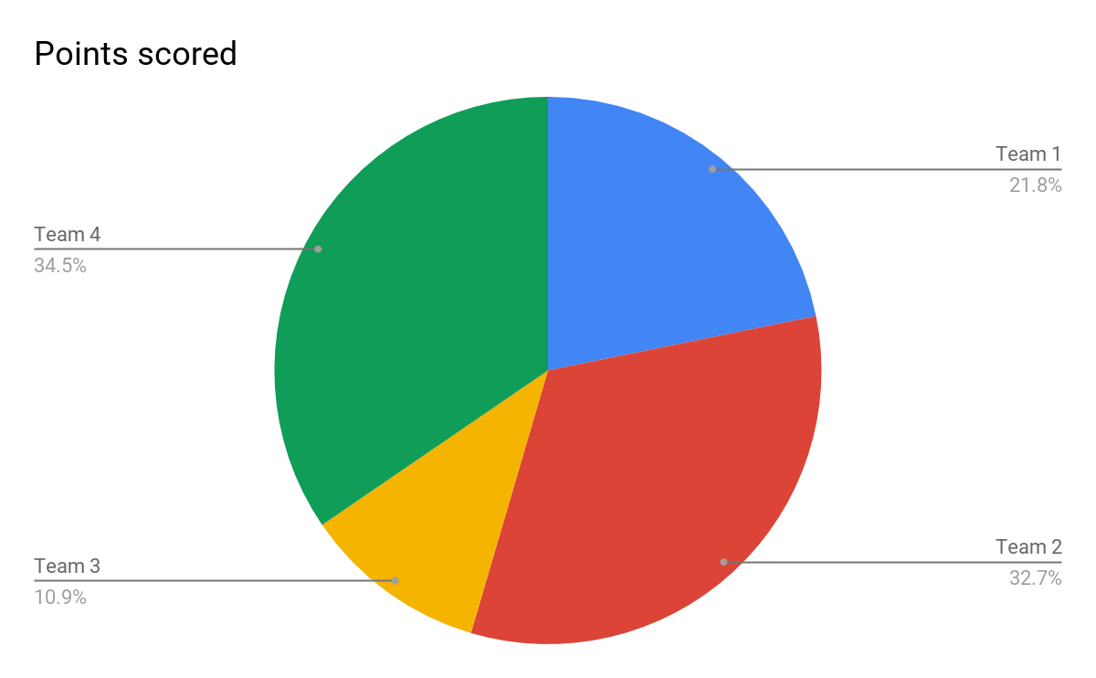
Rating.txt
5.0
Labels
+ve,-ve,+ve….
Review.txt
These are awesome and make my phone look so stylish Great quality!
Features.txt
NN Adj Adv Adj+Adv
0 0.22 0.77 0.23
Training Data
Summary.txt
Love Love Love
Features.txt
NN Adj Adv Adj+Adv
0 0.22 0.77 0.23
Data.json
Review text: "These are awesome and make my phone look so stylish Great quality!"
overall: 5.0,summary: "LOVE LOVE LOVE"”
Rating.txt
2.0
Labels
+ve,-ve,+ve….
Review.txt
This Product is so Waste that i ever buy earlier
Features.txt
NN Adj Adv Adj+Adv
0 0.22 0.77 0.23
Testing Data
Labels
+ve,-ve,+ve
Features.txt
NN Adj Adv Adj+Adv
0 0.22 0.77 0.23
Summary.txt

Slide 4
Splitting Data
Data.json
Review text: "These are awesome and make my phone look so stylish Great quality!"
overall: 5.0,summary: "LOVE LOVE LOVE"”
---------------------------
--------------------------
-------------------------
Training Data
Review text: "These make using the home button easy. My daughter and I both like them. Well worth the price."
overal": 3.0,
summary: "Cute"
---------------
---------------
Testing Data
Review text: it worked for the first week then it only charge my phone to 20%. it is a waste of money."
overal": 1.0,
summary: "Not a Good Idea"
---------------
---------------
Sentiment Analysis

Slide 5
Data Preprocessing
Input.json
Review text: "These are awesome and make my phone look so stylish Great quality!"
overall: 5.0,summary: "LOVE LOVE LOVE"”
---------------------------
--------------------------
-------------------------
Simple json.jar
Json parsing
Rating.txt
5.0
4.0
3.0
---
---
Review.txt
These are awesome and make my phone look so stylish Great quality!
----------------------
---------------------
----------------------
----------------------
Summary.txt
"LOVE LOVE LOVE"
------------
------------
------------
------------
Sentiment Analysis

Slide 6
Tagging
Data toTag.txt
Love Love Love.
Awesome.
It’s Worth.
Do not Buy.
------------
------------
Tagged Data
Love Love Love
Noun Noun Noun
Awesome
Adj
---------
----------
Stanford core NLP
Sentiment Analysis

Slide 7
Token Scoring
SentiWordNet Corpus
Scored_Data
Love Love Love
Noun Noun Noun
0.371 0.37 0.371
Awesome
Adj
1
Bad
Adj
-0.786
---------
----------
Tagged Data
Love Love Love
Noun Noun Noun
Awesome
Adj
Bad
Adj
---------
---------
SentiWordScore.java
Sentiment Analysis

Slide 8
Feature Extraction
Scored_Data
Love Love Love
Noun Noun Noun
0.371 0.371 0.371
Bad
Adj
-0.786
---------
----------
Features.txt
NN Adj Adv Adj+Adv
1.23 0 0 0
0.45 0.3 -0.3 0.12
----- --- ----- -----
----- --- ----- -----
----- --- ----- -----
Exctract_Features
Sentiment Analysis

Slide 9
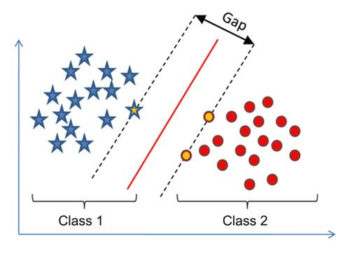
Support Vector Machine(SVM)
+ve Class
Margin
-ve Class
Feature2
Feature1
Sentiment Analysis

Slide 10

Training Data
Test Data
Features.txt
NN Adj Adv Adj+Adv
1.23 0 0 0
0.45 0.3 -0.3 0.12
----- --- ----- -----
----- --- ----- -----
----- --- ----- -----
Review.txt
These are awesome and make my phone look so stylish Great quality!
----------------------
---------------------
----------------------
----------------------
Output
+ve
+ve
-ve
+ve
-ve
-ve
….
….
….
model
SVM Classifier
Labels
Predict
Features.txt
NN Adj Adv Adj+Adv
1.23 0 0 0
0.45 0.3 -0.3 0.12
----- --- ----- -----
----- --- ----- -----
----- --- ----- -----
Summary.txt
"LOVE LOVE LOVE"
------------
------------
------------
------------
Sentiment Analysis

Slide 11
Future Work
> Parameterization of SVM
> Train SVM classifier with processed labeled data
> Predicting the sentiment of each review
> Measure Accuracy parameters like recall,precision etc..
> Will try to achieve better performance with folding methods
Sentiment Analysis

Slide 12
Thank You
B.Prasad,N130888
M .Vinod ,N130791

