Slide 1

Edge-Mesh SCADA: A Secure, Local-First Industrial IoT Framework
Vedant Jadhav | Prasad Kale | Sooraj Nair
Department of Electrical and Electronics Engineering
Dr. Vishwanath Karad MIT World Peace University, Pune [2025-26]

Slide 2




PROBLEM STATEMENT
High Cost & Complexity
Proprietary PLCs and SCADA software are prohibitively expensive for small-to-medium enterprises (SMEs).
Cloud Dependency
Reliance on external servers introduces latency and reliability issues when internet connectivity is unstable.
Security Vulnerabilities
Many IoT implementations lack "Defense-in-Depth," leaving networks exposed to unauthorized access and IP spoofing.
Retrofit Challenges
Existing solutions often require intrusive modifications to legacy machine firmware or electronics.

Slide 3







PROJECT OBJECTIVES
Non-Intrusive Retrofit
Edge Computing Hub
Wireless Mesh Network
Upgrade existing industrial infrastructure with smart factory capabilities without major hardware modifications.
Deploy Raspberry Pi 5 as a local gateway hosting MQTT, Node-RED, Fuxa SCADA, and InfluxDB.
Implement self-healing ESP-MESH topology for flexible and scalable sensor node deployment.
Multi-Pipeline Data Flow
Security Hardening
Route telemetry to local persistence (InfluxDB) and cloud-accessible live dashboards (Firebase).
Implement a 3-layer protection protocol (Auth, Encryption, Firewall) for industrial-grade stability.

Slide 4
SYSTEM ARCHITECTURE
Remote Layer
Firebase Dashboard, Chronograph, Remote Diagnostics
HTTPS / ngrok Tunnel
Application Layer
Node-RED Orchestration, Fuxa SCADA, InfluxDB, FastAPI
MQTT / WebSocket / REST
Edge Hub Layer
Raspberry Pi 5 (Local Gateway & Access Point)
TCP/IP / Wi-Fi
Physical Layer
Industrial Machines, ESP32 Mesh Nodes, Arduino RS485 Bridge
RS485 / UART / ESP-MESH

Slide 5

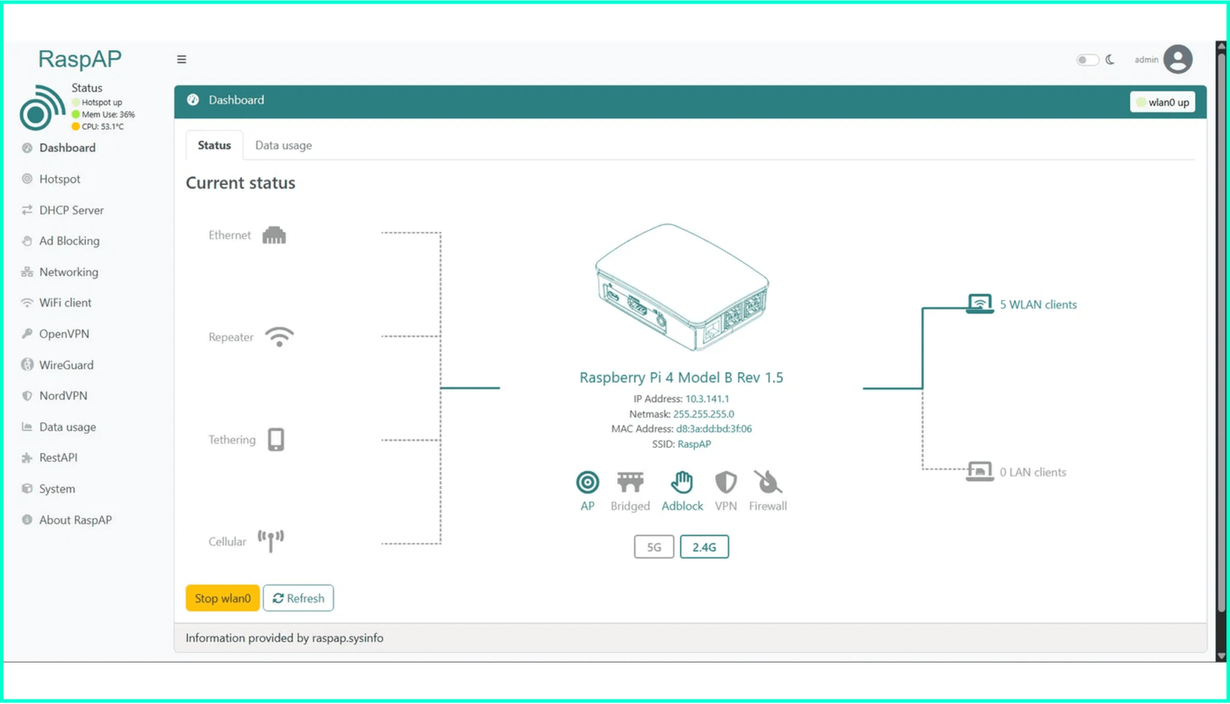
HARDWARE & NETWORK INFRASTRUCTURE
EDGE HUB
Raspberry Pi 5 (8GB RAM)
NETWORK GATEWAY
RaspAP Managed Subnet
LOCAL IP ADDRESS
10.3.141.1
IOT NODES
ESP32 (Wi-Fi & Mesh)
LEGACY BRIDGE
Arduino Uno + MAX485
Live RaspAP Dashboard: Managing 5 WLAN Clients

Slide 6

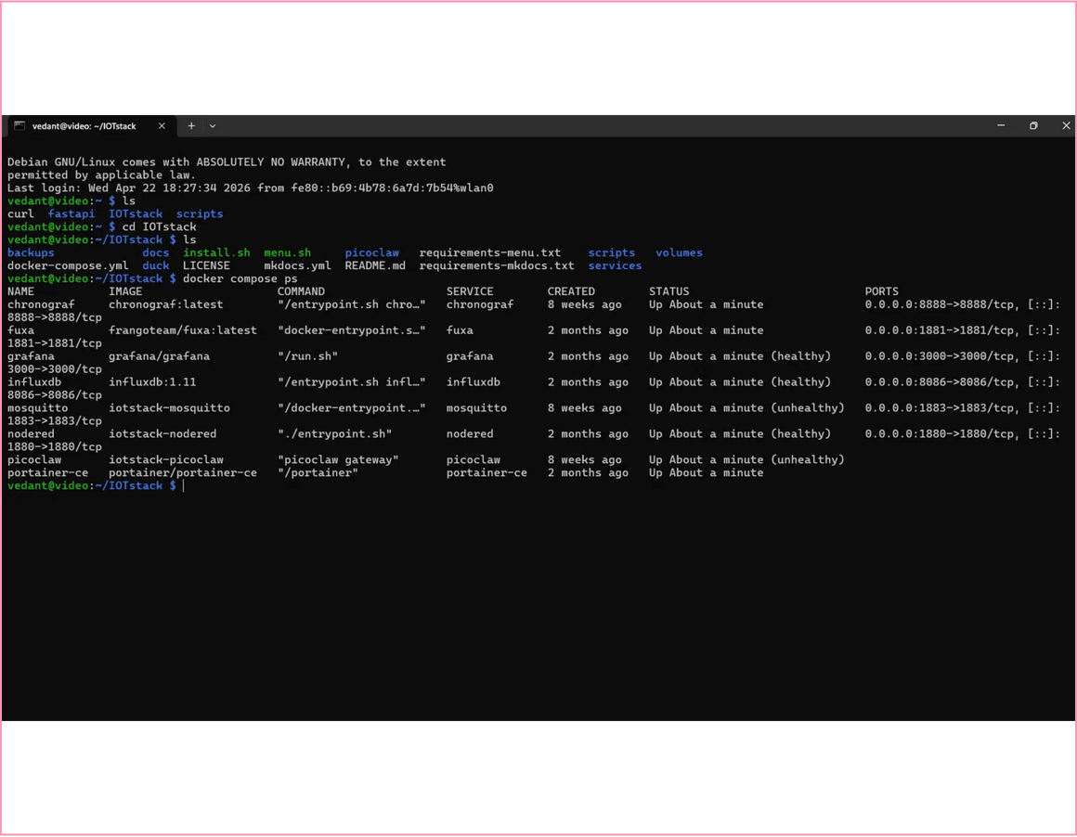
CONTAINERIZED SOFTWARE STACK
IOTstack Deployment
Docker-based orchestration for seamless service management on Raspberry Pi.
Mosquitto & InfluxDB
Messaging & Time-Series Storage
Node-RED & Fuxa
Logic & SCADA Visualization
Grafana & Chronograf
Analytics & Monitoring Dashboards
Terminal: Docker Compose Service Status (All Systems Nominal)

Slide 7

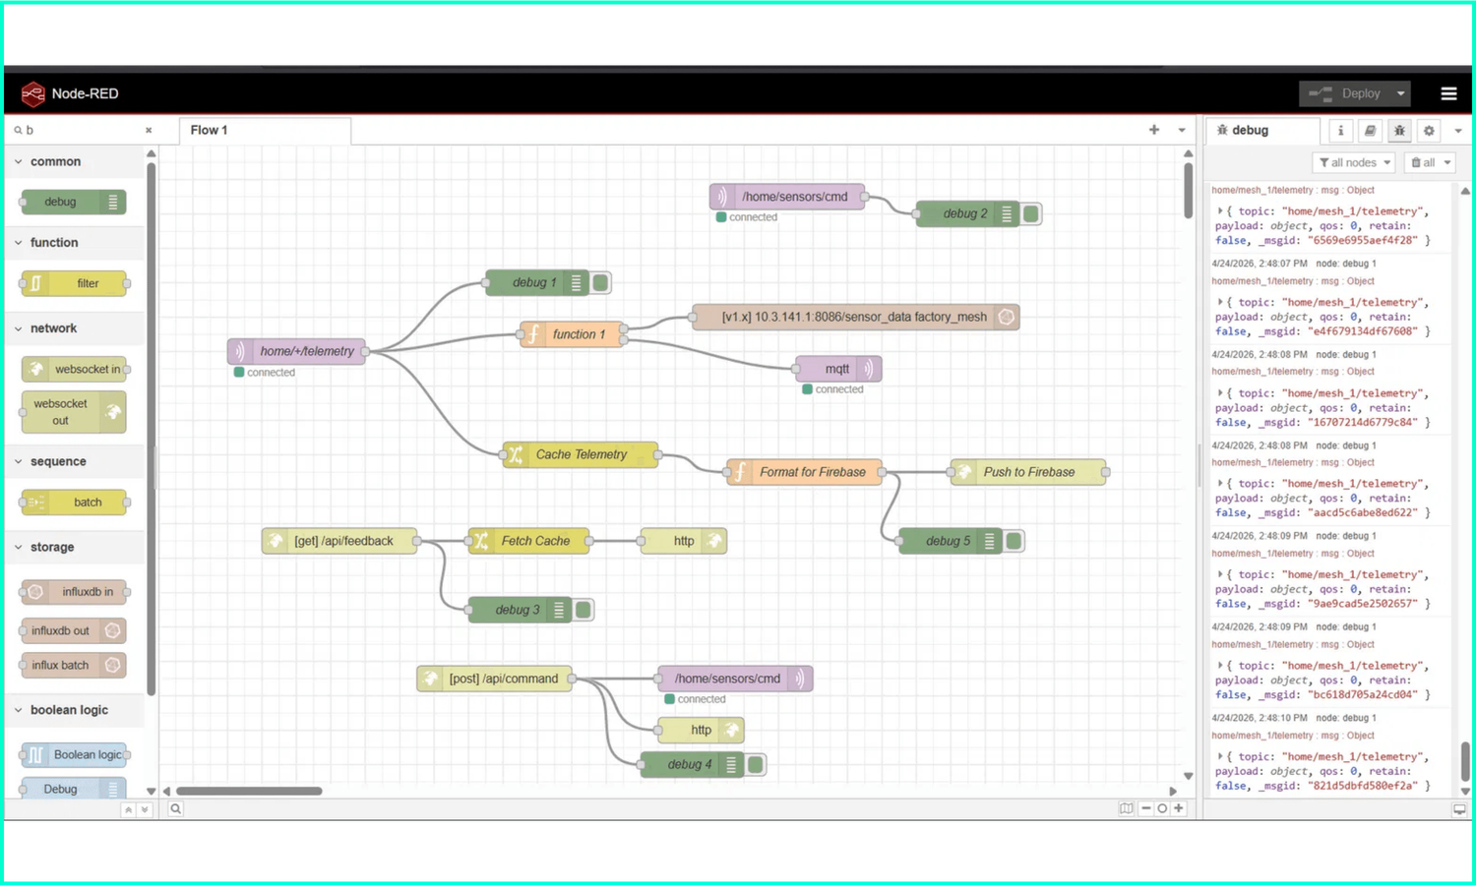
METHODOLOGY & ORCHESTRATION
PHASE 1
Edge Infrastructure
PHASE 2
ESP-MESH Network
PHASE 3
Node-RED Logic
PHASE 4
SCADA & Cloud Sync
PHASE 5
Security Hardening
Node-RED Flow: MQTT Ingestion, InfluxDB Storage & Firebase Push

Slide 8





SECURITY: 3-LAYER PROTECTION
Authentication (Auth)
01
MQTT Username/Password authentication prevents unauthorized messaging and ensures only verified nodes can publish or subscribe to telemetry topics.
Encryption
02
AES-128 mesh encryption for all wireless data transmission between ESP32 nodes, protecting the network from eavesdropping and packet injection.
Firewall
03
UFW (Uncomplicated Firewall) configuration on the Raspberry Pi edge hub to restrict access to essential ports (1883, 1880, 8000) and block all other traffic.
DEFENSE-IN-DEPTH: INDUSTRIAL-GRADE STABILITY & PROTECTION

Slide 9
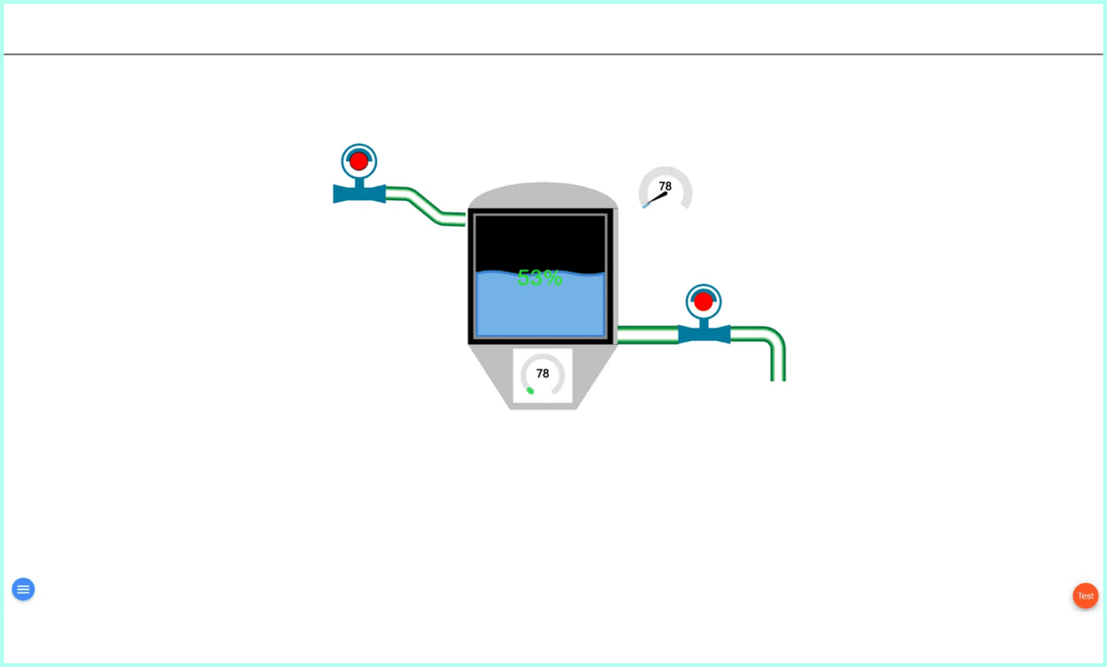
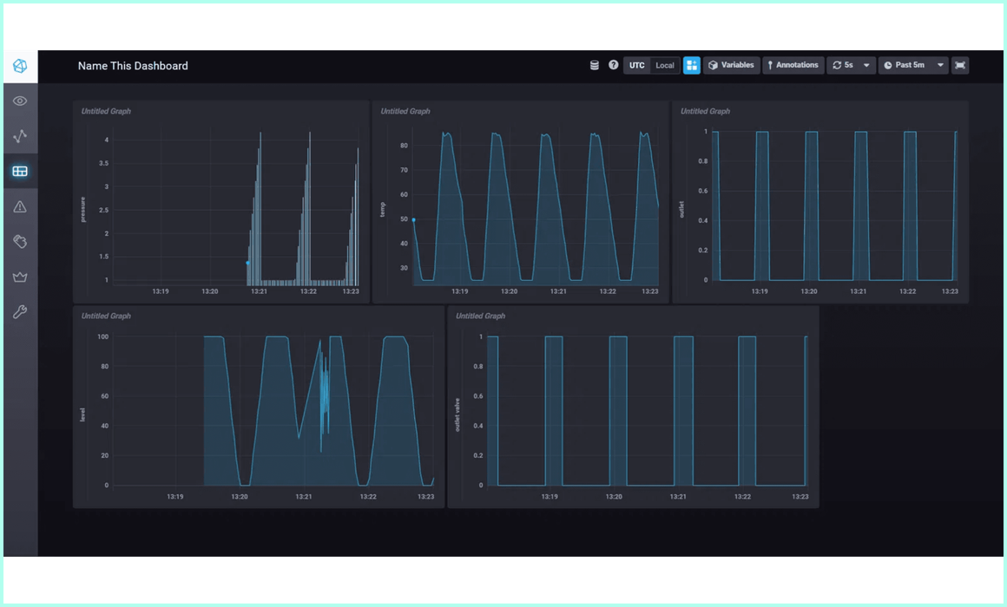
VISUALIZATION & MONITORING RESULTS
Fuxa SCADA (Local HMI)
Chronograf (Analytics)
Real-time process visualization and supervisory control on the local network.
Time-series data exploration and historical analysis via InfluxDB.
<200ms
100%
5+
LOCAL LATENCY
UPTIME (TEST PHASE)
ACTIVE NODES

Slide 10





CONCLUSION & FUTURE SCOPE
FUTURE ROADMAP
The Edge-Mesh SCADA project successfully demonstrates a viable, low-cost Industry 4.0 retrofit for SMEs.
AI Predictive Maintenance
Implementing machine learning models on the edge to predict equipment failure using historical time-series data.
Static Remote Access
By integrating commodity hardware with open-source software, we have bridged the gap between legacy industrial infrastructure and modern smart factory capabilities.
Transitioning from ngrok free tier to a static domain or self-hosted VPN tunnel for persistent remote monitoring.
Mesh Network Expansion
Scaling the ESP-MESH topology to cover larger factory floor areas with increased node density and reliability.
Protocol Integration
Expanding support for industrial communication standards including Modbus TCP, OPC-UA, and EtherCAT.

