Slide 1

ACHARYA NAGARJUNA UNIVERSITY
ANU COLLEGE OF SCIENCES
Department of Computer Science & Engineering.
Master of Computer Applications (MCA)
Final Semester Project Presentation
on
APPLICATION OF TEXT CLASSIFICATION AND CLUSTERING OF TWITTER DATA FOR BUSINESS ANALYTICS
Project Guide
Dr. U. Surya Kameswari
M.sc., M.Tech,. Ph.D
Asst. Professor
Dept. of CSE
Submitted by
G. Durga Prasad
Y23MC20018

Slide 2
Index
Abstract
Overview
Literature Survey
Algorithms
Results
Summary
Conclusion
References

Slide 3
Abstract
In recent years, the utilization of social networks for business growth has surged, driven by their capacity to provide insights into consumer sentiments and preferences. This project explores the application of social analysis in the context of a e-commerce brand's Twitter data. Leveraging the Twitter API, customer comments were collected and subjected to analysis using a Binary Tree classifier for sentiment polarity determination and k-means clustering for identifying trends and patterns. The study uncovered actionable insights for strategic decision-making, highlighting the importance of adapting marketing strategies to align with consumer preferences. The findings underscore the significance of text mining analysis in harnessing the vast volume of social data for driving business growth, while also suggesting avenues for future development and integration into marketing strategies for enhanced consumer engagement and brand perception.

Slide 4
Overview
The purpose of this project is to extract a list of tweets posted in real time about a specific company and build machine learning algorithms that can accurately classify these Tweets as positive tweets, negative tweets, or neutral tweets after calculating the polarity and subjectivity of the respective tweet.
Preparing The Test Set
Collection of Data
Pre-processing of Data
Model Preparation
Training of Data
Testing the Model

Slide 5
Literature Survey
Pang et.al. took into account the idea of sentiment type being primarily based on categorization research, with good and bad sentiments [5]. They have undertaken the test with 3 exceptional machine-learning algorithms, including, NB, SVM, and ME
Dave et. al. have used a device for synthesizing critiques, then shifted them and ultimately grouped them with the usage of aggregation sites [10]. These based critiques are used as training data out and testing data.
Esuli & Srinivasiah's studies splits associated task into different types [21]: the primary one works with detecting the phrase orientation and the alternative works with detecting the phrase subjectivity.

Slide 6
Naive Bayes Classifier
The Bayesian classification model, specifically the multinomial Naive Bayes technique, was employed in this project for its simplicity and effectiveness in categorizing text, particularly in detecting spam. This model operates under the assumption of conditional independence of each feature given the class. The objective is to determine the class "c" that maximizes the probability P(c | t) for a given tweet "t". Here, "c" can represent either 0 (Negative) or 1 (Positive or Neutral), while "t" denotes a sentence. To achieve this, parameters such as P(c) and P(wi | c) are trained using Maximum Likelihood Estimation. When predicting the class of a new tweet "t", the log likelihood log P(c) + ΣilogP(wi|c) is computed for different classes, and the class with the highest log likelihood is selected as the prediction.

Slide 7
Random Forest
Random forests, an ensemble learning method for classification, construct numerous decision trees during training and output the mode of classes generated by individual trees. At the input phase, it generates multiple decision trees, reducing correlation between them by random selection. This enhances prediction power and efficiency. Predictions are aggregated from various ensemble datasets. The algorithm functions by selecting the best node among randomly chosen predictors at each node for node splitting. Original data is replaced with newly created data for training, with random feature selection used to grow new trees, which are left unpruned. The random forests algorithm iteratively selects N records from the input dataset to build decision trees, repeating this process for a specified number of trees. Each tree's predictions are aggregated to assign new records to the majority prediction class.

Slide 8
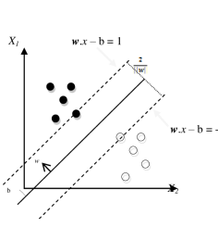
Support Vector Machine
Support Vector Machine (SVM) is a supervised machine learning technique utilized in this project for text classification and clustering of Twitter data for business analytics. It operates by leveraging reduced features obtained during the processing phase, forecasting attributes as either negative or non-negative (positive or neutral) based on labeled data. SVM functions as a non-probabilistic binary classifier, generating a hyperplane to separate the two groups. By plotting data values in an n-dimensional space, SVM algorithm is executed, where "n" represents the total number of data features. SVM is applicable in both classification and regression problems, employing a hyperplane classifier approach that relies on partitioning data using diverse lines. The optimum hyperplane is selected based on line distance, with SVM vectors aiding in class division.

Slide 9
K – Nearest Neighbor Classifier
K-Nearest-Neighbors (KNN) serves as a straightforward non-parametric classification algorithm, extensively applied in sentiment analysis, machine learning, and text classification. This method categorizes data by comparing unknown data points with training data points in their vicinity. Euclidean distance between data points is computed to establish unique similarity, followed by normalization of characteristic values to balance longer and shorter range attributes. Unlabeled data is then assigned the most common class among its similar neighbors, or in the case of a tie, the class with the least average distance. The KNN classifier's predictive accuracy heavily relies on variable scale, with larger scale variables exerting greater influence on the final output than smaller scale variables. For this project, the number of nearest neighbors is set to 3 or more to achieve acceptable accuracy levels.

Slide 10
Results
Prologue:
This project focuses on the implementation of various machine learning algorithms to perform sentiment analysis on real time Twitter data. This chapter deals with the results obtained after implementing the various algorithms. The data used for this project were at least 3000 real time live tweets that were extracted using Tweepy API Cursor method. As the tweets were extracted real time, the accuracy of various algorithms may vary, as Twitter is updated with posts on a constant basis.

Slide 11
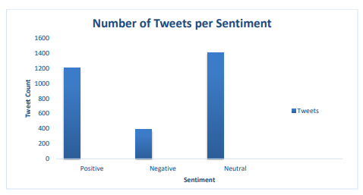
Classification of Tweets:
There were 1000 tweets of each search word extracted three times overall totaling 3000. After calculating the subjectivity and polarity of data, the number of tweets per sentiment were
Positive Tweets: 1207 (40.2 %)
Neutral Tweets: 1405 (46.9 %)
Negative Tweets: 388 (12.9 %

Slide 12
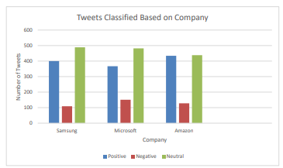
Classification of Tweets based on Company:
The next stage is to classify the tweets based on company to get a better understanding of which company had better reviews or sentiment. After performing this step, we got the following results.
1. Amazon: 128 negative, 434 neutral, and 438 positive tweets.
2. Microsoft: 151 negative, 482 neutral, and 367 positive tweets.
3. Samsung: 109 negative, 489 neutral, and 402 positive tweets.
From the above data, we can infer that Microsoft and Samsung had a lot more positive and neutral reviews as compared to Amazon. However, Microsoft had more negative tweets than Amazon and Samsung and Samsung had the least number of negative reviews. Based on this information, tweets posted on Amazon and Samsung have an overall better positive reception compared to tweets posted on Microsoft.

Slide 13
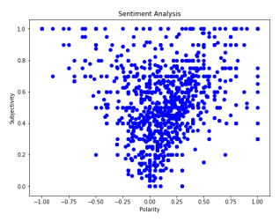
Polarity and Subjectivity of Tweets:
The tweets are assessed for calculating their subjectivity score and polarity score. These scores are then plotted in a scatter plot. If subjectivity of respective tweet is 0, then it can be considered as a fact, and if it is greater than 1, then it can be considered as an opinion. Polarity gives us an idea on what kind of sentiment is shown in the respective tweet.
If polarity of text is > 0, the tweet is positive, 0 if neutral and negative if < 0.

Slide 14
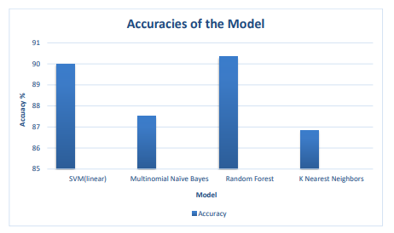
Performance Evaluation:
The next stage is to calculate the accuracy and plot the confusion matrix and classification report of all algorithms after implementing them on all 3000 tweets. We evaluate the performance parameters for two values 0 and 1, with 0 specifying negative sentiment and 1 for non-negative, i.e, positive or neutral sentiment.
The accuracies of the models can vary and change regularly if we get more data or if we run the program again as Twitter data gets updated constantly. Accuracy of any algorithm can change drastically if program is rerun an hour or two later after initial execution.

Slide 15
Summary
In this project, real-time Twitter data pertaining to a specific company was extracted using the Tweepy Cursor method, and various machine learning algorithms were employed to accurately classify these tweets as positive, negative, or neutral based on their polarity and subjectivity. Three distinct search terms were used, each yielding 1000 tweets, which were then aggregated and combined into a unified dataset alongside their corresponding company labels. The collected data underwent cleaning to eliminate irrelevant information, followed by calculation of subjectivity and polarity for categorization purposes. Subsequently, the data was preprocessed and split into training and testing sets using Vectorizer and stop words. Linear SVM, Multinomial Naïve Bayes, Random Forest, and K Nearest Neighbors algorithms were implemented on these sets for classification. The summarized results include the distribution of tweets among different sentiment categories and companies, as well as the accuracy rates of each classifier. Notably, each model exhibited high precision but low recall for negative tweets due to the imbalance between negative and non-negative tweet counts. Furthermore, comparative analyses revealed varying sentiment reception across different companies, with Amazon and Samsung generally receiving more positive feedback compared to Microsoft.

Slide 16
Conclusion
This endeavor demonstrates the feasibility of conducting sentiment analysis on Twitter data through various methodologies. Given the dynamic nature of Twitter data, continuously updated by numerous users simultaneously, the accuracy of classifiers fluctuates with the influx of new data, rendering the process time-consuming. Among the implemented algorithms, linear SVM and Random Forest Classifier exhibited the highest accuracy (>90%). Analysis of tweets from three companies revealed distinctive patterns: Samsung had the fewest negative tweets and the highest number of neutral tweets, while Amazon had the most positive tweets and Microsoft had the highest number of negative tweets. This suggests that Amazon and Samsung may be delivering superior services and customer satisfaction compared to Microsoft, as evidenced by their more positively received tweets.

Slide 17
References
B. Liu, "Sentiment Analysis and Opinion Mining", Synth. Lect. Hum. Lang. Technol., vol. 5, no. 1, pp. 1-167, 2012.
Text Analytics Market by Component (Software Services) Application (Customer Experience Management Marketing Management Governance Risk and Compliance Management) Deployment Model Organization Size Industry Vertical Region - Global Forecast to 20, 2017, [online] Available: marketsandmarkets.com.
F. N. Ribeiro, M. Araújo, P. Gonçalves, M. AndréGonçalves and F. Benevenuto, "SentiBench - a benchmark comparison of state-of-the-practice sentiment analysis methods", EPJ Data Sci., vol. 5, no. 1, 2016.
A. Moreno and T. Redondo, "Text Analytics: the convergence of Big Data and Artificial Intelligence", Int. J. Interact. Multimed. Artif. Intell., vol. 3, no. 6, pp. 57, 2016. 5. V. A. Kharde and S. S. Sonawane, "Sentiment Analysis of Twitter Data: A Survey of Techniques", Int. J. Comput. Appl., vol. 139, no. 11, pp. 975-8887, 2016

Slide 18
5. V. A. Kharde and S. S. Sonawane, "Sentiment Analysis of Twitter Data: A Survey of Techniques", Int. J. Comput. Appl., vol. 139, no. 11, pp. 975-8887, 2016. 6. W. Medhat, A. Hassan and H. Korashy, "Sentiment analysis algorithms and applications: A survey", Ain Shams Eng. J., vol. 5, no. 4, pp. 1093-1113, 2014. 7. L. Ziora, "The sentiment analysis as a tool of business analytics in contemporary organizations", Stud. Ekon., pp. 234-241, 2016. 8. S. Yaram, "Machine learning algorithms for document clustering and fraud detection", Proceedings of the 2016 International Conference on Data Science and Engineering ICDSE, 2016, 2017.

Slide 19
Thank You

