Slide 1
UNIVERSITY MODEL IMPLEMENTATION

Slide 2
Greetings from:
NUID: 001097224 Name: Ajay Prasad
NUID: 001562654 Name: Nakul Deshpande
NUID: 001090330 Name: Palak Agarwal

Slide 3
Education is the most powerful weapon which you can use to change the world

Slide 4
Problem Statement:
The objective of this assignment is to create a performance measurement solution to enable universities to measure the quality of the education they deliver to their students. We want to use software engineering techniques to improve the quality of education anywhere and hold people accountable for improving the quality of life through education, learning to learn, and feedback. The approach will be to investigate how an educational system in terms of faculty and courses contribute to the growth of their graduates over a 5-year period. We figure out ways to track the jobs and promotions, graduates get over time and assign rankings accordingly. In addition, track the connection of courses and their relevance to graduates' growth. Also, our university implementation model can be implemented on k-to-12 educational systems in the developing countries.

Slide 5
Proposed Solution:
Our important focus is to build a performance measurement solution to measure the quality of education they deliver to the students, so the future students will have a better idea about selecting courses by analyzing their interest and relevant university ranking.
Dashboard involves Admin, Student, Alumni portals, Company, Course & Alumni Ranking Systems.
Admin portal can view Top Ranked Alumni and Top-Rated Courses.
Student portal contains Basic Student Information, Courses taken & GPA.
Alumni portal contains current employement data.
Company is catergorized into Tier-1 & Tier-2, based on which Alumni are ranked.
Course Ranking is obtained using the feedbacks given by each Student.

Slide 6
Performance Measurement System
Digital Data System to analyze social impact on University and Students.

Slide 7
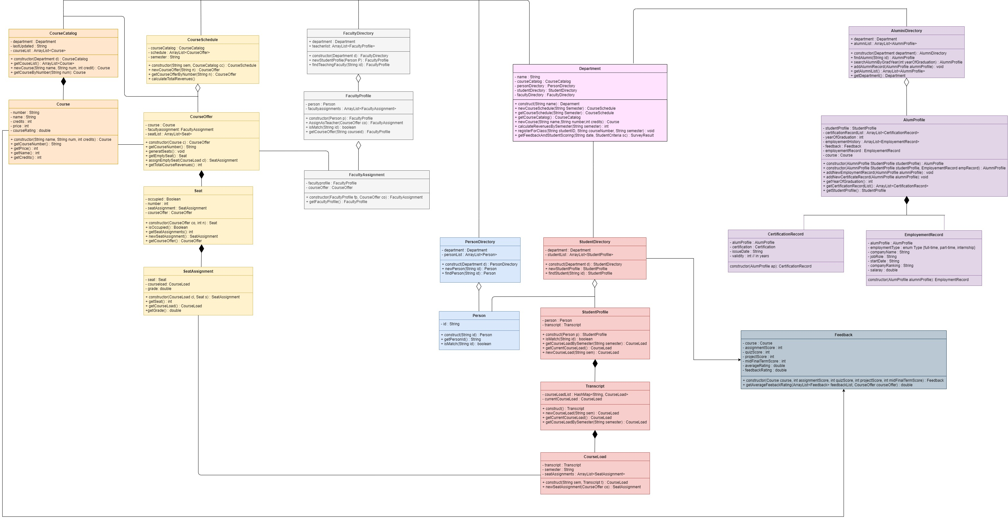
UML CLASS DIAGRAM - The UML class diagram below shows the university model that we would be implementing to obtain the performance review within academic units as well as to determine the ranking.

Slide 8
Course Rating as Per Students
INFO6205 - PSA
Percentage – 29.8%
INFO5100 - AED
Percentage – 43.8%
Rating
INFO6150 – Web Design
Percentage – 26.4%

Slide 9
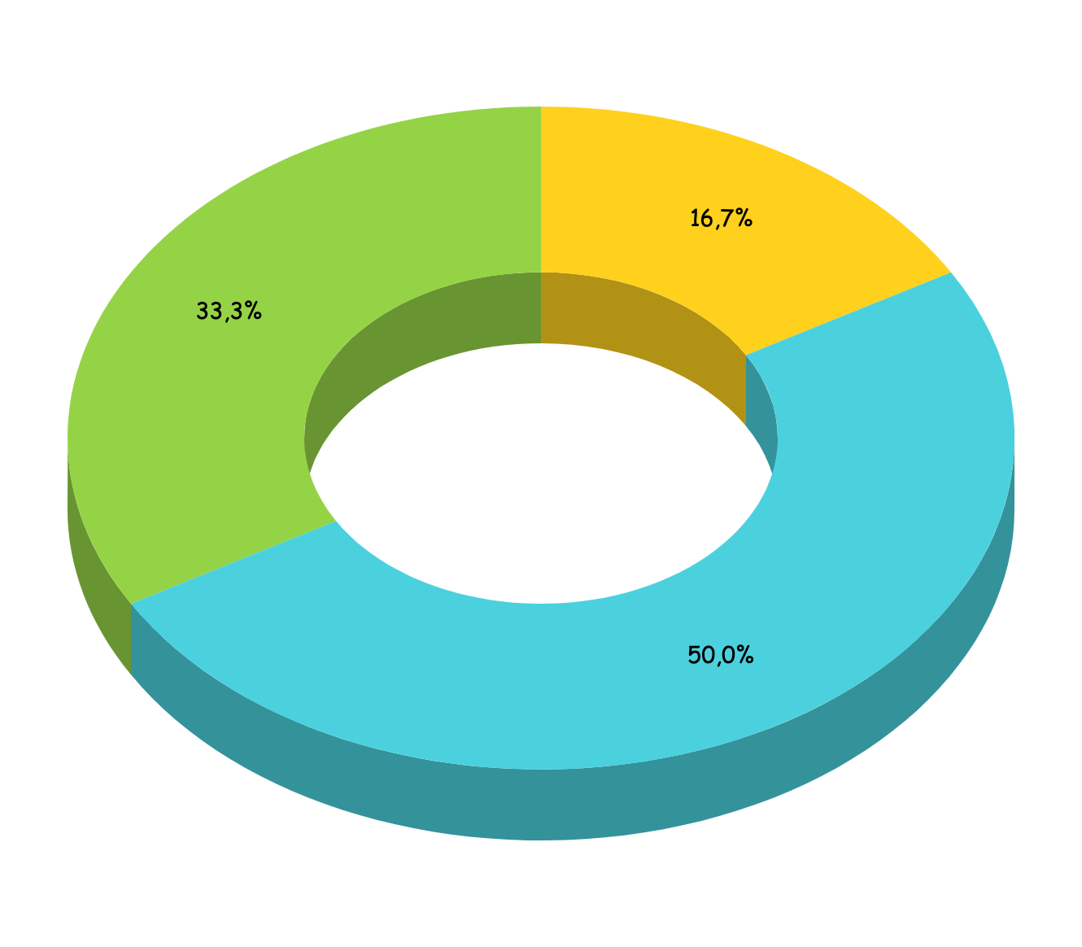
NEU Alumni Rating as per Company
Alumni currently working Tier-2 Company
Alumni currently working Tier-3 Company
Alumni currently working Tier-1 Company

Slide 10
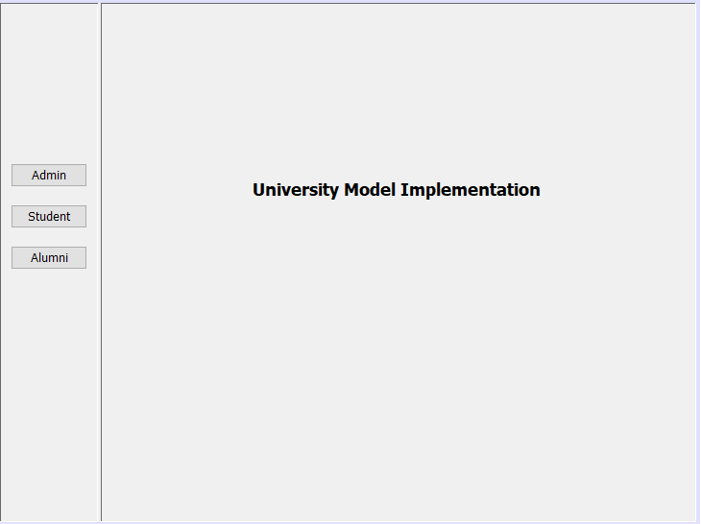
GUI REPRESENTATIONS

Slide 11
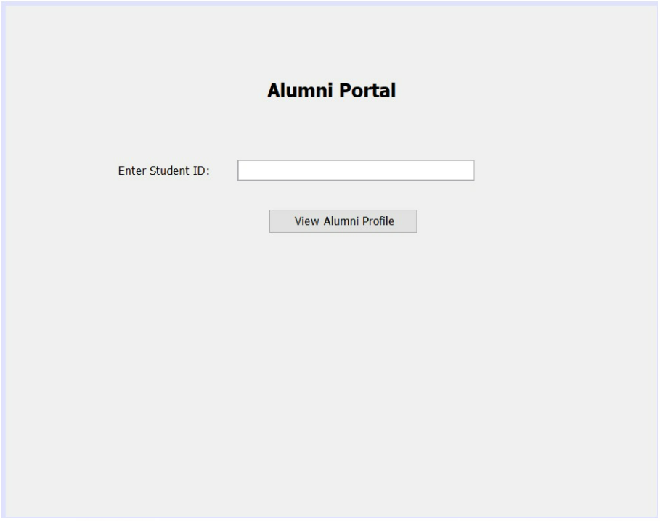
GUI REPRESENTATIONS

Slide 12
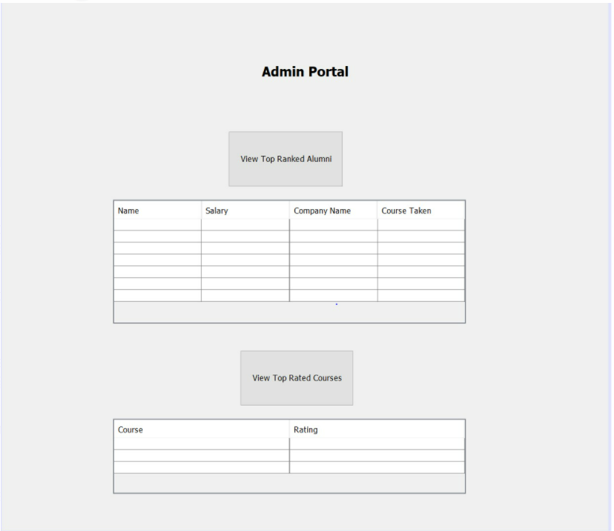
GUI REPRESENTATIONS

Slide 13
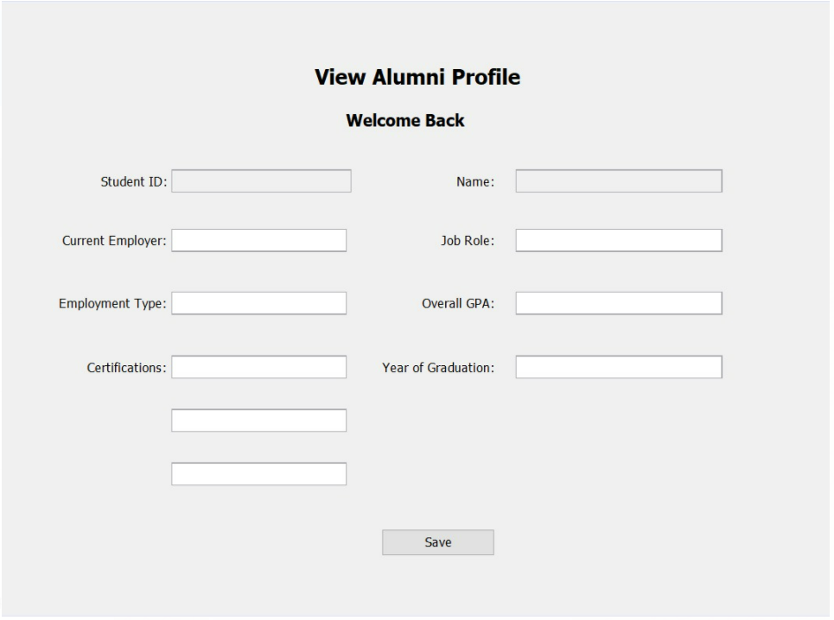
GUI REPRESENTATIONS

Slide 14
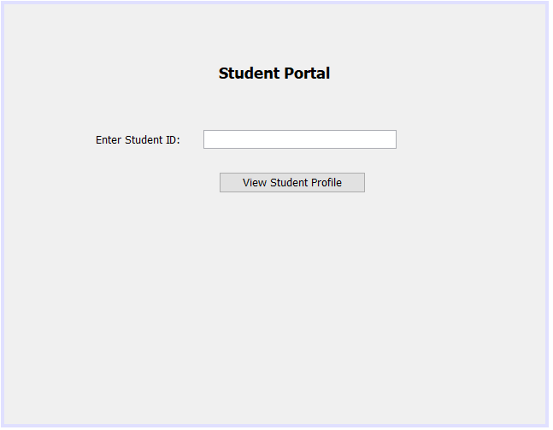
GUI REPRESENTATIONS

Slide 15
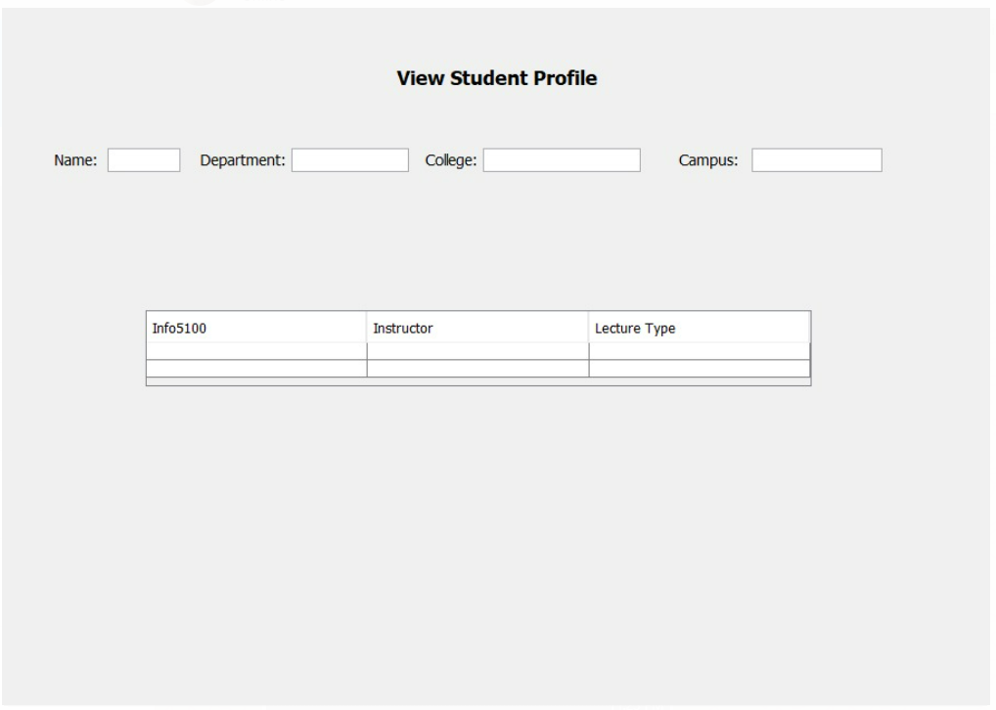
GUI REPRESENTATIONS

Slide 16
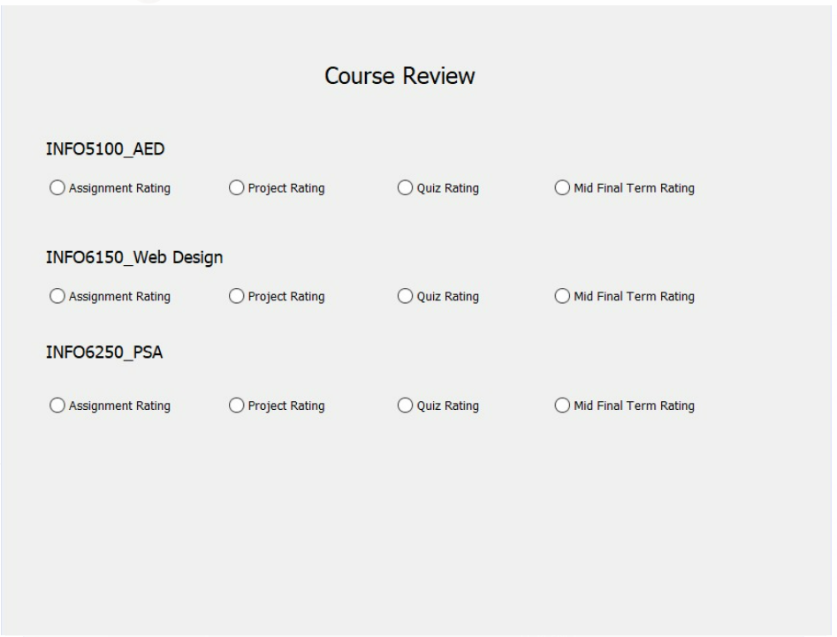
GUI REPRESENTATIONS

Slide 17
THANK YOU!!!

