Slide 1


AZKASHINE SOFTWARE & SERVICE PVT.LTD
BENGALURU
www.azkashine.com

Slide 2
Dynamic Data Intelligence Platform
www.azkashine.com

Slide 3
Executive Summary
The Dynamic Data Intelligence Platform is an innovative AI-driven solution that:
Automatically converts raw, unstructured data into domain-specific insights and analytics dashboards.
Uses advanced data-processing frameworks to identify the type of uploaded data.
Determines the relevant business domain and context automatically.
Instantly generates meaningful visualizations, KPIs, and performance metrics tailored to that domain.
Key Business Impact:
Addresses the major challenge of interpreting large and unstructured datasets.
Eliminates the dependency on data engineers or analysts for manual analysis.
Accelerates the time-to-insight through automation and intelligent data understanding.
Empowers business teams to make faster, more informed, and data-driven decisions.
www.azkashine.com

Slide 4
Project Objectives
The main objectives of the Adaptive Data Intelligence Platform are to:
Automate data understanding – Identify the domain or industry context of uploaded CSV files.
Accelerate insights generation – Instantly create domain-relevant analytics dashboards and KPIs.
Enable natural language exploration – Allow users to ask questions and obtain explanations directly from their data.
Enhance decision accuracy – Provide real-time insights customized to the dataset’s business logic.
Reduce manual workload – Eliminate repetitive dashboard creation and metric configuration.
Next phase: Integrate Agentic AI to enable autonomous data analysis and continuous learning, allowing intelligent agents to refine domain detection, insights, and recommendations dynamically.
www.azkashine.com

Slide 5
Scope of Work & Key Features
The scope of this engagement covers the design, development, deployment, and support of the Adaptive Data Intelligence Platform. Key features include:
Smart Data Upload: Accepts CSV datasets of varying formats.
Automatic Domain Detection: Recognizes data context (e.g., retail, healthcare, finance) using pattern analysis.
Adaptive Dashboards: Generates visualizations and KPIs aligned with the identified domain.
AI-Powered Chat Interface: Users can explore insights through natural language queries.
Dynamic Metrics: Real-time generation of relevant statistics using AI models.
Responsive Web Interface: Built with React + Tailwind for flexibility and accessibility.
Seamless API Communication: Backend powered by FastAPI for high performance.
Context-Aware LLM Integration: Uses Groq API with LangChain for intelligent interpretation and domain-specific context.
Next phase: In upcoming phases, the platform will extend beyond CSV uploads to support direct database integrations—enabling seamless connectivity with enterprise data sources for real-time analytics and automated insight generation.
www.azkashine.com

Slide 6
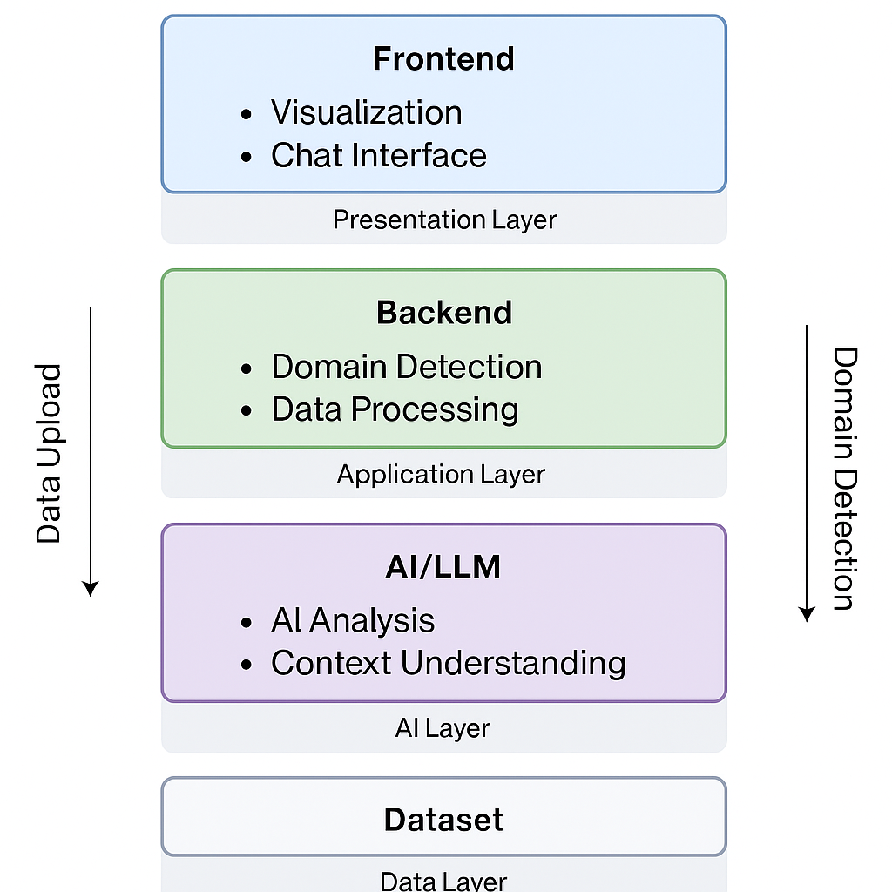
Solution Overview
The solution follows a modular, service-oriented architecture that ensures scalability, security, and maintainability.
Architecture Layers:
Presentation Layer (Frontend – React + Vite)
Provides interactive dashboards and a chat interface.
Uses Redux Toolkit for state management and Recharts for data visualization.
Application Layer (Backend – FastAPI)
Manages API requests for file uploads, domain analysis, and insight generation.
Handles preprocessing, transformation, and storage of processed data.
Intelligence Layer (LangChain + Groq LLM)
Interprets datasets to derive meaningful patterns and insights.
Powers natural-language understanding and domain-adaptive responses.
Data Layer
Temporary and structured storage for processed datasets and metrics.
Supports background preprocessing for optimized performance.
www.azkashine.com

Slide 7
Implementation Timeline & Milestones
Summary: The full implementation spans 20 weeks
Phase | Deliverables | Duration
Discovery & Requirements | Requirement analysis, domain mapping, architecture finalization | 2 Week
Design & Prototype | UI/UX wireframes, data flow diagrams, API contracts | 2 Weeks
Backend & Frontend Development | API endpoints, dashboard modules, data processors | 6 Weeks
AI Integration & Testing | Domain detection, Groq API integration, QA testing | 4 Weeks
User Acceptance Testing (UAT) | Final testing and feedback incorporation | 4 Weeks
Deployment & Documentation | Production deployment, technical & user manuals | 2 Week
Maintenance & Support | Patches, performance monitoring, LLM updates | Ongoing
Note: Additional industry-specific customization and configuration will require approximately 8 more weeks
www.azkashine.com

Slide 8
Assumptions
Value Proposition
Client will provide access to sample datasets for testing.
Required API credentials (Groq API, LangChain) will be available during integration.
Hosting and deployment will be carried out on a client-approved environment (e.g., GCP, AWS).
Data privacy and compliance will align with client’s internal governance policies.
The Dynamic Data Intelligence Platform delivers measurable value by:
Reducing manual reporting and dashboard creation time by up to 80%.
Providing real-time, domain-specific insights for faster strategic decisions.
Offering a scalable and future-ready architecture that can evolve with additional AI capabilities.
Empowering business teams to explore data through simple, conversational interfaces.
Dependencies & Prerequisites
Technical Dependencies: Groq API, LangChain libraries, Python 3.10+, Node.js 18+, FastAPI, React, and Tailwind CSS.
External Integrations: Internet connectivity for LLM APIs, access to CSV sample datasets.
Infrastructure Requirements: Cloud hosting with secure storage
www.azkashine.com

Slide 9
Risk & Mitigation
Risk | Mitigation Strategy
Data quality issues | Validate and cleanse uploaded data during preprocessing
Model accuracy drift | Continuous retraining with updated datasets
API latency or unavailability | Implement caching and fallback responses
Integration dependencies | Use modular, decoupled service architecture
User adoption challenges | Provide user training and documentation
www.azkashine.com

Slide 10
THANK YOU
www.azkashine.com

Slide 11
Technical Approach & Methodology
The project will follow a structured implementation methodology with emphasis on agility and quality assurance.
Step 1: Data Ingestion & Validation Uploaded CSV files are analyzed for structure, data types, and consistency. Invalid entries are flagged automatically.
Step 2: Domain Recognition Algorithms analyze headers, values, and statistical patterns to infer the domain (e.g., sales, healthcare, logistics).
Step 3: Data Processing & Metric Generation System computes key metrics (sales trends, inventory turnover, patient ratios, etc.) based on detected domain.
Step 4: Visualization & Dashboard Creation React-based dashboard displays metrics with context-adaptive layouts and charts.
Step 5: Conversational Insight Generation LangChain + Groq integration enables users to query data in natural language and receive instant, context-aware responses.
Step 6: Continuous Optimization Feedback loops improve model accuracy and performance over time.
www.azkashine.com

