Slide 1


“HDFC-Capstone Project”
Submitted by: Prasad B. Badwar
Submission type : Individual
Name: Prasad Bhausaheb Badwar
Batch : I
LMS Id :
Program : HDFC-API Developer
Date: 27/04/2023

Slide 2

Table of contents
Introduction
Project Overview
Architecture Design
Back-end Development
Testing
Deployment
Conclusion
References
Appendices

Slide 3
Introduction
A capstone project is a culmination of the knowledge and skills gained throughout an HDFC API Developer program to apply learning to a real-world project.
In this project, I have focused on developing a software solution that utilizes a single "getmapping" method to extract data from a database with some encryption format.
Throughout this project, I have utilized various Java Spring Boot libraries and frameworks, including Spring Data JPA, Lombok, Spring Validation, and PostgreSQL , to develop an efficient and user-friendly software solution. I have also implemented various data securing algorithms, like SSL validation,
AES algorithm to extract meaningful insights from employee data. Also integrate project with GitHub, Jenkin, Docker and Kubernetes.

Slide 4





Project Overview
Features:
SSL Configured
Data Encryption and Decryption-AES256
CI/CD Pipeline
Tools & Technology:
Language : Java
Framework: Spring Boot Rest API, Spring Data JPA
Database: PostgreSQL 14.7
Software : Eclipse, GitHub, Jenkin, Docker, Minikube.

Slide 5
Architecture Design
DTO Layer
Postman/
Swagger
Controller
Service
Repository
Database
Entity
Fig. Architecture Design Diagram

Slide 6
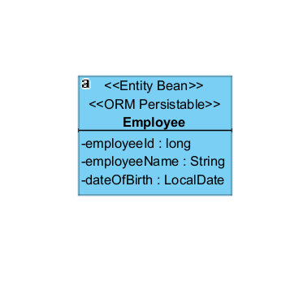
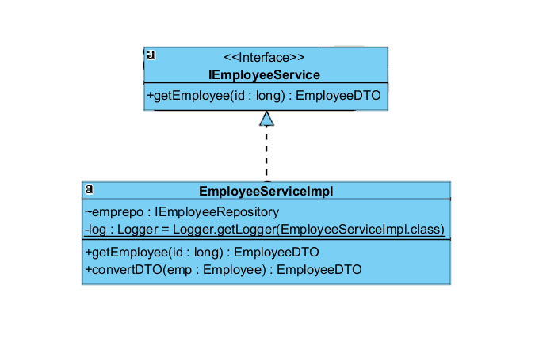
Architecture Design
Entity Class Diagram
Service Class Diagram

Slide 7
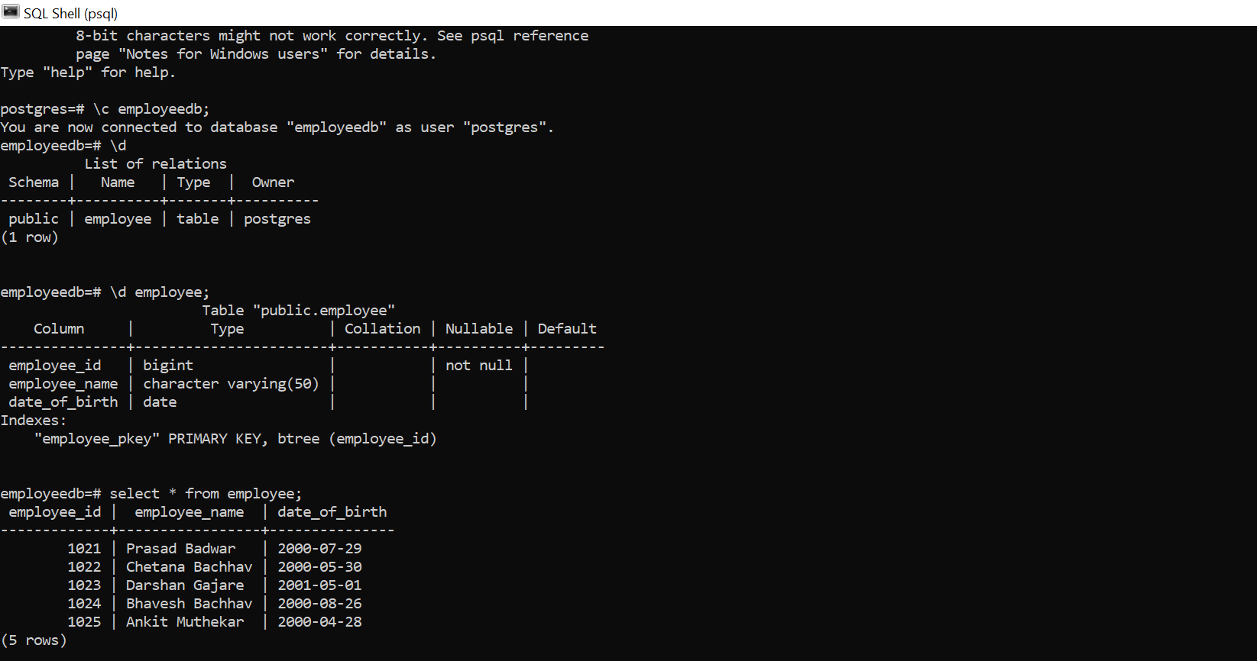
Back-end Development

Slide 8
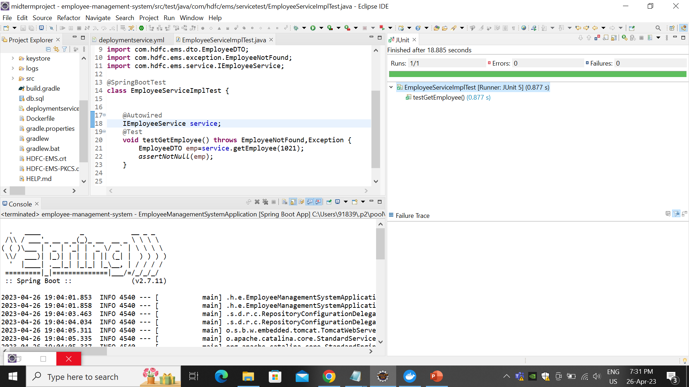
Integration and Testing

Slide 9
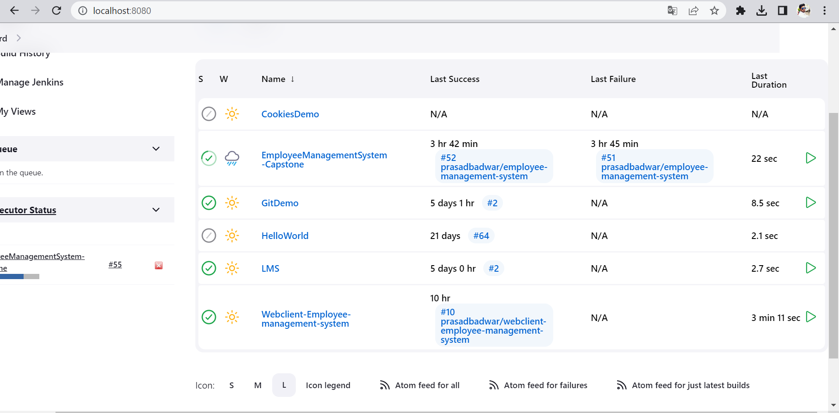

Slide 10
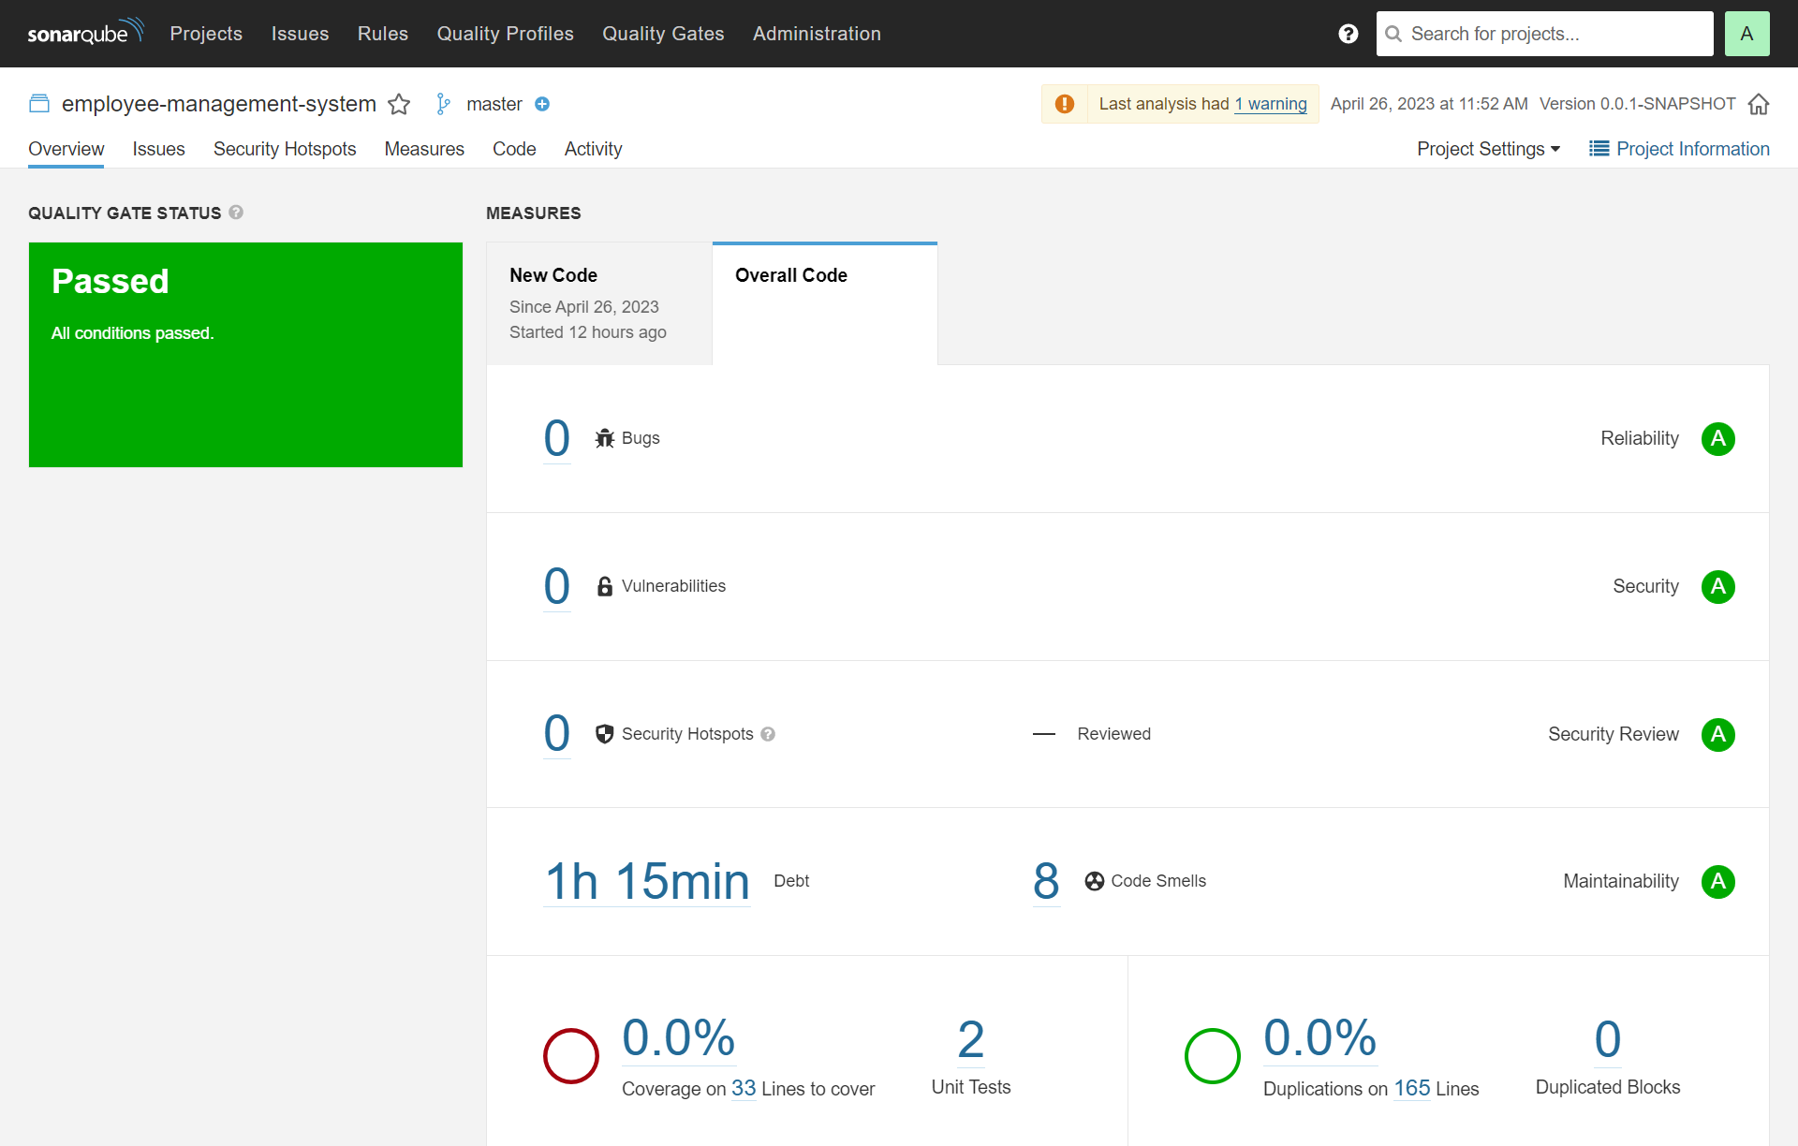

Slide 11





Deployment
Integrate GitHub with Jenkin
Creating image and
push to Docker hub
Upload Project to GitHub
Deploy image on Kubernetes

Slide 12
Conclusion
The software solution developed in this project has wide-ranging applications across industries, including human resources, finance, and operations. By leveraging the "employee getmapping" method, my software solution can provide users with actionable insights that can be used to optimize operations, improve employee performance, and inform decision-making processes.
Overall, this capstone project showcases my proficiency in Java Spring Boot programming, employee data processing, and demonstrates the potential of the "employee getmapping" method to generate valuable insights for various industries.

Slide 13
References
11Weeks of Training under Trainer Mr. Javeed Sir - Manipal Global Academy
Jenkin-Kubernetes Integration
https://sweetcode.io/how-to-deploy-an-application-to-kubernetes-cluster-using-jenkins-ci-cd-pipeline/
SSL Certificate validation https://www.thomasvitale.com/https-spring-boot-ssl-certificate/
Log File https://howtodoinjava.com/spring-boot2/logging/spring-boot2-log4j2-properties/

Slide 14
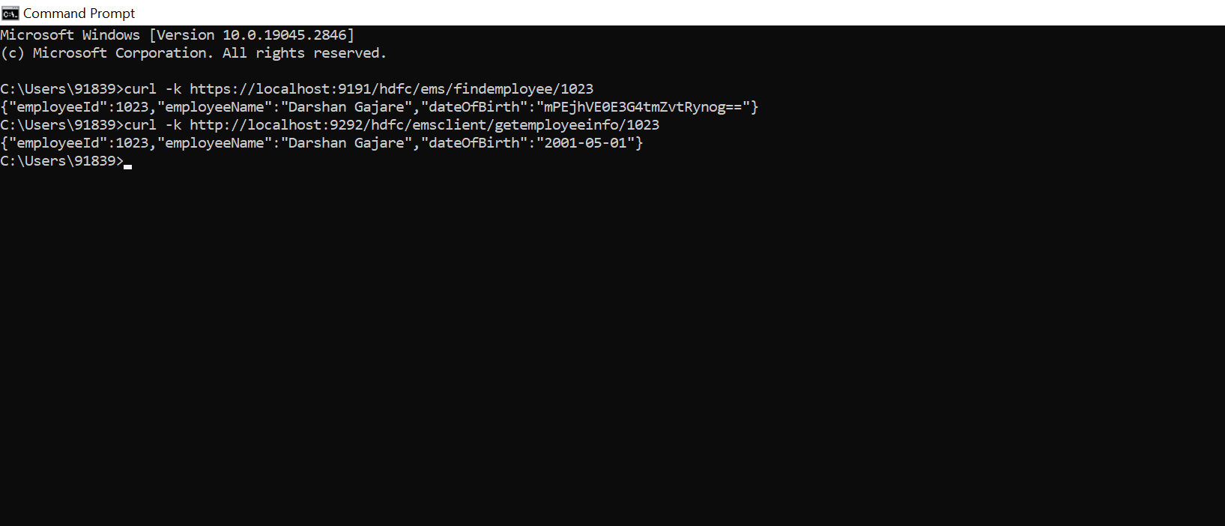
Appendices

Slide 15
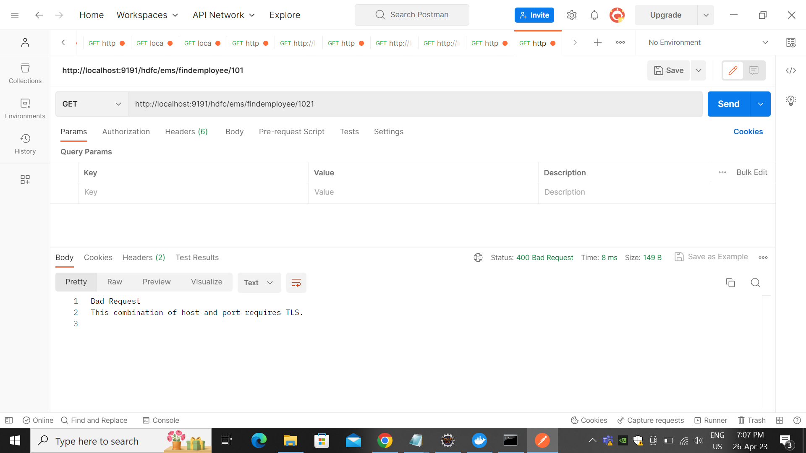

Slide 16
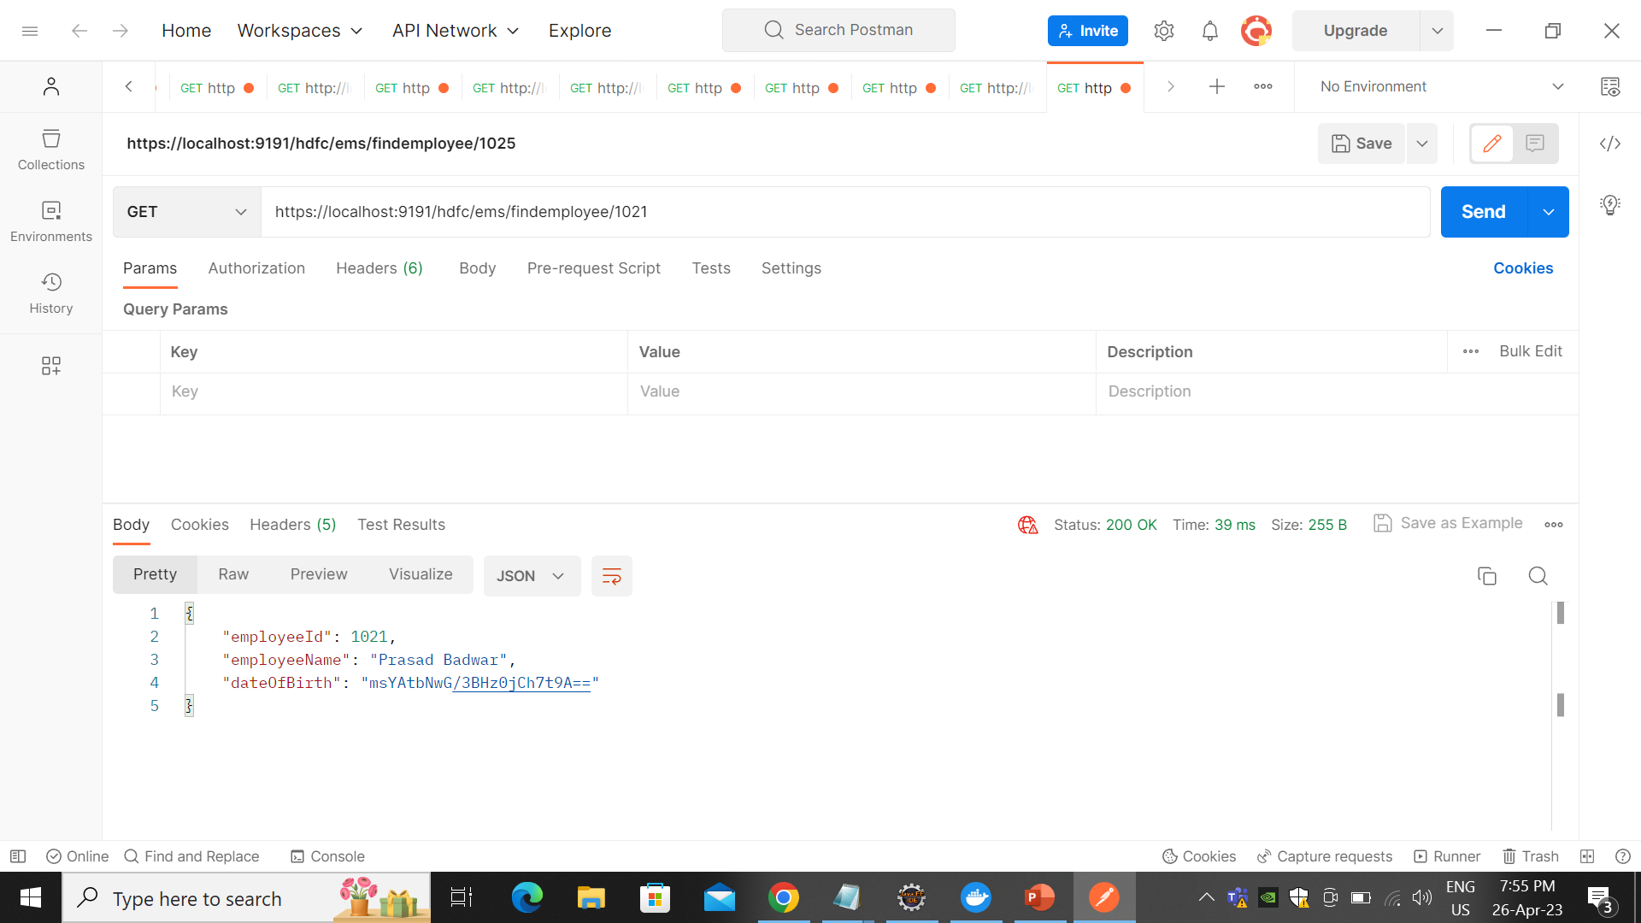

Slide 17
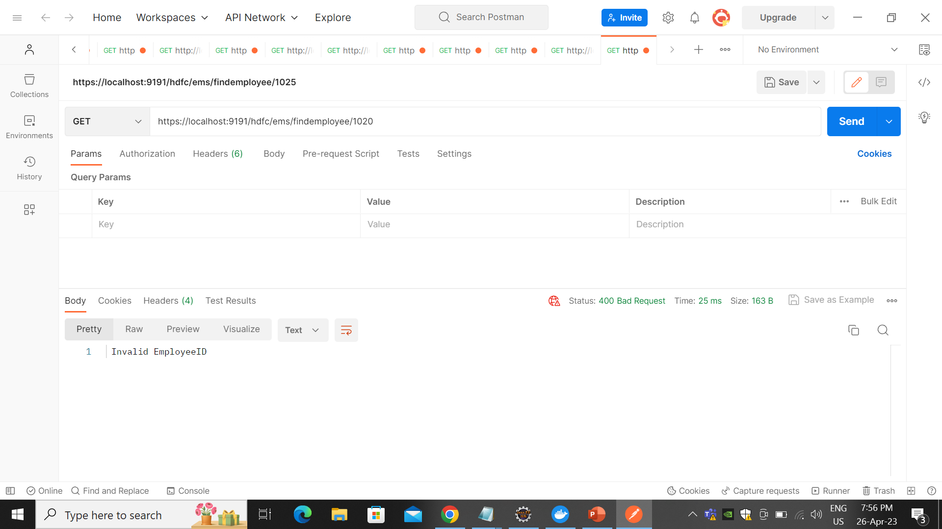

Slide 18


Slide 19
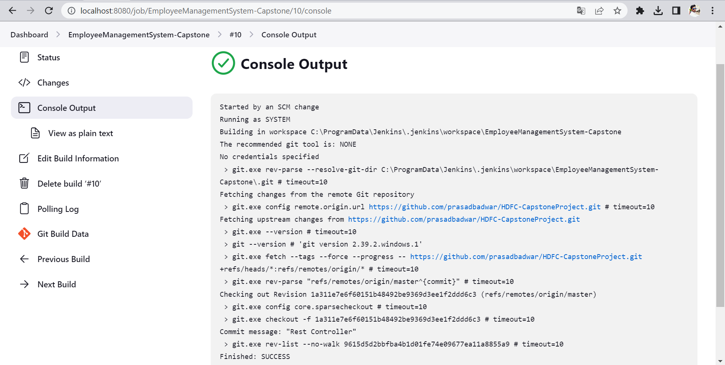
Integrate Github with Jenkin

Slide 20
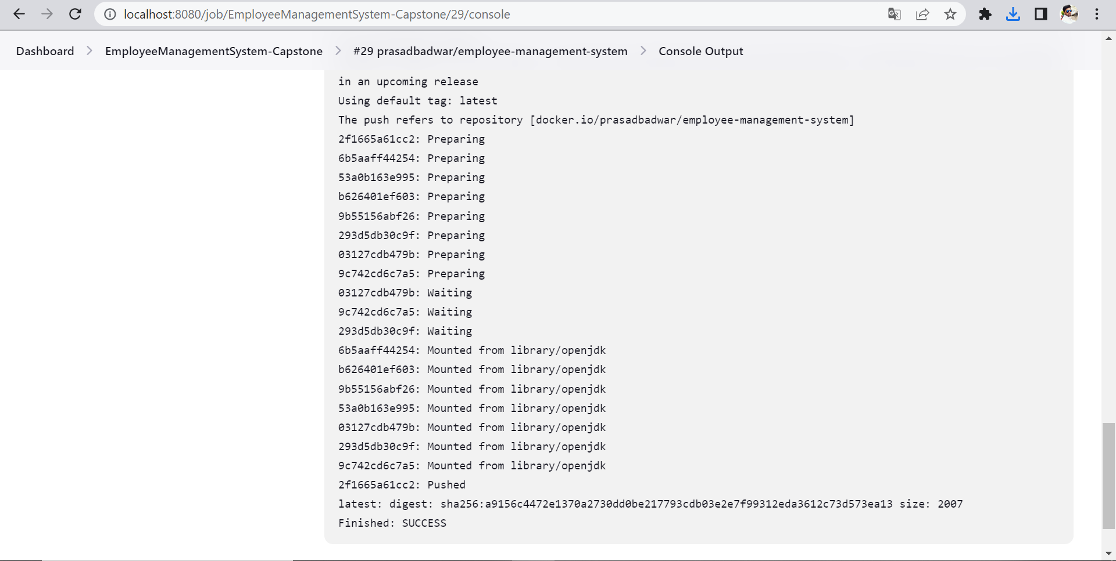
Pushed Image to Docker Hub

Slide 21
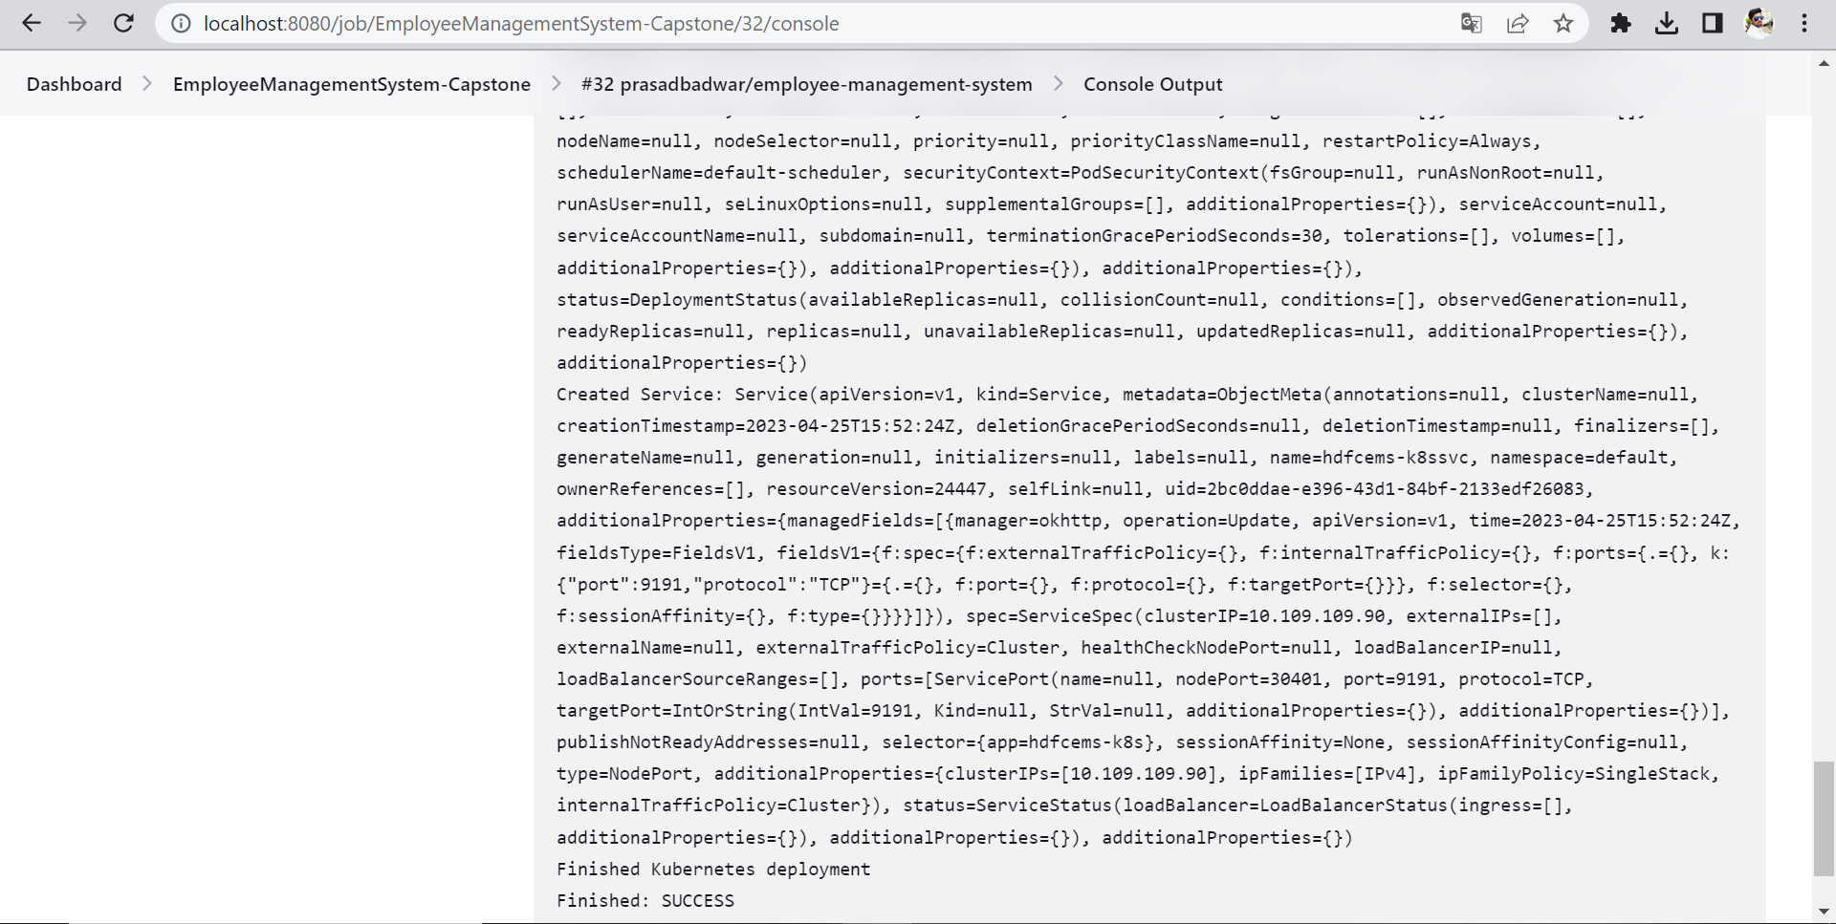
Deploy Docker Image on Kubernetes

Slide 22
Thank You

