Slide 1

Ansible 2.9 Day2

Slide 2
Agenda
Ansible Modules.
Inventory.
Ansible Configuration File. (Ansible.cfg)

Slide 3
What is Ansible Modules?
Modules do the actual work in Ansible, they are what gets executed in each playbook task.
Typically written in Python (but not limited to it)
● Modules can be idempotent
● Modules take user input in the form of parameters

Slide 4
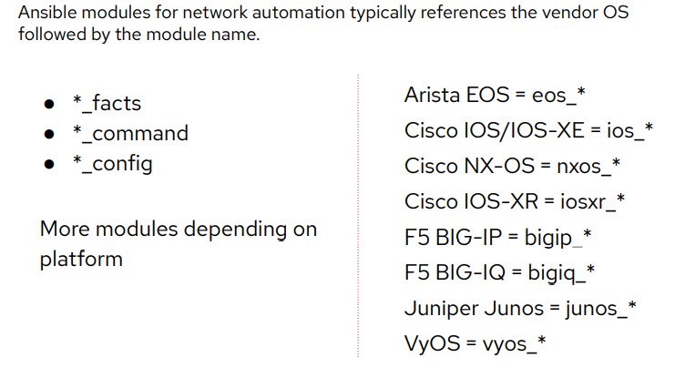
Network modules

Slide 5
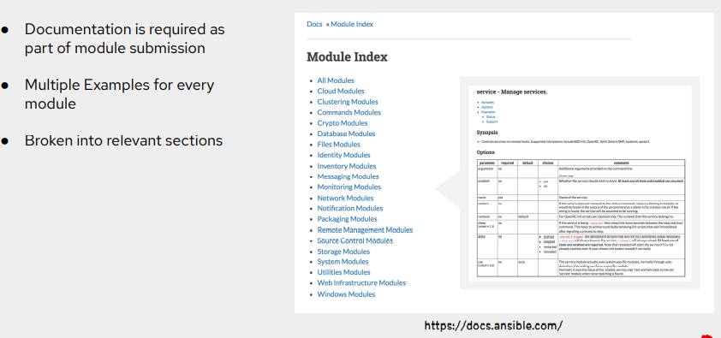
Module Documentation

Slide 6
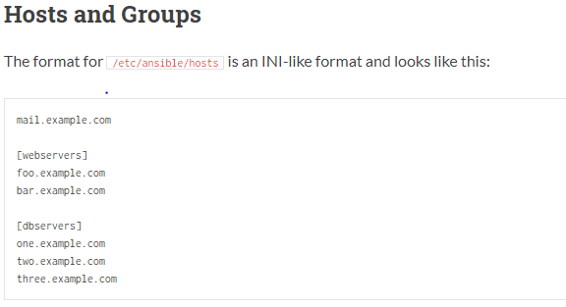
Inventory

Slide 7
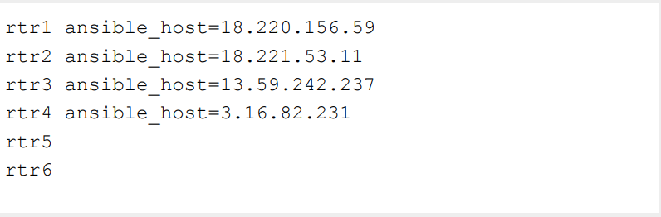
Including Hostname And IP Aswell.

Slide 8
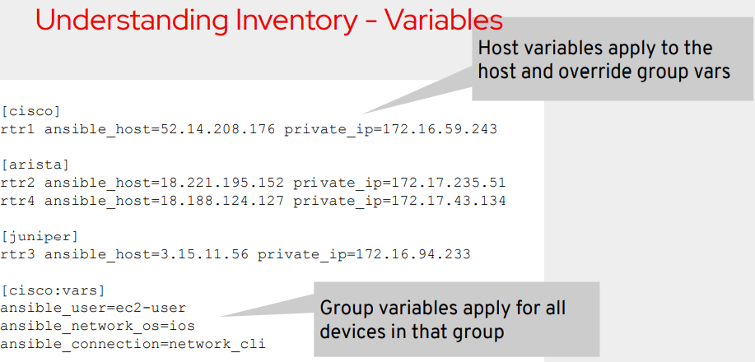
Variable inside Inventory.

Slide 9
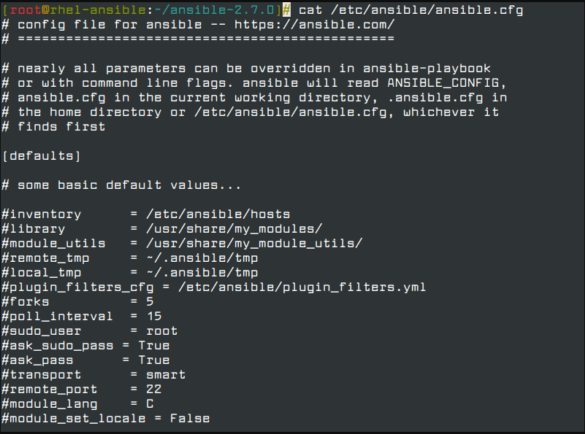
Ansinble Configuration File

Slide 10
Few Ansible.cfg Options
[defaults]
Host_key_checking=False
Gather_timeout=20
Command_timeout=30
Inventory_path = ~/inventory

Slide 11
DEMO AND Q&A

Slide 12
Thank you!

