Slide 1

Ansible 2.9 Day4

Slide 2
Agenda
Ansible Mode of working.
Ad-hoc Commands
Playbook.
YML syntax.

Slide 3
Ansible mode of working.
Ad-hoc commands.(not used often, but good to know.)
Playbooks YML (Widely used.)

Slide 4
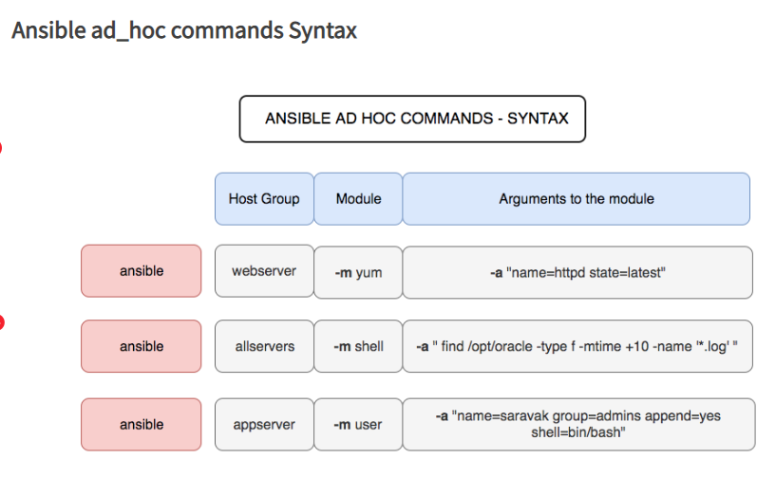
Ad-hoc commands:-

Slide 5
Few Ad-hoc commands network
Syntax:-
Ansible <remote host/group> -m <module name> -a <argument> -i <inventory name>
E.g:-
Ansible ios –m raw –a “show version” –i inventory
Ansible ios –m ping –c local –i inventory
Ansible ios –m ios_command –a “command=‘show ip interf bri’” –c local –i inventory
Ansible ios –m ios_config –a “lines=’ip access-list standard test123’” –c local –i inventory

Slide 6
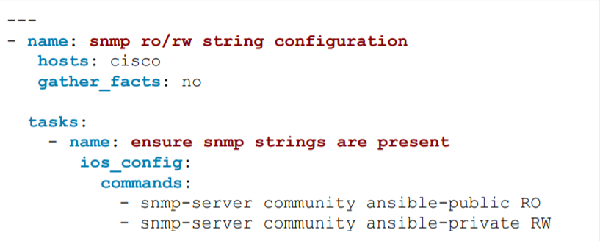
Playbook:-
Playbook is a collection of tasks which will execute from top to bottom.

