Slide 1

Ansible 2.9 Day1

Slide 2
Agenda
What is Ansible?
What can be done using Ansible?
Why Ansible? (Advantages)
Ansible Detailed Architecture.
Q&A
Demo

Slide 3
What is Ansible?
Ansible is an simple open-source IT Automation tool. Used to automate infrastructure.
It uses SSH to connect to remove device and run the configured Tasks.

Slide 4
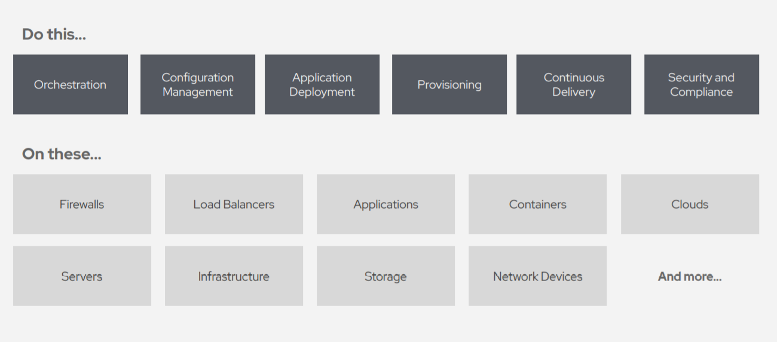
What can be done using Ansible?

Slide 5
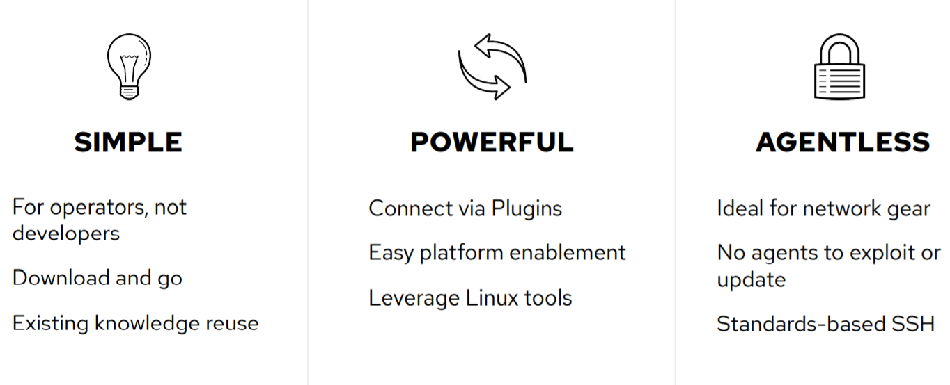
WHY ANSIBLE?

Slide 6
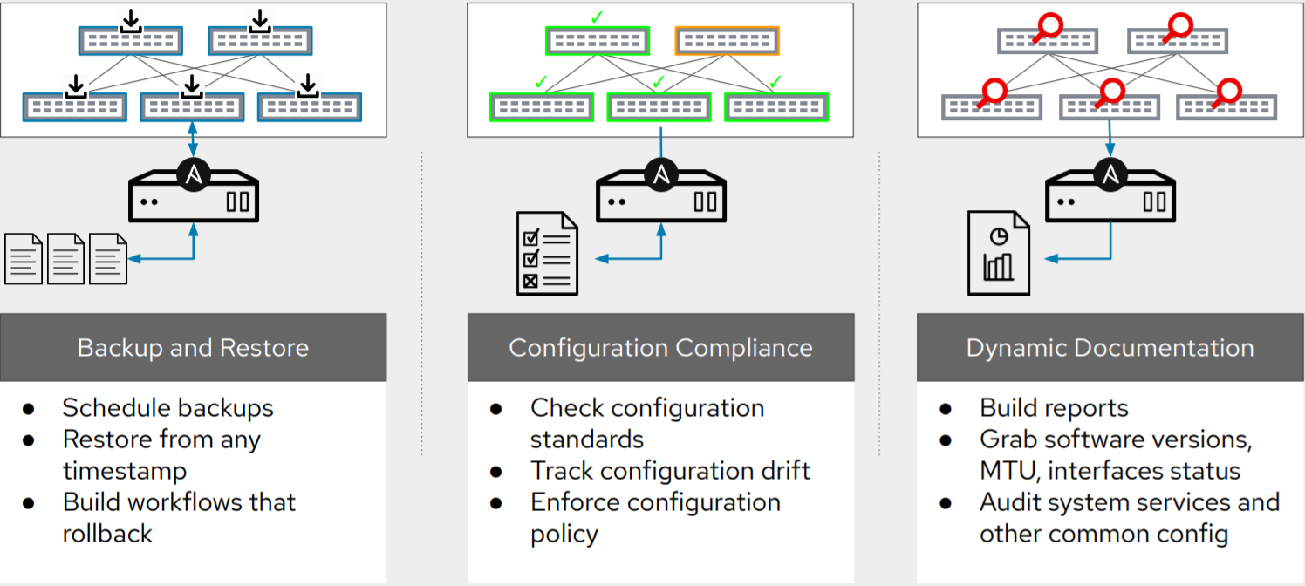
Common Used Cases:-

Slide 7
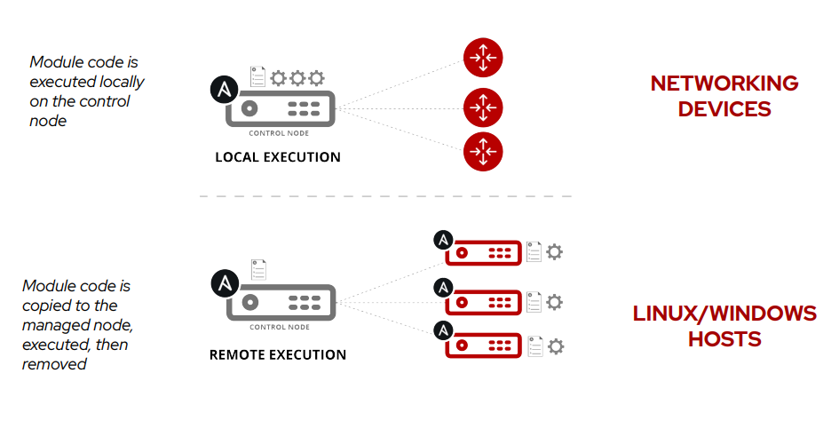
How Ansible Network Automation Works

Slide 8
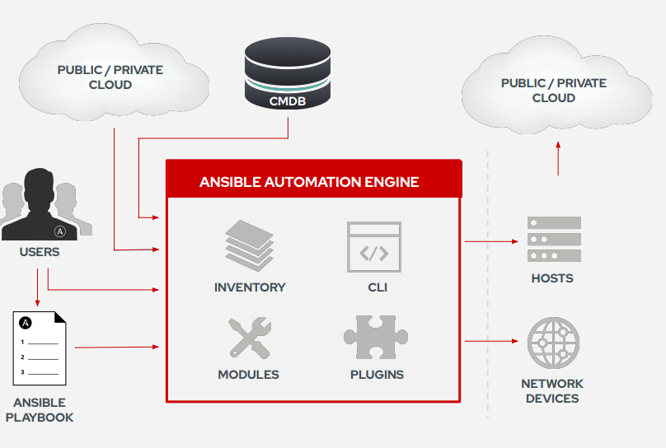
Detailed Architecture.

Slide 9
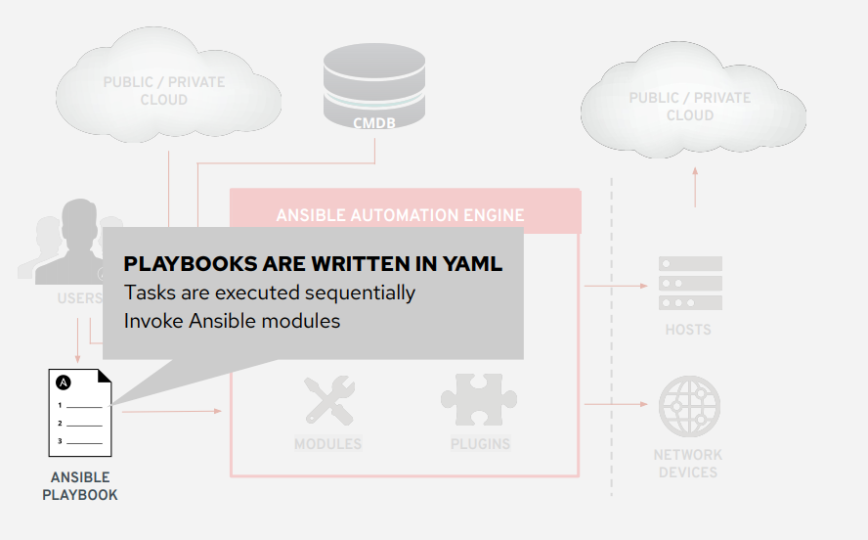
Playbook

Slide 10
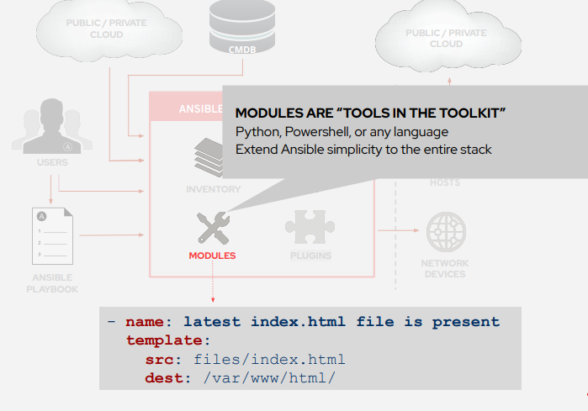
Module

Slide 11
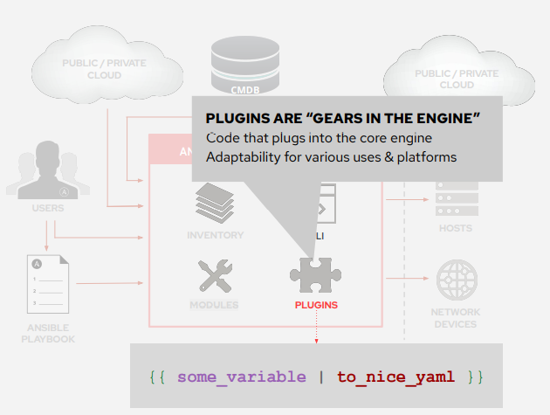
Plugins

Slide 12
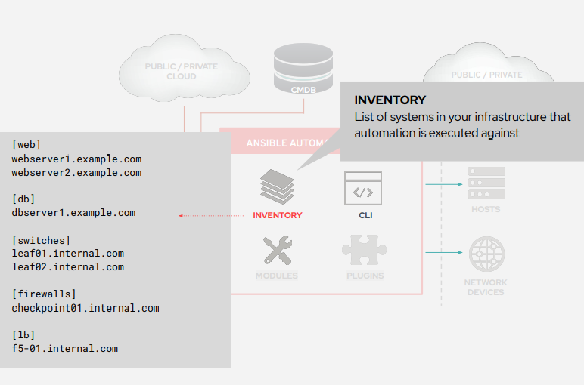
Inventory

Slide 13
DEMO AND Q&A

Slide 14
Thank you!

