Slide 1
JSPM's Rajarshi Shahu College of Engineering, Tathawade, Pune
(An Autonomous Institute affiliated to Savitribai Phule Pune University)
Department of Computer Science and Business Systems
FoundIt
A Campus Lost and Found Web Application
Matching lost and found reports automatically, and verifying ownership before anything changes hands
Prasad Bhalerao (RBT24CB026)
Course Coordinator: Prof. Rutuja S. Bachhav
Skill Development Lab-II | Academic Year 2026-27

Slide 2
Index
1. Introduction
2. Problem Definition & Objectives
3. Literature Survey
4. Feasibility Study
5. System Design & Architecture
6. Technology & Tools Used
7. Implementation & Results
8. Conclusion & References
FoundIt | Skill Development Lab-II
2

Slide 3
Introduction
What the project is, and why the problem is worth solving
A campus loses and finds things every day. Wallets, identity cards, earphones and hostel keys change hands constantly, and most lost items are found by somebody within hours.
The difficulty is not a shortage of honest finders. It is that the person who lost an object and the person holding it have no dependable way to find each other.
FoundIt is a web application that closes that gap, and then answers the harder question that follows: how do we know the person collecting the item is actually its owner?
Why it matters
• Shared spaces concentrate thousands of people and their belongings.
• Recovery today depends on chance encounters and word of mouth.
• Nothing records who received an item, or on what basis.
FoundIt | Skill Development Lab-II
3

Slide 4
Problem Definition & Objectives
Existing approaches fail in two distinct ways, and a system must address both.
1. Discovery
Two reports describing the same object never meet, because nothing compares them.
2. Verification
Publishing enough detail to be recognised also teaches a false claimant exactly what to say.
Objectives
# | Objective
1 | Centralise lost and found reporting in one searchable board
2 | Identify likely matches automatically, and explain every suggestion
3 | Verify ownership through a structured claim before any handover
4 | Keep the detail that proves ownership out of public view
5 | Record every report, decision and return for accountability
FoundIt | Skill Development Lab-II
4

Slide 5
Literature Survey
How the problem is handled today, and what is missing
Existing approach | How it works | Limitation
Physical notice board | Handwritten slips in a corridor | Seen only on location; never updated when an item is recovered
Security desk register | Found items logged in a book | Searchable only by asking staff, during office hours
Class / hostel chat groups | Messages forwarded to a group | Reaches one cohort; scrolls out of view within a day
Generic lost-found portals | Keyword search over listings | Matching left to the user; no ownership verification
Gaps identified
• Discovery is manual - nothing proposes that two reports describe the same object
• Verification is absent - systems stop at putting two people in contact
• No auditable record of what was returned, to whom, or on what basis
FoundIt | Skill Development Lab-II
5

Slide 6
Feasibility Study
Technical
• Built entirely on mature, documented technology: Jakarta EE 10, MySQL 8, GlassFish 7.
• No external services or paid APIs; the JDK supplies the cryptography.
• Runs on a single laboratory machine, deployed as one WAR file.
Financial / Business
• Every component is free and open source, so licensing cost is zero.
• Hosting is a single existing server; no recurring infrastructure spend.
• Value is recovered belongings and staff time saved at the security desk.
Operational
• Students already own the workflow; no staff member must mediate.
• The finder decides, so the institution carries no verification burden.
• Administrators moderate by exception rather than handling every case.
Conclusion: the project is feasible on all three counts and was built and deployed within the course timeline.
FoundIt | Skill Development Lab-II
6

Slide 7
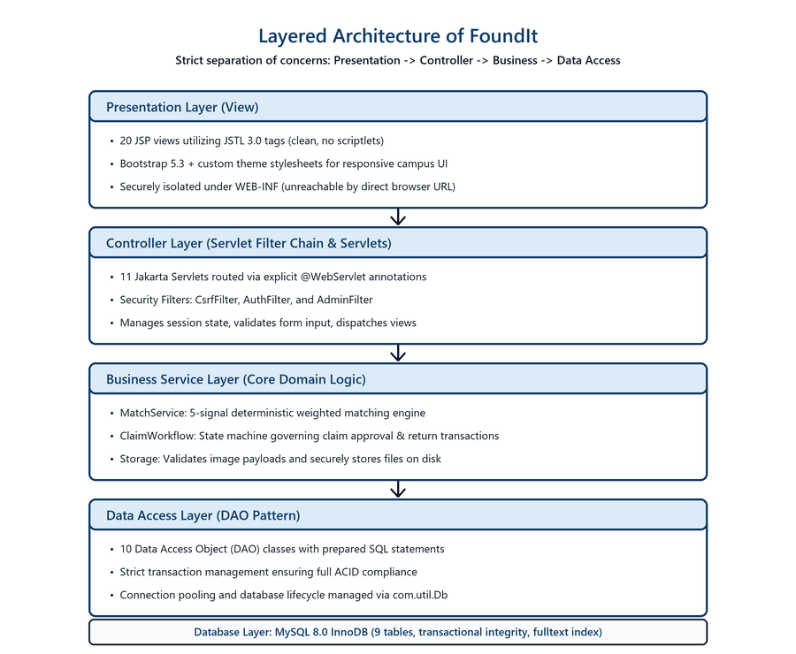
System Design & Architecture
Layered design: no layer reaches past the one below it
Design rules
• A view never touches a database connection.
• A data access class never writes HTML.
• Views live under WEB-INF, so no page can be reached by URL without passing its servlet.
• Business rules sit in services, not scattered across servlets.
FoundIt | Skill Development Lab-II
7

Slide 8
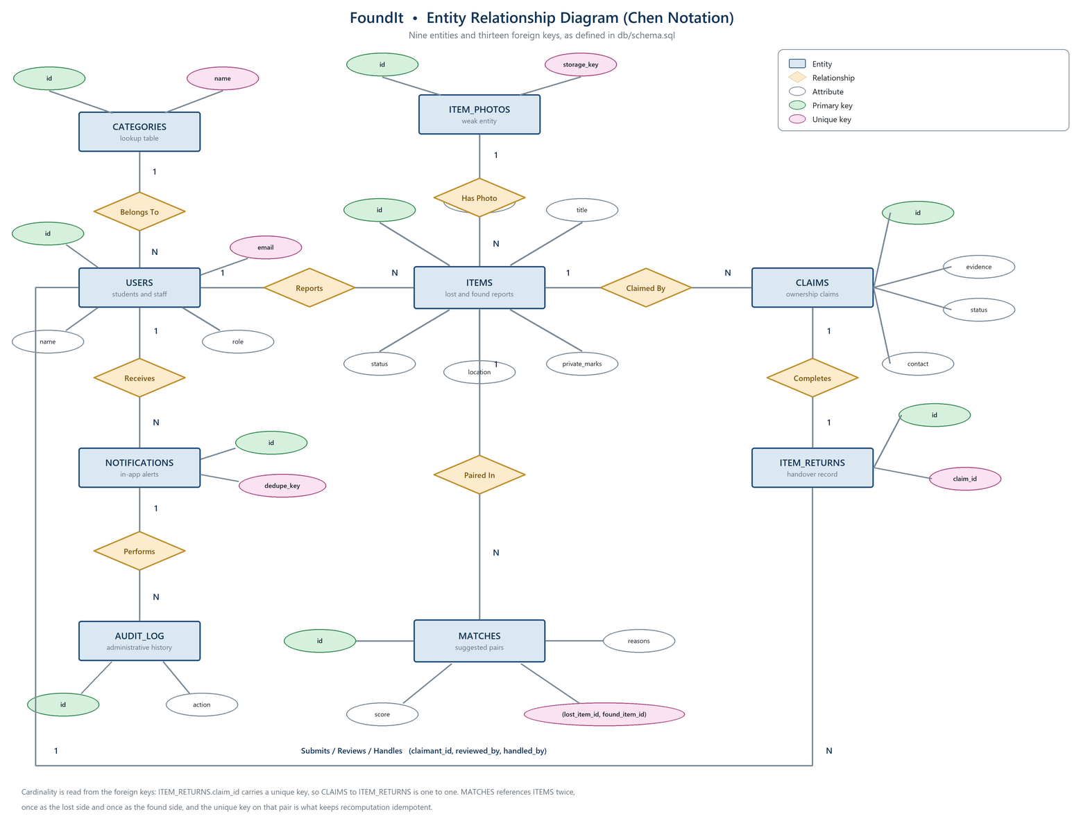
Database Design
Nine entities in third normal form, thirteen foreign keys
Constraints that carry logic
matches
A unique key on the (lost, found) pair makes recomputation idempotent: scores refresh, duplicates cannot accumulate.
notifications
A unique dedupe key makes notify-once a guarantee of the database, not a hope of the application.
deletion
Claims and returns refuse deletion, which forces the system to close and deactivate rather than destroy history.
FoundIt | Skill Development Lab-II
8

Slide 9
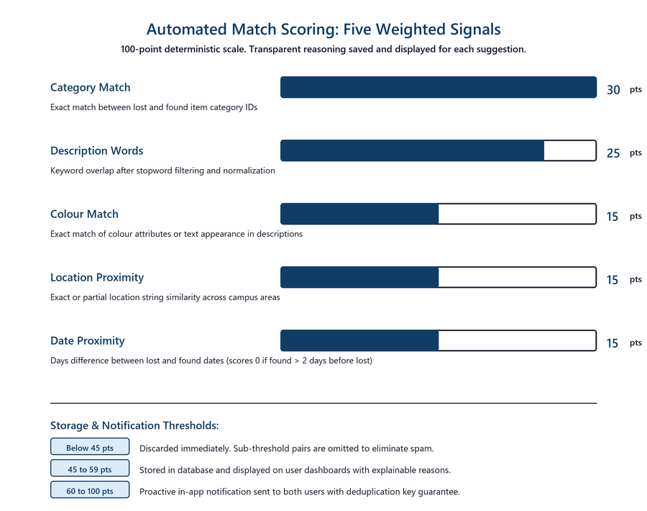
The Matching Engine
A deterministic weighted score, and the reason behind it
Worked example
Lost: hostel key, red tag, sports ground
Found: two keys, red tag, ground gate, next day
Same category +30
Shared words +22
Same colour +15
Nearby place +10
One day apart +15
92 / 100 Strong
The five reasons are stored with the match and shown to the user.
FoundIt | Skill Development Lab-II
9

Slide 10
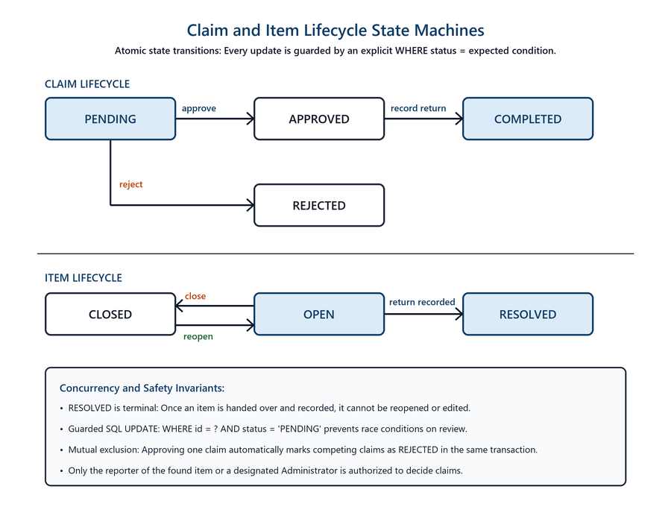
Claim & Return Workflow
The algorithm proposes; a person decides
Guarantees
• Every transition is guarded by the status it comes from, so an illegal jump cannot happen.
• Two reviewers clicking at once cannot both succeed.
• Approving one claim rejects the others, so two people are never both told they are the owner.
• A return runs as one transaction across five tables.
FoundIt | Skill Development Lab-II
10

Slide 11
Technology & Tools Used
Layer | Technology
IDE | Apache NetBeans (Ant)
Language | Java 17
Web | Jakarta EE 10, Servlet 6.0, JSP, JSTL 3.0
Server | GlassFish 7.1.1
Database | MySQL 8.0, Connector/J 9.7
Front end | HTML5, CSS3, Bootstrap 5
Security | PBKDF2-HMAC-SHA256 (JDK)
Security measures
• Passwords hashed with PBKDF2, 120,000 iterations, per-user salt
• CSRF token required on every state-changing request
• Every SQL statement prepared; no query built from user input
• All user content escaped on output
• Role fixed server-side, so no form can create an administrator
• Uploads must decode as an image; filenames never trusted
• Photographs served by id, never by path
FoundIt | Skill Development Lab-II
11

Slide 12
Implementation & Results
41
20
9
5
100%
Java classes
JSP views
database tables
scoring signals
match precision
Functional Verification
Matching accuracy on seeded data
Workflow Module | Observed Outcome
Authentication & RBAC | Role checks & session security verified
Lost & Found Reporting | Multipart image upload & validation
5-Signal Matching | Automatic scoring on item publish
Claim & Evidence Review | Private marks withheld from public
Handover & Return | Atomic return logging & audit trail
Candidate Pair | Score
Hostel keys <-> keys at ground gate | 92%
Earphones case <-> case on lab table | 86%
Brown wallet <-> wallet at canteen | 76%
Unmatched reports (ID, calculator) | No false match
Three genuine pairs identified; zero false positives.
FoundIt | Skill Development Lab-II
12

Slide 13

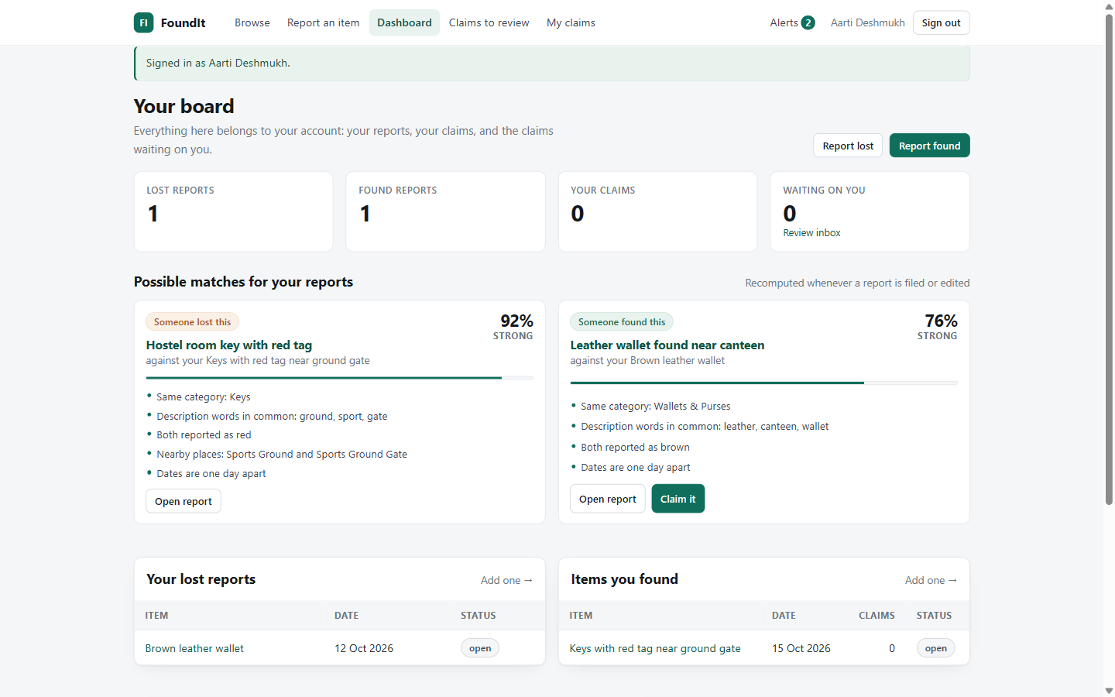
The Application
Running on GlassFish 7.1.1 with the seeded dataset
Browse: filters and found-item reports
Dashboard: scored match suggestions
FoundIt | Skill Development Lab-II
13

Slide 14
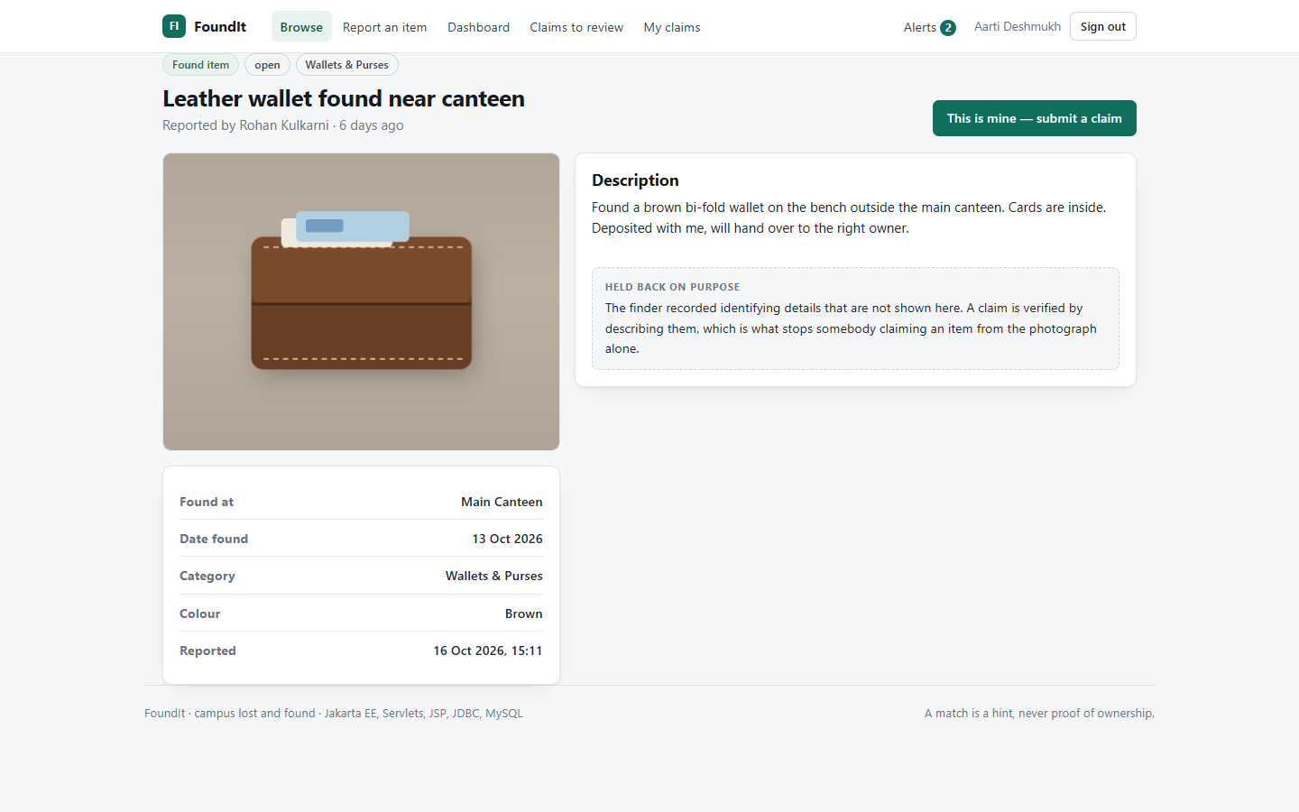

Verification in the Interface
The identifying detail is withheld, and the finder decides
Report detail: the held-back identifying detail
Administration: counts, claims and audit trail
FoundIt | Skill Development Lab-II
14

Slide 15
Conclusion
FoundIt shows that a campus lost-and-found service becomes markedly more useful when two capabilities are added to simple listing:
automatic matching, so the two halves of a case find each other without anybody searching, and structured verification, so an item is released only to someone who can describe what the public page does not show.
Correctness guarantees were placed in the layer best able to enforce them: uniqueness and deduplication in the database, status transitions inside the SQL that performs them, and authorisation on the server for the specific record being touched.
Future scope
• Email and push notification delivery
• Image similarity as a sixth matching signal
• Full-text relevance using the existing index
• Photograph attachments on claims
• QR-coded handover receipts
• REST API and a mobile client
FoundIt | Skill Development Lab-II
15

Slide 16
References
[1] M. Al-Mousa et al., Web-Based Lost and Found Information System for University Environments, IEEE ICCIS, 2020.
[2] S. R. Bharambe et al., Automated Lost and Found Management System Using Attribute Matching, IJARCCE, 2021.
[3] Jakarta EE 10 Platform Specification, Eclipse Foundation Standards, 2022.
[4] Jakarta Servlet 6.0 Specification, Eclipse Foundation Standards, 2022.
[5] MySQL 8.0 Reference Manual: InnoDB Storage Engine, Oracle Corporation, 2024.
[6] P. Christen, Survey of Indexing Techniques for Scalable Record Linkage, IEEE TKDE, 2012.
[7] OWASP Top 10 Web Application Security Risks, OWASP Foundation, 2021.
[8] Recommendation for Password-Based Key Derivation: PBKDF2, NIST SP 800-132, 2010.
FoundIt | Skill Development Lab-II
16

Slide 17
Thank you
Questions are welcome
Prasad Bhalerao (RBT24CB026) | github.com/prasadbhalerao1/FoundIt_SDL

