Slide 1
Lag-Based Health Risk Prediction from Urban Air Pollution: A Statistical and Machine Learning Approach Across Indian Cities
NAME: NAGA DESA VARA PRASAD BORRA
ROLL NO: CB.AI.P2DSC25009

Slide 2
PROBLEM STATEMENT
Air pollution is a critical public health crisis in India — PM2.5, NO₂, SO₂, CO, and O₃ are directly linked to respiratory and cardiovascular diseases.
Current systems show only today’s AQI, but health effects often appear 1-3 days later. Predicting next-day risk is important, yet missing.
No existing framework integrates multi-source data + statistical validation + lag-based ML prediction into a single pipeline.
Analyze air quality data from 26 Indian cities (2015–2020), use statistical tests to confirm how pollution affects health, include 1–3 day delay effects, and build accurate machine learning models to predict next-day health risk.

Slide 3
RESEARCH GAP IDENTIFIED
What Existing Studies Did | Gap Identified | Novelty
Predicted AQI as a continuous numerical value | Never classified AQI into actual health risk categories | Converted AQI into simple health risk (0 or 1) for easy understanding
Used only current-day pollutant values for prediction | Ignored the body’s delayed response to pollution. | Created lag features to capture 1–3 day delayed effects of pollution.
Used a single data source (either city-level or station-level) | Did not check or compare results across different data sources. | Integrated 4 data sources — city-day, city-hour, station-day, station-hour — into one unified dataset
Applied parametric statistical tests (t-test, Pearson) on skewed pollution data | Did not meet normal data assumptions, so results may be unreliable. | Applied non-parametric tests (Mann-Whitney U, Kruskal-Wallis) appropriate for right-skewed distributions
Rarely checked how health risk differs across locations | Assumed pollution risk is uniform across cities | Used Chi-Square test to statistically confirm city-wise variation in health risk
Did not address multicollinearity among pollutants | Repeated features increased model errors. | Applied VIF analysis to reduce 12 pollutants to 7 clean, non-redundant features

Slide 4
Air Quality & Health Risk Prediction — Architecture (India 2015–2020)
Phase 1 — Data Sources (5 CSV files · Kaggle · Jan 2015 – Jul 2020)
city_day.csv
city_hour.csv
station_day.csv
station_hour.csv
stations.csv
Daily AQI
+ pollutants
Hourly pollutants
→ daily avg
Station daily
pollutants
Station hourly
→ daily avg
StationId
→ City map
Phase 2 — Preprocessing (29,531 rows · 31 features · zero nulls after imputation)
Deduplication
Pollutant Filter
Final 7 Pollutants
Imputation & Merge
Remove exact
duplicate rows
across all 4 files
Drop >40% missing
Corr > 0.85 removed
VIF > 10 removed
PM2.5 · NO2 · NH3
CO · SO2 · O3
Benzene retained
Median fill · zero nulls
Merge on [City, Date]
Target: Health_Risk
Phase 3 — Exploratory Data Analysis (67.6% High Risk · class imbalance · city-level variation)
Distributions
Risk Group Compare
City Analysis
Station Agreement
Histogram + KDE
All 7 pollutants
Right-skewed (non-normal)
Low vs High Risk
PM2.5: 29 → 81 µg/m³
CO: 0.75 → 2.8
High-risk days ranked
Ahmedabad #1
Delhi · Patna follow
City vs station corr
CO: 0.99 near-perfect
NH3: 0.85 (localized)
Phase 4 — Statistical Validation (5 tests · all results significant at p < 0.001)
Mann-Whitney U (Test 1)
Chi-Square (Test 2)
Kruskal-Wallis (Test 3)
ADF Stationarity (Test 4)
Logistic OR (Test 5)
Low vs High Risk
All 7 pollutants differ
p < 0.001 · PM2.5 largest r
City × Health Risk
Geographic dependence
Cramér's V = Medium
PM2.5 across cities
+ Dunn post-hoc
All city pairs differ
All 7 pollutants
p < 0.05 → Stationary
Lag features valid
Odds Ratios + 95% CI
PM2.5 OR = 2.87
Strongest predictor
Phase 5 — Feature Engineering (21 lag features · 80/20 split · StandardScaler on train only)
Lag Features (1–3 days)
Train / Test Split
Standard Scaler
7 pollutants × 3 lags
= 21 features total
Captures delayed exposure
80% train · 20% test
random_state = 42
~23,623 / 5,906 rows
Fit on train only
Zero mean · unit var
LR / KNN / SVM only (not RF)
Phase 6 — Machine Learning Models (4 classifiers · 21 lag features · classification report + confusion matrix)
Logistic Regression
KNN (k = 5)
SVM (RBF kernel)
Random Forest ★
Baseline · scaled features
Precision / Recall / F1
~85.7% accuracy
Non-parametric · scaled
Distance-based
~85.7% accuracy
Non-linear boundary
Scaled features
86.8% accuracy
100 trees · unscaled
Highest F1 & accuracy
89.2% accuracy
Feature Importance Analysis (Random Forest)
PM2.5 Dominates
Lag Decay
Pollutant Rank
Cumulative Coverage
Lag1–3 = ~48.6%
Top single predictor
Lag1 > Lag2 > Lag3
Lag1 ~45% of total
CO 2nd · SO2 · NO2 · O3
Benzene = least important
Top 3 → ~50%
Top 10 → ~75–80%

Slide 5
DATASET OVERVIEW
SOURCE FILES
FINAL INTEGRATED DATASET
Level | Content
city_day | Daily AQI + Pollutants per city
city_hour | Hourly pollutants aggregated to daily avg
station_day | Daily pollutants per station
station_hour | Hourly pollutants aggregated to daily avg
stations | StationID-City mapping
Parameters | Details
Total Observations | 29,531 city-day records
Time Period | Jan 2015-July 2020
Cities Covered | 26 Indian Cities
Total Features | 31(Before Feature Engineering)
Final Pollutants List | 7 — PM2.5, NO₂, NH₃, CO, SO₂, O₃, Benzene
Lag Features Created | 21 (7 pollutants × 3 lags)
Missing Values | 0 (After Median Computation)
Target Variable | Health Risk — Binary (0 = Low Risk, 1 = High Risk)

Slide 6
DATA PREPROCESSING
Parameter | Before | After | Method Used
Multi-Source Integration | 4 separate files | Single unified dataset — 29,531 rows × 31 features | 4-way merge on [City, Date]
Total Pollutants | 12 | 7 | -
Missing Values | Present | 0 (Median Imputation) | Median imputation per pollutant
Multicollinear Features | PM10, NO, NOx (VIF > 10) | Removed | VIF Analysis
Hourly Data | Raw hourly timestamps | Aggregated to daily averages | groupby(['City','Date']).mean()
Station Data | Station ID level | Mapped to City level | Merge with stations.csv on StationID
Duplicates | Duplicates present | Remove Duplicates | drop_duplicates()
Drop columns | AQI, AQI_BUCKET Present | Remove AQI and AQI_Bucket | 0 = Low Risk, 1 = High Risk
Target Variable | AQI Bucket (6 categories) | Binary — 0 = Low Risk, 1 = High Risk | AQI Bucket → Binary encoding

Slide 7
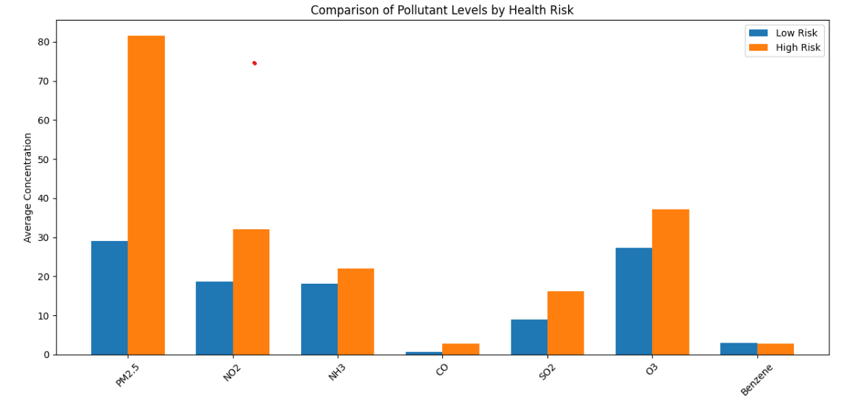
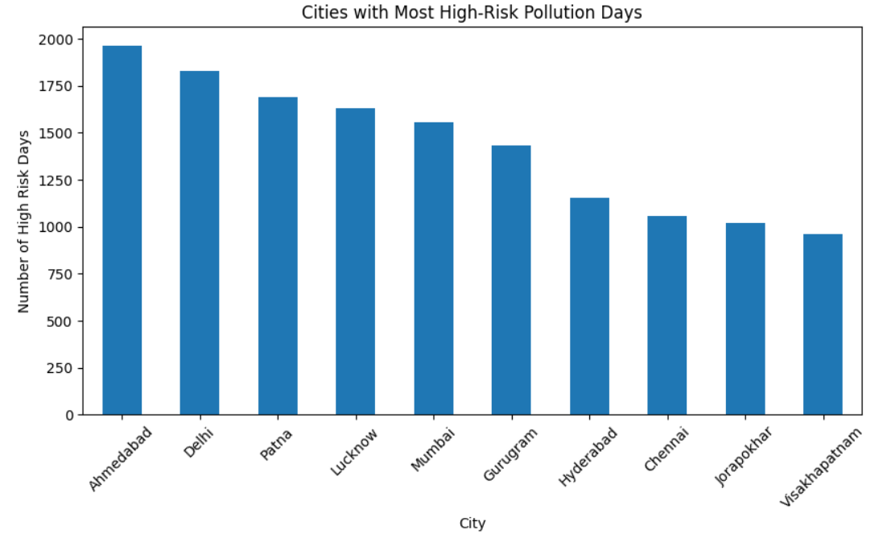
EDA
POLLUTANT LEVELS BY HEALTH RISK GROUP
CITY- LEVEL ANALYSIS
High-risk areas have higher levels of PM2.5, NO₂, and O₃, showing a strong link between these pollutants and increased health risk.
PM2.5 shows the largest gap between low- and high-risk groups, suggesting it is the most critical pollutant contributing to health risks in this dataset.
Some pollutants (like Benzene and CO) show minimal differences, less impact on health risk levels.
Ahmedabad and Delhi have the highest number of high-risk pollution days, indicating severe air quality issues.
Cities like Visakhapatnam, Jorapokhar, and Chennai have comparatively fewer high-risk days.
Overall, northern cities dominate the higher-risk category, suggesting regional pollution patterns.

Slide 8
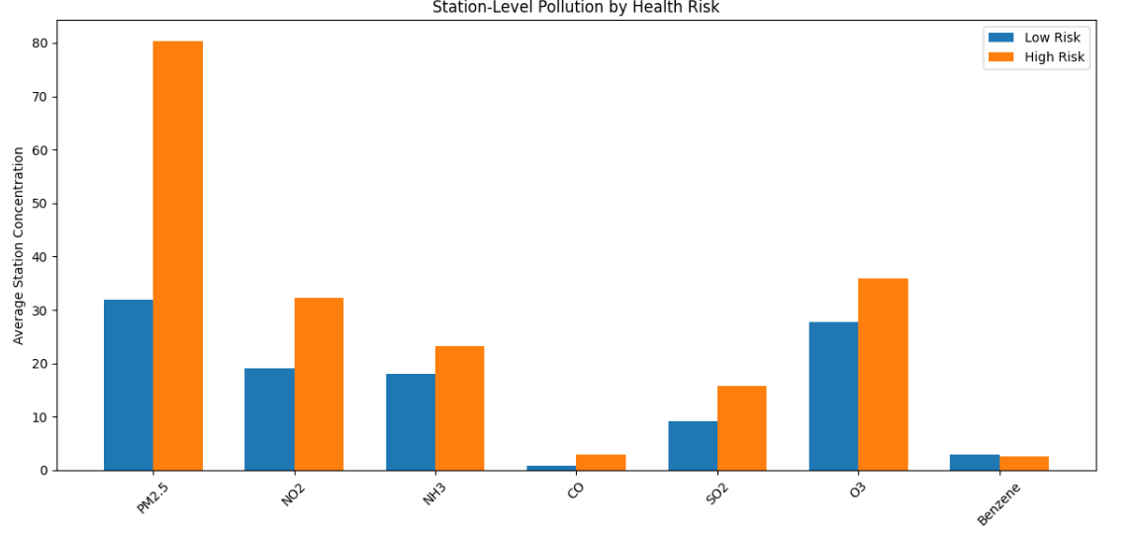
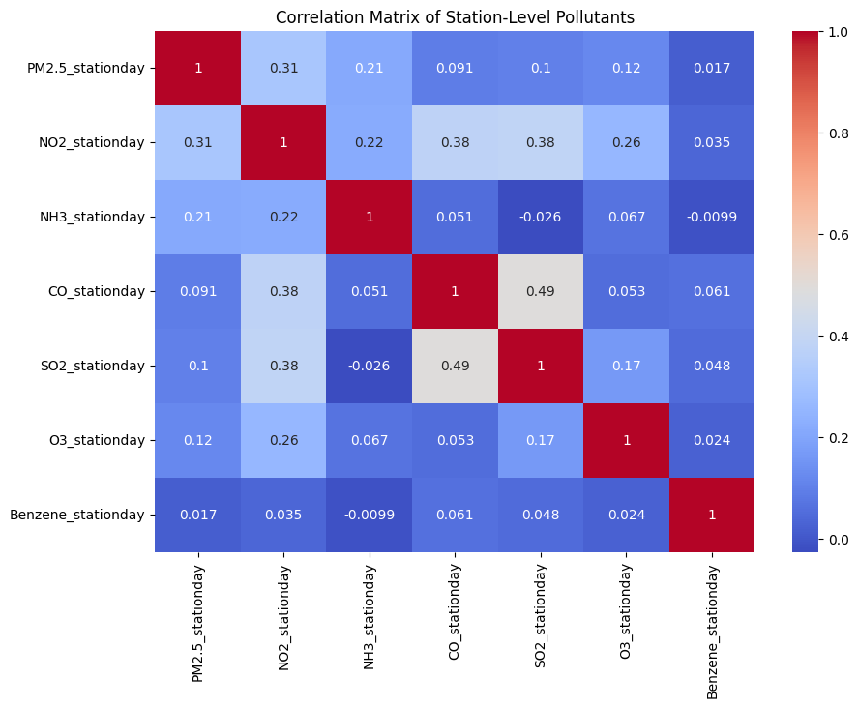
EDA
STATION-LEVEL POLLUTANTS BY HEALTH RISK
STATION-LEVEL POPULLANT CORRELATION MATRIX
High-risk areas have higher levels of PM2.5, NO₂, SO₂, and O₃, indicating these pollutants are strongly linked to health risk.
PM2.5 shows the largest increase, making it the most critical pollutant.
CO and Benzene show minimal differences, suggesting a weaker impact on health risk.
Most pollutants show weak to moderate correlation, meaning they don’t always increase together.
CO and SO₂ have the strongest correlation (~0.49), suggesting similar sources or behavior.
PM2.5 has only moderate links (e.g., with NO₂ ~0.31), indicating it is influenced by multiple factors.

Slide 9
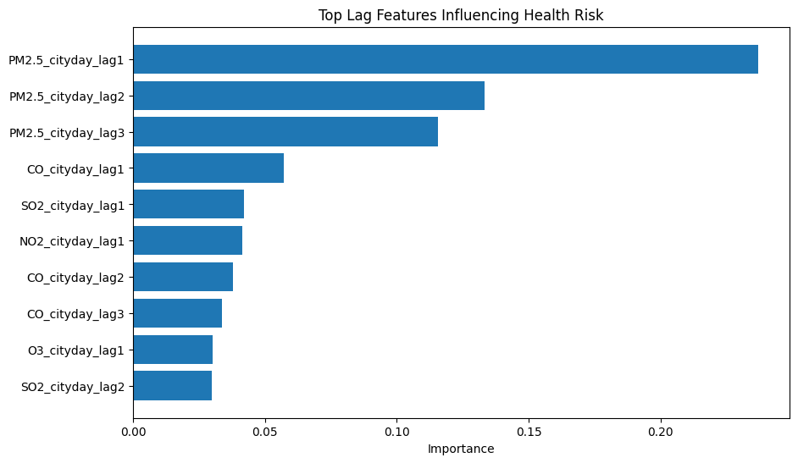
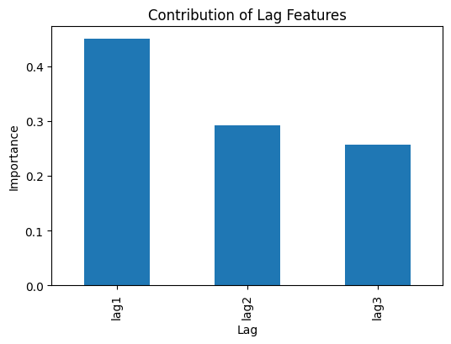
FEATURE IMPORTANCE ANALYSIS
LAG FEATURES INFLUENCING HEALTH RISK
CONTRIBUTION OF LAG FEATURES
PM2.5 lag features (lag1, lag2, lag3) are the most important, especially lag1 → strongest predictor of health risk.
Recent pollution (previous 1–3 days) has a major impact on current health risk.
Other pollutants (CO, NO₂, SO₂, O₃) have lower but still noticeable influence.
Lag1 has the highest contribution, meaning the previous day’s pollution has the strongest impact.
Influence decreases from lag1 → lag3, showing effect weakens over time.
Overall, recent exposure matters most for health risk prediction.

Slide 10
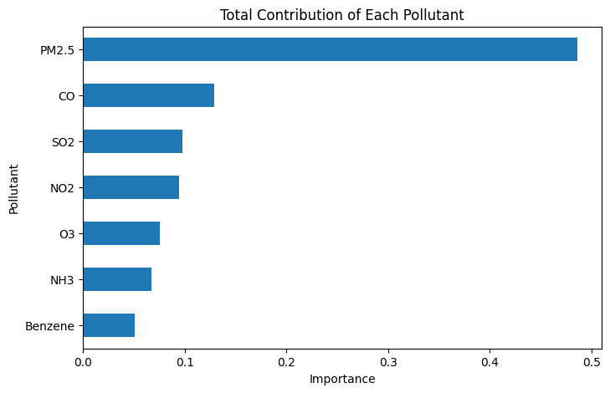
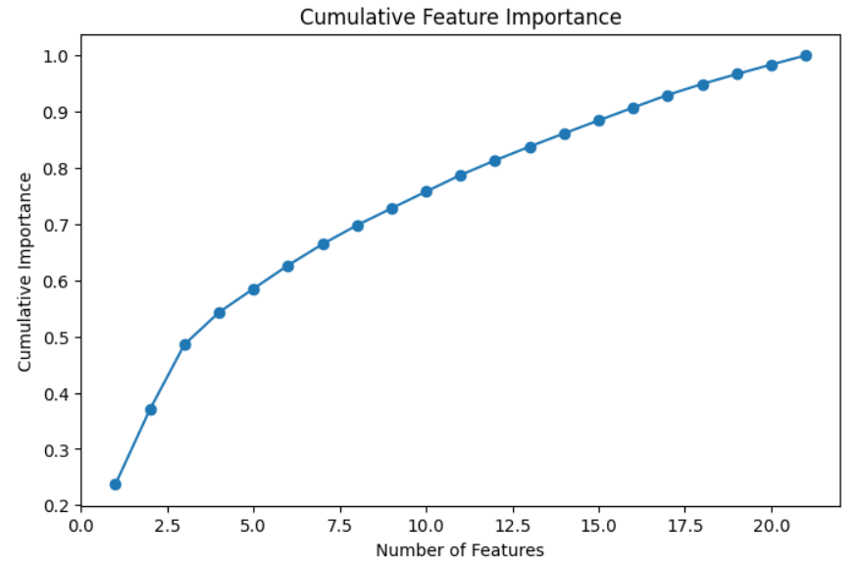
FEATURE IMPORTANCE ANALYSIS
CONTRIBUTION OF EACH POLLUTANT
CUMULATIVE FEATURE IMPORTANCE
PM2.5 has the highest contribution (~50%), making it the dominant factor in health risk.
CO is the second most important, followed by SO₂ and NO₂ with moderate impact.
O₃, NH₃, and Benzene have relatively low contributions, indicating a smaller role in risk prediction.
First few features contribute most (~50% by top 3–4 features), showing strong dominance of key variables.
After that, each additional feature adds smaller gains, indicating diminishing returns.
Most importance (~90%+) is captured within ~15–18 features, so not all features are equally necessary.

Slide 11
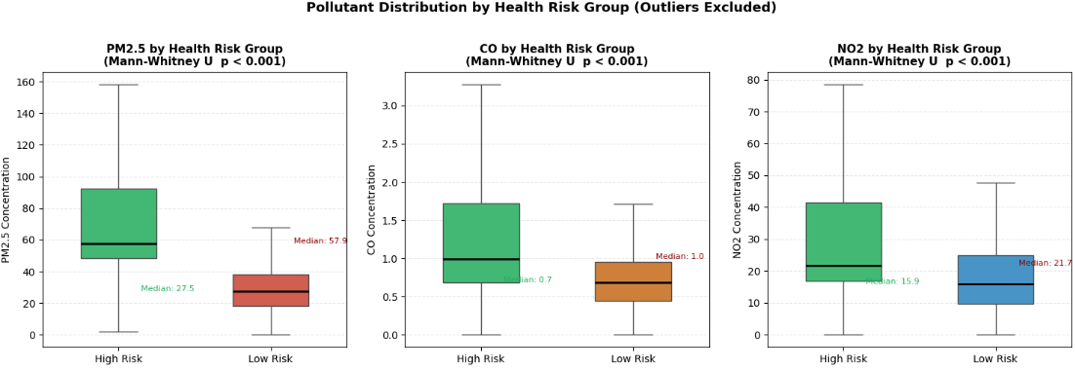
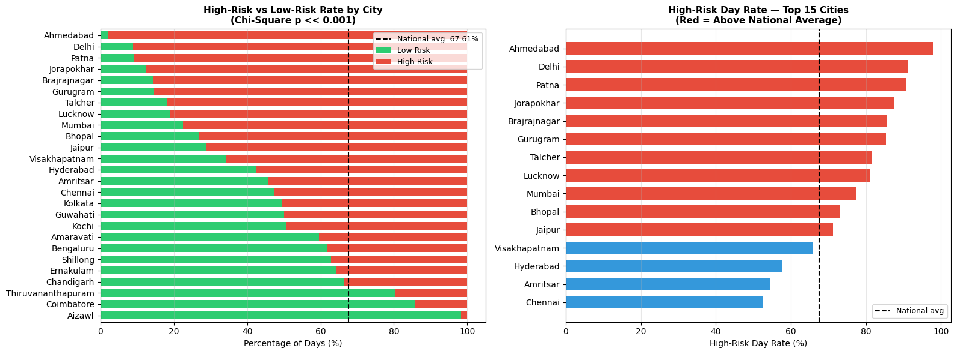
STATISTICAL RESULTS
Mann-Whitney U
CHI-SQUARE TEST
Cities like Ahmedabad, Delhi, and Patna have very high high-risk day percentages, well above the national average (~67%), indicating severe pollution exposure.
Clear variation across cities—some (like Chennai, Hyderabad) are below average, showing relatively better air quality.
Chi-square test (p << 0.001) confirms that differences between cities are statistically significant, not random.
High-risk group has significantly higher PM2.5, CO, and NO₂ levels than low-risk group.
The median values are clearly higher in high-risk areas, showing consistent differences.
Statistical test (p < 0.001) confirms these differences are highly significant, not due to chance.

Slide 12
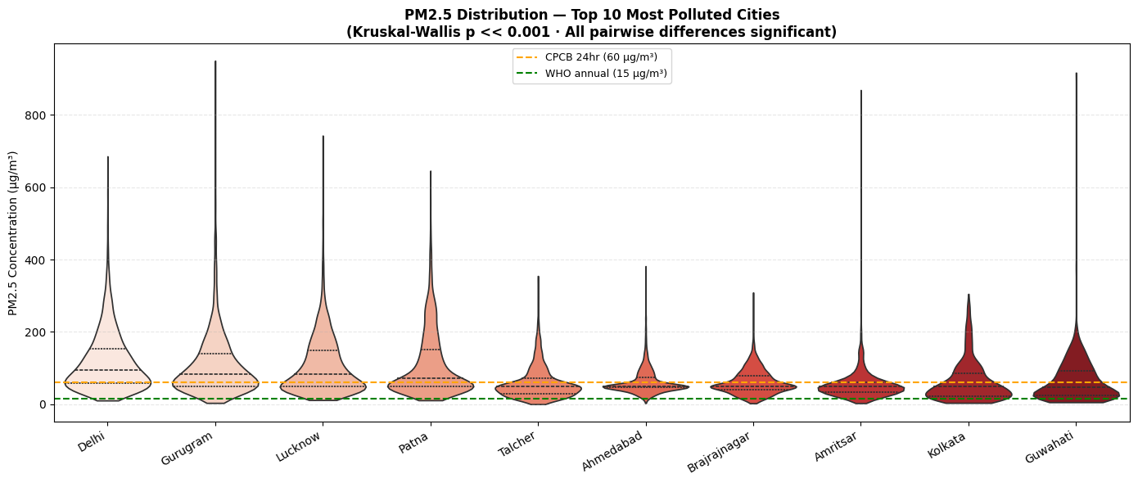
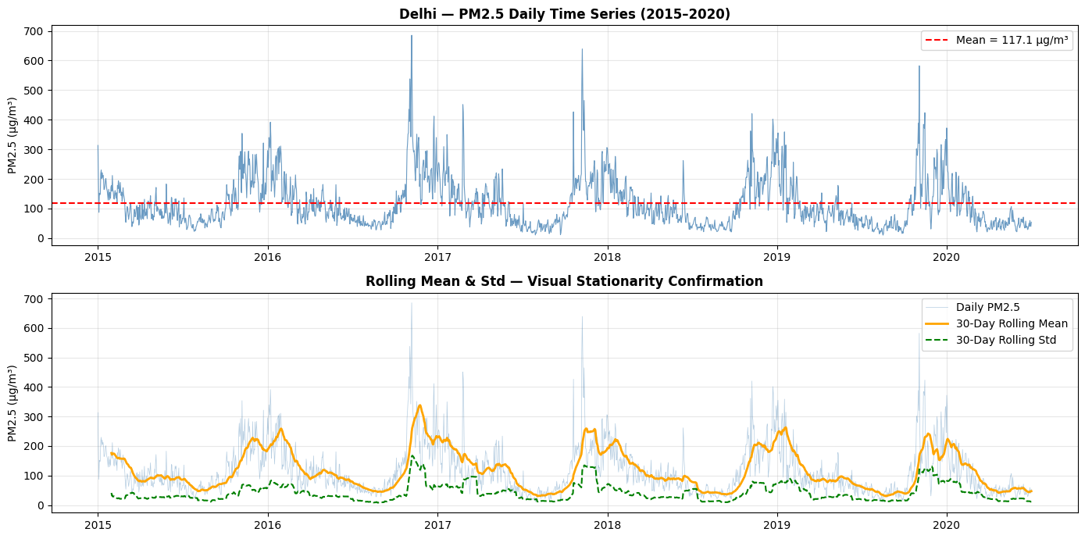
STATISTICAL RESULTS
KRUSKAL-WALLIS TEST
AUGMENTED-DICKER FULLER
All cities exceed WHO (15 µg/m³), and many exceed CPCB (60 µg/m³) limits, indicating severe pollution levels.
Cities like Gurugram, Delhi, and Lucknow show higher and more spread-out PM2.5 levels, meaning frequent extreme pollution events.
Kruskal-Wallis test (p << 0.001) confirms significant differences between cities’ pollution levels.
PM2.5 levels in Delhi fluctuate heavily over time, with frequent spikes, showing unstable air quality.
Seasonal pattern is visible—higher pollution peaks occur regularly (likely winters), while lower levels appear in other periods.
Rolling mean and standard deviation vary, indicating the data is not fully stationary (mean and variability change over time).

Slide 13
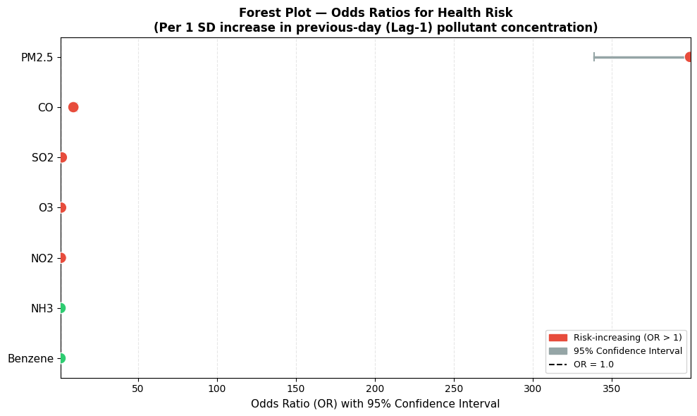
LOGISTIC REGRESSION ODDS RATIOS (OR)
PM2.5 has a very high odds ratio, making it the strongest contributor to increased health risk.
CO, SO₂, NO₂, and O₃ also increase risk (OR > 1) but with much smaller effects.
NH₃ and Benzene (OR < 1) show little or no significant risk increase.

Slide 14
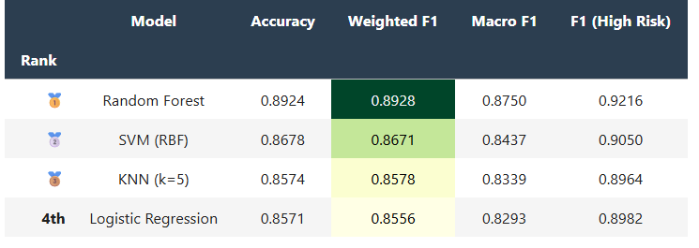
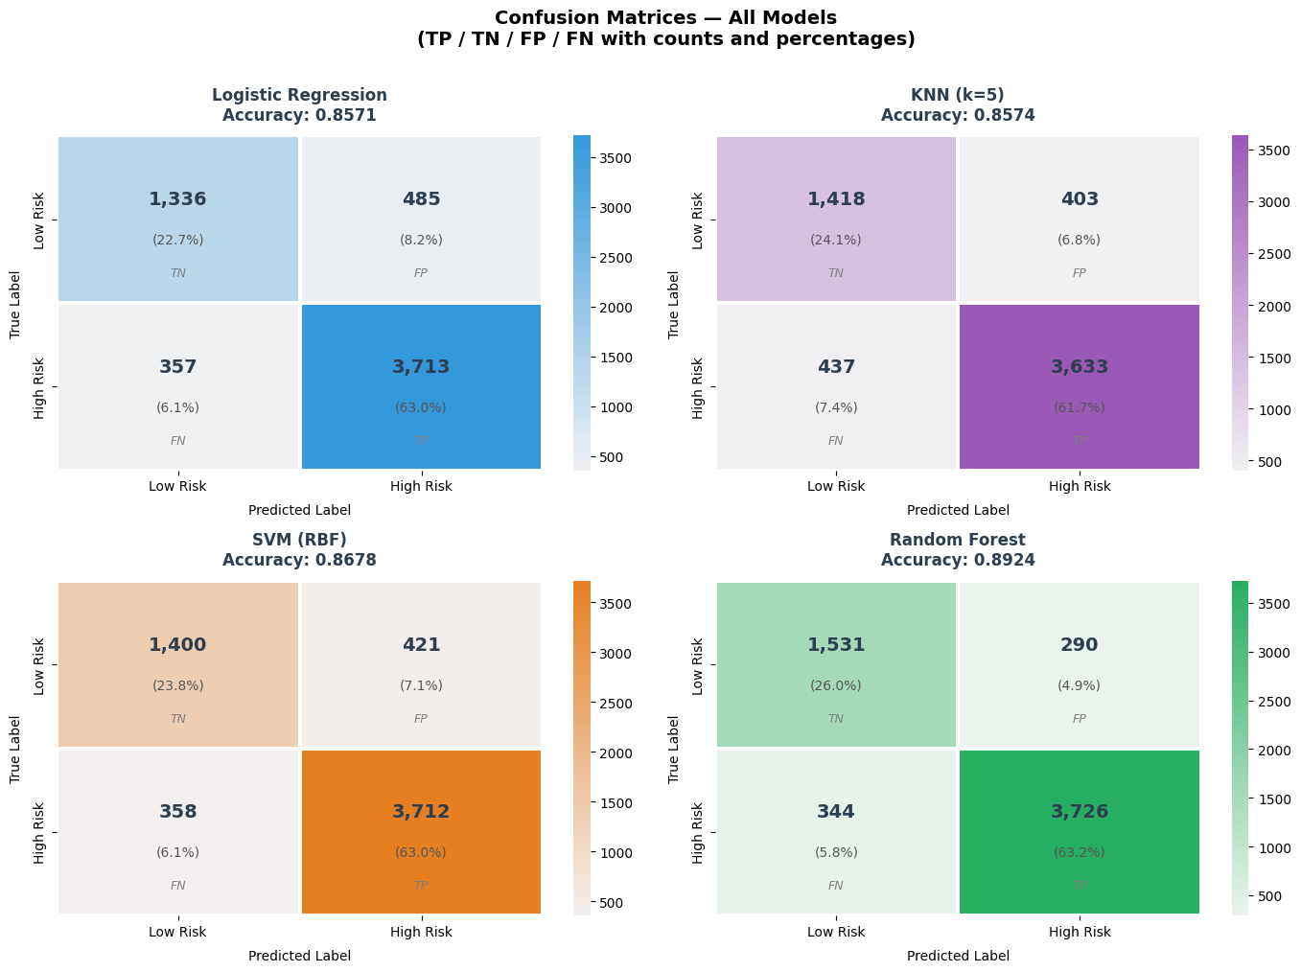
MODEL PERFORMANCE
MODEL EVALUATION
CONFUSION MATRIX
Random Forest performs best overall, with highest accuracy (89.2%) and F1 scores.
SVM is the second-best model, with slightly lower but strong performance.
KNN and Logistic Regression perform similarly, but slightly weaker than RF and SVM.
Random Forest performs best, with the highest true positives (3,726) and lowest errors (FP & FN).
SVM and KNN perform well, but have slightly more misclassifications than Random Forest.
Logistic Regression has the highest errors, especially false positives, making it the weakest among the four.

Slide 15
CONCLUSIONS
PM2.5 is the most important pollutant for health risk. largest effect size (r=0.81), OR=399, and 48.6% feature importance in Random Forest
Risk is different in each city, not the same everywhere(Chi-Square p≈0).
Random Forest with lag features achieves 89.2% accuracy — best among all 4 models tested.
Recent exposure (1–3 days) strongly predicts risk.
All pollutants differ significantly between low and high risk(Mann-Whitney U, all p < 0.001).
City-specific pollution policies are statistically justified — PM2.5 varies significantly across 26 cities (Kruskal-Wallis p≈0)
SOLUTION DEPLOYABILITY:
Use the last 3 days of data to predict next-day health risk and give alerts.
Hospitals can prepare in advance for high-risk days.
Create an app to show daily risk levels to people.
Make city-specific pollution rules instead of same rules for all.
Focus on reducing PM2.5 and CO for better health impact.

