Slide 1
Control Structures or Flow Controls

Slide 2
Introduction to Control Structures
Statements in Python programs are executed sequentially in the order in which they are written ,this is called sequential execution.
This involves a kind of decision making to see whether a particular condition has occurred or not and then direct the computer to execute certain statements accordingly .
We can achieve these through the use of control or decision making statements.
These statements alter the flow of execution of programs and the control statements control our program’s flow of execution, as such they form the backbone of our programs.
The statement which transfers control from one statement to another statement breaking normal sequence of the execution is knows as control structures or statements.

Slide 3
Introduction to Control Structures
Decision making is required when we want to execute a code only if a certain condition is satisfied.
Python provides three types of control structures. They are
Conditional control
Unconditional control
Loop control

Slide 4
Conditional Control Structures
The conditional control statements are mainly used for decision making purpose and required when we want to execute a code only if a certain condition is satisfied.
Python provides the following constructs to make decision or condition.
if Statement
if – else Statement
Nested if – else Statements
The if – else if – else or if- elif - else Statements
Extension of the if – else Statement(switch)

Slide 5
if Statement
The if statement is called a single –selection structure because it selects or ignores a single action.
if is also python keyword and as its name implies ,is used to make decisions .
The if statement takes a logical condition and evaluates it, Based on whether the condition evaluates to true or false
The simple form of the if statements is
If expression or condition: or if expression or condition: statement
statement
The expression may be any valid python expression and it must be enclosed with colon(:).
if the expression evaluates as true, the statement will be executed , if the expression evaluates not true, then the statement is not executed.
instead of that the statement is bypassed and next statement order is executed.

Slide 6
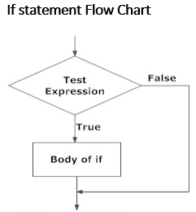
if Statement
In Python, the body of the if statement is indicated by the indentation. Body starts with an indentation and the first unindented line marks the end.
Python interprets non-zero values as True. None and 0 are interpreted as False.
Example : if marks<40:
print(“failed”)
Multiple Statements within if
If the programmer want to more than one
statement to execute following if statement.
General form : if condition :
statement 1
statement 2
…………….
statement n

Slide 7
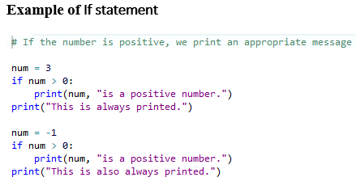
If statement Examples
Write a program to determine whether an integer of two numbers entered through the keyboard is swapped without using third number or variable
Write a program to determine whether an integer number entered through the keyboard is even or odd.
Write a program to find the largest of three numbers.
Write a program to find the total marks ,average and percentage of the student per his/her semester 1 and declare pass or fail.

Slide 8
If – else statement
The if statement lets you do something if condition is true, the statement will be executed , if the expression evaluates not true, then the statement is not executed.
In such cases, we will use the if – else statement.
It consists of if statement ,followed by a statement or block of statements ,followed by the keyword else, followed by another statement of block of statements.
The simple form of the if statements is
If expression or condition: or if expression or condition: (body of if) statement 1
(body of if) statement 1 else: (body of if) statement 2
else:
(body of if) statement 2
The if- else statement evaluates test expression and will execute body of if only when test condition is True.
If the condition is False, body of else is executed. Indentation is used to separate the blocks

Slide 9
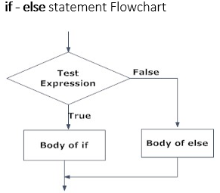
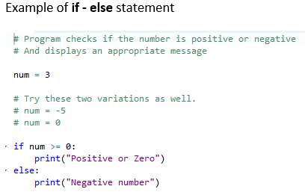
If – else Example and Flowchart

Slide 10
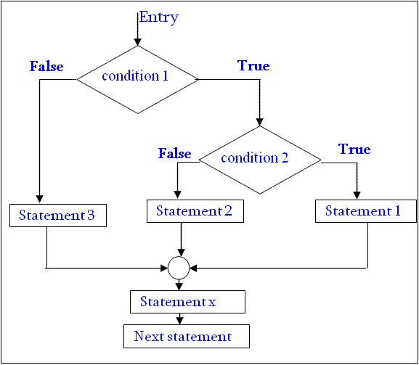
Nested if – else statement
An if statement may contain another if statement.
If either the if –block or else –block or both contains another if statements or if-else statement, then the construct is known as nested conditional statement or simply nesting of if statements.
This is useful when a series of decisions are involved
The syntax is as follows
if expression 1:
if expression 2:
statement – 1
else:
statement – 2
else:
if expression 3:
statement – 3
else:
statement – 4

Slide 11
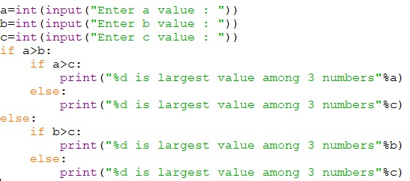
Nested if – else Example
Find the largest among 3 numbers ?
Write a Python program, we input a number check if the number is positive or negative or zero and display an appropriate message ?

Slide 12
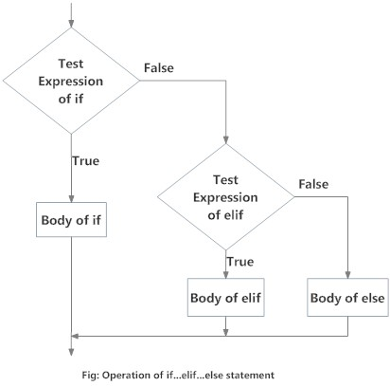
The if – else – if (elif)-else statement
Multi –way decisions arise when there are multiple conditions and different statements are to be executed under each condition.
The if block can have only one else block. But it can have multiple elif blocks.
There is another way of putting ifs together when multiple decisions are involved .
The syntax and Flowchart of if – elif -else
if expression 1:
statement – 1
elif expression 2
statement – 2
else:
statement – 3

Slide 13
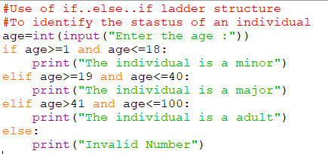
Example of if- elif- else

Slide 14
Extension of the if – else Statement(switch)
We have seen that when one of many alternatives is to be selected, we can design a program using if statements to control the selection.
Designing a program using if statements becomes cumbersome(Difficult to handle) when several alternatives needed.
C has a built – in multiway decision statement known as a switch.
The switch statement is in effect an extension of the if …else statement and it allows the user to select one of several alternatives.
The General form of switch in C (it consists of several case labels)
switch( expression )
{
case 1:
Statement 1;
Break;
case 2 :
Statement 2;
Break;
default :
Statement 3;
}

Slide 15
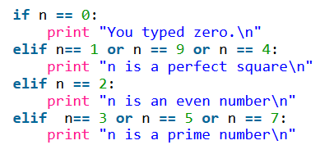
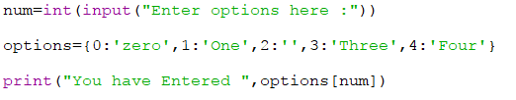
Python does not have a switch or case statement. To get around this fact, we use dictionary mapping:
Python’s dictionaries allow a simple one-to-one matching of a key and a value.

