Slide 1
Loop Control Structures (or) Iterative Control Structures

Slide 2
Loop Control Structures
Each instruction was executed only once.
But many programs require that a group of instructions to be executed repeatedly until some condition has been satisfied .This is known as looping or Iteration.
A loop is a group of instructions the computer executes repeatedly a certain number of times.
The repetition continue while a condition is true. When the condition becomes false, the loop terminates and the control passes to the statement(if any) following the loop.
The loop consists of two segments , one is known as the control statement and other is the body of the loop.
There are three kinds of loop structures or Iterative statements in C-Language.
for
while
do – while loop not used in python

Slide 3
While Loop Control Structures
The while Loop is often used if you don’t know how many times the loop is to be executed before you start the loop.
The for Loop is used in programming that you want to do something a fixed number of times.
The while loop provides a mechanism to repeat one or more statements while a particular condition is True.
Syntax of the while loop:-
Note in the while loop , the condition is tested before any of the statements in the statement block is executed.
If the condition is True , only then the loop statements will be executed otherwise
If the condition is False, then the control will jump to outside of the loop statements
statement x
while Condition :
statement block
statement y

Slide 4
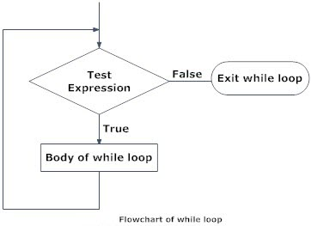


Flowchart and Example
Initially i=1 and is less than 10, that is, the condition is True, so in the while loop the value of i is printed and the condition is updated so that every execution of the loop , the condition becomes more approachable.

Slide 5
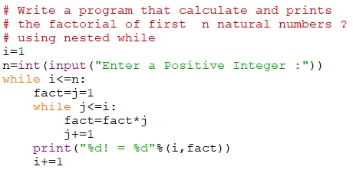
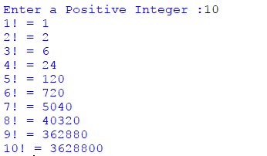
Nesting of while loops
Nesting of while loops, that is , one while loop within another while loop

Slide 6
Practice Problems
Write a program to calculate sum and Average of the first 100 natural numbers using while?
Write a program to print 30 horizontal asterisks(*) ?
Write a program to calculate sum and Average of numbers m to n using while?
Write a program to read the number until -1 is encountered .also count the no of Negative, Positive and Zeros and find the Sum,Avg of Positive and Negative numbers?
Write a program to find sum of even and odd numbers from m to n using while ?
Write a program to print the factorial of a given number using while loop?
Write a program to find the given number is an Armstrong Number or not?
Write a program to convert decimal to binary and binary to decimal ?
Write a program to find the GCD of two positive integer numbers using while loop?

Slide 7
for loop control structures
The for loop statement is used to repeat a statement or group of statements a fixed number of times.
It’s usually used when you know in advance how many times you want to execute a group of consecutive instructions.
The for …..in statement is a looping statement used to iterate over a sequence (list, tuple, string) or other iterable objects. Iterating over a sequence is called traversal.
There is a difference in for loop syntax. Python syntax uses the range function ,which makes the loop simpler ,more expensive and less prone error(s).
Syntax of for loop:- for loop_control_var in sequence :
statement block
When a for loop is used, a range of sequence is specified (only once).The items of the sequence are assigned to the loop control variable one after the other.
Loop continues until we reach the last item in the sequence. The body of for loop is separated from the rest of the code using indentation.

Slide 8
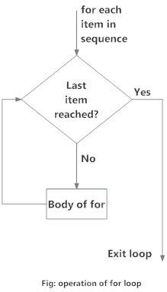
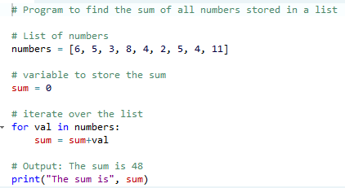
Flowchart and Example

Slide 9



The range() Function
The range() is built in function in python that is used to iterate over a sequence of numbers
Syntax is : - range(beg , end,[step])
The range() produces a sequence of numbers starting with beg and ending with one less than the number end.
The step argument is optional, by default, every number in the range is incremented by 1 but we can specify a different increment using step.
step can be both, negative and positive ,but not zero.
If range() is given single argument ,it produce an object values from 0 to argument-1
If range() is given two arguments , it produce an object values from beg to end .
If range() is given 3 arguments ,then third arguments specifies the interval of the sequence.

Slide 10
Nesting of for loops
When the body of one loop contains another, the second is said to be nested inside the first.
The inner and outer loop need not be generated by the same type of control structure.
One loop can be completely embedded within the other-there can be no overlap.
The way if statements can be nested, similarly for loops can also be nested.
Syntax:
for loop_control_var in sequence :
for loop_control_var in sequence :
statement block
Example:- for i in range(5) :
print(i,”-”,end=“ “)
for j in range(5) :
print(j,”-”,end=“ “)
print()

Slide 11
Practice Problems
Write a program to calculate sum and Average of the first 100 natural numbers using for?
Write a program to print even numbers between 1 and 20 ?
Write a program to print multiplication table for n number ?
Write a program to display squares, square roots, cubes and cube roots of the 1 to 10 ?
Write a program to print the factorial of a given number using for loop?
Write a program to find the maximum of a given set of numbers ?
Write a program to generate the first n Fibonacci numbers where n is the value entered by user ?
Write a program to generate Prime numbers up to n where n is the value entered by user ?
Write a program to find the pow(x,n) ?

Slide 12
Unconditional (Breaking)Control Structures
In Some situations, the flow of control my be transferred to another part of the program without testing for any condition.
Sometimes ,when executing a loop it becomes essential to skip a part of the loop or leave the loop as soon as a certain condition occurs.
In such cases, the following control(jump) statements are used.
Break
Continue
Pass
The break statement provides an early exit from a loop and it is used in while and for loop.
The continue statement skips the rest of the statements in the loop and transfers the control unconditionally to the loop-continuation portion of the nearest enclosing loop.
Causes the next iteration of the loop.
The pass statement is a do-nothing statement in a loop.it is just added to make the loop syntactically correct. That is ,a pass statement is written as we cannot have an empty body of the loop. Note :- Refer Keywords PPT

