Slide 1
Strings & String Functions

Slide 2
What are Strings ?
A String is a series / sequence of Unicode characters enclosed within double/single/triple quotation marks to represent Strings and Strings are immutable.
A String may contain letters,digits,and various special characters such as +,-,*,/ and $,string constants also referred as string literals.
Declaring & Initializing String Variables
>>> s1 = "This is a string one“
>>> s2 = ‘This is a string two’
>>> s3=‘’ #empty string
>>> type(s1) <class 'str'>
Multi-line strings can be denoted using triple quotes, ''' or """.
Even triple quotes can be used in Python but generally used to represent multiline strings or docstrings.
>>> s4 = '''a multiline
string''‘
>>>

Slide 3

How to access characters in String
We can access individual characters using indexing and a range of characters using slicing operator [ ] or The Subscript Operator
Index starts from 0. Trying to access a character out of index range will raise an IndexError.
The index must be an integer. We can't use float or other types, this will result into TypeError.
Python allows negative indexing for its sequences.
The index of -1 refers to the last item, -2 to the second last item and so on.
We can access a range of items in a string by using the slicing operator with colon
[ : ].
String=‘HELLO’

Slide 4
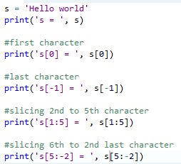

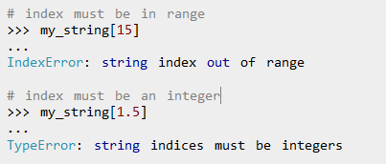
If we try to access index out of the range or use decimal number, we will get errors.

Slide 5
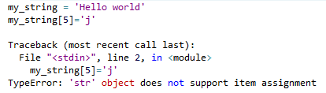
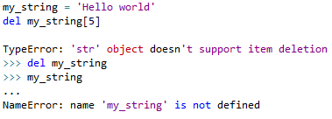
How to change or delete a string?
Strings are immutable. This means that elements of a string cannot be changed once it has been assigned.
We can simply reassign different strings to the same name.
We cannot delete or remove characters from string ,deleting the string is possible use the keyword del.

Slide 6
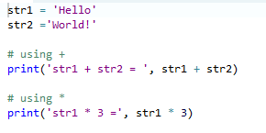
Python String Operations
There are many operations that can be performed with string which makes it one of the most used datatypes in Python.
Concatenation of Two or More Strings
Joining of two or more strings into a single one is called concatenation.
The + operator does this in Python. Simply writing two string literals together also concatenates them.
The * operator can be used to repeat the string for a given number of times.
Writing two string literals together also concatenates them like + operator.
If we want to concatenate strings in different lines, we can use parentheses.

Slide 7
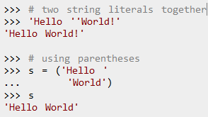

Writing two string literals together also concatenates them like + operator.
If we want to concatenate strings in different lines, we can use parentheses.
Iterating Through String
Using for loop we can iterate through a string. Here is an example to count the number of 'l' in a string.

Slide 8

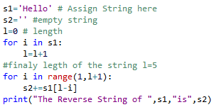
String Membership Test
We can test if a substring is exists within a string or not , for that we have to use in keyword.
How to print reverse string using for loop?

Slide 9
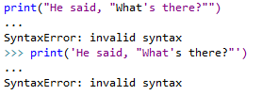
Python String Formatting
Escape Sequence
If we want to print a text like - He said, "What's there?“
we can neither use single quote or double quotes.
This will result into SyntaxError as the text itself contains both single and double quotes.
One way to get around this problem is to use triple quotes. Alternatively, we can use escape sequences.

Slide 10
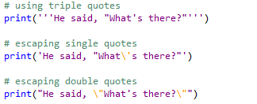

An escape sequence starts with a backslash and is interpreted differently. If we use single quote to represent a string, all the single quotes inside the string must be escaped. Similar is the case with double quotes.
Here is how it can be done to represent the above text
We can even format strings with % Operator

Slide 11
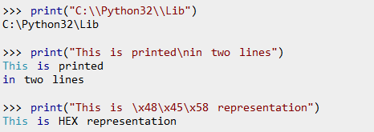
list of all the escape sequence
Escape Sequence | Description
\newline | Backslash and newline ignored
\\ | Backslash
\' | Single quote
\" | Double quote
\a | ASCII Bell
\b | ASCII Backspace
\f | ASCII Formfeed
\n | ASCII Linefeed
\r | ASCII Carriage Return
\t | ASCII Horizontal Tab
\v | ASCII Vertical Tab
\ooo | Character with octal value ooo
\xHH | Character with hexadecimal value HH
Here are some examples

Slide 12

Raw String to ignore escape sequence
Sometimes we may wish to ignore the escape sequences inside a string. To do this we can place r or R in front of the string.
This will imply that it is a raw string and any escape sequence inside it will be ignored.

Slide 13
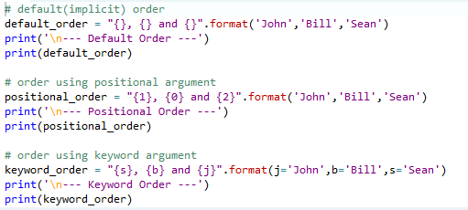
The format() Method for Formatting Strings
The format() method that is available with the string object is very versatile and powerful in formatting strings.
Format strings contains curly braces {} as placeholders or replacement fields which gets replaced.
We can use positional arguments or keyword arguments to specify the order.

Slide 14
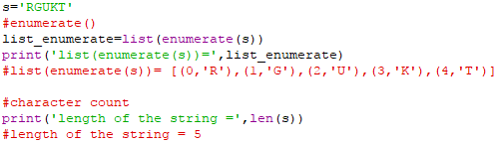
Built-in functions to Work with Python
Various built-in functions that work with sequence, works with string as well.
The enumerate() function returns an enumerate object. It contains the index and value of all the items in the string as pairs. This can be useful for iteration.
The len() function returns the length (number of characters) of the string.

Slide 15

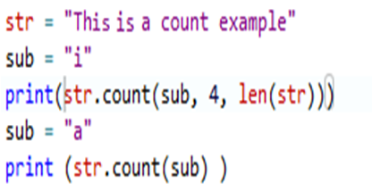
The method center() makes str centred by taking width parameter into account. Padding is specified by parameter fillchar. Default filler is a space.
Syntax : - str.center(width[, fillchar])
The method count() returns the number of occurrence of Python string substr in string str. By using parameter start and end you can give slice of str .
Syntax : - str.count(substr [, start [, end]])

Slide 16
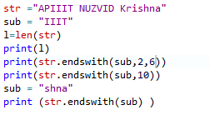
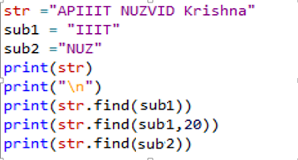
This method endswith() returns True if the string ends with the specified substring, otherwise return False ,
The use of start and end to generate slice
of Python string str.
Syntax :- str.endswith(suffix[, start[, end]])
The find() method used to find out whether a string occur in given string or its substrings.
If given Python string is found, then
the find() method returns its index.
If Python string is not found then
-1 would be returned.
Syntax : - str.find(str, beg=0 end=len(string))

Slide 17
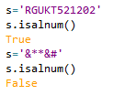
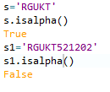
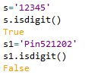
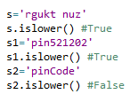
The method isalnum() is used to determine
whether the Python string consists of
alphanumeric characters, false otherwise
Syntax :- str.isalnum()
The method isalpha() return true if the Python
string contains only alphabetic character(s),
false otherwise.
Syntax :- str.isalpha()
The method isdigit() return true if the Python string
contains only digit(s),false otherwise.
Syntax :- str.isdigit()
The method islower() return true if the Python
string contains only lower cased character(s),
false otherwise
Syntax :- str.isdigit()

Slide 18

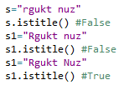
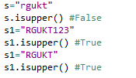

The method isspace() return true
if the Python string contains only
white space(s).
Syntax :- str.isspace()
The method istitle() return true
if the string is a titlecased
Syntax :- str.istitle()
The method isupper() return true if the string
ontains only upper cased character(s),
false otherwise.
Sytax:- str.isupper()
The method ljust(), it returns the string left justified.
Total length of string is defined in first parameter
of method width . Padding is done as defined
in second parameter fillchar .( default is space)

Slide 19



Syntax : - str.ljust(width[, fillchar])
In above example you can see that if you don't define the fillchar then the method ljust() automatically take space as fillchar.
The method rjust(), it returns the string right justified.
Total length of string is defined in first parameter of
method width . Padding is done as defined in
second parameter fillchar .( default is space)
Syntax:- str.rjust(width[, fillchar])
This function capitalize() first letter of string.
Syntax:- str.capitalize()
The method lower() returns a copy of the string in
which all case-based characters have been
converted to lower case.
Syntax:- str.lower() ,str.upper()
The method upper() returns a copy of the string in which all case-based characters have been converted to upper case.

Slide 20



The method title() returns a copy of the string
in which first character of all words of string
are capitalised.
Syntax:- str.title()
The method swapcase() returns a copy of
the string in which all cased based
character swap their case
Syntax:- str.swapcase()
This method join() returns a string which is the
concatenation of given sequence and string
as shown in example.
seq = it contains the seqeunce of separated strings. str = it is the string which is used to replace the
separator of seqcence
Syntax:- str.join(seq)

Slide 21



The method lstrip() returns a copy of the string
in which specified char(s) have been stripped
from left side of string. If char is not specified
then space is taken as default.
Syntax : - str.lstrip([chars])
The method rstrip() returns a copy of the string
in which specified char(s) have been stripped
from right side of string. If char is not specified
then space is taken as default.
Syntax : - str.rstrip([chars])
The method strip() returns a copy of the string
in which specified char(s) have been stripped
from both side of string. If char is not specified
then space is taken as default.
Syntax : - str.strip([chars])

Slide 22



The method splits returns a list of all words in the
string, delimiter separates the words. If delimiter
is not specified then whitespace is taken as
delimiter, paramter num
Syntax :- str.split("delimiter", num)
The method max() returns the max character from
string str according to ASCII value.
in first print statement y is max character, because
ASCII code of "y" is 121. In second print statement
"s" is max character, ASCII code of "s" is 115.
Syntax :- max(str)
The method min() returns the min character
from string str according to ASCII value.
Syntax :- min(str)

Slide 23

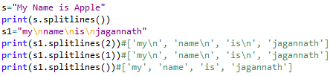
The method replace() returns the string in which
occurrences of string specified by parameter old
have been replaced with string specified by
parameter new .
The parameter max defined how many occurrences
have been replaced. If max is not specified then
all occurrences will be replaced.
Syntax :- str.replace(old, new[, max])
The method splitlines() returns a list with all the lines
in string, In num is specified then it would include
line break. num greater than 1 it include line break.
num -- This is any number, if present then it would
be assumed that line breaks need to be
included in the lines.
Syntax :- str.splitlines( num)

Slide 24


The method startswith() return true if a string str starts with the string specified by parameter str1.
parameter beg and end are used to slice the string str .
Syntax :- str.startswith(str1, beg=0,end=len(string));
This method pads the string on the left with zeros to fill width.
Syntax :- str.zfill(width)

Slide 25


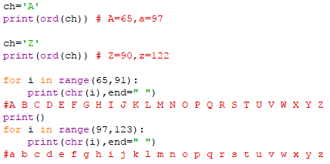
The ord() function returns ASCII code of the character.
The chr() function returns character represented by a ASCII number.
Write a program to print Alphabet using ASCII Numbers ?

Slide 26
Comparing Strings
Python allows you to compare strings using relational(or comparison) operator such as >, <, < =, < =,etc.
== if two strings are equal ,it returns True → ‘Abc’ ==‘Abc’ →True
!= or <> if two strings are not equal, it returns True → ‘AbC’ != ‘ABC’ →True
> if first string is greater than the second ,it returns True → “abc”>”Abc” →True
< if second string is greater than the first ,it returns True → “abC”<”abc” →True
>= if first string is greater than or equal to the second ,it returns True → “aBC”>=”ABC”→True
<= if second string is greater than or equal to the first ,it returns True → “ABc”<=”ABc”→True
Note:
These operators compare the strings by using the lexicographical order i.e using ASCII values of the characters.
The ASCII values of A-Z is 65 -90 and ASCII code for a-z is 97-122 .

Slide 27
Practice Problems on Strings
Write a program to find number of digits ,alphabets and symbols ?
Write a program to convert lower case to upper case from given string?
Write a program to print the following output?
R
R G
R G U
R G U K
R G U K T
R G U K
R G U
R G
R
Write a program to check whether given string is palindrome or not? Radar,liril,
Write a program to find no_ words,no_letters,no_digits and no_blanks in a line?
Write a program to sort list names in alphabetical order?

Slide 28
To find the first character from given string ,count the number of times repeated and replaced with * except first character then print final string?
To find the strings in a list which are matched with first character equals to last character in a string?
Write a program that accepts a string from user and redisplays the same string after removing vowels from it?
This is a Python Program to take in two strings and display the larger string without using built-in functions.?
Python Program to Read a List of Words and Return the Length of the Longest One?
Python Program to Calculate the Number of Upper Case Letters and Lower Case Letters in a String ?

