Slide 1
Lists in Python

Slide 2

What is List in Python?
List is a versatile data type and an ordered sequence of items. It is one of the most used datatype in Python and is very flexible.
All the items in a list do not need to be of the same data type.
Declaring a list is pretty straight forward.
Items separated by commas are enclosed within brackets [ ].
Syntax:- List_Variable=[val1,val2,val3…….]
Lists are mutable which means that value of its elements can be changed or altered

Slide 3


How to create a list?
In Python programming, a list is created by placing all the items (elements) inside a square bracket [ ], separated by commas.
It can have any number of items and they may be of different types (integer, float, string etc.).
Nested List: - a list can even have another list as an item. This is called nested list.

Slide 4
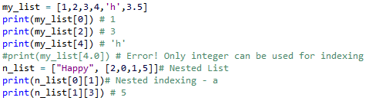
How to access elements from a list?
Similar to strings ,lists can also be sliced and concatenated .
To access values in lists ,square brackets [] are used to slice along with the index or indices to get value stored at that index.
We can use the index operator [] to access an item in a list. Index starts from 0. So, a list having 5 elements will have index from 0 to 4.
Trying to access an element other that this will raise an IndexError.
The index must be an integer. We can't use float or other types, this will result into TypeError
Nested list are accessed using nested indexing.

Slide 5
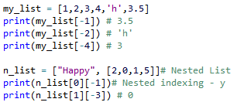

Negative indexing
Python allows negative indexing for its sequences. The index of -1 refers to the last item, -2 to the second last item and so on.
Negative and Positive Indexing in Figure shown below
List_S=[‘H’,’E’,’L’,’L’,’O’]

Slide 6
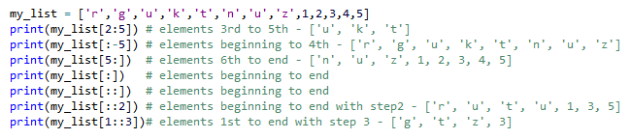
Slicing Operations with range/Slicing Operator
Slicing can be best considering the index to be between the elements along with slicing operator [Colon : ]
We can access a range of items in a list by using the slicing operator (colon)
Syntax : - List[start:end:step]
start – starting point of the index value
end or stop – ending point of the index value
step- increment of the index values

Slide 7


How to change or add elements to a list?
List are mutable, meaning, their elements can be changed unlike string or tuple.
We can use assignment operator (=) to change an item or a range of items.
Syntax : - list[index]=item
We can add one item to a list using append() method and add Several Items to a list using extend() method.
Syntax:-
list.append(item)
list.extend(items)

Slide 8



To insert ,Concatenate and Repeat
We can also use + operator to combine two lists. This is also called concatenation.
The * operator repeats a list for the given number of times.
Syntax :- list3=list1+list2
we can insert one item at a desired location by using the method insert() or
insert multiple items by squeezing it into an empty slice of a list.
Syntax : -
List.insert(listValue,newValue)
List[empty_slice]=[items]

Slide 9
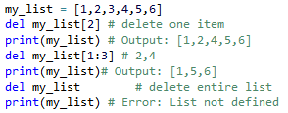
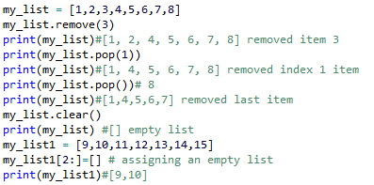
How to delete or remove elements from a list?
We can delete one or more items from a list
using the keyword del. It can even delete
the list entirely.
Syntax : - del list
We can use remove() method to remove the
given item or pop() method to remove an
item at the given index.
The pop() method removes and returns the
last item if index is not provided. This helps
us implement lists as stacks
(first in, last out data structure).
We can also use the clear() method to empty a list.
Finally, we can also delete items in a list by assigning
an empty list to a slice of elements.

Slide 10
How to delete or remove elements from a list?
We can delete one or more items from a list
using the keyword del. It can even delete
the list entirely.
Syntax : - del list
We can use remove() method to remove the
given item or pop() method to remove an
item at the given index.
The pop() method removes and returns the
last item if index is not provided. This helps
us implement lists as stacks
(first in, last out data structure).
We can also use the clear() method to empty a list.
Finally, we can also delete items in a list by assigning
an empty list to a slice of elements.

Slide 11
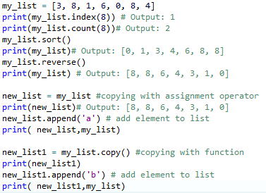
Example program for index(),count(),copy(),sort(),reverse() Methods
index() - Returns the index of the first matched item
Syntax:- list.index(element)
count() - Returns the count of number of items passed as an argument
Syntax: - list.count(element)
sort() - Sort items in a list in ascending order
Syntax: - list.sort()
reverse() - Reverse the order of items in the list
Syntax: - list.reverse()
copy() - Returns a shallow copy of the list
Syntax: - list.copy()

Slide 12
Python List Methods
They are accessed as list.method()
append() - Add an element to the end of the list
extend() - Add all elements of a list to the another list
insert() - Insert an item at the defined index
remove() - Removes an item from the list
pop() - Removes and returns an element at the given index
clear() - Removes all items from the list
index() - Returns the index of the first matched item
count() - Returns the count of number of items passed as an argument
sort() - Sort items in a list in ascending order
reverse() - Reverse the order of items in the list
copy() - Returns a shallow copy of the list

Slide 13
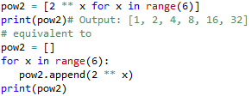

List Comprehension: Elegant way to create new List
List comprehension is an elegant and concise way to create new list from an existing list in Python.
List comprehension consists of an expression followed by for statement inside square brackets.
A list comprehension can optionally contain more for or if statements. An optional if statement can filter out items for the new list.

Slide 14
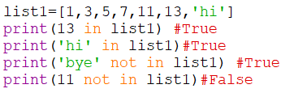
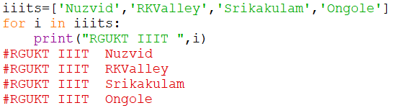
Using with Membership Operators and for loop in a list
We can test if an item exists in a list or not, using the keyword in and not in
Using a for loop we can iterate each item in a list

Slide 15
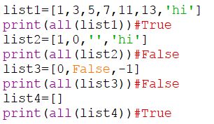
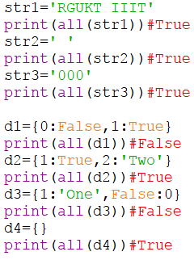
Built-in Functions with List
The all() method returns True when all elements in the given iterable are true. If not, it returns False.
Syntax: all(iterable)
The all() method takes a single parameter:
iterable - any iterable (list, tuple, dictionary, etc.) which contains the elements
In case of dictionaries,
if all keys (not values) are true or
the dictionary is empty, all() returns True.
Else, it returns false for all other cases

Slide 16
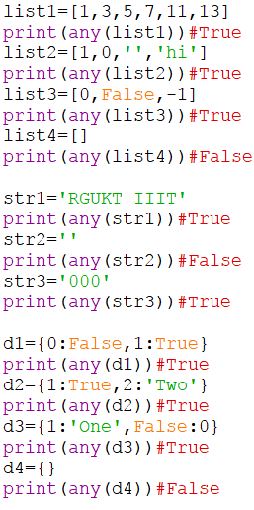
The any() method returns True if any element of an iterable is true. If not, this method returns False.
They any() method takes an iterable (list, string, dictionary etc.) in Python.
The any method returns: - any(iterable)
True if at least one element of an iterable is true
False if all elements are false or if an iterable is empty
In case of dictionaries, if all keys (not values) are false, any() returns False. If at least one key is true, any() returns True.
When | Return Value
All values are true | True
All values are false | False
One value is true (others are false) | True
One value is false (others are true) | True
Empty Iterable | False

Slide 17
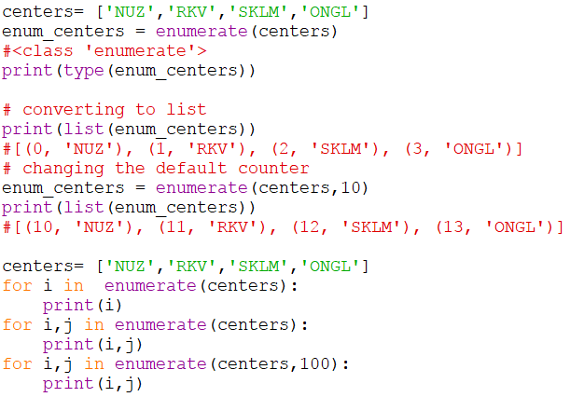
The enumerate() method adds counter to an iterable and returns it (the enumerate object).
Syntax : enumerate(iterable , start=0)
The enumerate() method takes two parameters:
iterable - a sequence, an iterator, or objects that supports iteration
start (optional) - enumerate() starts counting from this number. If start is omitted, 0 is taken as start.
Return Value from enumerate()
The enumerate() method adds counter to an iterable and returns it. The returned object is a enumerate object.
You can convert enumerate objects to list and tuple using list() and tuple() method respectively.

Slide 18
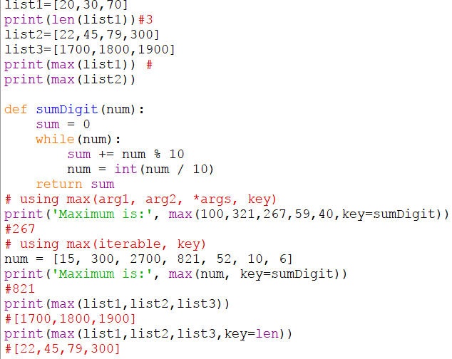
The len() function returns the number of items (length) of an object.
The max() method returns the largest element in an iterable or largest of two or more parameters.
Syntax : -
max / min (items)
or
Max(list1,list2,key=function)
min(list1,list2,key=function)
The min() method returns the smallest element in an iterable or smallest of two or more parameters

Slide 19
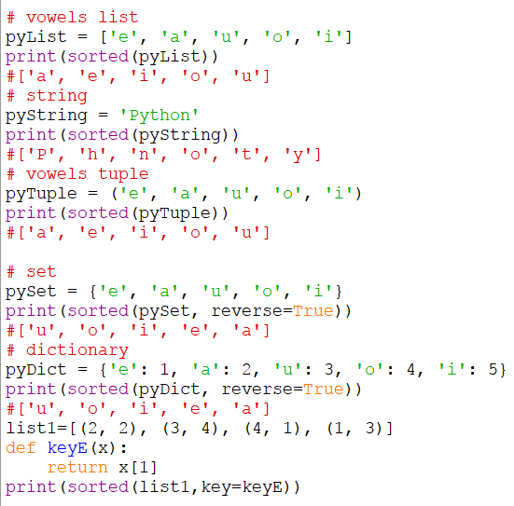
The sorted() method returns a sorted list from the given iterable.
The sorted() method sorts the elements of a given iterable in a specific order - Ascending or Descending.
Syntax : sorted(iterable[, key][, reverse])
Three parameters of sorted()
iterable - sequence (string, tuple, list) or collection (set, dictionary, frozen set) or any iterator
reverse (Optional) - If true, the sorted list is reversed (or sorted in Descending order)
key (Optional) - function that serves as a key for the sort comparison
A list also has sort() method which performs the same way as sorted(). Only difference being, sort() method doesn't return any value and changes the original list itself.

Slide 20
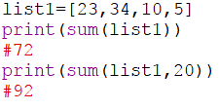
The sum() function adds the items of an iterable and returns the sum.
Syntax:- sum(iterable, start)
The sum() function adds start and items of the given iterable from left to right.

Slide 21
Practice Problems on Lists
Python program to find the sum of natural numbers up to n using recursive function ?
Matrix Addition using Nested List Comprehension ?
Write a program to find the median of a list of numbers ?
Write a Python program to sum and multiplies all the items in a list ?
Write a Python program to get the largest and smallest number from a list ?
Write a Python function that takes two lists and returns True if they have at least one common member ?
Write a Python program to print a specified list after removing the prime index elements ?
Write a Python program to find the list of words that are longer than n from a given list of words ?
Write a Python program to generate and print a list of first and last 5 elements where the values are square of numbers between 1 and 30 (both included).?
Write a Python program to convert list to list of dictionaries?
Write a program to remove all duplicate values from a list?

