Slide 1
Tuple in Python

Slide 2
What is Tuple in Python?
In Python programming Language Tuple is an ordered sequence of items and it is similar to a list.
The only difference is that tuples are immutable.
Tuples are once created cannot be modified.
They are used to write-protect data and are usually faster than list as it cannot change dynamically.
Tuple is defined within parentheses () where items are separated by commas.
Syntax:-
tuple_1=(val1,val2,val3…….)
Since, tuples are quite similar to lists, both of them are used in similar situations as well

Slide 3
Advantages of Tuple over List
We generally use tuple for heterogeneous (different) data types and list for homogeneous (similar) data types.
Since tuple are immutable, iterating through tuple is faster than with list. So there is a slight performance boost.
Tuples that contain immutable elements can be used as key for a dictionary. With list, this is not possible.
If you have data that doesn't change, implementing it as tuple will guarantee that it remains write-protected.

Slide 4
Creating a Tuple
A tuple is created by placing all the items (elements) inside a parentheses (), separated by comma.
The parentheses are optional but is a good practice to write it.
A tuple can have any number of items and they may be of different types (integer, float, list, string etc.).
Create Empty tuple →
Tuple having integers →
Tuple with mixed data types →
Nested tuple →
Tuple can be created without parentheses also called tuple packing

Slide 5
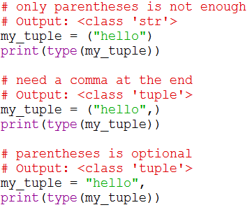
Like Tuple packing ,tuple unpacking also possible.
Creating a tuple with one element is Not to be trusted.
Having one element within parentheses is not enough. We will need a trailing comma to indicate that it is in fact a tuple.

Slide 6

Accessing Elements in a Tuple
Accessing elements in a tuple two ways in python programing language.
We can access elements by using index operator [] and index value must be an integer
We cannot use float or other types ,this will leads to rise an error call typeError
Positive Indexing
Negative Indexing
Slicing Operations
Positive Indexing:
In positive indexing index value start with 0 and end with length-1
If you try access elements more than ( > ) length-1 it will rise an indexError or out of the indexError
Negative Indexing:
Python allows negative indexing for its sequences.
The index of -1 refers to the last item, -2 to the second last item and so on.
Slicing :
We can access a range of items in a tuple by using the slicing operator - colon ":".
Syntax : - [start : end : step]

Slide 7
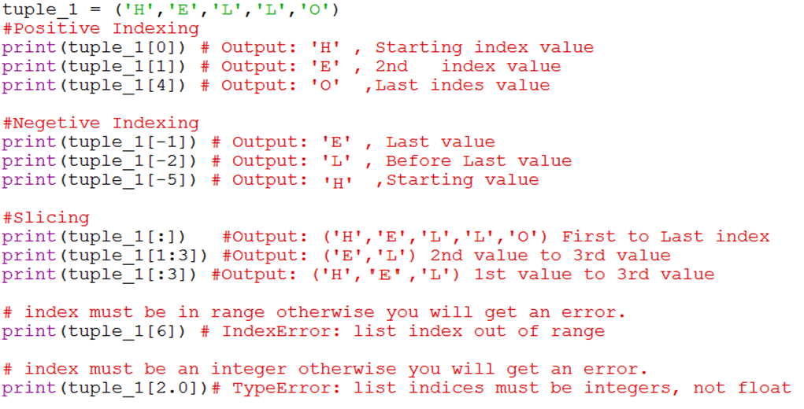
Accessing Elements in tuple

Slide 8
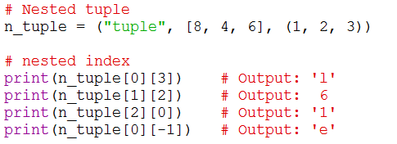
Nested Indexing in tuple
We can also access nested tuple using nested indexing .
Syntax:
n_tuple[tupleIndex][nestedTuple_index]

Slide 9
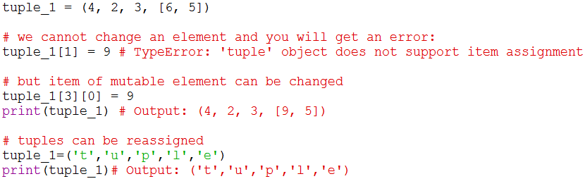
How to Change a tuple ?
Unlike lists tuples are immutable
If you have data that doesn't change, implementing it as tuple will guarantee that it remains write-protected.
This means that elements of a tuple cannot be changed once it has been assigned.
But, if the element is itself a mutable datatype like list, its nested items can be changed.
We can also assign a tuple to different values (reassignment).

Slide 10
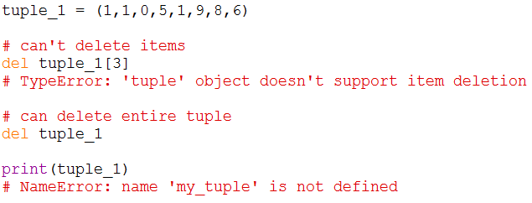
How to Delete a tuple ?
As discussed in previous slide, we cannot change the elements in a tuple.
That means we cannot delete or remove items from a tuple.
But deleting entire tuple is possible by using the keyword del.

Slide 11
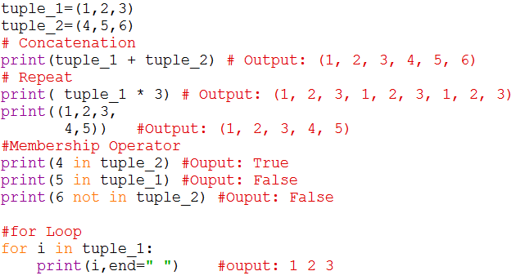
Tuple Operations
We can use + operator to combine two tuples. This is also called concatenation.
We can also repeat the elements in a tuple for a given number of times using the * operator.
We can test if an item exists in a tuple or not, using the keyword in or not in (membership operator).
Using a for loop we can iterate though each item in a tuple.

Slide 12


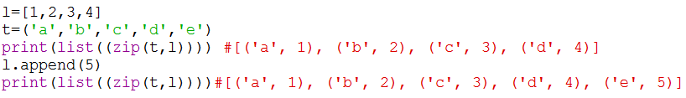
Built-in Functions & Methods in Python
Methods that add items or remove items are not available with tuple. Only count() and index() methods are available.
Built-in functions are commonly used with tuple to perform different tasks.
count(x)
The count() method returns the number of occurrences of an element in a tuple
Syntax: - tuple. count(element)
index(x)
The index() method searches an element in a tuple and returns its index
Syntax:- tuple.index(element)
Zip()
The zip() function takes two or more sequences and zips them into list of tuples
Syntax: - list(zip(sequences)) {* list of tuples formed with smallest length of given sequence}

Slide 13
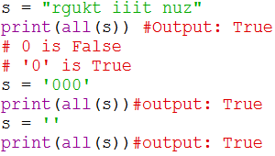
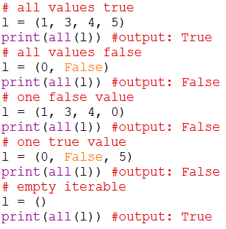
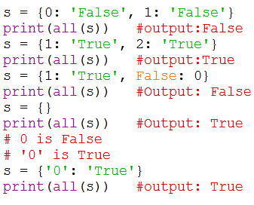
all()
Return True if all elements of the tuple are true (or if the tuple is empty is true).
Syntax:- all(iterable)
any()
Return True if any element of the tuple is true. If the tuple is empty, return False.
Syntax: - any(iterable)

Slide 14
enumerate()
Return an enumerate object. It contains the index and value of all the items of tuple as pairs.
Syntax:- enumerate(iterable,start=0)
len()
Return the length (the number of items) in the tuple.
Syntax:- len(tuple)
max() and min()
Max Return the largest item in the tuple. Min Returns the smallest item in the tuple
Syntax:- max(iterable, *iterables[,key, default]) or max(arg1, arg2, *args[, key])
sorted()
Take elements in the tuple and return a new sorted list (does not sort the tuple itself).
Syntax: - sorted(iterable[, key][, reverse])
sum()
Retrun the sum of all elements in the tuple.
Syntax: - sum(iterable, start)
tuple()
Convert an iterable (list, string, set, dictionary) to a tuple.
Syntax: - tuple(iterable)

Slide 15
Example Programs in Tuple
Write a program to swap two values using assignment?
Write a program using a function that returns the area and circumference of a circle whose radius is passed as an argument?
Write a program that has a nested tuple to store toppers details. Edit the details and reprint the details ?
Write a program that has a list of numbers (both positive as well as negative).Make a new tuple that has only positive values from this list?

