Slide 1
Dictionaries in Python

Slide 2
Definition of the Dictionary
Dictionary is a data structure in which we store values as a pair of key and value.
Each key is separated from its value by a colon(:) and consecutive items are separated by commas.
Dictionary is an unordered collection of key-value pairs and it is generally used when we have a huge amount of data.
The entire items in a dictionary are enclosed in curly brackets { }.
Syntax : - dict_name={ key1:val1, key2:val2 ,key3:val3 }
Dictionary keys are case- sensitive .Two keys with same name but in different case are not the same in python.

Slide 3
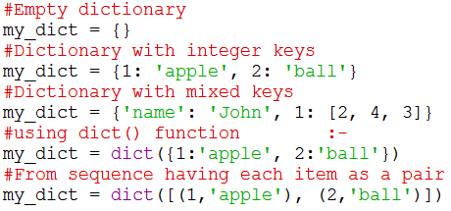
Creating a Dictionary
Creating a dictionary is as simple as placing items inside curly braces {} separated by comma.
An item has a key and the corresponding value expressed as a pair, key: value.
While values can be of any data type and can repeat, keys must be of immutable type (string, number or tuple with immutable elements) and must be unique.

Slide 4
Dictionary Comprehension
Dictionary comprehension is another way of Creating a dictionary.
Dictionary comprehension a syntactic construct which creates a dictionary based on existing dictionary.
Syntax: - D= {expression for variable in sequence [if condition]}
The Dictionary comprehension is placed within curly brackets .
It has three parts – for loop , condition and expression .
First ,the for loop is used to go through the sequence .
The if condition is optional and if specified , only those values in the sequence are evaluated using the expression which satisfy the condition.

Slide 5
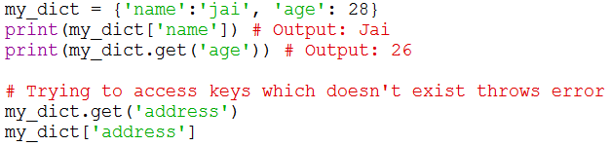
Access Elements from a Dictionary
To access values in dictionary, get() Method or square brackets are used along with key to obtain its value.
Note that if you try to access an item with key ,which is not specified in the dictionary , a keyError is generated .
The difference while using get() is that it returns None instead of KeyError, if the key is not found.
Collision means two or more keys pointing to the same location.

Slide 6
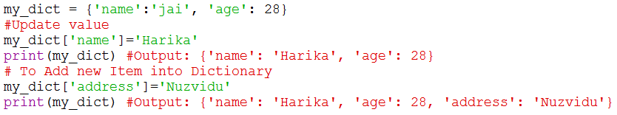
Adding and Modifying an Item in a Dictionary
Dictionaries are mutable. We can add new items or change the value of existing items using assignment operator.
If the key is already present, value gets updated, else a new key: value pair is added to the dictionary.
Dictionary is an associative array also known as hashes since any key of the dictionary can be associated or mapped to a value.

Slide 7
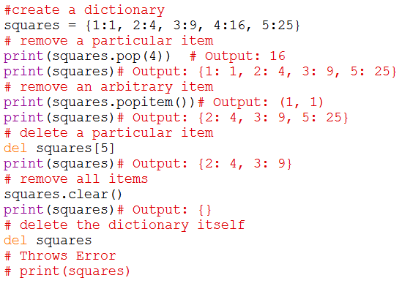
Deleting or removing an Item in a Dictionary
We can remove a particular item in a dictionary by using the method pop(). This method removes as item with the provided key and returns the value.
The method, popitem() can also be used to remove and return an arbitrary item (key, value) form the dictionary.
All the items can be removed at once using the clear() method.
We can also use the del keyword to remove individual items or the entire dictionary itself.

Slide 8
Key points to Remember
Keys must have unique values, not even a single key can be duplicated in a dictionary.
If you try to add a duplicate key ,then the last assignment is retained.
In dictionary ,keys should be strictly of a type that is immutable, this means that a key can be of strings ,number, or tuple type but it cannot be a list which is mutable.
In case you try to make your keys of a mutable type then a typeError will generated.
The in or not in keyword can be used to check whether a single key is present in the dictionary(Membership Operator).

Slide 9
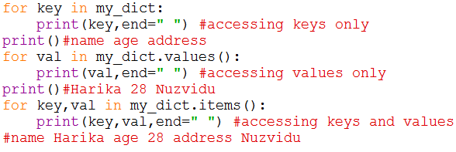
Sorting and Looping Items in a Dictionary
The keys() method of dictionary returns a list of all the keys used in the dictionary in an arbitrary order and the sorted() function is used to sort the keys
We can access only values ,only keys and both using with for loop
Here values() method returns only values and items() method returns both keys and values in a dictionary

Slide 10
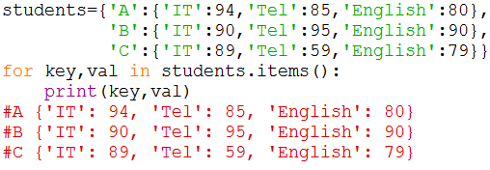
Nested Dictionaries
We can also create nested dictionary like nested lists or nested tuples.
To define a dictionary inside another dictionary.

Slide 11

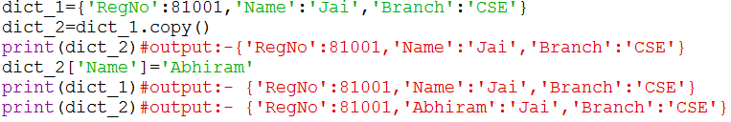
Built-in Dictionary Functions and Methods
Len(Dict) :- Returns the length of dictionary ,that is number of items(key-value pairs)
str(Dict) :- Returns a string representation of the dictionary
Dict.clear() :- Delete all entries in the dictionary
Dict.copy() :- Returns a shallow copy of the dictionary, i.e., the dictionary returned will not have a duplicate copy of Dict but will have the same reference.

Slide 12


Dict.fromkeys(seq[,val]):- Create a new dictionary with keys from seq and values set to val. If no val is specified then, none is assigned as default value.
Dict.get(key):- Returns the value for the key passed as argument. If the key is not present in dictionary. It will return the default value is specified then it will return none.
Dict.items():- Returns a list of tuples (key-value pair),keys() returns list of keys and values() returns list of values in the dictionary,

Slide 13
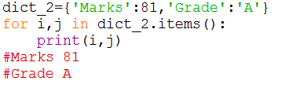

Dict.setdefault(key,value): - Sets a default value for a key that is not present in the Dict
Dict1.update(Dict2):- Adds the key-value pairs of Dict2 to the key-value pairs of Dict1
Dict.iteritems():- Used to iterate through items in the dictionary.
in and not in :- Check whether a given key is present in dictionary or not

Slide 14
All(): - Return True if all keys of the dictionary are true or if the dictionary is empty
Any():- Return True if all and any key of the dictionary is true or if the dictionary is empty it returns False
Cmp():- Compare items of the two dictionaries.

Slide 15
Difference between List and Dictionary
A list is an ordered set of items ,But a dictionary is a data structure that is used for matching one item(key) with another(value).
In lists ,you can use indexing to access a particular item, But these indexes should be a number.
In dictionaries ,you can use any type (immutable) of value as an index.
For Example , here when we write Dict[‘Name’] , Name acts as an index but it is not a number but a string.
Lists are used to look up a value whereas a dictionary is used take one value and loop up another value . For this reason , dictionary is also known as a lookup table.

Slide 16
Advantages of a Dictionary
In fact , the main advantage of a dictionary is that you don’t need to search for a value one by one in the entire set of values, you can find a value instantly.
The key-value pair may not be displayed in the order in which it was specified while defining the dictionary.
This is because python uses complex algorithms(called hashing) to provide fast access to the items stored in the dictionary.
This also makes dictionary preferable to use over a list of tuples.

Slide 17
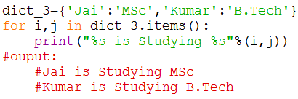
String Formatting with Dictionary
Python also allow you to use string formatting feature with dictionaries.
So you can use the following representation and etc..
%s → Strings
%d→ Integer
%f→ Float point numbers

Slide 18
When to use which Data Structure
Use lists to store a collection of data that does not need random access.
Use lists if the data has to be modified frequently.
Use a set if you want to ensure that every element in the data structure must be unique.
Use tuples when you want that your data should not be altered
Use dictionary to accessing very fast to the items stored in the dictionary.
Dictionaries are the best data structure for frequent lookup operations.

Slide 19
Practice Problems on Dictionaries
Write a program that combines the lists to a dictionary?
Write a program to count the numbers of characters in the given string and store them in a dictionary data structure?
Write a program that print a histogram of frequencies of characters occurring in message?
Write a program that has dictionary of names of students and a list of their marks in 4 subjects. Create another dictionary from this dictionary that has name of the students and their total marks .Find out the topper and his/her score?
Write a program that inverts a dictionary .That is , it makes key of one dictionary value of another and vice versa?
Write a program that creates a dictionary of cubes of odd numbers in the range of n?

Slide 20
Write a program that calculates fib(n) using dictionary?
Write a program that has set of even numbers and their corresponding squares, to define another dictionary that has a list of even numbers and their corresponding cubes and take all values from dict_1 and dict_2 and display squares and cube values ?
Write a program that creates two dictionaries one that stores conversion values from meters to centimeters and the other that stores values from centimeters to meters?
Write a program that creates a dictionary of radius of a circle and its circumference using break statements ?

