Slide 1
Sets in Python

Slide 2
Definition of the Set
Sets is another data structure supported by python.
Basically ,sets are same as lists but with difference that sets are lists with duplicate entries.
Technically , a set is a mutable and an unordered collection of items.
The set itself is mutable. we can add or remove items from it.
Set can be used to perform mathematical set operations like union, intersection ,symmetric difference etc.
Syntax :-
set_Variable ={val1, val2, …..}

Slide 3
Creation of the Sets
Sets is created by placing all the items (elements) inside curly braces,{} separated by comma or by using the built-in function set() method.
It can have any number of items and they may be of different types (integer,float,tuple, string etc.).
But a set cannot have a mutable element, like list, set or dictionary, as its element.
Creating an empty set is a bit tricky, empty curly braces {} will make an empty dictionary in python.
To make a set without any elements we have to use the set() function.
Syntax : setVariable={elements}

Slide 4
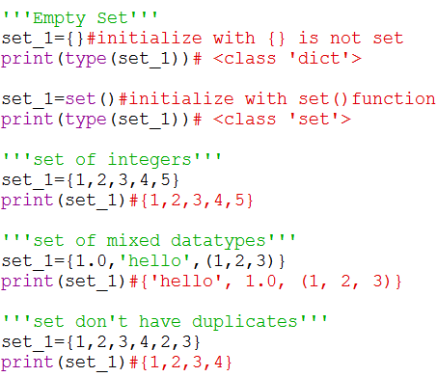
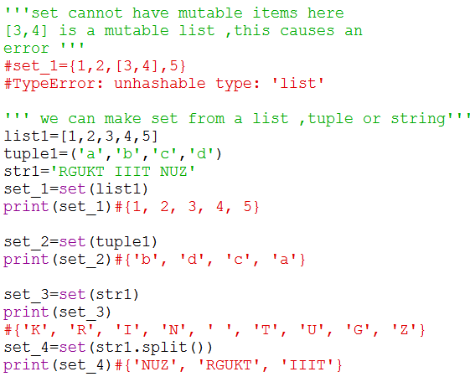
Creation of the Sets with Examples

Slide 5
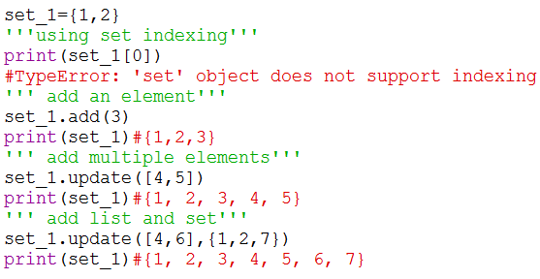
Modifications or Changes in Sets
Sets are mutable .But since they are unordered, indexing have no meaning.
We cannot access or change an element of set using indexing or slicing , set does not support it.
We can add single element using the add() method and multiple elements using update().
The updated() method can take tuples, list ,string or other sets as its argument, in all cases, duplicates are avoided.

Slide 6
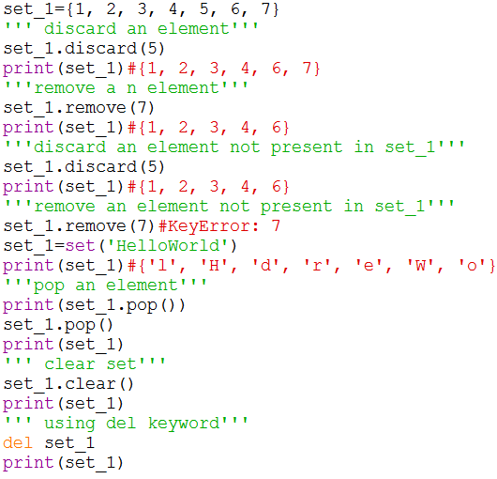
How to remove elements from a Set
Sets are mutable. A particular item ca be removed from set using methods, discard() and remove().
The only difference between the two methods, when using discard() if the item does not exist in the set, it remains unchanged. But remove() method will raise an error in such condition.
Similarly , we can remove and return an item using the pop() method.
Set being unordered, there is no way of determining which item will be popped.it is completely arbitrary.
We can also remove all item from a set using clear() method.

Slide 7
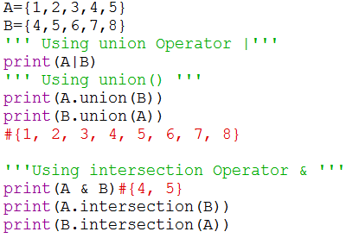
Set Operations
Sets can be used to carry out mathematical set operations like union, intersection, difference and symmetric difference.
We can do this with operators or methods.
Set Union
Union of A and B is a set of all elements from both sets.
Union is performed using | operator.
Same can be accomplished using the method union().
Set intersection
Intersection of A and B is a set elements that are common in both sets.
Intersection is performed using & operator and intersection() method .

Slide 8
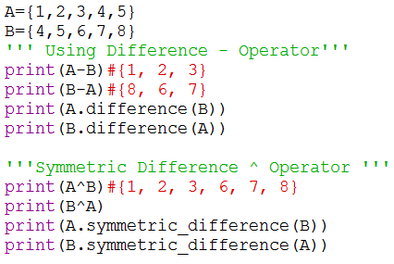
Set Operations
Set Difference
Difference of A and B (A – B ) is a set of elements that are only in A but not in B. Similarly ,(B – A ) is a set of element in B but not in A.
Difference is performed using – Operator and difference() Method.
Set Symmetric difference
Symmetric Difference of A and B is a set of elements in both A and B except those that are common in both.
Symmetric difference is performed using ^ Operator and symmetric_difference() Method.

Slide 9
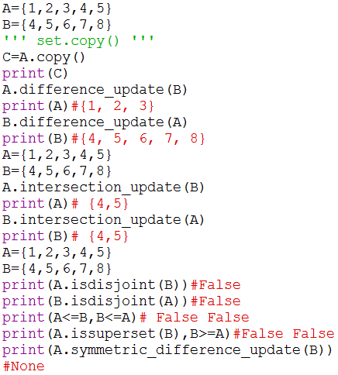
Python Methods
set.copy()
Return a copy of set
set.difference_update(B)
Remove all elements of another set from this set.
set.intersection_update(B)
Returns a set that has elements which are common to both the sets A and B.
A.isdisjoint(B)
Returns True if two sets have a null intersection.
A.issubset(B) or A <=B
Return True if another set contains this set.
A.issuperset(B) or A>=B
Return True if this set contains another set.
A.symmetric_difference.update(B) or A>=B
Update a set with the symmetric difference of itself and another.

Slide 10
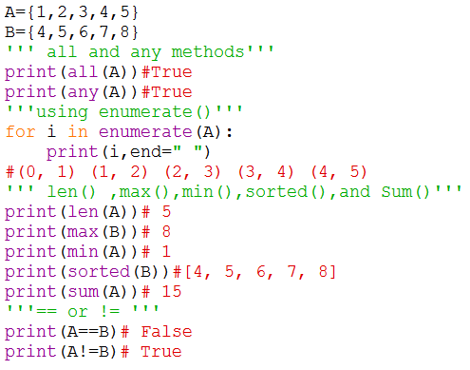
all() :- Return True if all elements of the set are true (or if the set is empty)
any():-Return True if any elements of the set is true and if the set is empty return false.
Enumerate():-Returns an enumerate object. It contains the index and value of all the items of set as a pair.
len() :-Return the length (number of items )in the set.
Max() :-Return the largest item in the set.
Min():- Return the smallest item in the set.
Sum():- Return the sum of all elements in the set
Sorted() :-Return a new sorted list from elements in the set(does not sort the set itself.
A==B :-Two Set are equal Returns True otherwise false.
A!=B:- Two Set are not equal returns True otherwise false.

Slide 11
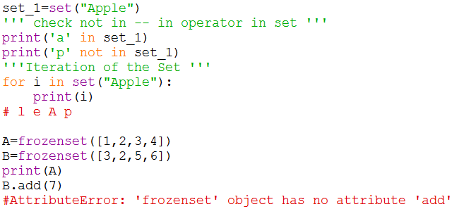
Membership operator and Iteration
in
if an item exists in a set, than use in keyword
not in
if an item not exists in a set, than use not in keyword
Iteration Through a Set
Using for loop, we can iterate though each item in a set.
Frozenset()
Frozenset is a new class that has the characteristics of a set, but its elements cannot be changed once assigned.
Like tuple , frozensets are also immutable.
Set being mutable ,are unhashable, so they can’t be used as dictionary keys.
Frozenset are hashable and can be used as keys to a dictionary and to create use frozenset() .

Slide 12
Practice Problems
Write a program that generates a set of prime numbers and another set of add numbers. Demonstrate the result of union, intersection, difference, and symmetric difference operations on these sets.
Write a program that creates two sets .one of even numbers in range 1-10 and the other has all composite numbers in range 1-20.Demonstrate the use all(),issuperset(),len(),and num() functions on the sets.
Write a program that create two sets –squares and cubes in range 1-10,Demonstrate the use of update(),pop(),remove(),add() and clear() functions.
Write a program that has a list countries ,Create a set of the countries and print the names of the countries in sorted order.

