Slide 1
Functions or Procedures in Python

Slide 2
Introduction
In python programming language when we wrote large programs sequentially using all the constructs of a language.
As a result, the program may become too complex and large, this leads to difficulties in debugging, testing and even understanding .
The best way to develop a large program is to construct it from smaller pieces or modules .
A module can be a single function or group of related functions carrying out a specific task, then we can divide large program into a series of individual modules that related to each other.
Finally it is easer to break down a difficult task into a series of smaller tasks and then solve those subtasks individually and later combined into a single unit.
These subtasks are made user-defined functions and in python programing language such modules are called as functions.
The functions are much easier to understand ,debug and test.

Slide 3
Definition of the function
A function is a block of statements that performs a specific task.
Syntax :- def functionName(Parameters):
“““ docString”””
statement(s)
return expression
Keyword def marks the start of function header.
A function name to uniquely identify it. Function naming follows the same rules of writing identifiers in Python.
Parameters (arguments) through which we pass values to a function. They are optional.
A colon (:) to mark the end of function header.
Optional documentation string (docstring) to describe what the function does.
One or more valid python statements that make up the function body. Statements must have same indentation level.
An optional return statement to return a value from the function.

Slide 4
Advantages of functions
Using functions one can avoid rewriting the same code again and again
It is easy to write a function that does a particular job
The complexity of the entire program can be divided into simple subtask and function, subprograms can be written for each subtask.
It is very efficient, clear and compact source code.
The length of the program can be reduced.
It is easier to write , testing and debugging individual functions
It increases program readability and helps documentation.
A function can call itself again ,it is called recursiveness.
Many calculations can be done easily using recursive process such as calculation of sum of natural numbers, factorial of a number etc.

Slide 5
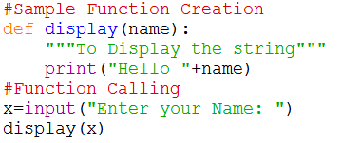
Sample Program using function
Here def is keyword.
display is function name and name is function argument.
Inside we have created docstring it tells about functions what it does.
In statements we have used print() to display to given string.
We have just created the function and then called with name of function i.e. display(x)

Slide 6
Arguments or Parameters
The argument list contains valid variable names separated by commas.
The argument variable receive values from a calling function .Thus they provide the link between the main program and the function.
Arguments also known as parameters ,the parameters provided the means for communicating between functions.
We have two types of arguments :- formal(dummy) arguments and actual arguments.
The formal arguments are defined in the function declaration in the called function .
The data, which are passed from the calling function to called function are called the actual arguments .
The actual arguments are passed to called function through a function call.
A function may be without arguments ,in which case the argument list is empty.
However, even if there are no arguments, the parentheses must be present.

Slide 7
Passing Arguments(values) to a Function
Arguments to a function are usually passed into two ways.
The first one is known as (sending the values of the arguments )passing by value or call by value.
When a single value is passed to a function via an actual argument, the value of the actual argument is copied into the function.
Therefore, the value of corresponding formal argument can be changed within the function, but the value of the actual argument within the calling function will not change.
This procedure for passing the value of an argument to a function is known as call by value.
The Second method is known as call by reference (i.e., sending the address of the argument ),in which the address of the each argument is passed to the function .
By this method ,the changes made to the parameters of the function will effect the variables which called the function
Notes:
.

Slide 8
Calling a Function
A function can be called by specifying function name, followed by a list of arguments enclosed in parentheses and separated by commas.
If a function call does not require any arguments ,an empty pair of parentheses must follow the function’s name.
A function can be called any number of times .
A function which returns a value can be used in expressions like any other variable.
A function does not returns any value cannot be used in an expression.
Any function can be called from any other function
The following conditions must be satisfied for a function call .
There must a one –to –one correspondence between the actual and formal parameters.
Corresponding parameters(arguments ) must be same data type.

Slide 9
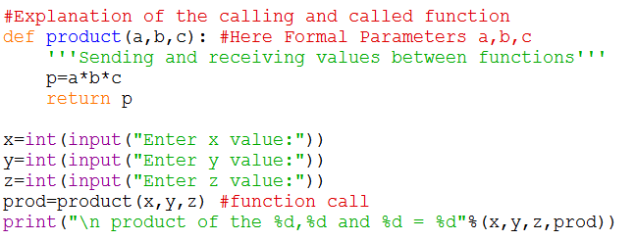
Explanation of the calling and called function
Sending and receiving values between functions
Called Function
Formal parameters
Calling Function
Actual parameters

Slide 10
return statement
A function may return any type data except sequences .
return statement is used inside a function to exit it and return a value.
The return statement also causes control to be returned to the point from which the function was called.
A function may or may not send back any value to the calling function. It is an optional statement .
Purpose of return Statement :-
Transferring control from the function back to the calling program (None).
It returns the value present in the parentheses after return to the calling program.
General form of the return statement
return or return (expression)

Slide 11
Characteristics of a Function
Any function can return only one value.
Parameter argument list is optional
return statement indicates exit from the function and return to the point from where the function was invoked.
A function can call any number of times
Any function cannot be defined in other function
When a function is not returning any value ,void type can be used as return type.
Python allows recursion i.e. a function can call itself.

Slide 12
Function Categories
In python programing language mainly we can categories two types:-
Built – in Functions these are developed along with language we can call it as a pre-defined functions (i.e. math.sqrt(9),list.append(5)…etc)
User – defined functions here user has to develop in existing circumstance.
def is keyword is used to create user –defined functions in python
Syntax :- def functionName(Parameters):
“““ docString”””
statement(s)
return expression
A function ,depending on whether arguments are present or not and whether a values is returned or not, may belong to one of the following categories
Functions with no arguments and no return values
Functions with arguments and no return values
Functions with arguments and return values

Slide 13
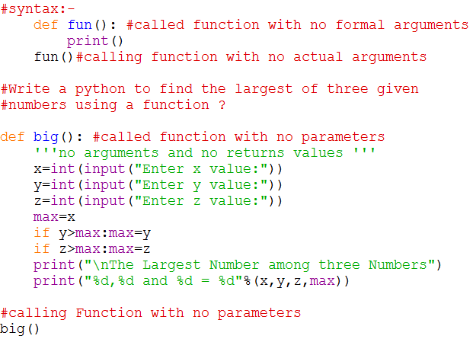
Functions with no arguments and no return values
It is simplest way of writing a user defined function in python.
When function has no arguments , it does not receive any data from the calling function.
Similarly ,when it does not return a value.
The calling function does not receive any data from the called function
In effect ,there is no data communication between a calling and a called function.
Note that the function does not contain any return statement

Slide 14
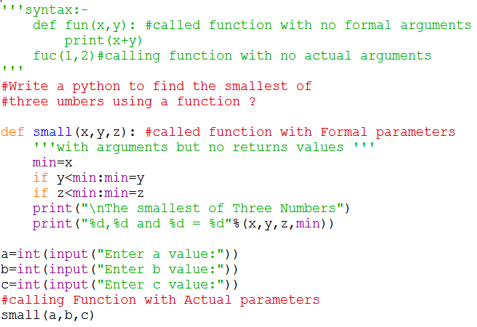
Functions with arguments but no return values
These functions have some arguments which are passed to a function but the functions does not return back any value to the accessing function.
It is one way data communication between the calling function and called function.
The function does not return any value.

Slide 15
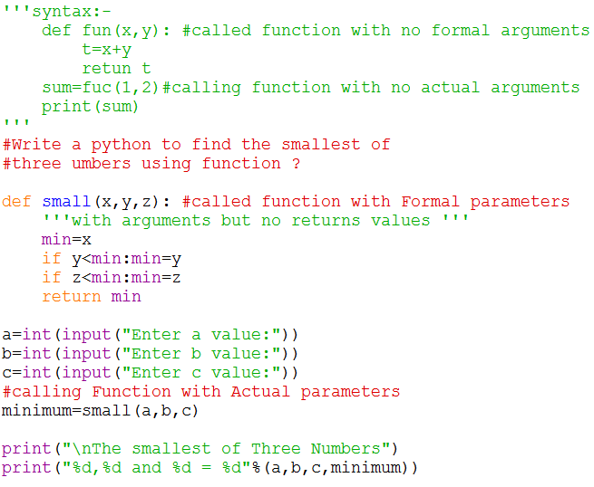
Functions with arguments and return values
These functions have some arguments and are passed to a function from the calling program and computed values .
If any ,are transferred back to the calling function .
It is two way data communication between the calling and called function.
These functions receives a predefined form of input and outputs a desired value.

Slide 16
Docstring
Docstring is short note for documentation string.
Docstring serve the same purpose as that of comments, as they are designed to explain code an Triple quotes are used to extend the docstring to multiple lines.
However ,they are more specific and have proper syntax
def functionName(paremeters):
‘‘‘ function_docstring’’’
statements
return expression
It is a string that occurs as the first statement in a module, function, class, or method definition and inside we have created docstring it tells about functions what it does.
Docstring is specified can be accessed through the __doc__ attribute of the function.
>>> print(functionaName.__doc__)

Slide 17
Variable Scope and Lifetime
In python ,you cannot access any variable from any part of the program.
Some of the variables may not even exist for the entire duration of the program.
In which part of the program we can access a variable and in which part of the program a variable exists depends on how the variable has been declared.
Therefore we need to understand two things:
Scope of the variable
Part of the program in which a variable is accessible is called its scope
Lifetime of the variable
Duration for which the variable exists is called its lifetime

Slide 18
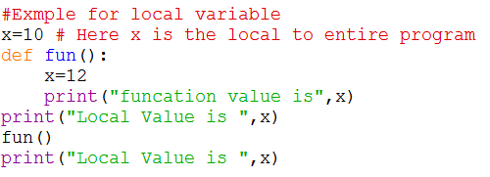
Local Variable
Variable declared within functions are called local variable .
They are known only in the function in which they are declared and They are not known to other functions.
Local variable in one function have no relationship to the local variable in another function.
In other words ,local variables of the same name in different functions are unrelated.
Local variable are created when a function is called ,and they are destroyed when the function is exited,
Therefore local variable do not maintain their value between function calls

Slide 19
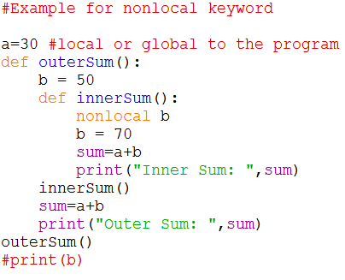
nonlocal Keyword
The use of nonlocal keyword is very much similar to the global keyword.
nonlocal is used to declare that a variable inside a nested function is not local to it, meaning it lies in the outer inclosing function.
If we need to modify the value of a non-local variable inside a nested function, then we must declare it with nonlocal.
Otherwise a local variable with that name is created inside the nested function.
Here, the innerSum() is nested within the outerSum() function and the variable b is in the outerSum().
So, if we want to modify it in the innerSum(), we must declare it as nonlocal and notice that b is not a global variable.

Slide 20
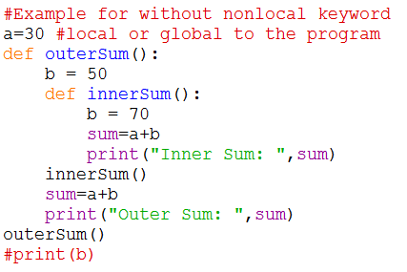
The result of not using the nonlocal keyword is as follows:
Here, we do not declare that the variable a inside the nested function is nonlocal.
Hence, a new local variable with the same name is created, but the non-local b is not modified

Slide 21
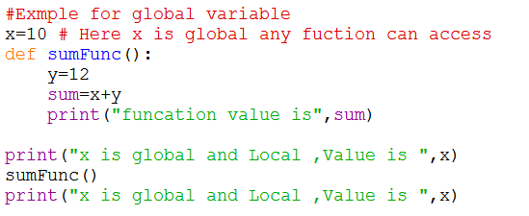
Global Variable
Variable declared outside functions are called global variables and they may be accessed by any function in the program.
It need not be declared in other functions .
A global variable is also known as external variable.
The global variables provides two-way communications among the functions.

Slide 22
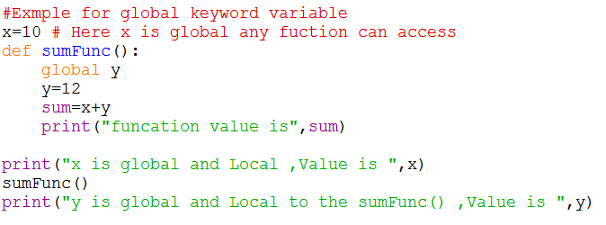
global Keyword
global is used to declare that a variable inside the function is global.
If we need to read the value of a global variable, it is not necessary to define it as global and this is understood.
But if we need to modify the value of a global variable inside a function, then we must declare it with global.
Otherwise a local variable with that name is created

Slide 23
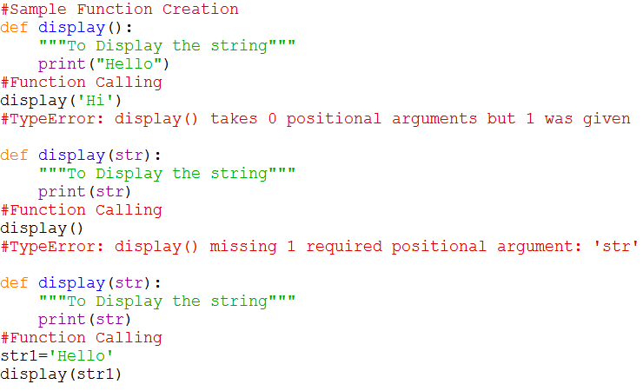
Required arguments
The number of arguments in the function call should exactly match with the number of arguments specified in the function definition.
otherwise a typeError or argument error is returned.

Slide 24
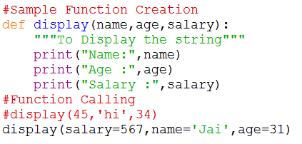
Keyword Arguments
When we call a function with some values , the values are assigned to the arguments based on their position.
Python allows functions to be called using keyword arguments in which the order of the arguments can be changed.
The values are not assigned to arguments according to their position but based on their name or keyword.

Slide 25
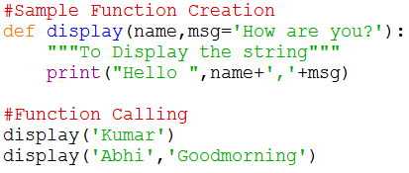
Default Arguments
Python allow users to specify function arguments that can have default values .
Function can be called with fewer arguments than it is defined to have .
If the function accepts three parameters , but function call provides only two arguments ,then the third parameter will be assigned the default value.
The default value to an argument is provided by using the assignment operator(=)

Slide 26
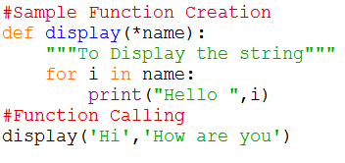
Variable –Length Arguments/ Arbitrary Arguments
In some situation ,it is not known in advance how many arguments will be passed to a function.
In such case python allows programmers to make function calls with arbitrary (or any ) number of arguments .
When use arbitrary argument or variable length arguments ,then the function definition uses an asterisk (*)before parameter name.
Syntax: def funName(*names):
Inside the called function ,for loop is used to access the arguments.

Slide 27
Lambda or anonymous function
Lambda keyword is used to create an anonymous function (function with no name) ,they are not declared as other function using def keyword.
They are just needed where they have been created and can be used anywhere a function is required.
It is an inline or single line function that does not contain a return statement.
It consists of an expression that is evaluated and returned.
Syntax : - lambda arguments :expression
The arguments contain a comma separated list of arguments and the expression is an arithmetic expression that uses these arguments.
The function can be assigned to a variable to give it name.
We can use lambda functions wherever function objects are required.

Slide 28
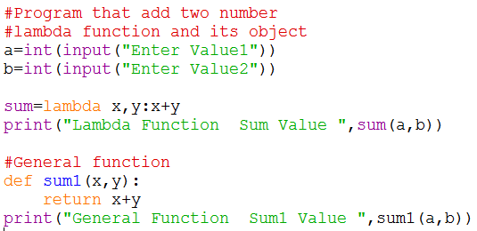
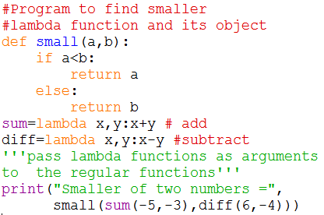
Examples of lambda

Slide 29
Recursive Functions
A function which invokes itself repeatedly until some condition is satisfied ,is called a recursive function.
A recursive function is defined as a function that calls itself to solve a smaller version of its task until final call is made which does not require a call to itself.
Every recursive function has two major cases : base case ,recursive case
Base case :- in which case the problem is simple enough to be solved directly without making any further calls to the same function.
Recursive case:- in which case
First the problem at hand is divided into simpler sub-parts,
Second ,the function calls itself but with sub-parts of the problem obtained in the first step.
Third ,the result is obtained by combining the solutions of simpler sub-parts
The recursive utilized divide and conquer technique of the problem solving.

Slide 30
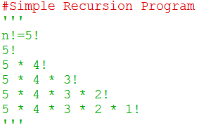
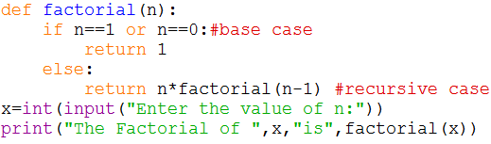
Divide and conquer technique is a method of solving a given problem by dividing into two or more smaller instances.
Each of the smaller instance is recursively solved ,and the solutions are combined to produce a solution for original problem.
Every recursive function must have at least one base case, otherwise, the recursive function will generate an infinite sequence of calls thereby resulting in an error condition known as infinite stack.
Let us calculating factorial of a number, n!
What we have to do is multiply the number with factorial of number that is 1 less than that number, in other words n!=n*(n-1)!
Let us take n=5 than we need to find n!=5!

Slide 31
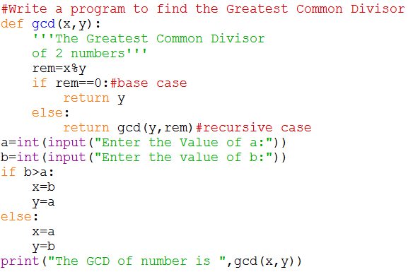
Note :- The base case of a recursive function act as the terminating condition.
Write a program to find the Greatest Common Divisor
Explanation: -
a=62,b=8
gcd(62,8)
rem=62 % 8=6
gcd(8,6)
rem=8 % 6=2
gcd(6,2)
rem=6%2=0
return 2
return 2
return 2

Slide 32
Practice Problems
Write a program to print the Fibonacci series using recursion?
Write a program to calculate the exponent(x,y) using recursion?
Write a program using functions and return statement to check whether a number is even or odd?
Write a program to convert hours into minutes?
Write a program to determine whether a given number is prime or not using a function?
Create a simple calculator using functions ?
Write a program to find the reverse number using functions?
Write a program to find the sum of digits of from given number using functions?
Write a program in python to find out the number of words in a line of text using a function (Avoid Pre-defined Methods) ?
Write a program to display the number into words (i.e., 12 – OneTwo)?

