Slide 1
Searching in Python

Slide 2
What is Searching ?
Searching is an operation or a technique that helps to finds the place of a given element or value in the list.
Any search is said to be successful or unsuccessful depending upon whether the element that is being searched is found or not.
Definition : - Searching involves to deciding whether a search key is present in the data.
For example, looking up a phone book or address book.
To search an element in a given list or array, it can be done in two ways of followed data structure is listed below:
Linear Search or Sequential Search
Binary Search

Slide 3
Linear Search
A linear search is the basic and simple technique of searching algorithm.
A linear search searches an element or value from an array or list till the desired element or value is not found and it searches in a sequence order.
It compares the element with all the other elements given in the list and if the element is matched it returns the value index else it return -1.
Linear Search is applied on the unsorted or unordered list when there are fewer elements in a list.
Unsorted or Unordered List is
8 | 2 | 6 | 3 | 5

Slide 4
Example with Implementation
The list given below is the list of elements in an unsorted array. The array contains 5 elements.
Suppose the element to be searched is ’5’, so 5 is compared with all the elements starting from the 0th element and searching process ends where 5 is found or the list ends.
list_1=
The performance of the linear search can be measured by counting the comparisons done to find out an element.
The number of comparison is 0(n).
The worst-case and average-case time complexity is O(n). The best-case is O(1).
8 | 2 | 6 | 3 | 5

Slide 5
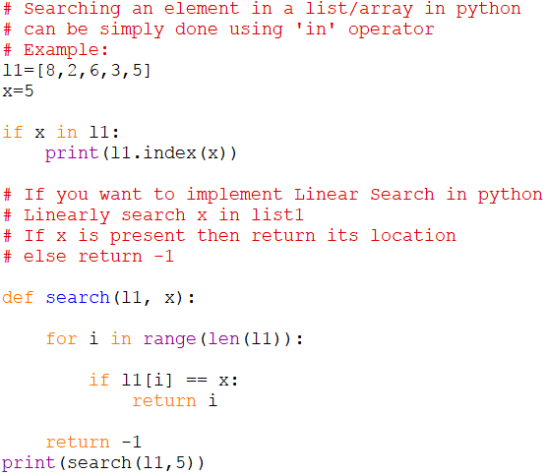
Sample Program & Tracing
Here Searching Element is x=5
Searching Start from the index 0
Key List
5
5
5
5
5
8 | 2 | 6 | 3 | 5
8 | 2 | 6 | 3 | 5
8 | 2 | 6 | 3 | 5
8 | 2 | 6 | 3 | 5
8 | 2 | 6 | 3 | 5

Slide 6
Binary Search
Binary search is a very fast and efficient searching technique.
Binary Search is applied on the sorted array or list. In binary search, we first compare the value with the elements in the middle position of the array or list.
If the value is matched, then we return the value index.
If the value is less than the middle element, then it must lie in the lower(left) half of the array and if it's greater than the element then it must lie in the upper(right) half of the array or list.
We repeat this procedure on the lower(left) or upper(right) half of the array until the value is found or the interval is empty.
Binary Search is useful when there are large numbers of elements in an array.

Slide 7
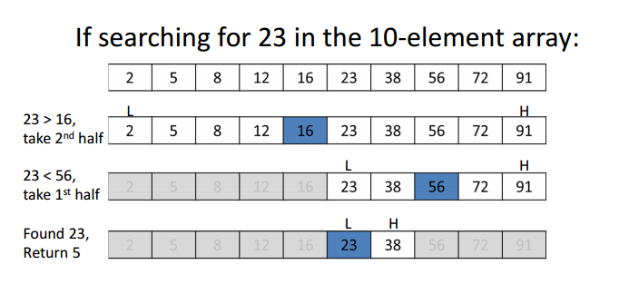
Example with Implementation
As we can see the list is sorted in ascending order ,to search an element 23.
Binary Search is applied on sorted lists only, so that we can make the search fast, by breaking the list every time.
Start with middle element 16, it its Equal to the number we are searching (23),then Return.
If its more than middle element 16 , then move to the UPPER(right)
If its less than middle element 16, then move to the LOWER(left)
And then,REPEAT ,till you find the number.

Slide 8
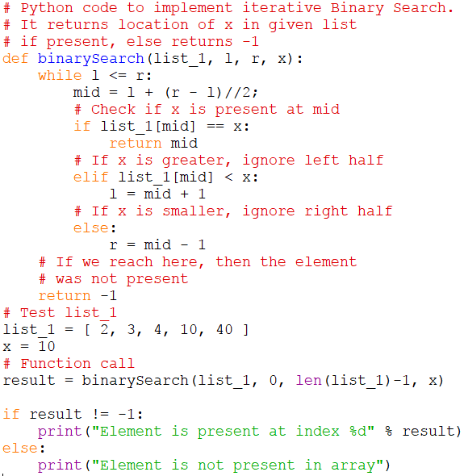
Time Complexity:
The time complexity of Binary Search can be written as
T(n) = T(n/2) + c
.
Auxiliary Space:
O(1) in case of iterative implementation.
In case of recursive implementation, O(Logn) recursion call stack space.

